Slide 1
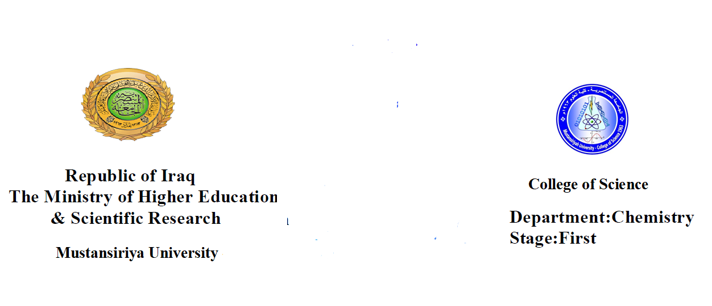

Slide 2
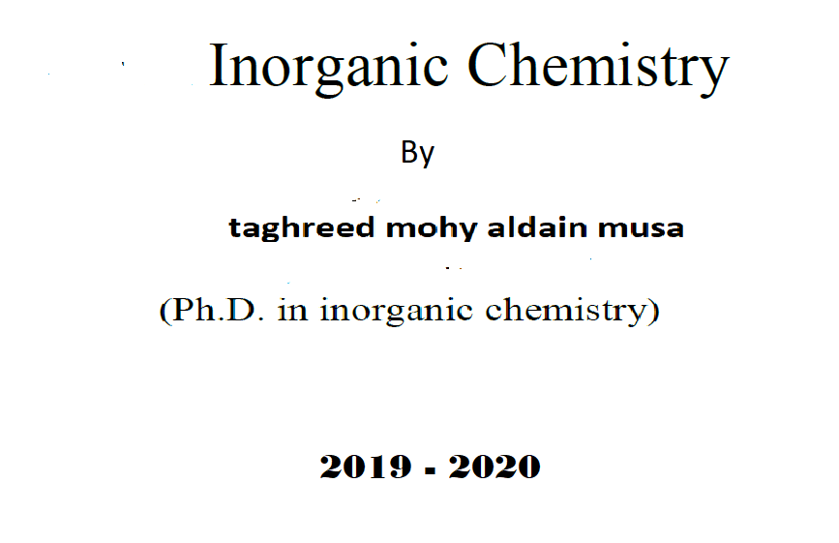

Slide 3
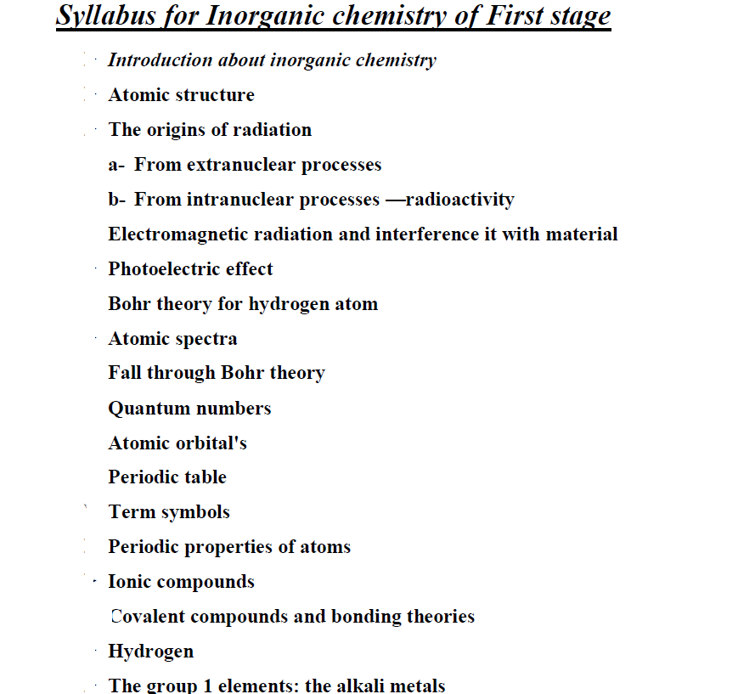

Slide 4
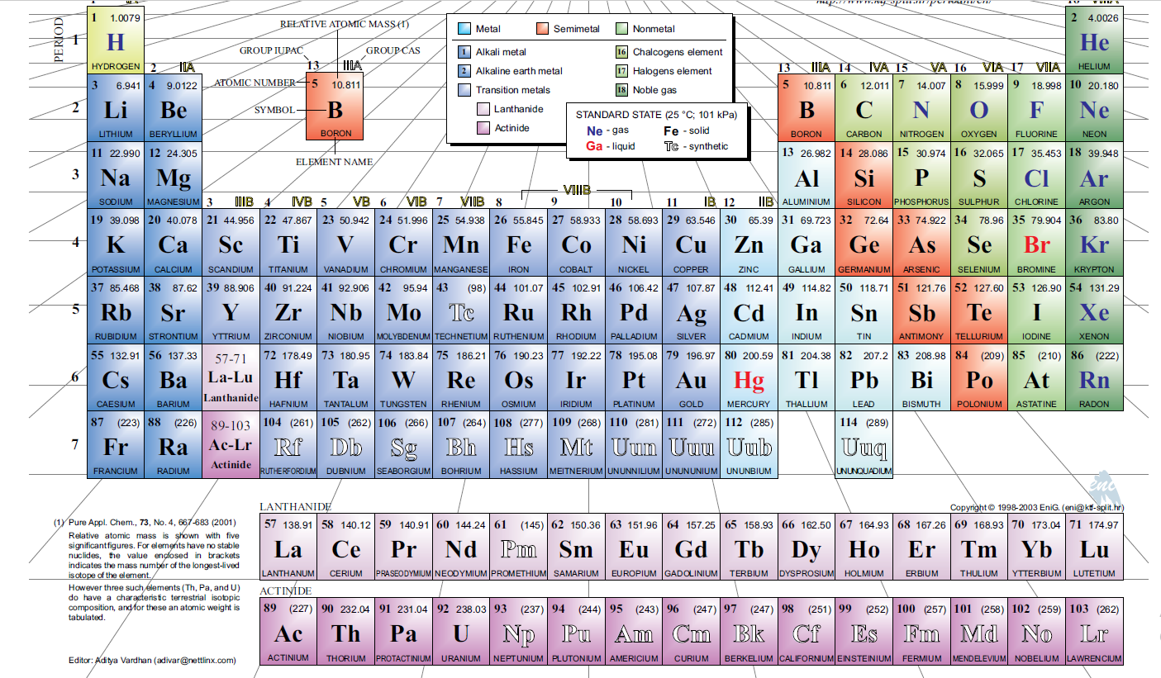
PERIODIC TABLE OF THE ELEMENTS
PERIODIC TABLE OF THE ELEMENTS

Slide 5
Atomic structure
Basic structure of atom
An atom consist of two parts ,a nucleus and one or more electrons.
nucleus
is the central core of an atom; it has most of the mass of the atom and is positively
charged.
electron is very light, negatively charged particles that exists around appositively
charged nucleus.
proton is one of the particles found in the atomic nucleus; it has a positively
charged particle with a mass over 1800 times of that of electron
neutron is another particle found in the nucleus it has a mass almost identical to that
of the proton but has no electrical charged

Slide 7
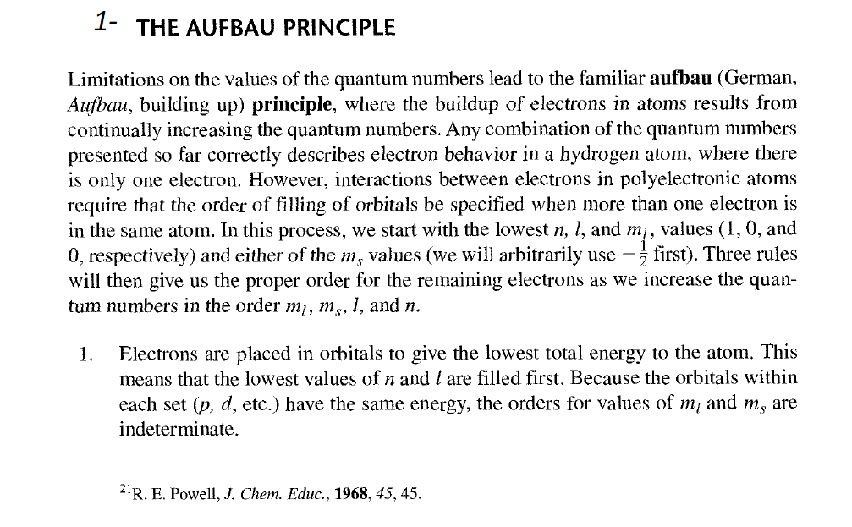

Slide 8
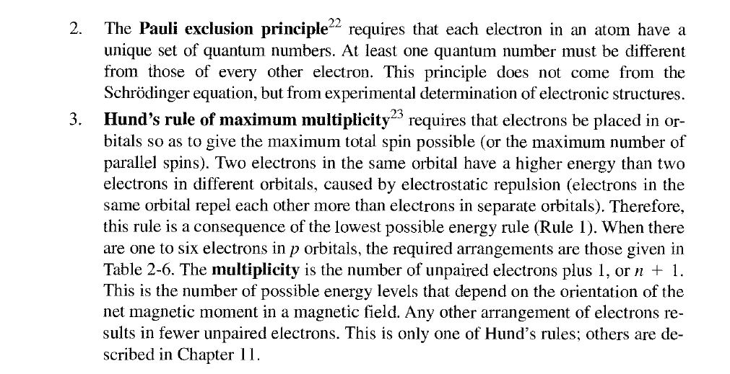

Slide 9
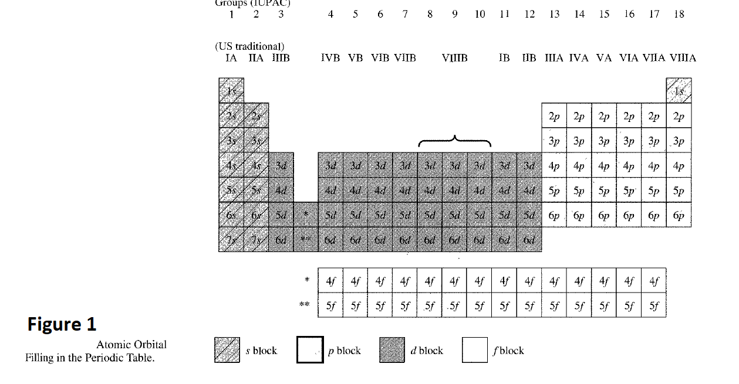

Slide 10
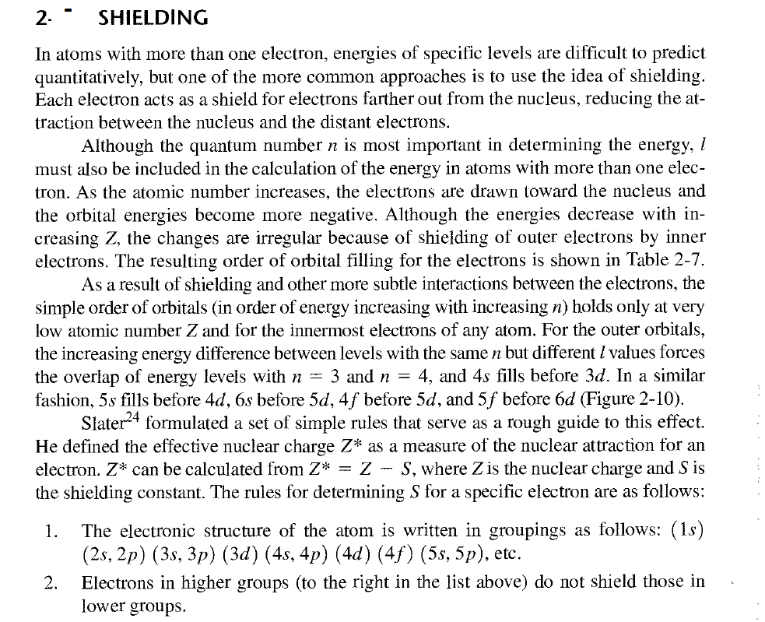

Slide 11
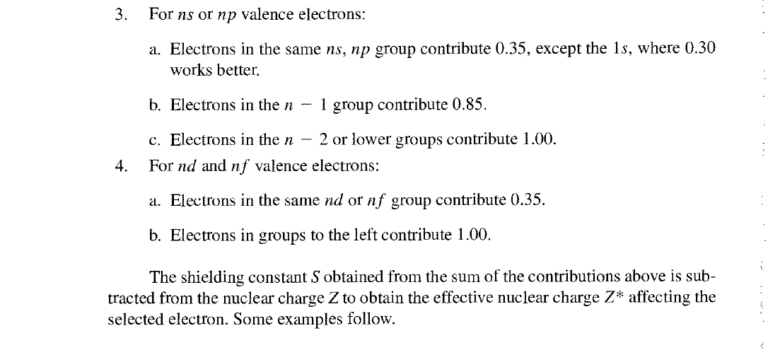

Slide 12
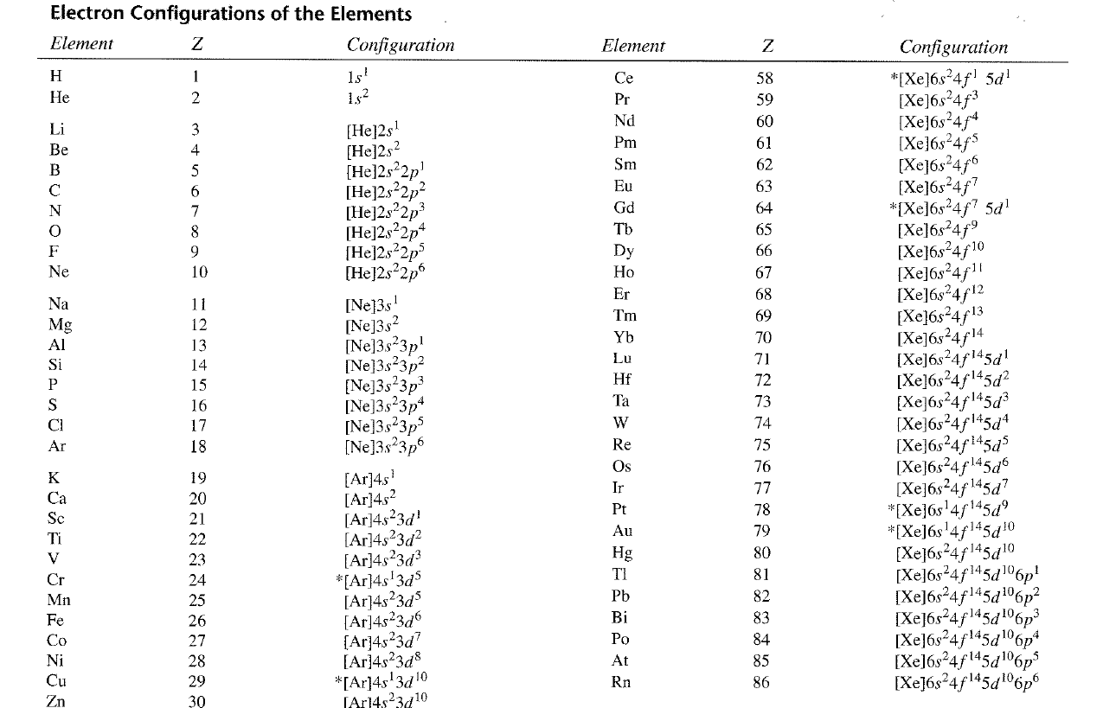

Slide 13
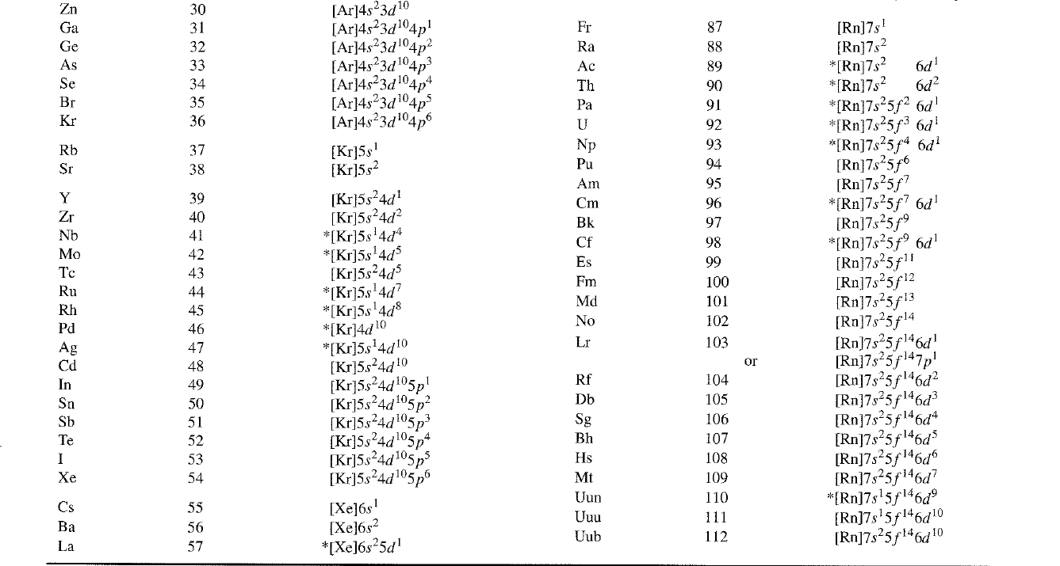

Slide 14
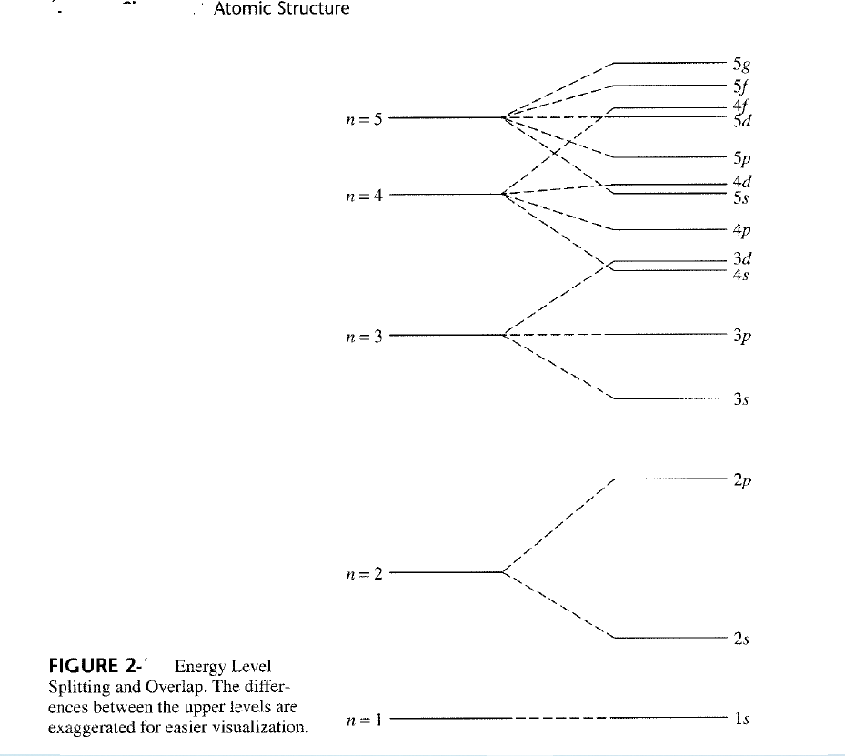

Slide 15
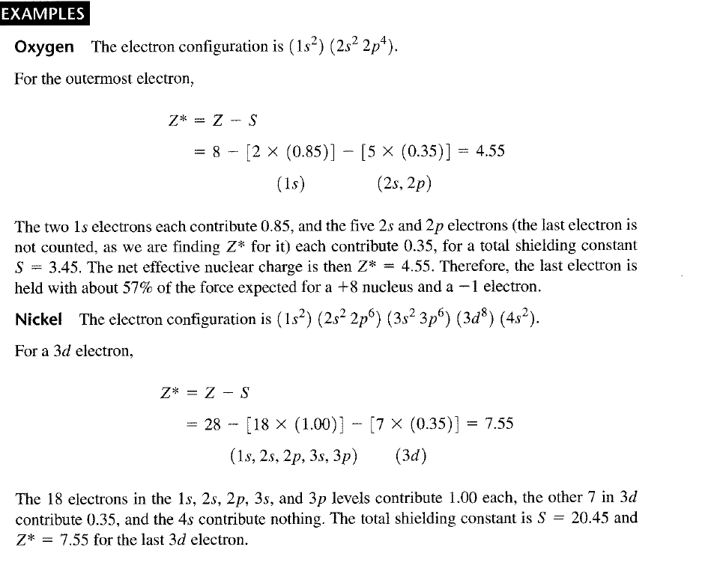

Slide 16
