Slide 1
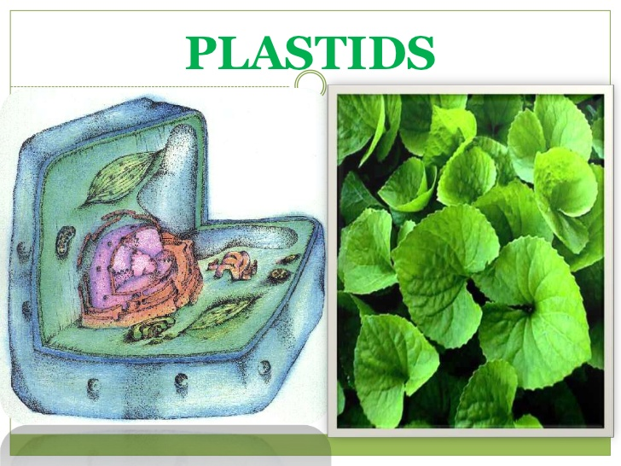
Plastids
Plastids are double membrane bound organelles found inside plants and algae, which are primarily responsible for activities related to manufacture and storage of important chemical compounds used by the cells . the types of pigments present can determine the cell's color.
In plants, plastids may differentiate into several forms, depending upon which function they play in the cell. Undifferentiated plastids (proplastids) may develop into of the following:
^{Chloroplasts}
^{Chromoplasts}
^{Leucoplasts}

Slide 2
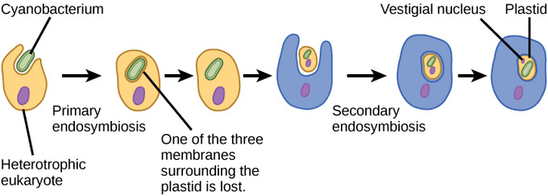
Origin of plastids
symbiosis may explain the origin of chloroplasts. Chloroplasts have many similarities with Photosynthetic bacteria ,including a circular DNA , prokaryotic-type ribosomes , and similar proteins in the photosynthetic reaction center. The endosymbiosis theory suggests that photosynthetic bacteria were engulfed by early eukaryotic cells to form the firs plant cells. Therefore, chloroplasts may be photosynthetic bacteria that adapted to life inside plant cells.

Slide 3
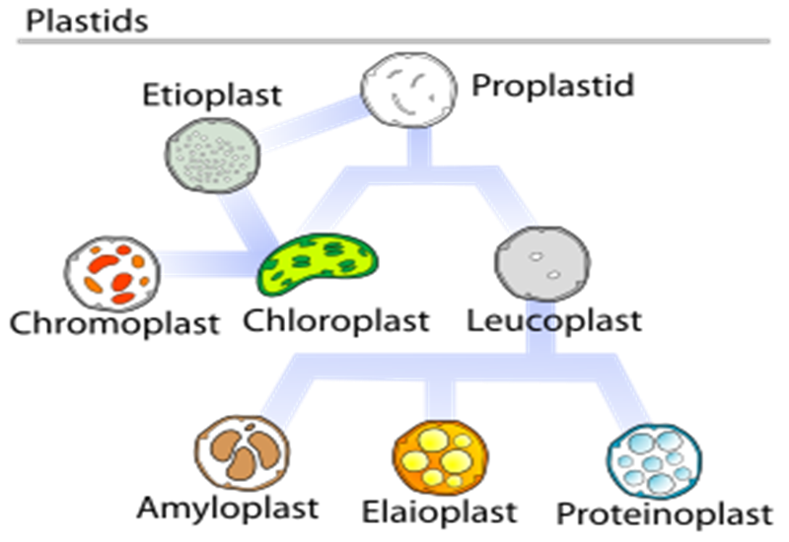

Slide 6
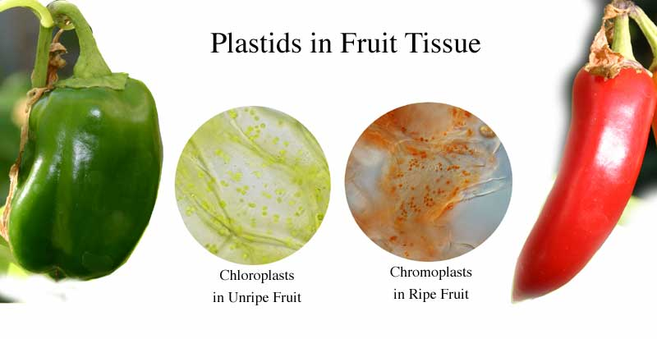
proplastids may develop into of the following:
Chloroplasts
Chromoplasts
Leucoplasts
Chromoplasts
Chromoplasts are red , yellow or orange in color and are found in petals of flowers and in fruit. Their color is due to two pigments, Carotene and Xanthophyll.
Functions of chromoplast
Flowers is to attract agents of pollination.
Fruit to attract agents of dispersal.

Slide 7
Leucoplasts
Leucoplasts are colorless plastids and occur in plant cells not exposed to light, such as roots and seeds. They are colorless due the absent of pigments. leucoplasts sometimes differentiate into more specialized plastids
Amyloplasts :for starch storage and detecting gravity
Elaioplasts :for lipids storage
Proteinoplasts :for storing and modifying protein
Tannosomes :for synthesizing and producing tannins and polyphenols
Functions of leucoplasts
starch grain , oils ,proteins
and lipids are stored .
the synthesis of fatty acids,
amino acids.

Slide 9
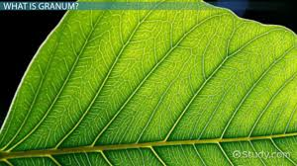
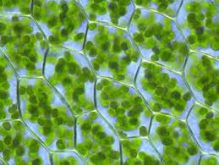
Chloroplasts
A chloroplast is an organelle unique to plant cells that contains chlorophyll are responsible for photosynthesis process so that plants can convert sunlight into chemical energy.
Functions of chloroplasts
chloroplasts are the sites for photosynthesis and glucose production

Slide 10
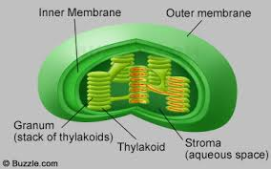
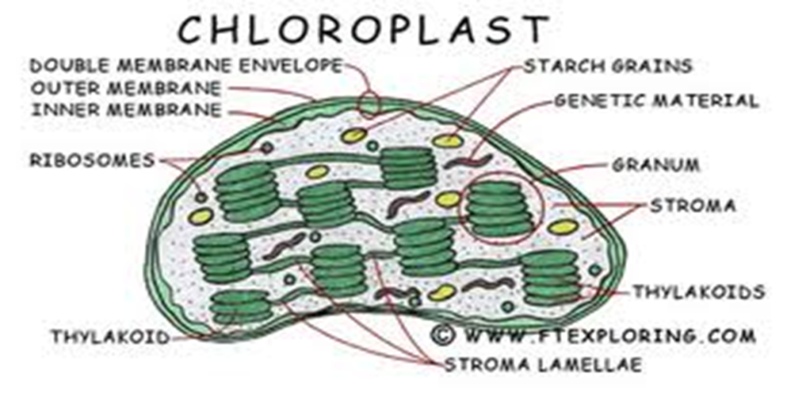
Chloroplast structures include:
Outer membrane - It is a semi-porous membrane and is permeable to small molecules and ions and not permeable to larger proteins.
Intermembrane Space - It is usually a thin intermembrane space about 10-20 nanometers and it is present between the outer and the inner membrane of the chloroplast.
Inner membrane - The inner membrane of the chloroplast forms a border to the stroma. It regulates passage of materials in and out of the chloroplast. In addition the fatty acids, lipids and carotenoids are synthesized in the inner chloroplast membrane.

Slide 12
Grana (singular granum) - dense layered stacks of thylakoid sacs that serve as the sites of conversion of light energy to chemical energy.
Thylakoid Membrane - internal membrane system consisting of flattened sac-like membrane structures called thylakoids
Chlorophyll-a green photosynthetic pigment and ethers pigment within the chloroplast grana that absorbs light energy .
Stroma - dense fluid within the chloroplast that lies inside the envelope but outside the thylakoid membrane. This is the site of conversion of carbon dioxide to carbohydrates (sugar).
DNA of chloroplast, ribosomes ,thylakoid system, starch granules and many enzymes are found floating around the stroma.

Slide 15
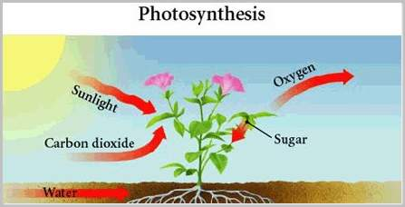
Photosynthesis
Photosynthesis is the process of converting light energy to chemical energy and storing it in the bonds of sugar. This process occurs in plants and algae. Plants need only light energy, CO₂, H₂O and light are converted to sugar and oxygen . The process of photosynthesis takes place in the chloroplasts , in chloroplast are pigment that absorb wavelength of light .
The overall chemical reaction involved in photosynthesis is: 6CO₂ + 6H₂O + light energy → C₆H₁₂O₆ + 6O₂

Slide 17
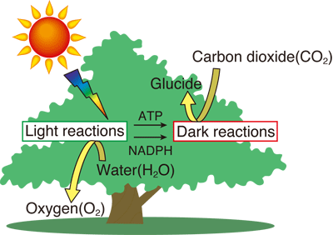
Green plants are green because they contain a pigment called chlorophyll. Chlorophyll absorbs certain wavelengths of light within the visible light spectrum. As shown in detail in the absorption spectra, chlorophyll absorbs light in the red (long wavelength) and the blue (short wavelength) regions of the visible light spectrum. Green light is not absorbed but reflected, making the plant appear green.

Slide 18
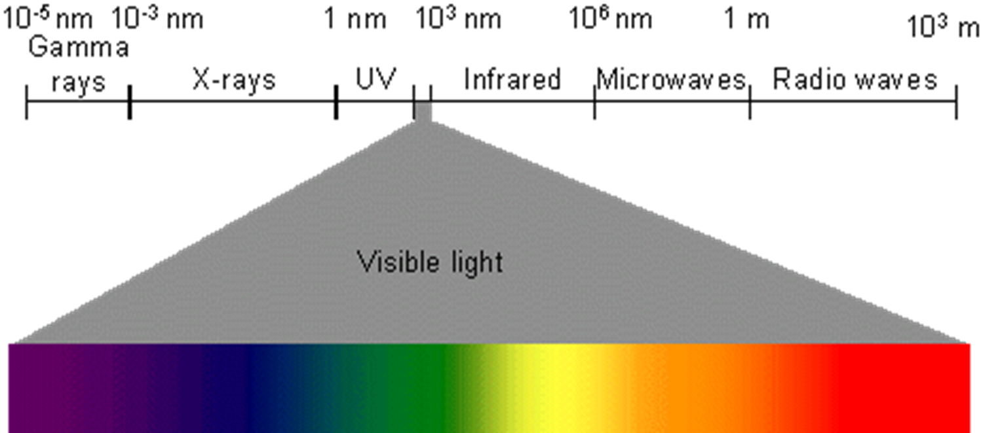
Visible light is only a small part of the electromagnetic spectrum (all forms of light).

Slide 19
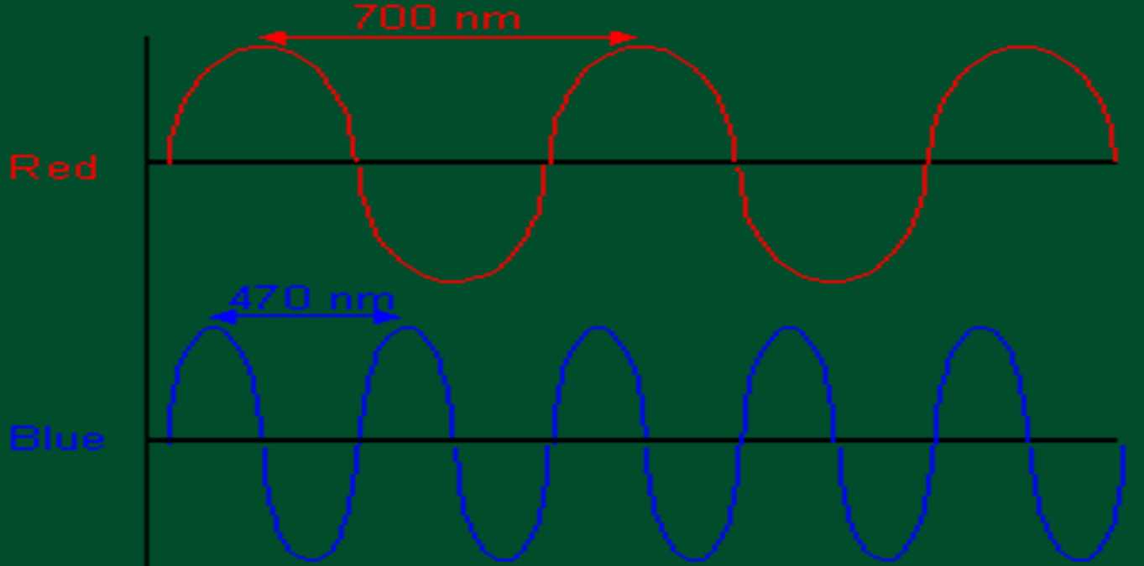
LIGHT behaves as if it were composed of "units" or "packets" of energy that travel in waves. These packets are photons .
The wavelength of light determines its color.

Slide 20
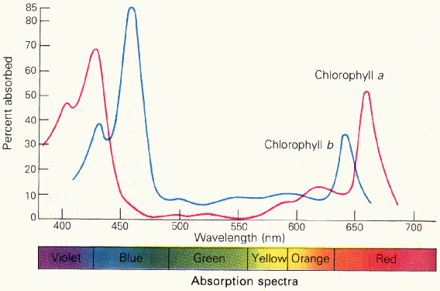

Slide 21
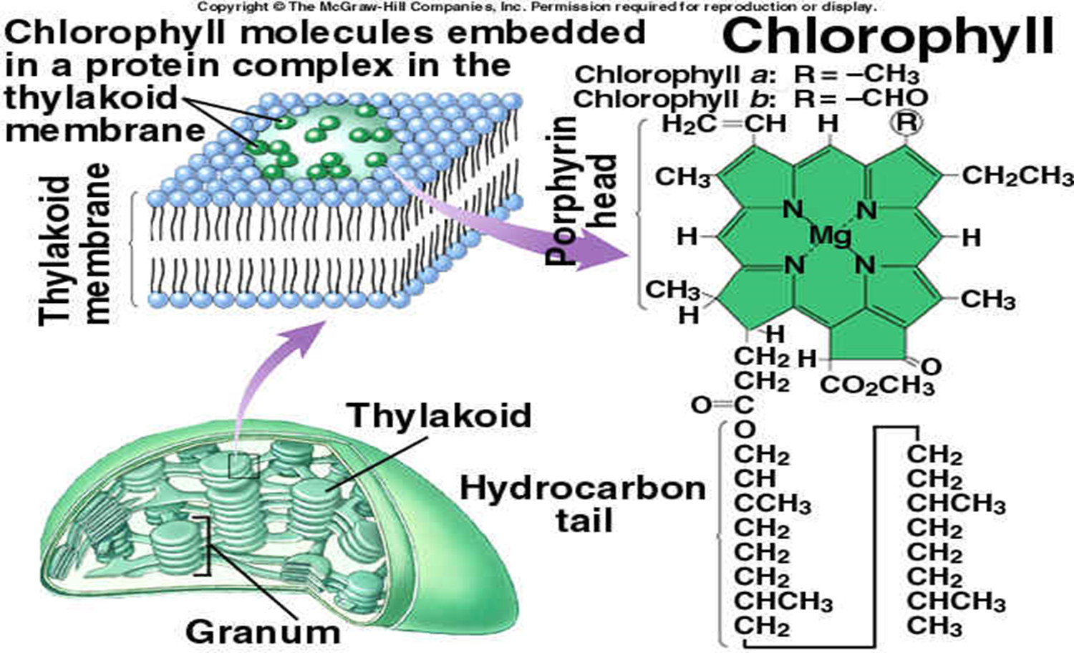

Slide 22
photosynthesis occurs in two stages:
light reaction stage (light-dependent reactions) or Hill reaction takes place in the presence of light and occurs within the chloroplast grana. The primary pigment used to convert light energy into chemical energy is chlorophyll a and other pigments involved in light absorption include chlorophyll b, xanthophyll and carotene. In the light reaction stage, sunlight is converted to chemical energy in the form of ATP and NADPH .
Both ATP and NADPH are used in the dark reaction stage to produce sugar.
Dark reaction stage (light-independent reactions). is also known the Calvin cycle. Dark reactions occur in the stroma. The stroma contains enzymes which facilitate a series of reactions that use ATP, NADPH, and carbon dioxide to produce sugar.

Slide 23
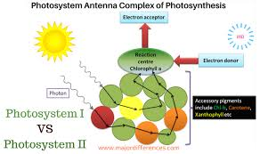
Photosystem
They are Tow types of photosystems in thylakoid membrane:
Photosystems I (PSI): is defined as containing reaction center chlorophyll with maximal light absorption at 700nm and are called P700 molecules
Photosystems II (PSII): The chlorophyll molecules of PSII absorb light with a peak wavelength of 680 nm and are called P680 molecules.
The tow photosystems work to gather to used light energy to generate ATP and NADPH

Slide 25
Difference between light and dark reaction in photosynthesis
Light Reaction | Dark Reaction
Occurs : Grana of the chloroplasts. | Occurs: Stroma of the chloroplast
It is a light dependent process Involves two photosystems: PS I and PS II | This process does not require light. No photosystem is required.
Photolysis of water takes place and oxygen is liberated. | Photolysis of water does not take place. Carbon dioxide is absorbed.
ATP and NADPH is produced and they are used to drive the dark reaction. | Glucose is produced. Reduced NADP is oxidised.

Slide 26
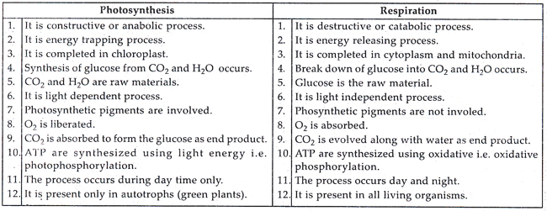
Compare between photosynthesis and Respiration

