Slide 1
Vorticity
بسم الله الرحمن الرحيم

Slide 2
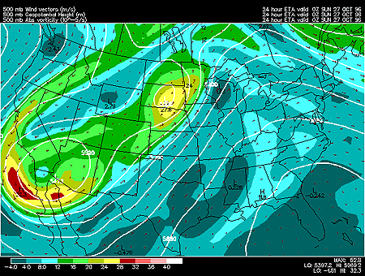
Vorticity is measurement of the spin of air parcels. In meteorology, we are most concerned with the spin of horizontally flowing air about a vertical axis. Of most interest are localized regions of much higher vorticity values, called positive vorticity maxima (generally above 16 X10e-5 s^-1). East of a vorticity max., upward motion helps to strengthen surface low pressure centers and induce precipitation. Conversely, west of a vorticity maximum, air is generally sinking, resulting in fair weather.

Slide 3
لدوامية أو الدردورية^{[1}Vorticity) ورمزهمبدأ في علم جريان الموائع يعرف أنه مقياس لمدى ميل أجزاء المائع للف والاستدارة.
بناء على ذلك، فإن الدردورية يمكن حسابها برصد مدى تغير الدوران في مساحة صغيرة وكلما استدق الرصد وصغرت المساحة كان القياس أحرى للدقة. من أجل ذلك فإن الدردورية تعرف رياضيا على أنها التغير المتناهى في الصغر لدوران المائع ضمن مساحة موحلة كذلك في الصغر.
Vorticity Definition
The angular velocity is a measure of rotation of a body.
This is a suitable quantity for a body that retains its shape.
The fluid, on the other hand, can be distorted and we must consider two components of rotation: shear and curvature.
Shear
Consider a marker in the fluid such as the dashed line crossing the streamlines, of a river for example. Initially, the marker might be normal to the streamlines, as at time t1, but later the marker will be rotated to the position at t2. The marker line has undergone an anticlockwise rotation (cyclonic in the N-hemisphere). We evaluate the contribution to the vorticity as −𝑑𝑣/𝑑𝑛

Slide 4
Curvature
If, at radial distance r, the velocity is v, the curvature component of vorticity is evaluated as v/r in the same way we define angular velocity.

Slide 6
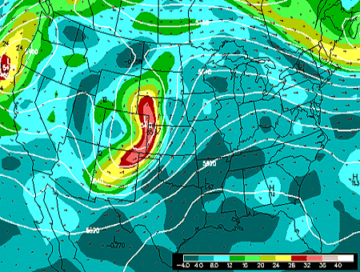
Vorticity Advection leads to rising/falling pressures at the surface. Vorticity is the localized rotation of the air. Air that rotates counter clockwise, such as in cyclones and troughs, is said to have positive vorticity. Clockwise rotating air, such as in high pressure systems and ridges, has negative vorticity. The advection of vorticity at high levels will result in a response at the surface which will attempt to offset the effects of the advection. More specifically, vorticity advection is indicative of rising motion/falling pressures at the surface. For example, look at this 500 mb map for 12Z, October 29, 1995.

