Slide 1
Enterobacteriaceae

Slide 2
Enterobacteriaceae
Classification – more than15 different genera
Escherichia
Shigella
Edwardsiella
Salmonella
Citrobacter
Klebsiella
Enterobacter
Hafnia
Serratia

Slide 3
Enterobacteriaceae
Proteus
Providencia
Morganella
Yersinia
Erwinia
Pectinobacterium

Slide 4
Enterobacteriaceae
Somatic O antigens – these are the heat stable polysaccharide part of the LPS.
Variation from smooth to rough colonial forms is accompanied by progressive loss of smooth O Antigen.
Flagellar H antigens – are heat labile
Envelope or capsule K antigens – overlay the surface O antigen and may block agglutination by O specific antisera.
Boiling for 15 minutes will destroy the K antigen and unmask O antigens.
The K antigen is called the Vi (virulence) antigen in Salmonella typhi.

Slide 5
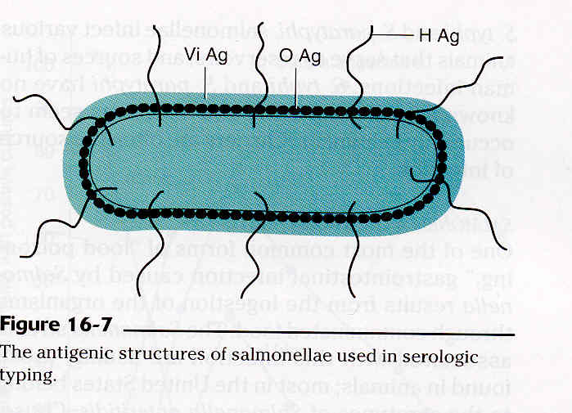
Antigenic Structure of Enterobacteriaceae

Slide 6
Enterobacteriaceae
Escherichia coli
Normal inhabitant of the gastrointestinal (GI) tract.
Some strains cause various forms of gastroenteritis.
Is a major cause of urinary tract infection and neonatal meningitis and septicemia.
May have a capsule.
Biochemistry
Most are motile.

Slide 7
E. coli
May be hemolytic on BA – more common in pathogenic strains
KEY tests for the normal strain:
TSI is A/A + gas
Urea –
Indole +
Citrate –
Motility +
There is an inactive biotype that is anaerogenic (G -), lactose –, and nonmotile.

Slide 8
E. coli
Antigenic structure - has O, H, and K antigens. K1 has a strong association with virulence, particularly meningitis in neonates.
Virulence factors
Toxins
Enterotoxins – produced by enterotoxigenic strains of E. coli (ETEC). Causes a movement of water and ions from the tissues to the bowel resulting in watery diarrhea. There are two types of enterotoxin:
LT – is heat labile and binds to specific Gm₁ gangliosides on the epithelial cells of the small intestine where it ADP-ribosylates Gs which stimulates adenylate cyclase to increase production of cAMP.
Increased cAMP alters the activity of sodium and chloride transporters producing an ion imbalance that results in fluid transport into the bowel.

Slide 10
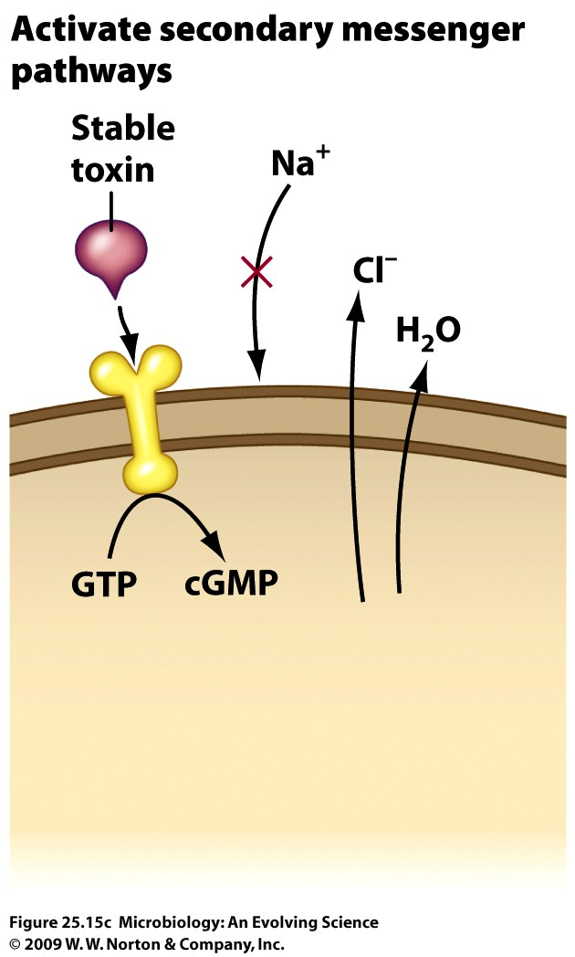
E. coli toxins
ST – is heat stable and binds to specific receptors to stimulate the production of cGMP with the same results as with LT.

Slide 11
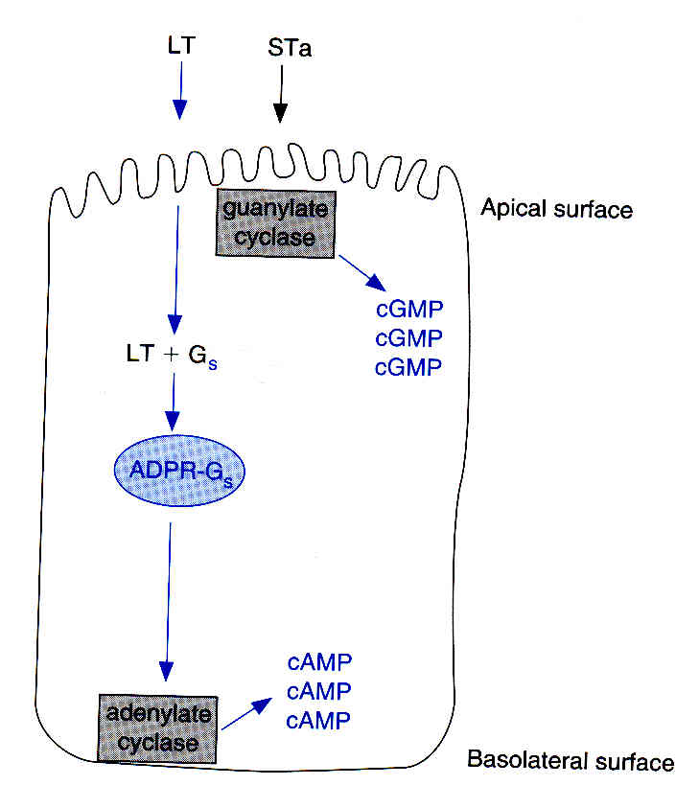
LT vs ST activity

Slide 12
E. coli toxins
Both enterotoxins are composed of five beta subunits (for binding) and 1 alpha subunit (has the toxic enzymatic activity).

Slide 13
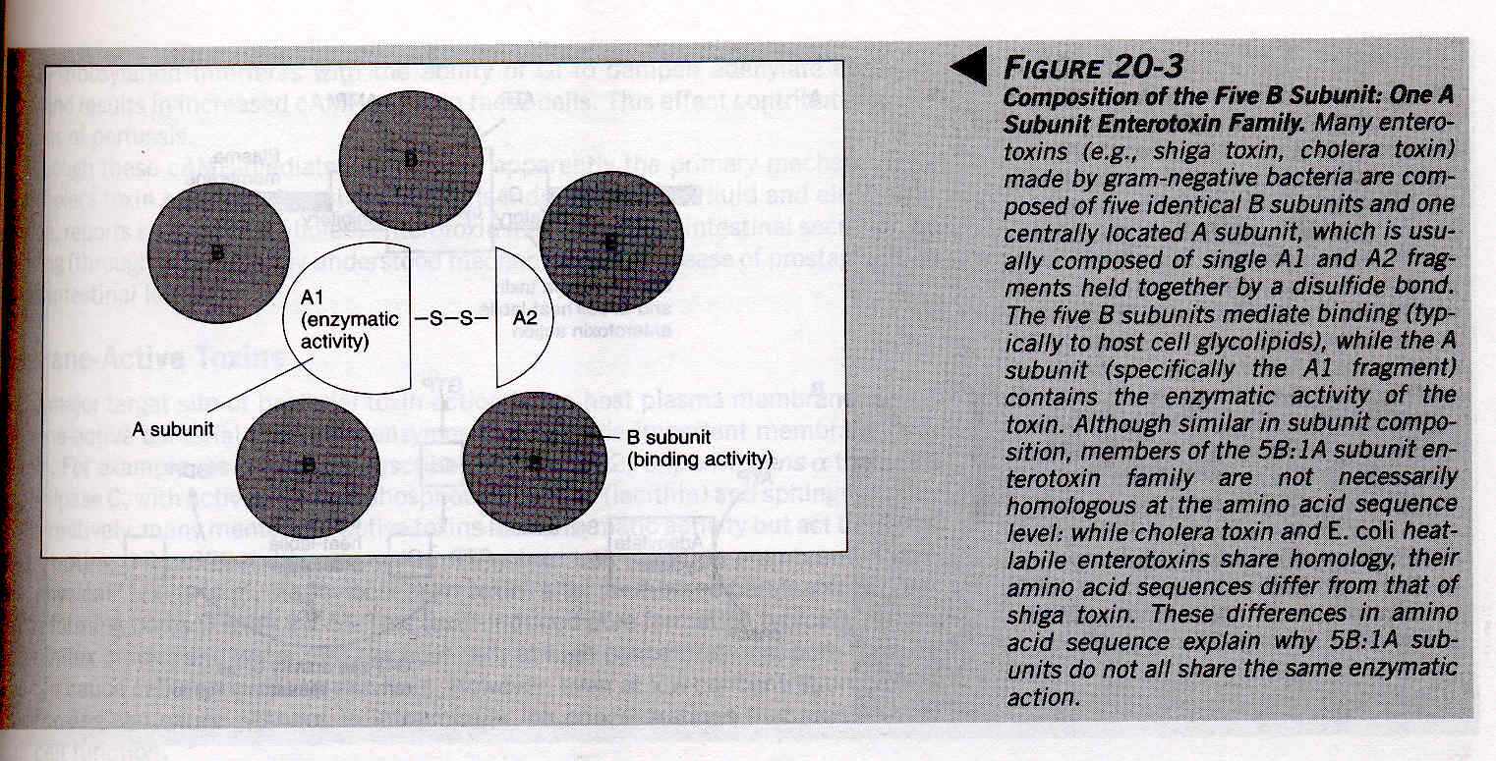
Composition of subunits of enterotoxins

Slide 14
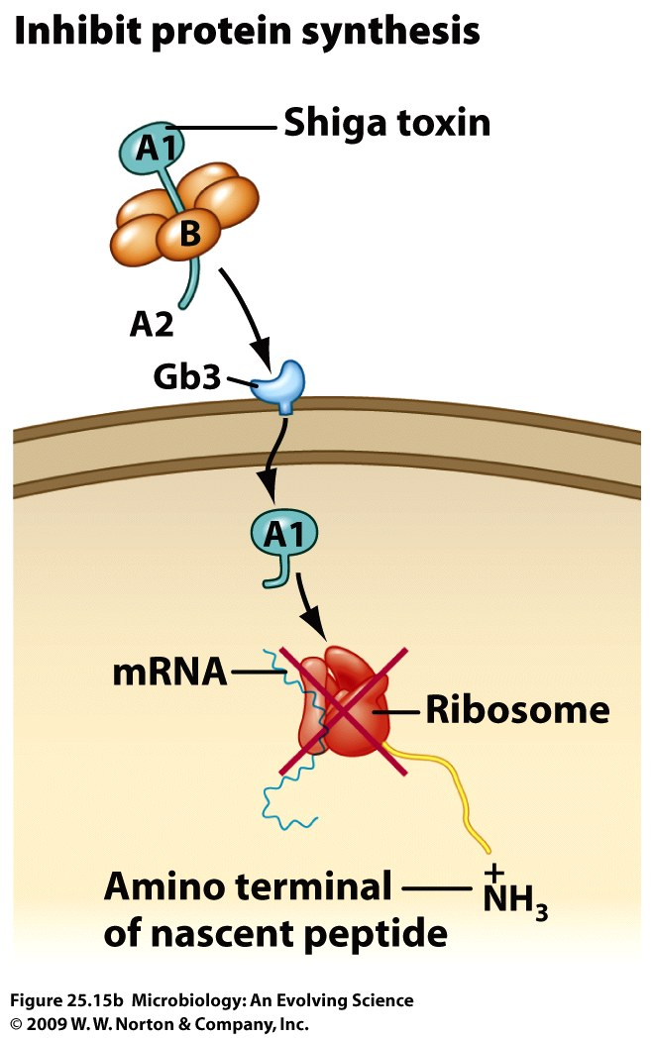
E. coli toxins
Shiga-type toxin – also called the verotoxin -produced by enterohemorrhagic strains of E. coli (EHEC) – is cytotoxic, enterotoxic, neurotoxic, and may cause diarrhea and ulceration of the G.I. tract.
There are two types shiga-like toxin 1 and shiga-like toxin 2.
Inhibit protein synthesis by cleaving a 28S rRNA that’s part of the 60S subunit

Slide 15
E. coli toxins
Enteroaggregative ST-like toxin – produced by enteroaggregative strains of E. coli (EAEC) – causes watery diarrhea.
Hemolysins – two different types may be found: cell bound and secreted.
They lyse RBCs and leukocytes and may help to inhibit phagocytosis when cell bound.
Endotoxin

Slide 16
E. coli gastroenteritis
EHEC – The organism attaches via pili to the intestinal mucosa and liberates the shiga-like toxin.
The symptoms start with a watery diarrhea that progresses to bloody diarrhea without pus and crampy abdominal pain with no fever or a low-grade fever.
This may progress to hemolytic-uremic syndrome that is characterized by low platlet count, hemolytic anemia, and kidney failure.
This is most often caused by serotypes O157:H7.
This strain of E. coli can be differentiated from other strains of E. coli by the fact that it does not ferment sorbitol in 48 hours (other strains do).
A sorbitol-Mac (SMAC) plate (contains sorbitol instead of lactose) is used to selectively isolate this organism.
One must confirm that the isolate is E. coli O1547:H7 using serological testing and confirm production of the shiga-like toxin before reporting out results.
Serotypes of E. coli other than O157H7 have now been found to cause this disease

