Slide 1
5. Fractal Compression
Fractal compression is a lossy compression method used to compress images using fractals. The method is best suited for photographs of natural scenes (trees, mountains, ferns, clouds). The fractal compression technique relies on the fact that in certain images, parts of the image resemble other parts of the same image.

Slide 2
Fractal compression appeared to be a promising technology in the late 1980s, when in some circumstances it appeared to compress much better than JPEG, its main competitor at that time.
However, fractal compression never achieved widespread use. Fractal compression is much, much slower to compress and much slower to decompress than JPEG. Furthermore, its patents were not widely licensed. Also, the improved compression ratio is an illusion.

Slide 3
Fractal compression only has a large advantage over JPEG at low image quality levels, which is usually undesirable. The claim that fractal compressed images, when enlarged beyond their original size, looked better than similarly enlarged JPEG images seems also to have been an irrelevant distinction.

Slide 4
Fractal Image Compression

Slide 5
Overview
Introduction
Why Fractal Image Compression
Mathematical Background
How does it work?
Examples
Possible Improvements

Slide 6
Introduction
Images are stored on computers as collections of bits representing pixels or points forming the picture elements.
Most data contains some amount of redundancy, which can sometimes be removed for storage and replaced for recovery.
this redundancy does not lead to high compression ratios.
An image can be changed in many ways that are either not detectable by the human eye or do not contribute to the degradation of the image.

Slide 7
Fractal Image Compression
Is a compression method developed in the late 80’s Is patented Compression ratios from 1:4 to 1:100
Compressing is slow.
Decoding is fast.
Best suited for images of natural scenes, such as mountains, trees, clouds etc.
Compresses color images better than grey scale images.

Slide 8
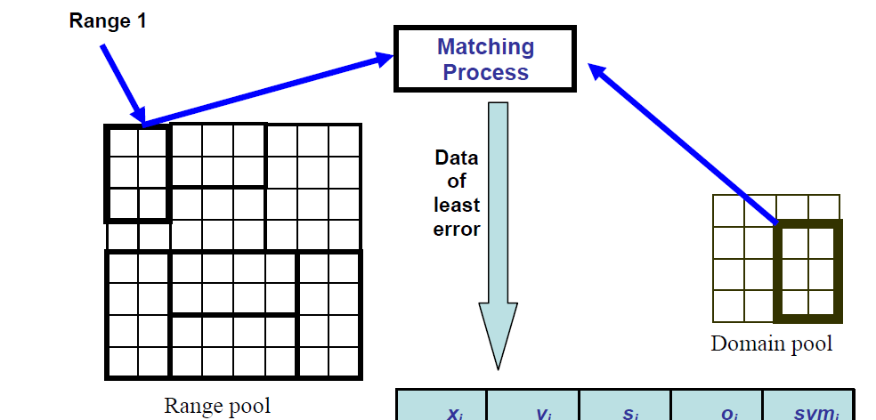
Fractal Compression
The idea is to look for parts in a picture that resembles other parts in the same picture.
The picture is divided into (range blocks) (small) and (domain blocks) (big).
Uses a domain block to describe a range block.
For each range block, search for the domain block that most closely resembles the range block.

Slide 9
Compression
The searching that is done when trying to find the most suited domain block for each range block takes a lot of time.
  Have to check many transformations per domain block.
Can take from 5 seconds up to 5 hours (or more) to compress an image.
What is stored in the compressed file:
    The translation done on the domain blocks to match the position of their associated range blocks
    The transformations done on the domain blocks.
    The colour, brightness, contrast adjustments.
This information is called fractal codes.
No pixels are stored at all, only mathematical functions.

Slide 10
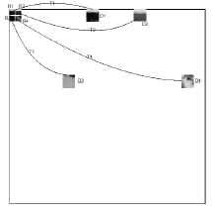
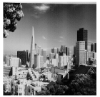

Compression 2
Mapping of range blocks (R) and domain blocks (D) and their transformations (T)
Typical pixel sizes of the range and domain blocks:
The domain blocks are double the size of the range blocks.
• Smaller size of the blocks means a larger compressed file, because of more fractal codes.

Slide 11
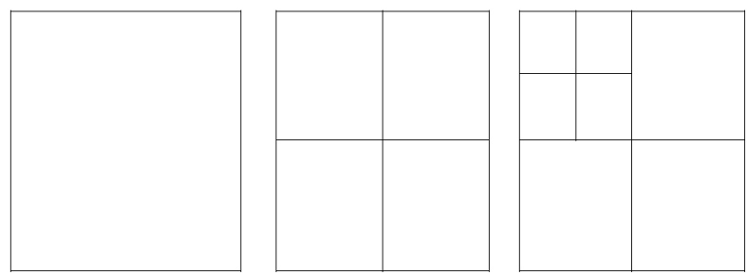
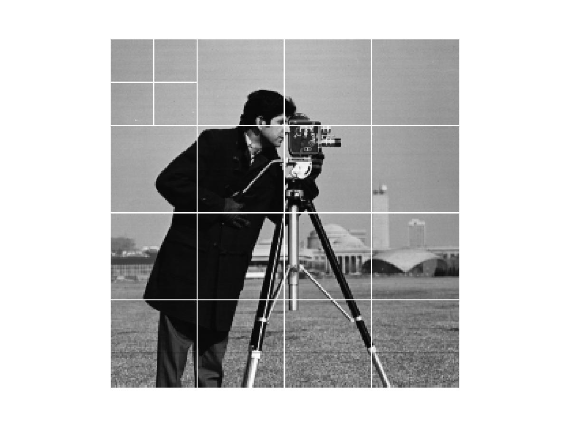
How does it work? Encoding
divide image into small, non-overlapping, square blocks, typically called “parent blocks”.
Divide each parent block into 4 each blocks, or “child blocks.”
Compare each child block against a subset of all possible overlapping blocks of parent block size.
  Need to reduce the size of the parent to allow the comparison to work.
Determine which larger block has the lowest difference, according to some measure, between it and the child block.

Slide 12

Decompression
Decompression is done by applying the transformations and translations described in the fractal codes on an arbitrary image.
Easy to automate.
Is fast.
Decoding is resolution independent:
  If a 64x64 image was compressed, it can be decompressed to any size (e.g. 128x128) without as much loss in quality as for a normal zoom.
  Read in child block and transform block position, transform, and size information.
  Use any blank starting image of same size as original image

Slide 13
Overview
Why Fractal Image Compression
Mathematical Background
How does it work?
Examples
Possible Improvements

Slide 14
Why Fractal Image Compression
Different type of compression scheme worth exploring
Takes advantage of similarities within an image
Advanced detail interpolation
High theoretical compression rates
Fast decompression times

Slide 15
Mathematical Background
Started with Michael Barnsley, and refined by A. Jacquin
Try and find a set of transforms that map an image onto itself.
The key is the Collage Theorem
  States that if the error difference between the target image and the transformation of that image is less than a certain value the transforms are an equivalent representation of the image.

Slide 16
How does it work?-Encoding
Take a starting image and divide it into small, non-overlapping, square blocks, typically called “parent blocks”.
Divide each parent block into 4 each blocks, or “child blocks.”
Compare each child block against a subset of all possible overlapping blocks of parent block size.
  Need to reduce the size of the parent to allow the comparison to work.
Determine which larger block has the lowest difference, according to some measure, between it and the child block.
Calculate a grayscale transform to match intensity levels between large block and child block precisely. Typically an affine transform is used (w*x = a*x + b) to match grayscale levels.
Notes:
Draw Pictures on a board here.

Slide 17
How does it work? – Encoding
Upper left corner child block, very similar to upper right parent block.
Compute affine transform.
Store location of parent block (or transform block), affine transform components, and related child block into a file.
Repeat for each child block.
Lots of comparisons can calculations.
  256x256 original image
  16x16 sized parent blocks
  241*241 = 58,081 block comparisons

Slide 18
How does it work?- Decoding
Read in child block and tranform block position, transform, and size information.
Use any blank starting image of same size as original image
For each child block apply stored transforms against specified transform block
Overwrite child block pixel values with transform block pixel values
Repeat until acceptable image quality is reached.

Slide 19
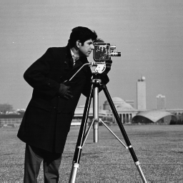
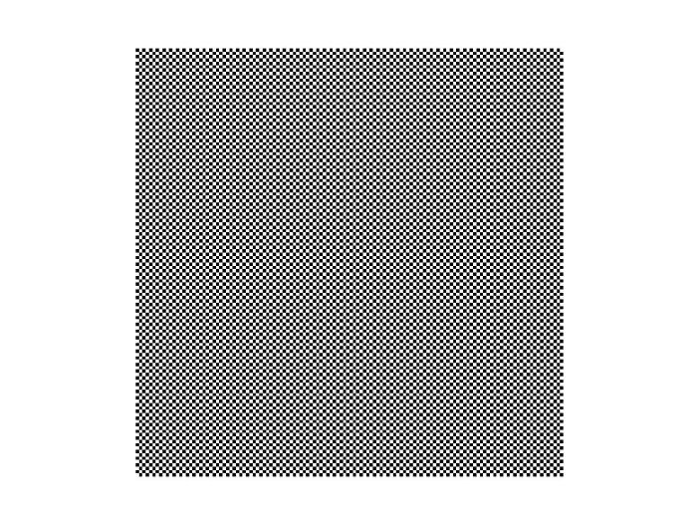
Examples
Original Image
Starting Image for Decoding

Slide 20
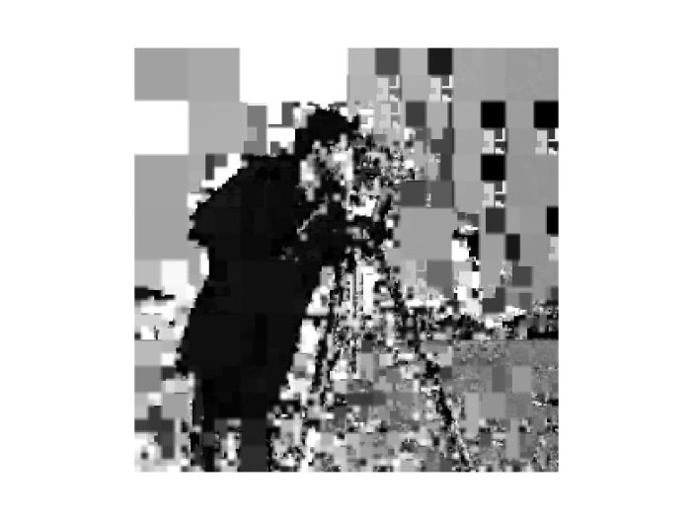
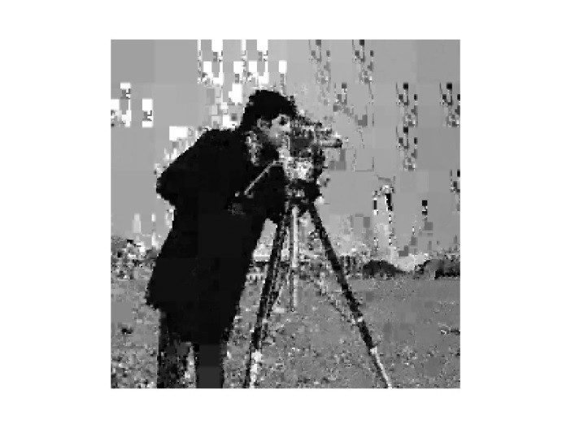
How does it Work? – Decoding
First Iteration
Second Iteration

Slide 21
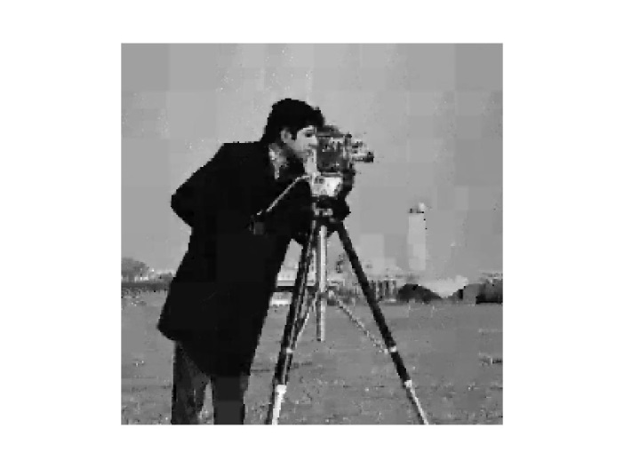

How does it work? - Decoding
Fifth Iteration
Tenth Iteration

Slide 22
Possible Improvments
Greatest weakness is time for encoding
  Possible speed ups
    Order transform blocks into domains based off of average intensity and variance
    Only search through blocks with similar structures
    Do not search all possible blocks
    Reduce number of child blocks
Quality and Compression Improvements through
  Quadtrees or HV Trees
  Rotations of Transform Blocks during comparison
  Improved grayscale transforms

Slide 23
Math Modeling Final Project
APPLICATIONS of FRACTALS
FRACTAL LANDSCAPES
FRACTAL IMAGE COMPRESSION
Advisor: Professor Alber
Fang Qi
Pu Wan
Xue Rui

Slide 24

Review:
Two important properties of a fractal F
F has detail at every level.
F is exactly, approximately or statistically self-similar.

Slide 25
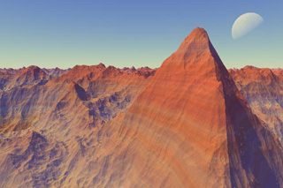
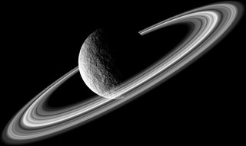
Fractal Landscapes
Fractals are now used in many forms to create textured landscapes and other intricate models. It is possible to create all sorts of realistic fractal forgeries, images of natural scenes, such as lunar landscapes, mountain ranges and coastlines. This is seen in many special effects within Hollywood movies and also in television advertisements.
A fractal planet.
A fractal landscape created by Professor Ken Musgrave (Copyright: Ken Musgrave)

Slide 26
Simulation process
First:
Already known
The average of the 2 neighbor blue points plus r
The average of the 4 neighbor red points plus r
This random value r is normally distributed and scaled by a factor d1 related to the original d by
d is the scale constant.
H is the smoothness constant.

Slide 27
We can now carry out exactly the same procedure on each of the four smaller squares, continuing for as long as we like, but where we make the scaling factor at each stage smaller and smaller; by doing this we ensure that as we look closer into the landscape, the 'bumps' in the surface will become smaller, just as for a real landscape. The scaling factor at stage n is dn, given by
Simulation result by MATLAB
Using a 64x64 grid and
H=1.25
d=15

Slide 28
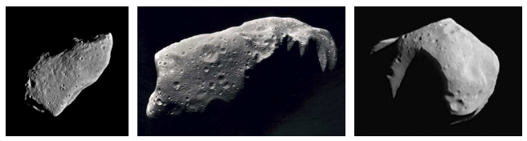

Slide 29
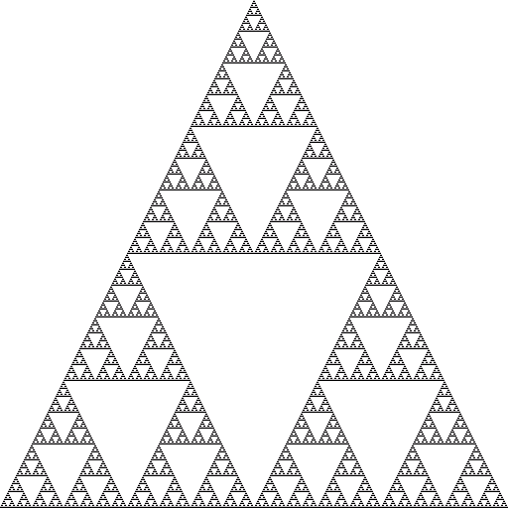

FRACTAL IMAGE COMPRESSION
What is Fractal Image Compression ?
The output images converge to the Sierpinski triangle. This final image is called attractor for this photocopying machine. Any initial image will be transformed to the attractor if we repeatedly run the machine.
On the other words, the attractor for this machine is always the same image without regardless of the initial image. This feature is one of the keys to the fractal image compression.

Slide 30
How can we describe behavior of the machine ? Transformations of the form as follows will help us.
Such transformations are called affine transformations. Affine transformations are able to skew, stretch, rotate, scale and translate an input image.
M.Barnsley suggested that perhaps storing images as collections of transformations could lead to image compression.

Slide 31
Iterated Function Systems ( IFS )
An iterated function system consists of a collection of contractive affine transformations.
For an input set S, we can compute wi for each i, take the union of these sets, and get a new set W(S).
Hutchinson proved that in IFS, if the wi are contractive, then W is contractive, thus the map W will have a unique fixed point in the space of all images. That means, whatever image we start with, we can repeatedly apply W to it and our initial image will converge to a fixed image. Thus W completely determine a unique image.

Slide 32
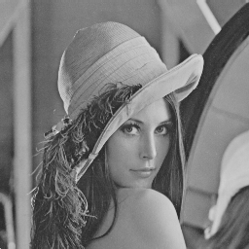
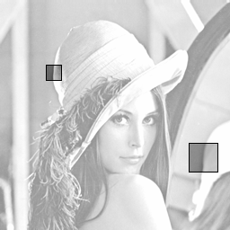
Self-Similarity in Images
We define the distance of two images by:
where f and g are value of the level of grey of pixel, P is the space of the image
JAVA
Original Lena image Self-similar portions of the image

Slide 33
Affine transformation mentioned earlier is able to "geometrically" transform part of the image but is not able to transform grey level of the pixel. so we have to add a new dimension into affine transformation
Here si represents the contrast, oi the brightness of the transformation
For encoding of the image, we divide it into:
non-overlapped pieces (so called ranges, R)
overlapped pieces (so called domains, D)

Slide 34
Encoding Images
Suppose we have an image f that we want to encode. On the other words, we want to find a IFS W which f to be the fixed point of the map W
We seek a partition of f into N non-overlapped pieces of the image to which we apply the transforms wi and get back f.
We should find pieces Di and maps wi, so that when we apply a wi to the part of the image over Di , we should get something that is very close to the any other part of the image over Ri .
Finding the pieces Ri and corresponding Di by minimizing distances between them is the goal of the problem.

Slide 35
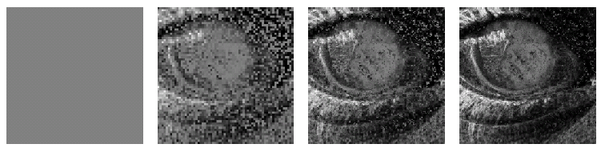
Decoding Images
The decoding step is very simple. We start with any image and apply the stored affine transformations repeatedly till the image no longer changes or changes very little. This is the decoded image.
First three iterations of the decompression of the image of an eye from an initial solid grey image

Slide 36
An Example
Suppose we have to encode 256x256 pixel grayscale image.
let R1~R1024 be the 8x8 pixel non-overlapping sub-squares of the image, and let D be the collection of all overlapping 16x16 pixel sub-squares of the image (general, domain is 4 times greater than range). The collection D contains (256-16+1) * (256-16+1) = 58,081 squares. For each Ri search through all of D to find Di with minimal distances
To find most-likely sub-squares we have to minimize distance equation. That means we must find a good choice for Di that most looks like the image above Ri (in any of 8 ways of orientations) and find a good contrast si and brightness oi. For each Ri , Di pair we can compute contrast and brightness using least squares regression.

Slide 37
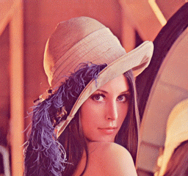

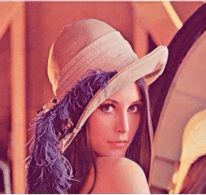
Fractal Image Compression versus JPEG Compression
Original Lena image (184,320 bytes)
JPEG-max. quality (32,072)
comp. ratio: 5.75:1
FIF-max. quality (30,368)
comp. ratio: 6.07:1

Slide 38
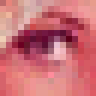
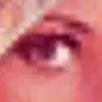
Resolution Independence
One very important feature of the Fractal Image Compression is Resolution Independence.
When we want to decode image, the only thing we have to do is apply these transformations on any initial image. After each iteration, details on the decoded image are sharper and sharper. That means, the decoded image can be decoded at any size.
So we can zone in the image on the larger sizes without having the "pixelization" effect..
Lena's eye
original image enlarged to 4 times
Lena's eye
decoded at 4 times its encoding size

