Slide 1
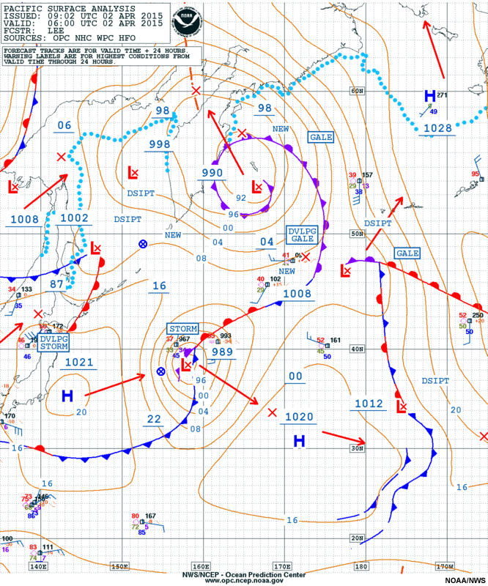
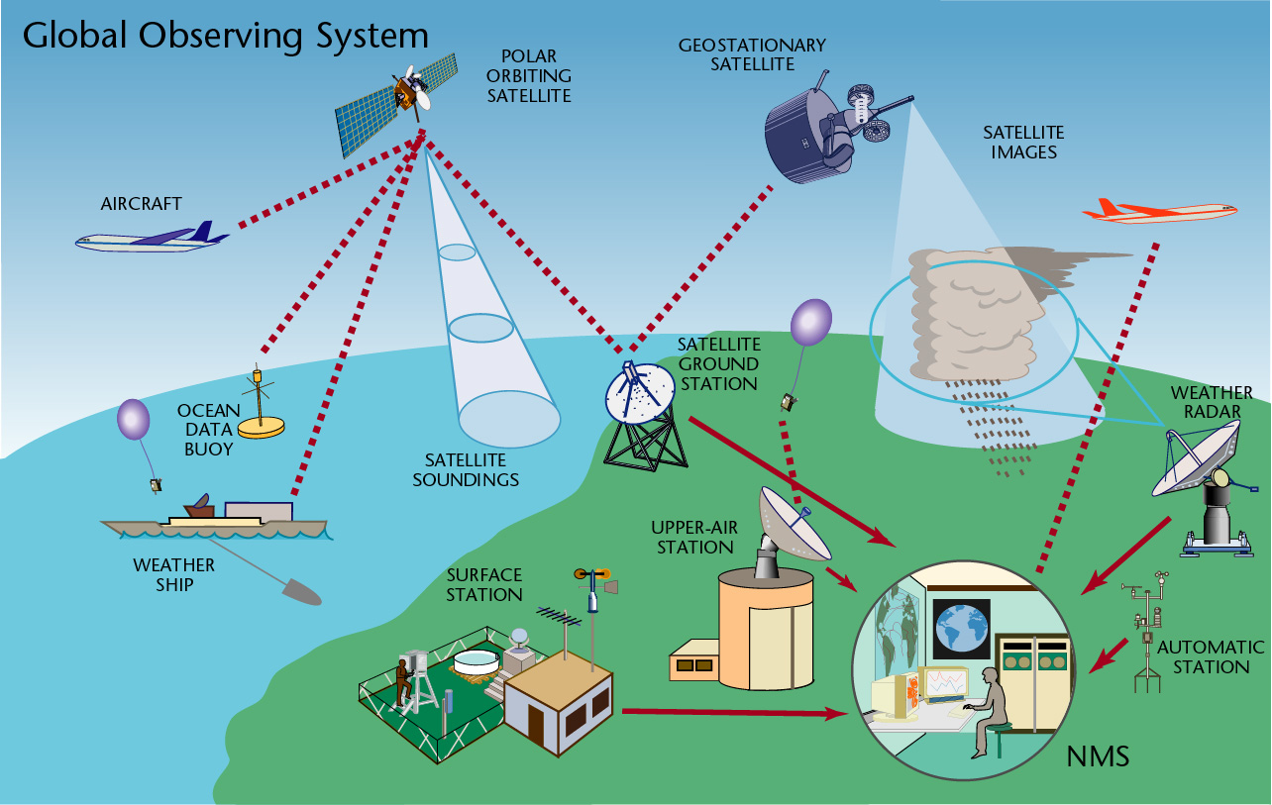
The Course of Synoptic Meteorology
MUSTANSIRIYAH UNIVERSITY
COLLEGE OF SCIENCES
ATMOSPHERIC SCIENCES DEPARTMENT
2018-2019
Dr. Sama Khalid Mohammed
SECOND STAGE

Slide 2

WELCOME STUDENTS TO LECTURE 4 ☺

Slide 3
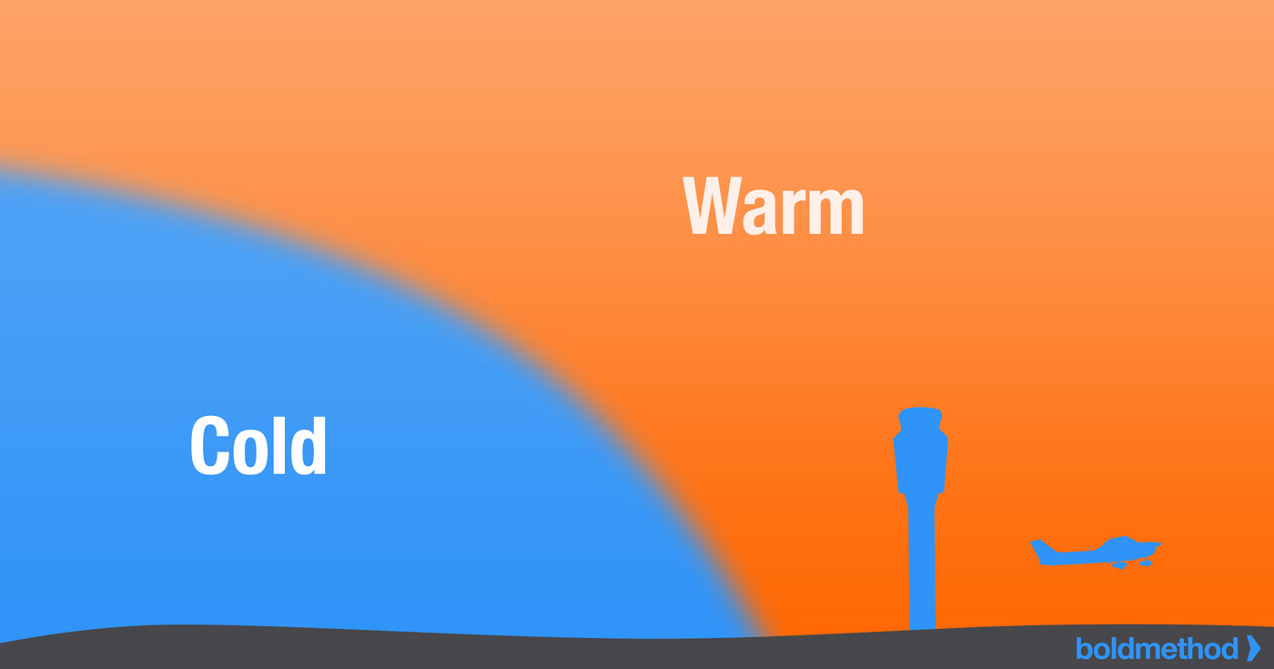
Front
Fronts are a boundary surfaces that separate air masses of different densities (warmer and moister) than the other and are the principal cause of meteorological phenomena.
front has horizontal and vertical extent, the upward extension of a front is referred to as a frontal surface, or a frontal zone.
As one air mass moves into another, the warmer (less dense) air mass is forced aloft in a process called overrunning.

Slide 4
The general properties of fronts are:
  sharp temperature contrast (isotherms lines will be tightly packed near frontal zone) and packing will be greatest on cold side of front on a weather map
  moisture contrast and cyclonic wind shift.
  In general, the sharper temperature contrast across the front and the faster front moves, the weather will be more severe, which is why cold fronts are more violent than warm fronts as we will see later.
  Falling pressure means front hasn’t yet passed, while rising pressure means front has passed.
  Sometimes, fronts are dry, meaning that even though there is uplifting along the front and there is not enough moisture to cause clouds or precipitation.
  Fronts lie in a trough

Slide 5
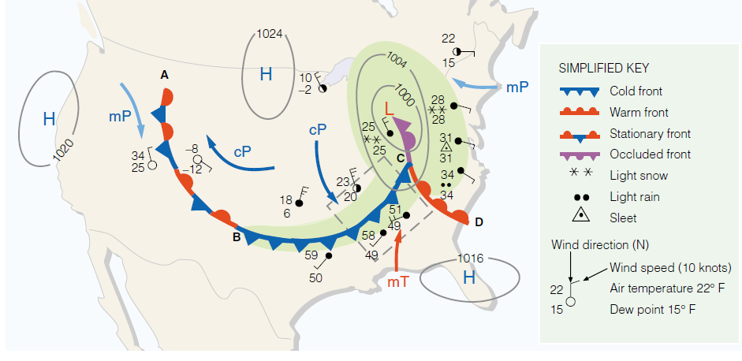
There are four types of fronts:
  cold fronts
  warm fronts
  occluded fronts
  stationary fronts
A weather map showing surface-pressure systems, air masses, fronts, and isobars (in millibars) as solid gray lines. Large arrows in color show air flow. (Green-shaded area represents precipitation.)

Slide 6
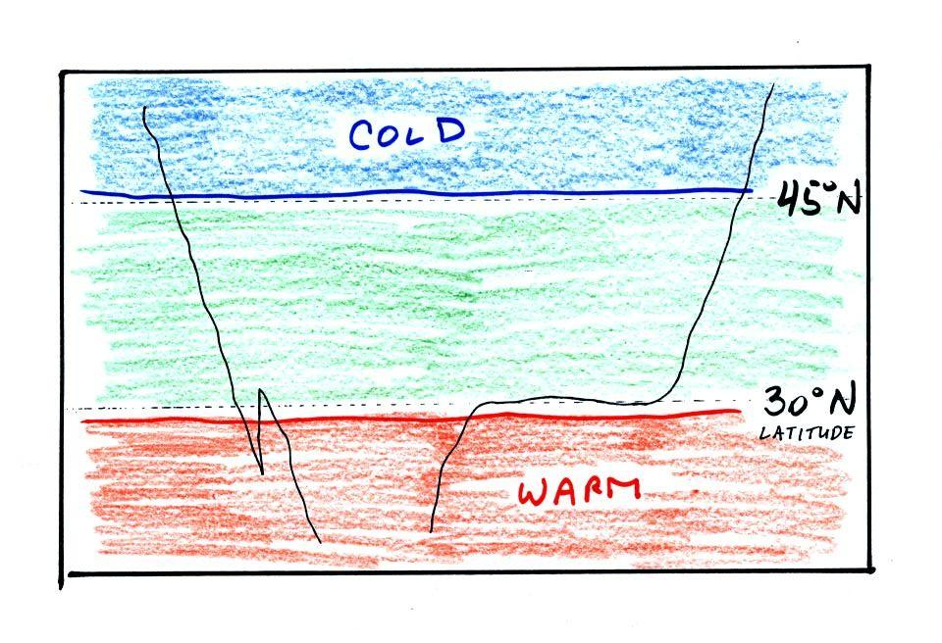
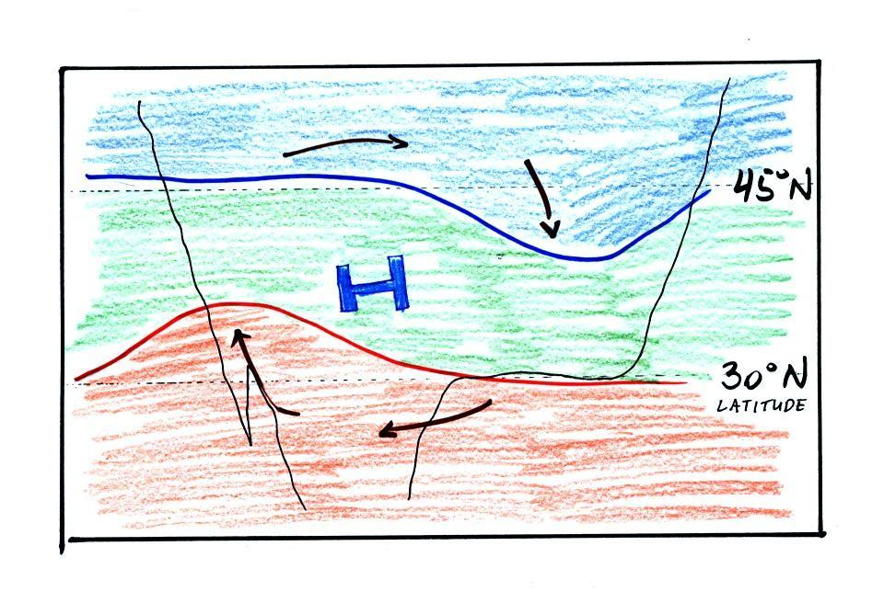
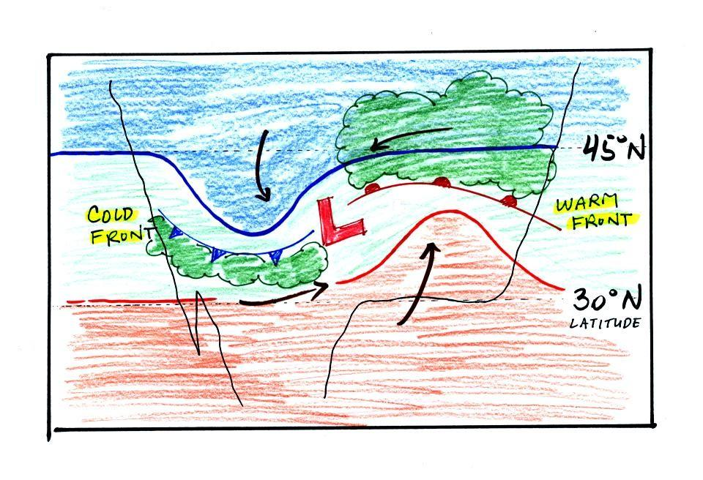
  Fronts lie in a trough, why?
Counterclockwise winds move cold air toward the south on the west side of the Low. Warm air advances toward the north on the eastern side of the low.
The converging winds in the case of low pressure will move the air masses of different temperature in toward the center of low pressure and cause them to collide with each other. The boundaries between these colliding air masses are called fronts.
The clockwise spinning winds move warm air to the north on the western side of the High. Cold air moves toward the south on the eastern side of the High. The diverging winds also move the warm and cold air away from the center of the High.
Temperature changes from south to north

Slide 7
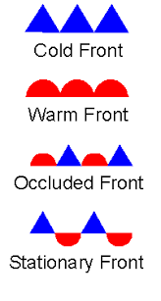
Cold Front
Represents a zone where cold, dry stable polar air is replacing warm moist unstable tropical air.
The cold front is represented by a blue line with triangles pointing the direction of cold air moving.
Cold fronts generally move from northwest to southeast.
The cold air that's arriving behind a cold front is colder and drier than the air ahead of it.
When a cold front passes through, temperatures can drop more than 15 degrees within the first hour, while the temperature difference across the front can be small, weather is determined by the moisture content of the warm air mass

Slide 8
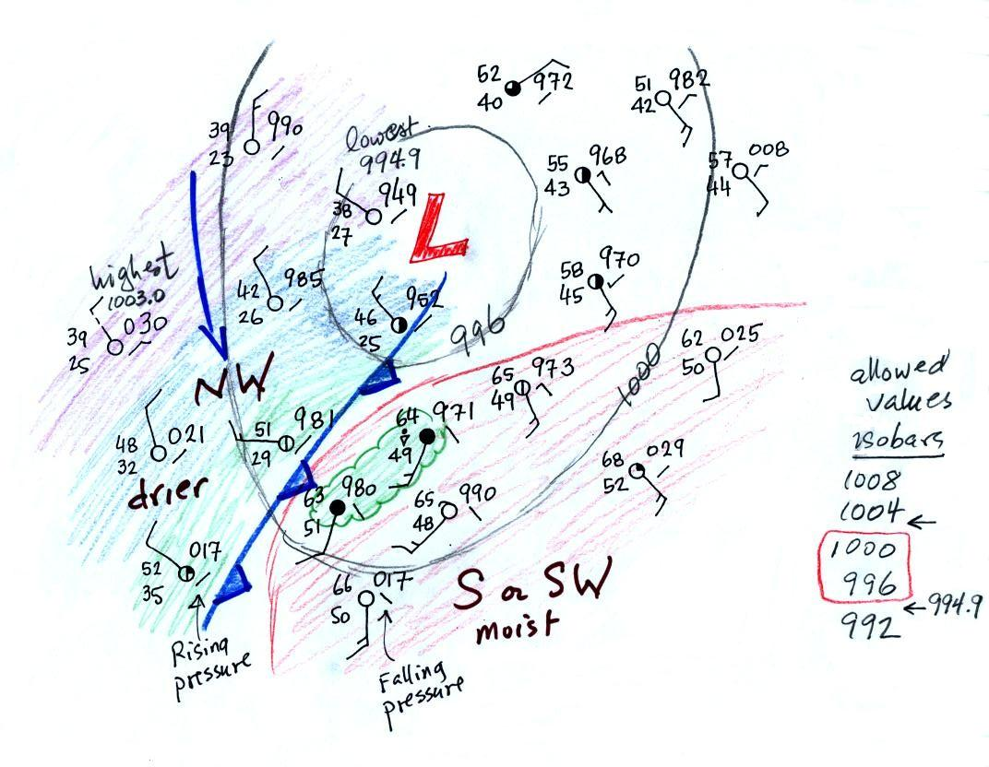
The Pressure Falls steadily before passing , minimum at passing, rises after.
Precipitation – Showers before; heavy precip. at front, snow; precip. decreases then clearing
Visibility – Hazy before; poor at front; improving after
Dew point – High before(why); sharp drop when pass; lowering after.
As a cold front moves into an area, the heavier, cool air pushes under the lighter, warm air and replacing it, and the warm air cools as it rises.

Slide 9
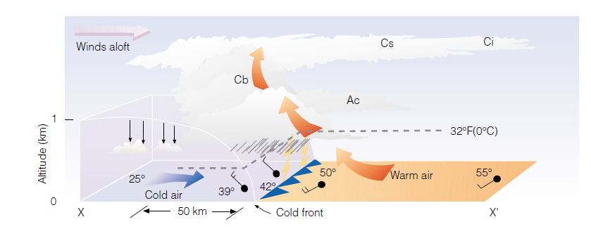
The leading edge of the front is steep, steepness due to friction.
Distance from leading edge of front to cold air =100 km. But the front aloft is about 1 km over our head.
Thus it is said to have a slope of 1:100
This is a fast moving front, slow moving fronts have less slope
front moves forward at 9 – 16m/s (much faster than warm front).

Slide 10
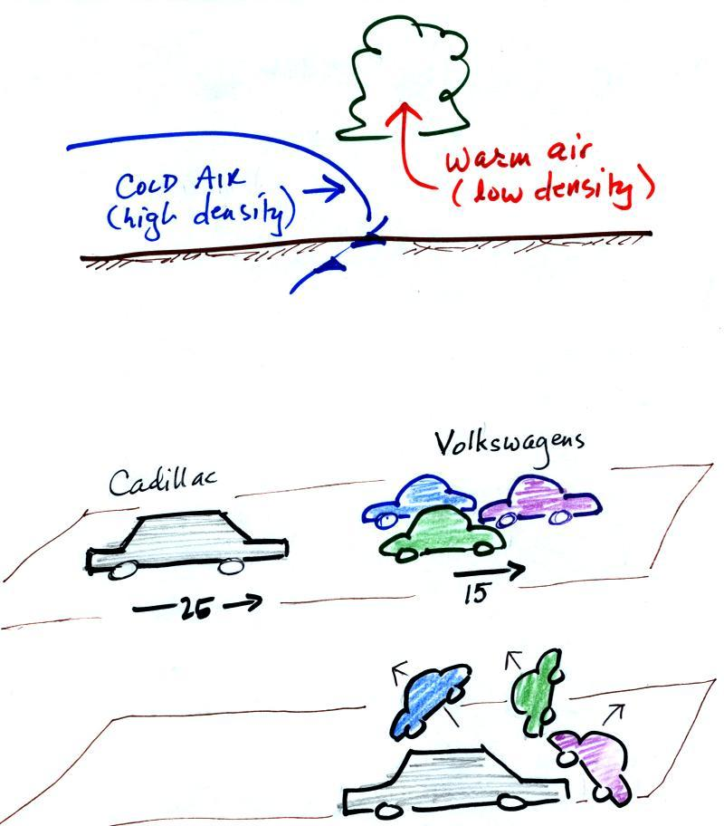
cold dense air on the left is advancing into warmer lower density air on the right. We are looking at the front edge of the cold air mass, note the sharp rounded shape. The warm low density air is lifted out of the way by the cold air. The warm air is rising.
The figure shows an analogous situation, a big heavy Cadillac rushing into a bunch of Volkswagens. The VWs are thrown up into the air by the Cadillac.

Slide 11
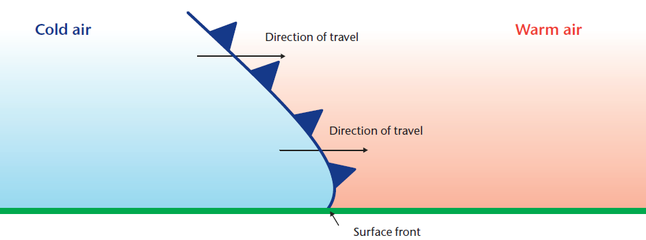
Cold fronts come in many varieties, including some that quickly bring clearing skies, and some that are followed by Cb, Cs and Ci clouds and rain.
If thunderstorms are associated, a scud roll or wall of dust will mark the front near the ground.
Precipitation ahead of a cold front can be continuous, but behind the front, becomes showery.
Winds ahead of a cold front tend to be from a southerly direction while those behind the front - in the cooler air - tend to be northerly.
Surface winds veer and increase or become gusty.
When wind direction shift from a southerly to a northerly indicating that a cold front has passed

Slide 12
Here are the typical weather conditions in advance of and following the frontal passage.
Weather variable | Behind, after the cold front has passed through | As the front is passing through | Ahead, before the arrival of the cold front
Temperature | cool, cold, colder* |  | warm
Dew Point | usually much drier* |  | may be moist (though that is often not the case here in the desert southwest)
Winds | northwest | gusty winds (dusty) | from the southwest
Clouds, Weather | clearing | rain clouds, thunderstorms in narrow band along the front (if the warm air mass is moist) | might see some high clouds
Pressure | rising | reaches a minimum | falling

Slide 13
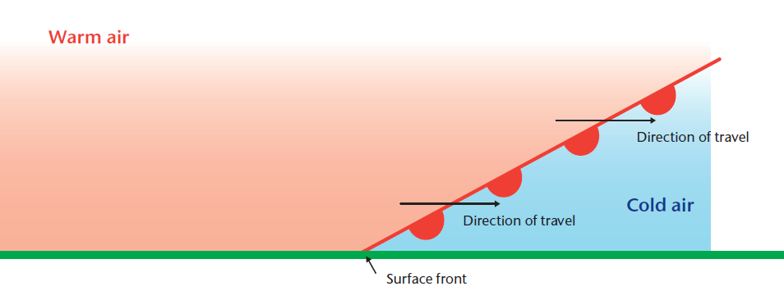
Warm Front
A warm front is the boundary between warm and cold air when the warm air is replacing the cold air
Warm fronts generally move from southwest to northeast and the air behind a warm front is warmer and moister than the air ahead of it. As the warm air advances it rides over the cold air, which is heavier.
As the warm air rises the water vapor in it condenses into clouds that can produce rain, snow, sleet or freezing rain, often all four, so it is easy to assume that the weather at a warm front is determined by the moisture content, the stability of the warm air, and the degree of overrunning (warm air over top the cold).
The warm front represented by semi-circles on the red line point in the direction of warm air moving.

Slide 14
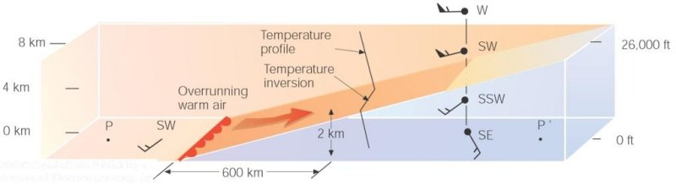
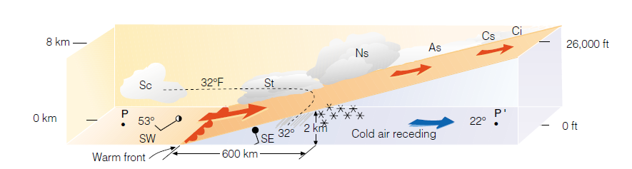
Vertical view of clouds and precipitation across the warm front

Slide 15
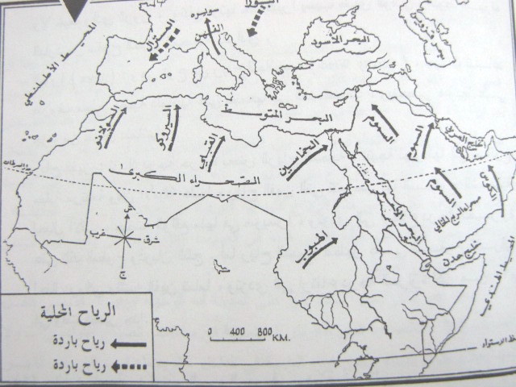
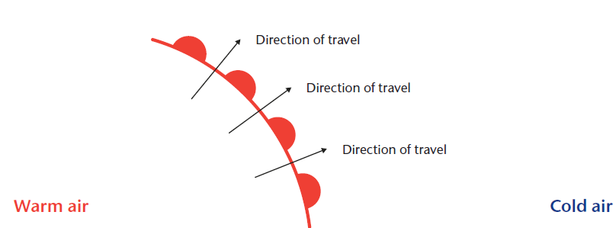

Slide 16
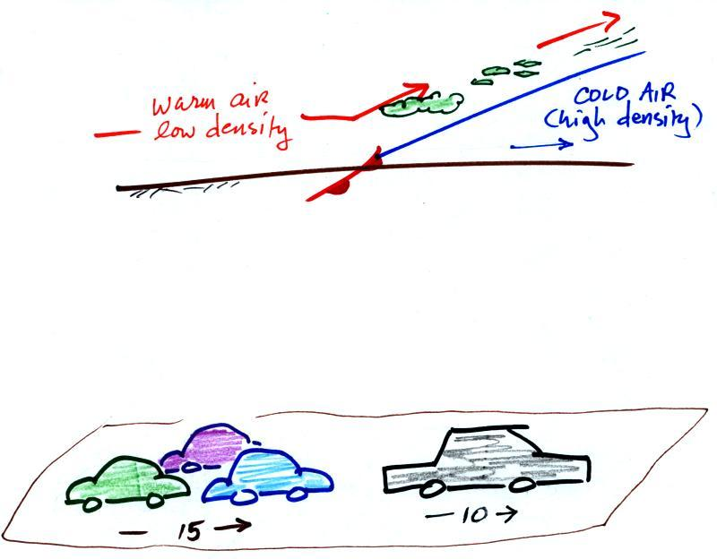
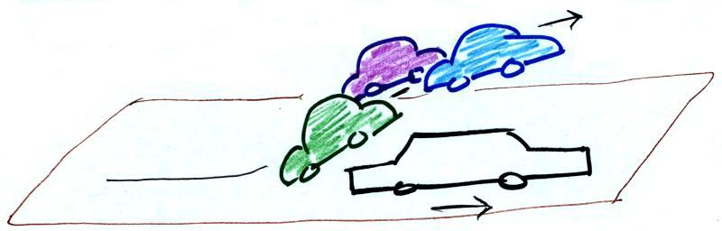
In the case of a warm front we are looking at the back, trailing edge of cold air (moving slowly to the right). Note the ramp like shape of the cold air mass. Warm air overtakes the cold air. The warm air is still less dense than the cold air, it can't wedge its way underneath the cold air. Rather the warm air overruns the cold air. The front can advance only as fast as the cooler air moves away to the right.
The warm air rises again and clouds form. Because the warm air rises more gradually, clouds that form are generally spread out over a larger area than with cold fronts.
The Volkswagens aren't heavy enough to lift the Cadillac. They run up and over the Cadillac.

Slide 17
This is why a slow-moving warm front can mean hours, if not days, of cloudy, wet weather before the warm air finally arrives.
The frontal surface slopes very shallowly with height (about 1:200) and the front moves forward at 7 - 9 m/s.
The passage of the front is accompanied by, a gradual veer of wind direction, increase in temperature and dew point, layer type cloud with light continuous precipitation and the pressure falls as the front approaches, then becomes steady or rises as the front passes.
Along warm front boundary clouds such as St, Ns , As, Cs, Ci and precipitation, can stretch hundreds of kilometers over the cold air.

Slide 18
Here are the typical weather conditions in advance of and following the frontal passage.
Weather Variable | Behind, after the front has passed through | As the front is passing through | Ahead, before the front arrives
Temperature | warmer |  | cool
Dew point | may be moister |  | drier
Winds | from S or SW |  | from E or SE
Clouds, Weather | clearing |  | wide variety of clouds well ahead of the front, may be a wide variety of types of precipitation also.
Pressure | rising | reaches a minimum | falling

Slide 19
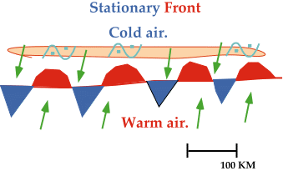
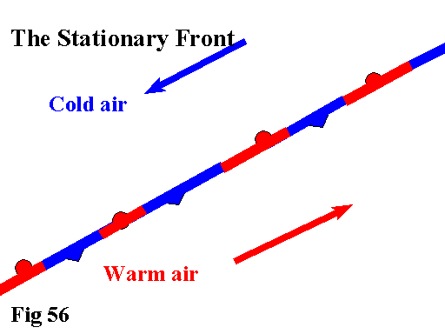
Stationary Front
A front with essentially no movement
Drawn as alternating red and blue line. Semicircles face toward colder air on the red line and triangles point toward warmer air on the blue line.
Winds tend to blow parallel to a stationary front.
If either a cold or warm front stops moving, it becomes a stationary front
If the stationary front starts moving north in the example above, it will become a????

Slide 20
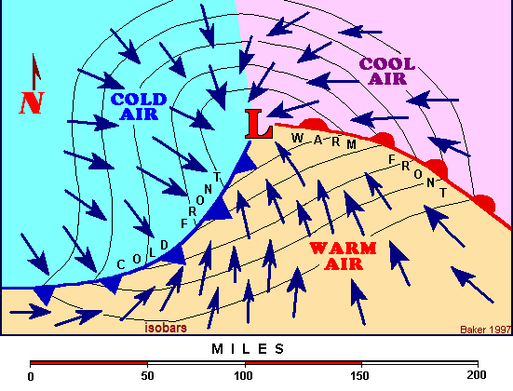
Occluded Fronts
It is the boundary that separates the new cold air mass (to the west) from the older cool air mass already in place north of the warm front, it means when a cold front overtakes a warm front.
When a cold front catches up to and overtakes a warm front, the frontal boundary created between the two air masses is called an occluded front or simply an occlusion

Slide 21
Represented as a solid purple line with alternating cold front type triangles and warm front half circles.
Changes in temperature, dew point temperature, and wind direction can occur with the passage of an occluded front.
Two types: Warm and cold occlusions;
Warm occlusion is, when air behind cold front is warmer than air ahead of warm front, and almost have the same characteristics associated with warm front.
Cold occlusion is, when air behind cold front is colder than air ahead of warm front and almost have the same characteristics associated with cold front.

Slide 22
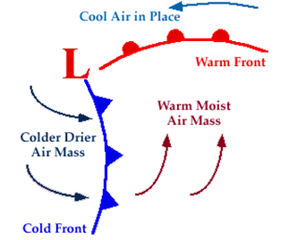
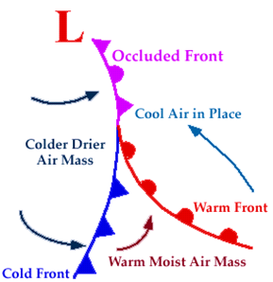
Occluded Front Development
Phase 1:
Phase 2

Slide 23
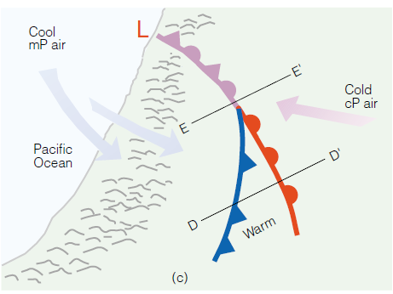
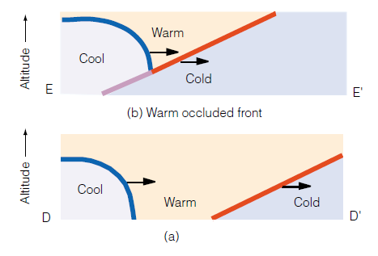
The formation of a warm-type occluded front.
The faster-moving cold front in (a) overtakes the slower-moving warm front in (b).
The lighter air behind the cold front rises up and over the denser air ahead of the warm front.
Diagram (c) shows a surface map of the situation.

Slide 24
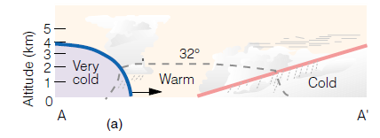
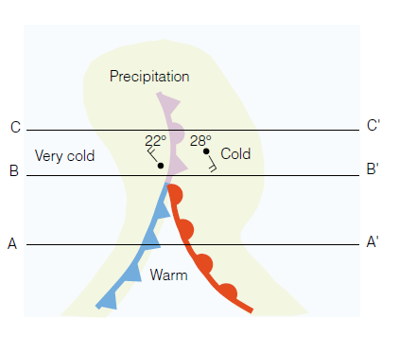
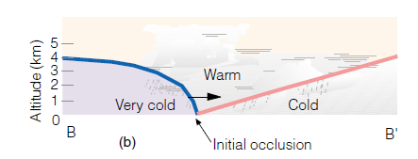
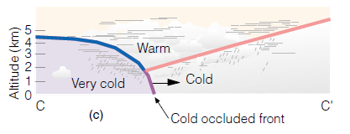
The formation of a cold-occluded front.
The faster-moving cold front (a) catches up to the slower-moving warm front (b)
and forces it to rise off the ground (c) (Green-shaded area represents precipitation.)

