Slide 1
How to describe a scientific graph in English

Slide 2
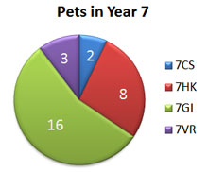
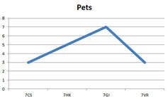
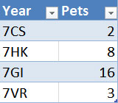
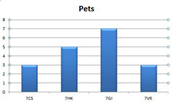
Types of graphs
Types of charts

Slide 3
List with phrases to describe charts
The pie chart is about ...
The bar chart deals with ...
The line graph (clearly) shows ...
The slices of the pie chart compare the ...
The chart is divided into ... parts.

Slide 4
Mean points
It highlights ...
... has the largest (number of) ...
... has the second largest (number of) ...
... is as big as ...
... is twice as big as ...
... is bigger than ...
more than ... per cent ...
only one third ...
less than half ...
The number ... increases/goes up/grows by ...
The number ... decreases/goes down/sinks by ...
The number ... does not change/remains stable
I was really surprising

Slide 5
Use of Tenses
Mind the correct use of tenses when describung a chart. If the charts deals with facts in the present (as in our example), use the Simple Present, if the facts are the past, then use the Simple Past. If there is a connection between the past and the present, use the Present Perfect.
How to describe a chart
With the following example we would like to show you how charts are described. Mind the three parts and do not repeat the global message in the conclusion.

Slide 6
Pets in Year 7 at a school
We have chosen the pie chart because we think it shows the number of pets in Year 7 best.

Slide 7
How to describe a chart
1 Introduction
Here you say what the diagram is about. Mind the title of it and do not forget to include the source.
The pie chart is about the pets in Year 7. The chart is divided into 5 parts. It is taken from ...
2 Message of the diagram
The largest number of pets are in form 7GI. There are 16 pets. The second largest number of pets are in form 7HK. There are 8 pets. So there are more than twice as many pets in form 7GI. The chart shows that there are only 2 pets in form 7CS and 3 in form 7VR.
3 Conclusion
So we can say that the most pets of Year 7 are in form 7GI and the least in form 7CS. There are more than 50 per cent of all the pets in one form - form 7GI.

Slide 8
Describing Trends in Graphs

Slide 9
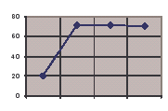
1
Production started climbing steadily but flattened off at a level of around 70. Since then, it has fallen steadily.

Slide 10
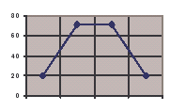
2
Production grew more and more rapidly over the first three quarters but then reached a peak. Since then, it has quickly dropped.

Slide 11
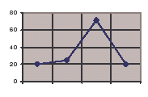
3
Production grew rapidly in the first quarter, but reached a plateau of about 70. Since then it has remained more or less stable.

Slide 12
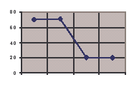
4
Production has dropped slowly but steadily over the year.

Slide 13
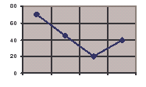
5
Production started the year in a stable position, but then plunged in the third quarter. It has now flattened out at a level of 20.

Slide 14
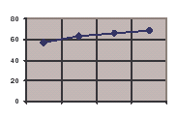
6
Production fell considerably over the first three quarters, reaching a low of 20. Since then it has staged a partial recovery.

Slide 15
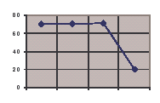
7
Production started off steady, but fell sharply in the last quarter

Slide 16
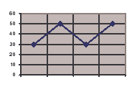
8
.
Production has fluctuated all year.

Slide 17
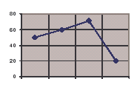
9
Production showed a marginal rise in the first three quarters, but then suffered a sharp drop.

Slide 18
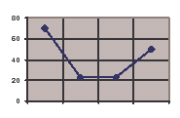
10
After a considerable drop in the first two quarters, production bottomed out at 20. Since then it has started to rise.

Slide 19
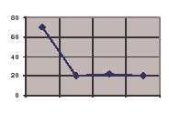
11
Production has experienced a strong, steady growth over the whole year.

Slide 20
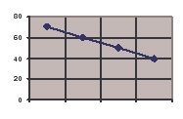
12
There has been a slight increase in production over the year.

Slide 21
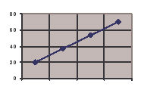
13
There was a rapid drop in production in the first quarter, but it bottomed out at about 20.

