Slide 1
Instruction execution and ALU

Slide 2
Hardware Implementation
Information transfer from one register to another
R2 ⬅ R1
If the transfer is occur under predetermined control signal then x: R2⬅R1
This required microoperation called load , thus the H.W implementation
of this operation is :

Slide 3
What is the HW Implementation for the following process t:R1 ← R1+R2

Slide 4
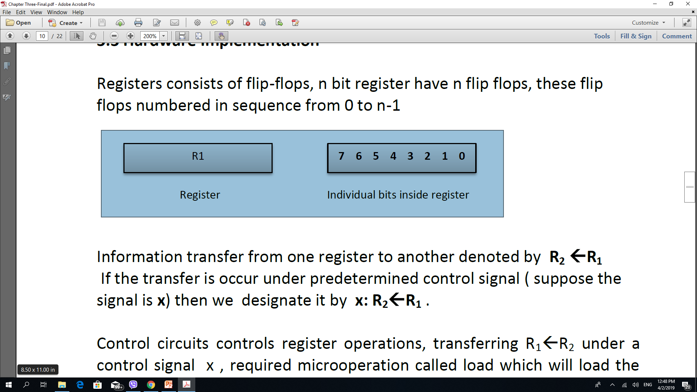
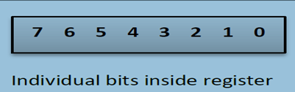

This is not a realistic approach to be used in a large digital system. The solution is to use a common “Bus”.
The solution is to use a common “Bus”.
N-bits/Reg. Needs n(n-1) lines.
So the cost is in order of O(n²)
Registers are connected using bus
bus structure consists of a set of common lines, one for each bit of a register
control signal used to determine which register is selected
One way of constructing a such a bus is by using multiplexers.

Slide 5
k-registers
each with n-bits
need n-line bus
need n multiplexer (one for each bit)
Multiplexer size
k x1 The number of selected lines required is log k
Show the bus h.w connection for 4 Registers connections?
S₀, S₁ Control signals
Multiplexer size= 4x1
4-Muliplexer needed

Slide 6
Bus Construction ways
Multiplexers
3-stage gates
Three state gate is a digital circuit that represent three states two of the states are logic 0 and 1, the third state is high impedance state ( behave as an open circuits). The following figure represent three state gate

Slide 7
Arithmetic Microoperation
To implement arithmetic microperation we will review basic components needed which are:
A Binary adder
Binary Incremental
Binary Full Adder
Half Adder

Slide 8
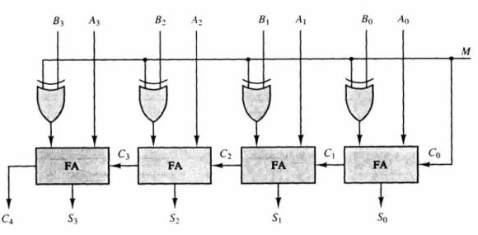
Build digital Circuit that can perform the following operation
A+B, A-B (Hint: assume both A & B are 4-bits size)
The subtraction of A-B required three steps : A + B + 1
implements 1’s complements for B,
add 1 to get 2’s complements
and finally add result to A.
Binary Full Adder

Slide 9
Binary Incremental
Binary Incrementor: The binary incremental always adds one to the number in a register. To implement the incremental we will use:
A counter. When clock transition arrives the count is incremented.
2) half adders. incremental of n bits.
least significant adder always have one of its input as “1” while its carry is cascaded to other half adders.
Design an incremental for the number A ( it is 4-bit number)

Slide 10
Arithmetic micro operations
can be implemented in one composite arithmetic circuit. comprised of :
full adders and
multiplexers controls which data is fed into input of the adder
(suppose B, A represent that inputs (4-bits) ). The output of the binary adder is computed from
D = A + B +Cin
The B input can have one of 4 different values: B, B, always “1”, or always “0”

Slide 11
D = A + B +C_{in} ( 4-bits )

Slide 12
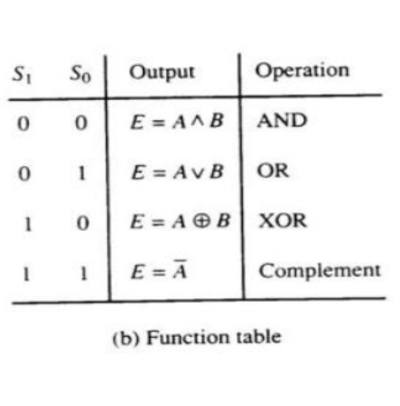
Logical Microoperation
Build a logical circuit to generates the four basic logic micro operations required:
four gates (AND, OR, XOR, NOT) and
a multiplexer.
The two selection lines of the multiplexer selects one of the four logic operations .

Slide 13
Shift Microoperation
Shift micro-operations are used for serial transfer
There are 3 types of shift micro operations.
Logical shift : Logical shift is one that transfers 0 through the serial input
Circular shift : The circular shift rotates of the register around the two ends without loss of information
Arithmetic shift : Arithmetic shift is a micro-operation that shifts a signed binary number to the left or right. Arithmetic shift must leave sign bit unchanged.
implement Shift microoperation using :
Use bidirectional shift register with parallel load , In that case we need two clock pulse one to load the value and another to shift.
combinational circuits ( combinational circuit will constructed using multiplexers .) this is more efficient way to implement the shift operation.

Slide 15
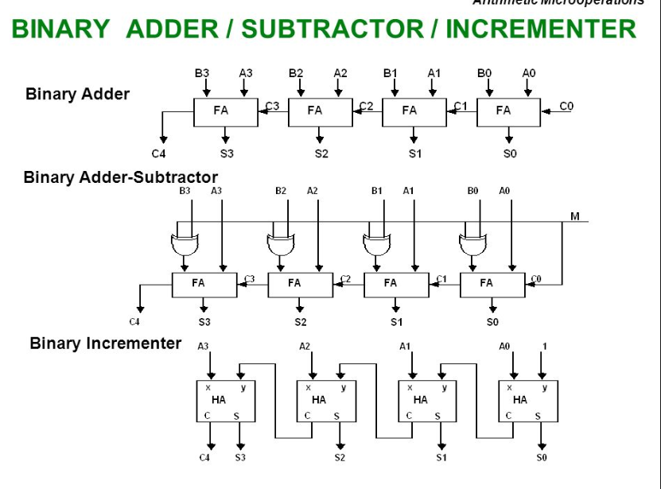

Slide 16
Instead of having individual registers performing micro-operations directly, computer systems employ a number of storage registers connected to a unit called Arithmetic Logic Unit (ALU).
Ex: show the HW implementation for simple ALU with following characteristics:
Or Design simple ALU showing HW required ?
8 arithmetic operations,
4 logic operations, and
2 shift operations.

Slide 17
Function table

Slide 18
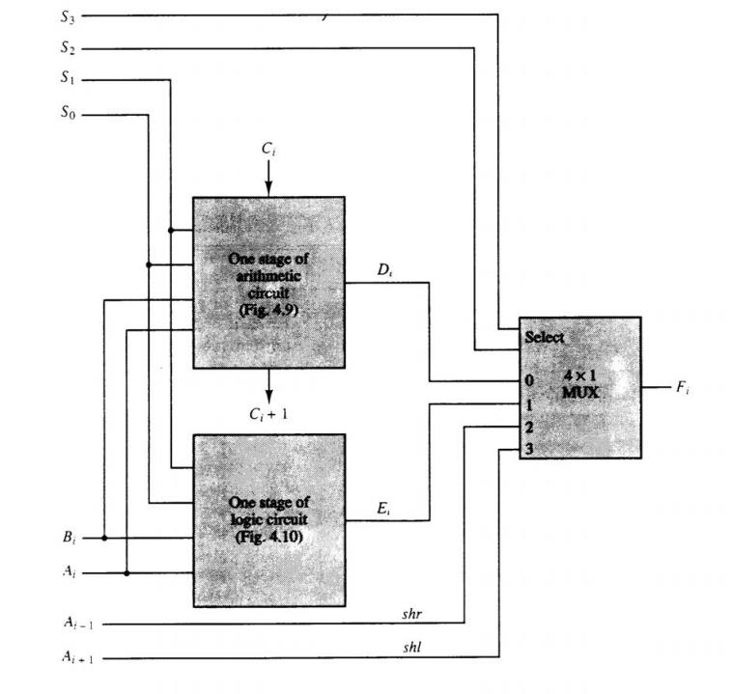
Arithmetic circuit
S₂ & S₃ - select one of those unit outputs or a shift left bit stage or shift right bit stage.
S₀ and S₁ used to select arithmetic and logic
Logic circuit

Slide 19
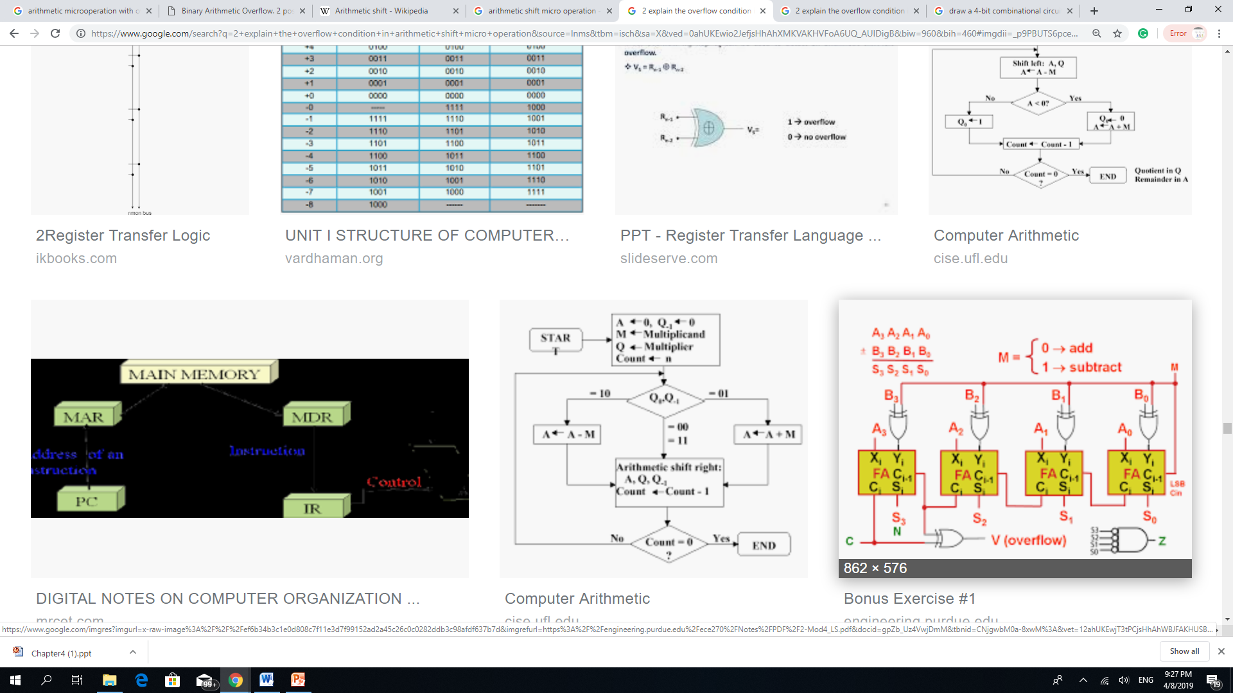
4-bit addr.-Sub. with overflow control

