Slide 1
Instruction execution and ALU
Dr. Wurood Albayati

Slide 2

CPU Organisation & Operation
Begin
Are there any instruction wating execution ?
No
Yes
Fetch Cycle
Fetch the next instruction
Execute Cycle
Execute the instruction
interrupt requiring service?
No
Yes
Transfer control to interrupt handling program

Slide 3


Slide 4

Example : A = B + C
LOAD R2, B Copy the contents of memory location designated by B into Register 2
ADD R2, C Add the contents of the memory location designated by C to the contents of Register 2 and put the result back into Register 2
STORE R2, A Copy the contents of Register 2 into the memory location designated by A.
Each of these assembly instructions needs to be encoded into binary for execution by (CPU)
Instruction to be represented specific Instruction format
We can represent the above Assembly instruction using 16 bits word as below.

Slide 5

To execute the program, instructions + data ➔ main memory. We’ll place our 3-instruction program in memory starting at address 080H and we’ll place the variables A,B & C at memory words 200H, 201H, and 202H ---- prior to program execution.
Memory Address | Memory | Assembly Instruction
080 | 1A01 | LOAD R2, [201H]
081 | 3A02 | ADD R2, [202H]
082 | 2A00 | STORE R2, [200H]
… | … | …
200 | 00 | A = 0
201 | 09 | B = 9
202 | 06 | C = 6
Fetch-Execute Cycle
Fetch the Instruction
Increment the Program Counter
Decode the Instruction
Fetch the Operands
Perform the Operation
Store the results
Repeat forever

Slide 8

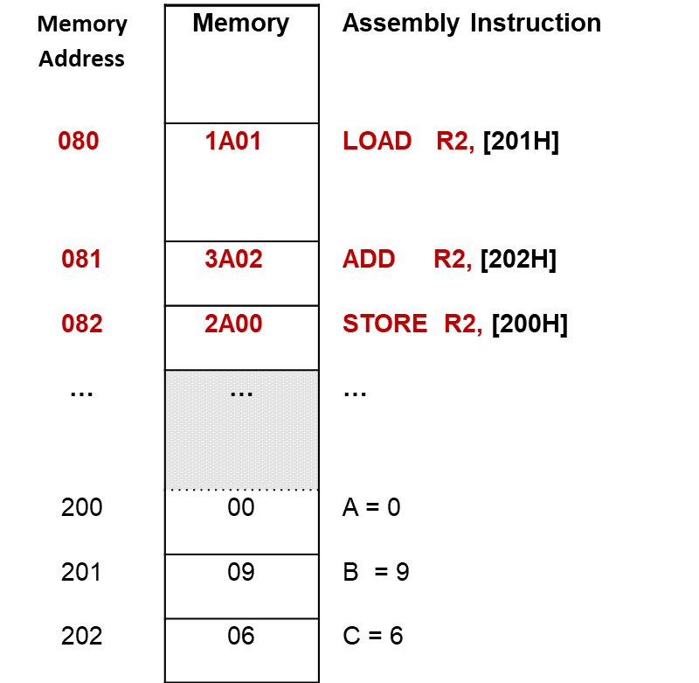

[080]→ Load R2,[201]
1A01
080
081
09
Read
Load
Read [201]

Slide 9
[081]→ ADD R2,[202]
9
1A01
9
15
3A02
081
082
09
06
Read
ADD
Load Input2, 202
LoaD R2, iNPUT1

