Slide 1
Practical Network Computer Science IT&CS Third Class part 4 2019 Teacher Mohanad Ali

Slide 2
Tester for cable utp &stp

Slide 3
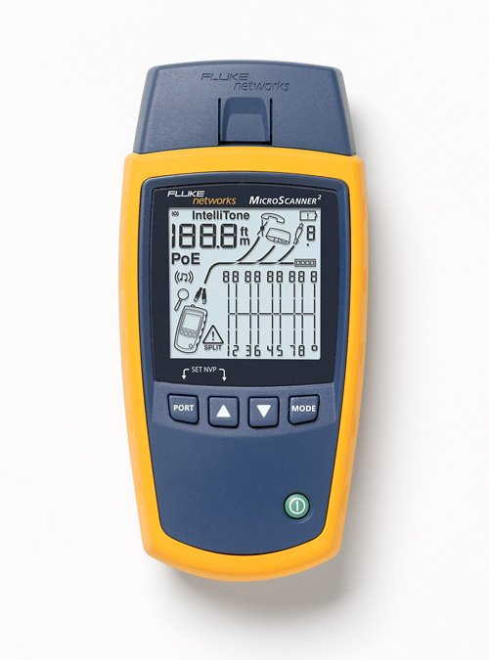
Other type foe tester

Slide 4
Pee wheel

Slide 5
Pee wheel

Slide 6
Crimping tool

