Slide 1
Histogram
The histogram of an image is a plot of the gray _levels values versus the number of pixels at that value.
A histogram appears as a graph with "brightness" on the horizontal axis from 0 to 255 (for an 8-bit) intensity scale) and "number of pixels "on the vertical axis. For each colored image three histogram are computed, one for each component (RGB, HSL).The histogram gives us a convenient -easy -to -read representation of the concentration of pixels versus brightness of an image, using this graph we able to see immediately:
1- Whether an image is basically dark or light and high or low contrast.
2- Give us our first clues a bout what contrast enhancement would be appropriately applied to make the image more subjectively pleasing to an observer, or easier to interpret by succeeding image analysis operations.
So the shape of histogram provide us with information about nature of the image or sub image if we considering an object within the image. For example:
1-Very narrow histogram implies a low-contrast image
( مائل ) 2-Histogram skewed to word the high end implies a bright image
3- Histogram with two major peaks , called bimodal, implies an object that is in contrast with the background ……Next slide some examples

Slide 2
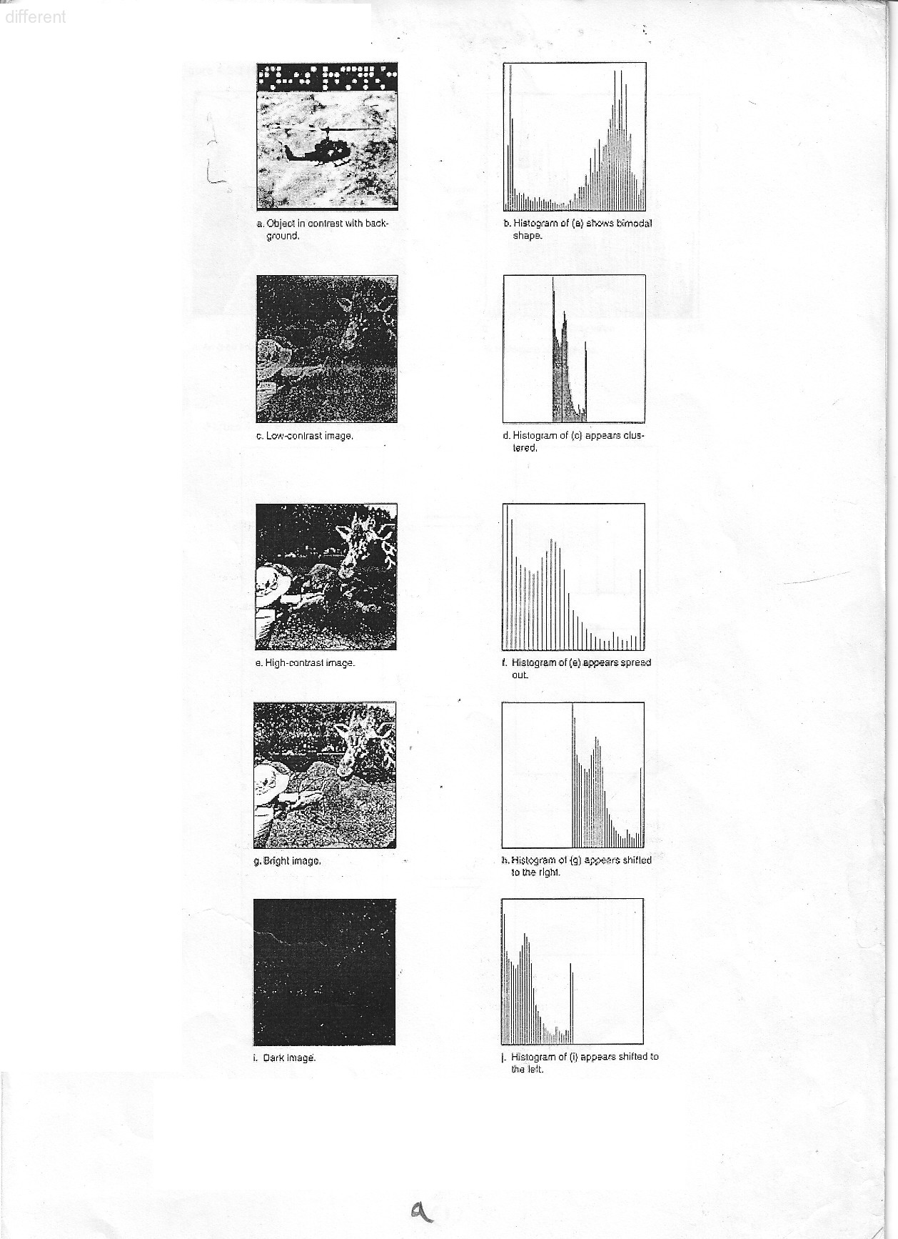

Slide 3
Histogram Modifications
The gray level histogram of an image is the distribution of the gray level in an image.
The histogram can be modified by mapping functions, which will stretch, shrink (compress), or slide the histogram. Next Figure illustrates a graphical representation of histogram stretch, shrink and slide.
.

Slide 4
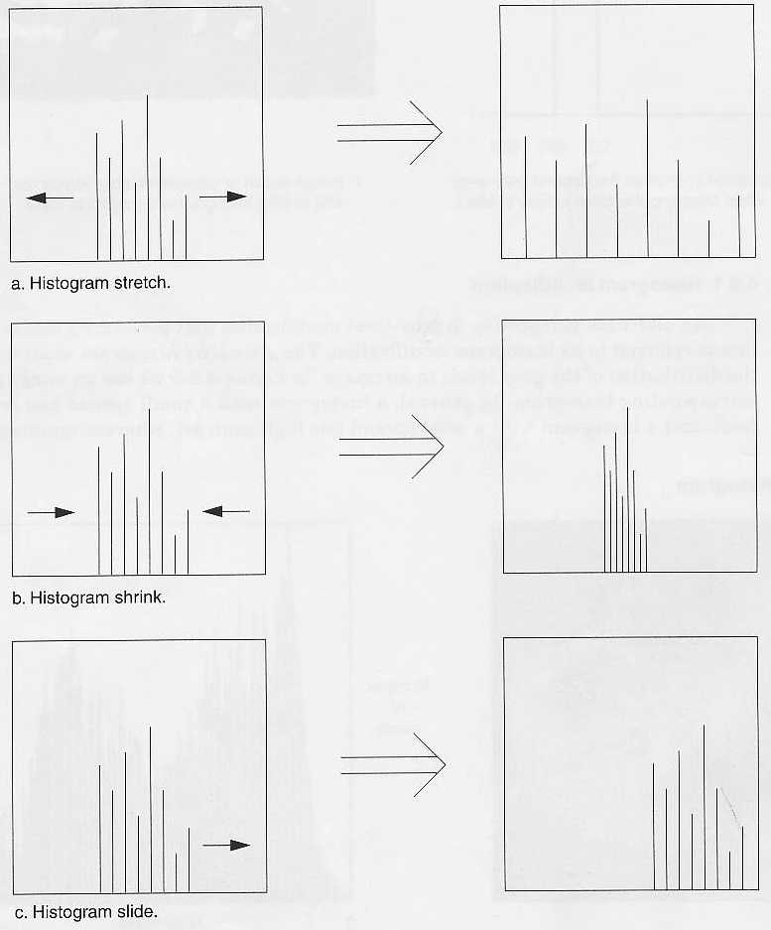

Slide 5
mapping function
The mapping function for histogram stretch can be found by the
following equation:
Stretch (I (r, c)) = [MAX-MIN] + MIN
Where, I(r,c) max is the largest gray- level in the image I(r,c).
I(r,c) min is the smallest gray- level in the image I(r,c).
MAX and MIN correspond to the maximum and minimum gray –
level values possible (for an 8-bit image these are 255 and 0).
This equation will take an image and stretch the histogram a cross the entire gray-level range which has the effect of increasing the contrast of a low contrast image of histogram stretching).
.

Slide 6
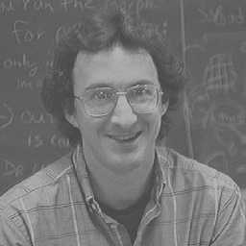
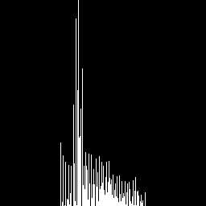
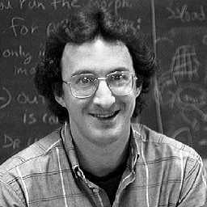
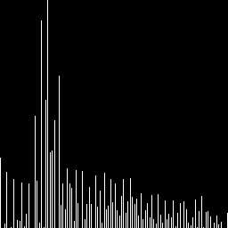
Low-contrast image
Histogram of low-contrast image
Image after histogram stretching
Histogram of image after stretching

Slide 7
Mapping Function Cont.
In most of the pixel values in an image fall within small range, but a few outlines force the histogram to span the entire range, a pure histogram stretch will not improve the image. In this case it is useful to allow a small proceeding of the pixel values to be aliped at the low and high end of the range (for an 8-bit image this means truncating at 0 and 255). See figure (2.20) of stretched and clipped histogram).

Slide 10
Histogram Shrink
The opposite of a histogram stretch is a histogram shrink, which will decrease image contrast by compressing the gray levels. The mapping function for a histogram shrinking can be found by the following equation:
[ I(r,c)-I(r,c)_{min}]+ Shrink _{min} Shrink ((r,c))=
Shrink _{max} and shrink _{min} correspond to the maximum and minimum desired in the compressed histogram. In general, this process produces an image of reduced contrast and may not seem to be useful an image enhancement (see figure (2-21) of shrink histogram).
.

Slide 12
Histogram Slide Techniques
The histogram slide techniques can be used to make an image either darker or lighter but retain the relationship between gray-level values. This can be a accomplished by simply adding or subtracting a fixed number for all the gray-level values, as follows:
Slide (I(r,c)) = I (r,c)+ OFFSET.
Where OFFSET values is the amount to slide the In this equation, a positive OFFSET value will increase the overall brightness; where as a negative OFFSET will create a darker image, figure (2-22) shows histogram sliding.

Slide 14
Histogram Equalization
Is a popular technique for improving the appearance of a poor image. It's a function is similar to that of a histogram stretch but often provides more visually pleasing results a cross a wide rang of images.
Histogram equalization is a technique where the histogram of the resultant image is as flat as possible (with histogram stretching the overall shape of the histogram remains the same).
The results in a histogram with a mountain grouped closely together to "spreading or flatting histogram makes the dark pixels appear darker and the light pixels appear lighter (the key word is "appear" the dark pixels in a photograph can not by any darker. If, however, the pixels that are only slightly lighter become much lighter, then the dark pixels will appear darker).
.

Slide 15
Histogram Equalization Cont.
The histogram equalization process for digital images consists of four steps:
1- Find the running sum of the histogram values
2- Normalize the values from step1 by dividing by total number of pixels.
3- Multiply the values from step2 by the maximum gray level value and round.
4- Map the gray-level values to the results from step 3, using a one-to-one correspondence. The following example will help to clarify this process.

Slide 16
Example
We have an image with 3 bit /pixel, so the possible range of values is 0 to 7. We have an image with the following histogram.
Step 1: Great a running sum of histogram values. This means that the
values is 10, the second is 10+8=18, next is 10+8+9=27, and
soon. Here we get 10,18,27,29,43,44,49,51.
Step 2: Normalize by dividing by total number of pixels. The total
number of pixels is 10+8+9+2+14+1+5+0=51.
Step 3: Multiply these values by the maximum gray – level values in this case 7 , and then round the result to the closet integer. After this
is done we obtain 1,2,4,4,6,6,7,7.
Step 4 : Map the original values to the results from step3 by a one –to-
one correspondence.
Gray-level value | 0 | 1 | 2 | 3 | 4 | 5 | 6 | 7
No of Pixel Histogram value | 10 | 8 | 9 | 2 | 14 | 1 | 5 | 2

Slide 17
Histogram Equalization Cont.
The first three steps:
.
The fourth step:
All pixel in the original image with gray level 0 are set to 1, values of 1 are set to 2, 2 set to 4, 3 set to 4, and so on (see figure (2-21)) histogram equalization, you can see the original histogram and the resulting histogram equalized histogram. Although the result is not flat, it is closer to being flat than the original
Gray-level | 0 | 1 | 2 | 3 | 4 | 5 | 6 | 7
No. of Pixel | 10 | 8 | 9 | 2 | 14 | 1 | 5 | 2
Run Sum | 10 | 18 | 27 | 29 | 43 | 44 | 49 | 51
Normalized | 10/51 | 18/51 | 27/51 | 29/51 | 43/51 | 44/51 | 49/51 | 51/51
Multiply by 7 | 1 | 2 | 4 | 4 | 6 | 6 | 7 | 7
Old | 0 | 1 | 2 | 3 | 4 | 5 | 6 | 7
New | 1 | 2 | 4 | 4 | 6 | 6 | 7 | 7

