Slide 1

Enzymes
2nd year Biology department
د. نجلاء قاسم د. زهراء سالم د. غسق جبار

Slide 2
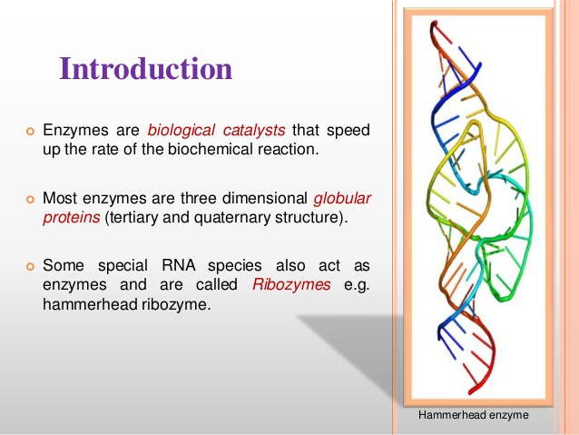

Slide 3
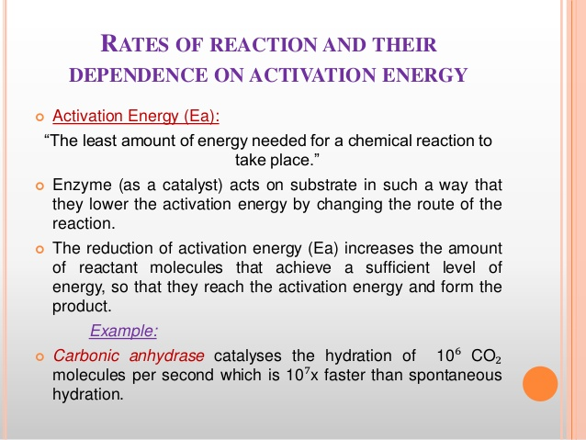

Slide 4
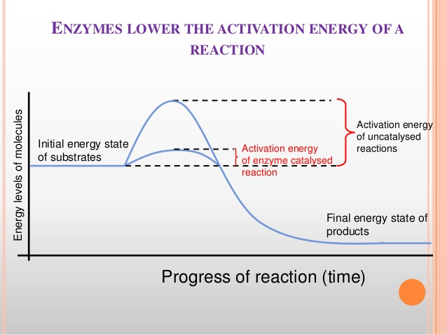

Slide 5
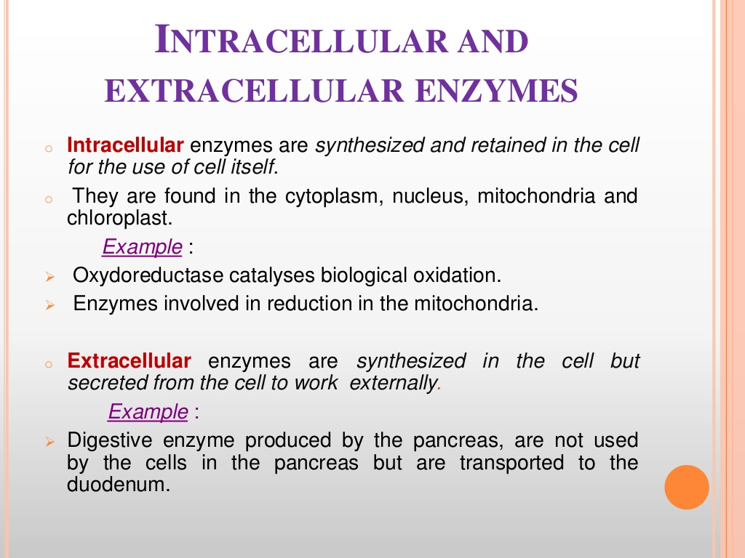
Location of enzymes

Slide 6
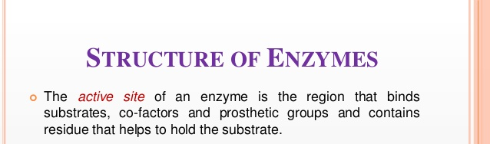
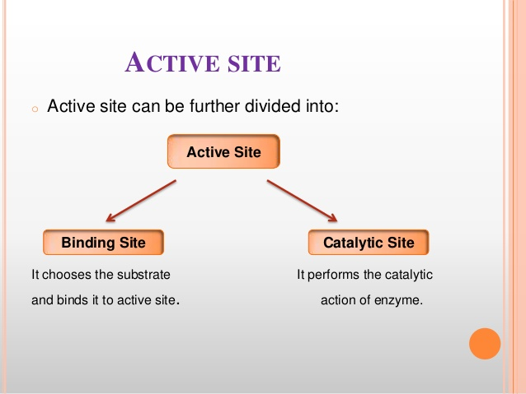
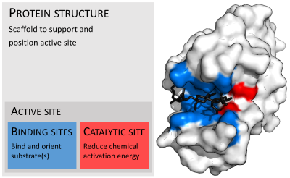

Slide 7
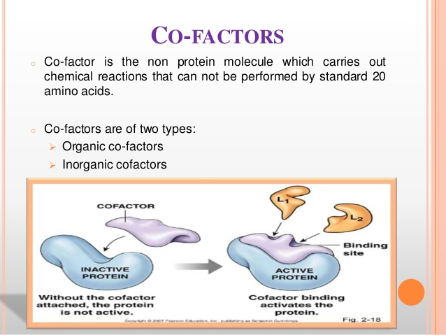
Flavin, heme, Niacin
Zn⁺², Mg ⁺²

Slide 8
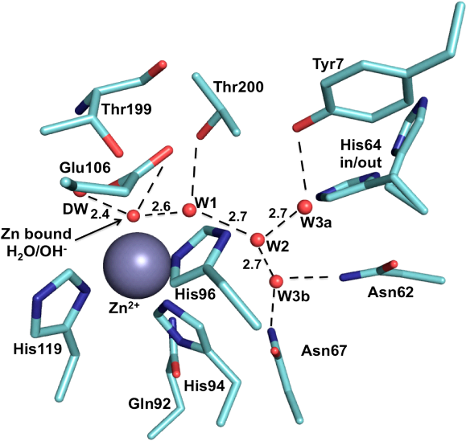
Cofactors:
The enzyme with its cofactor called Holoenzyme .
The protein portion of the holoenzyme is called Apoenzyme.
In the absence of the appropriate cofactor, the apoenzyme typically does not show biologic activity.
A prosthetic group is a tightly bound coenzyme that does not dissociate from the enzyme
Carbonic anhydrase enzyme
Co-factor= Zn⁺²
Apoenzyme= Only the protein
Holoenzyme= Zn⁺² + the enzyme

Slide 9
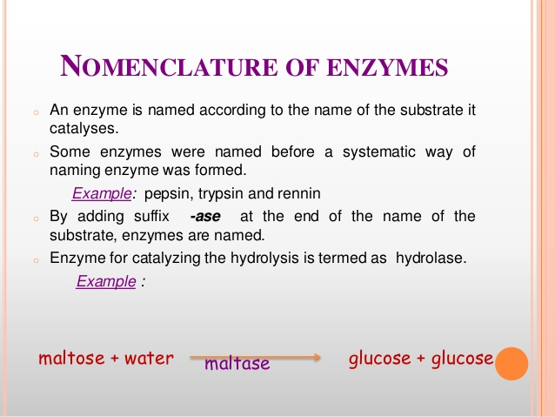

Slide 10
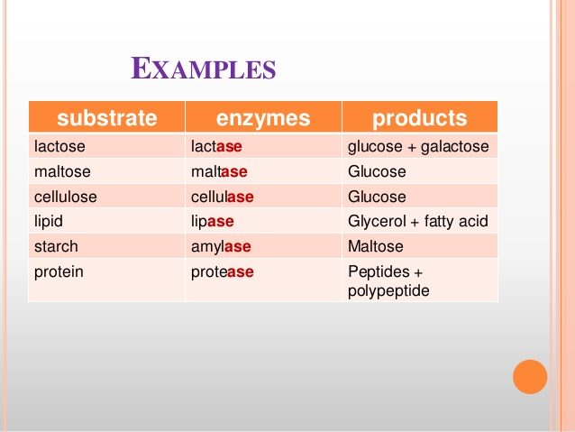

Slide 11


Slide 12
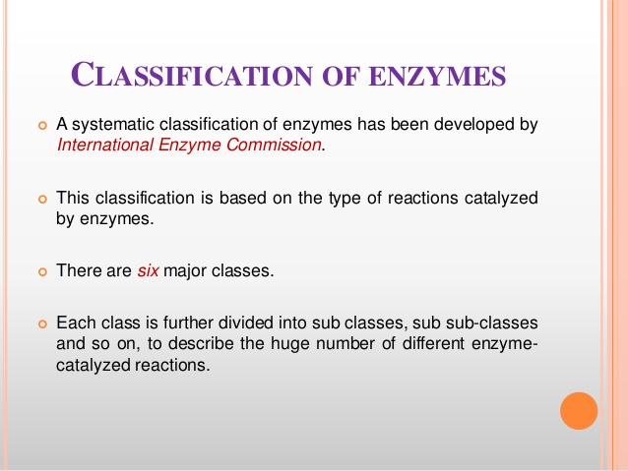

Slide 13
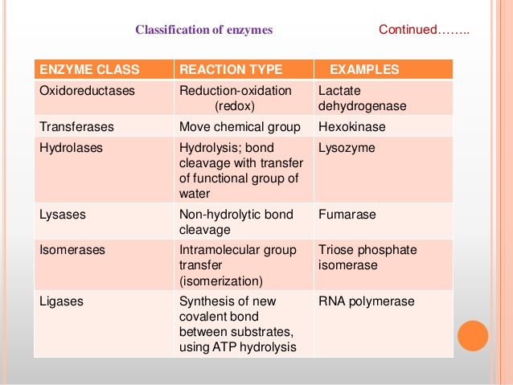

Slide 16
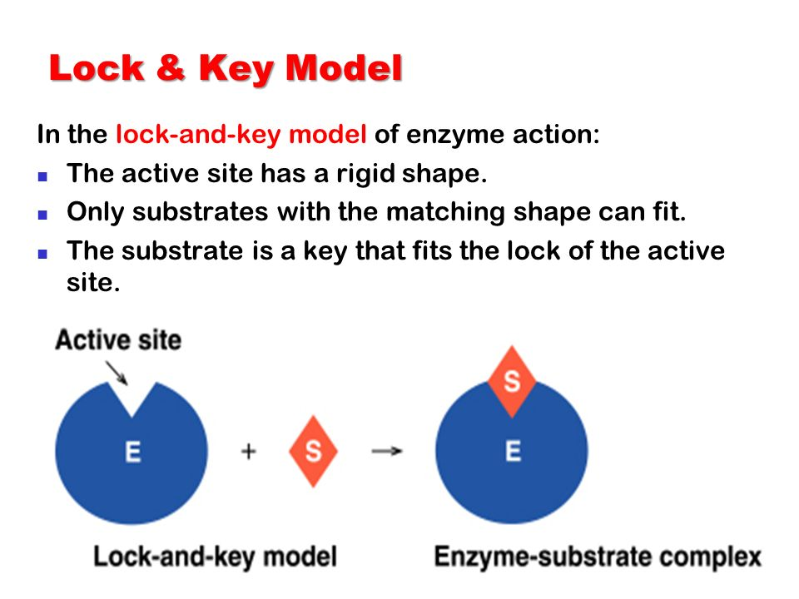
Substrate binding

Slide 17
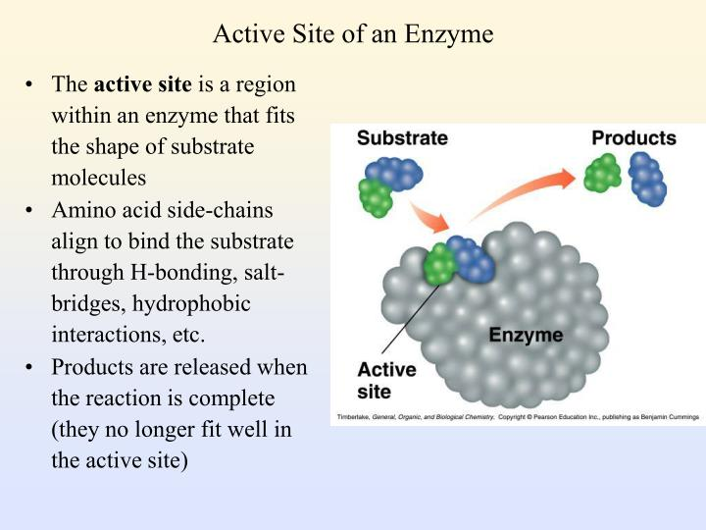

Slide 18
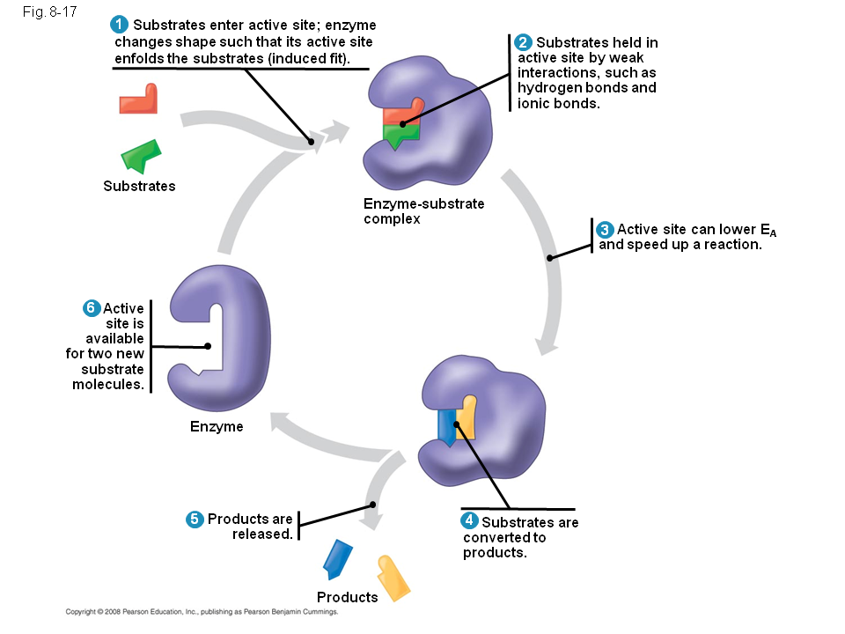

Slide 19


Slide 20
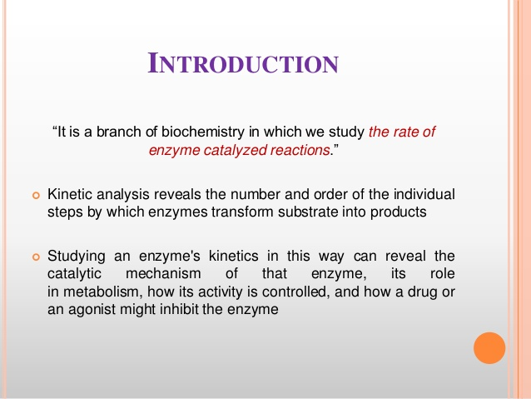

Slide 21
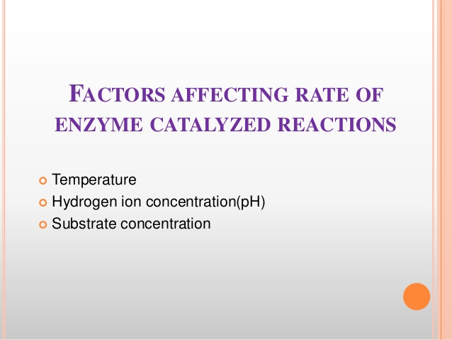

Slide 22
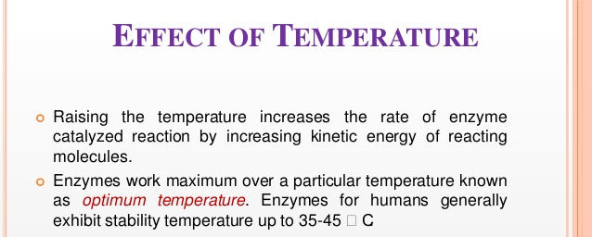
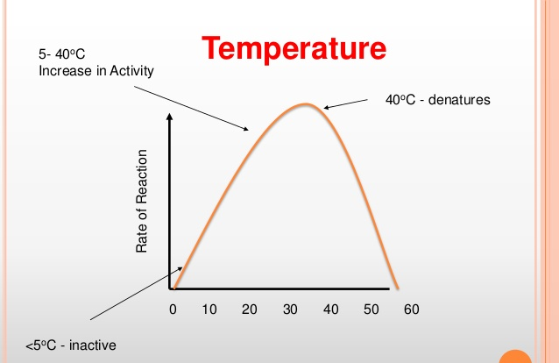

Slide 23
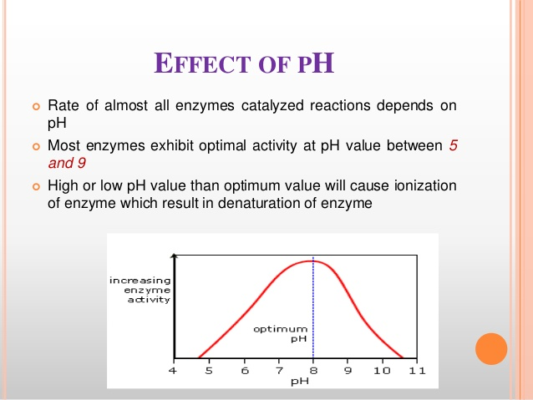

Slide 24
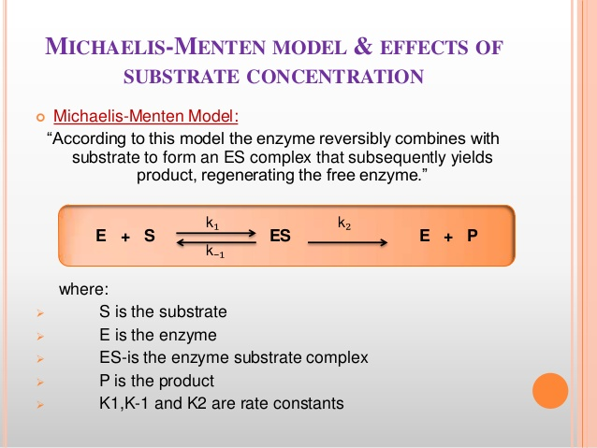

Slide 25
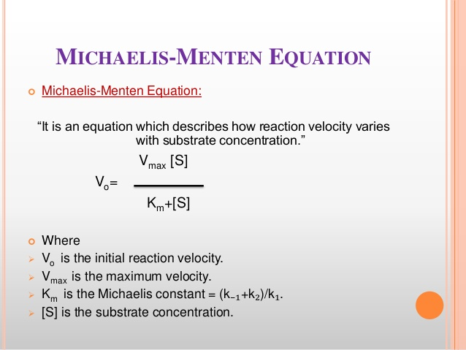

Slide 26
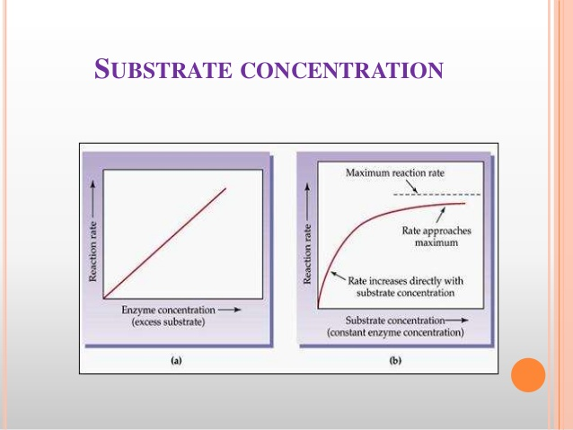

Slide 27
Michaelis-Menten plot

Slide 28
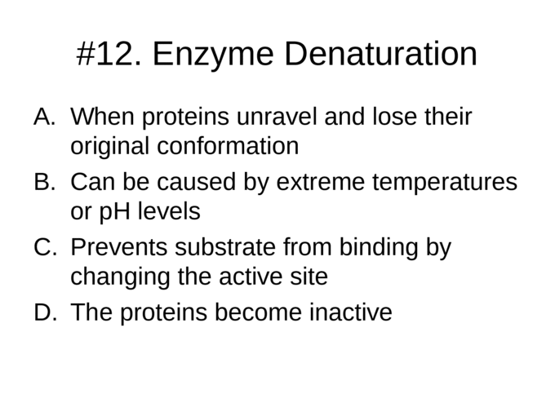

Slide 29


Slide 30
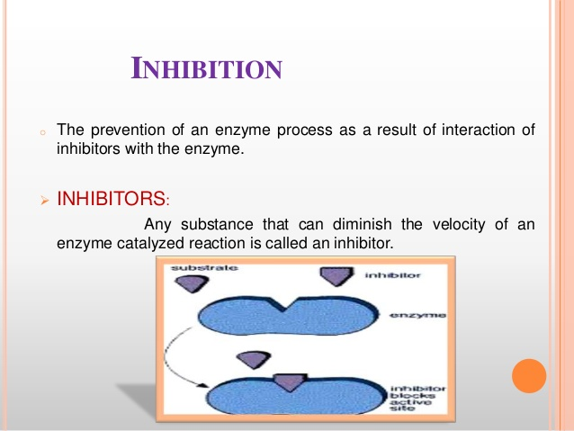

Slide 31
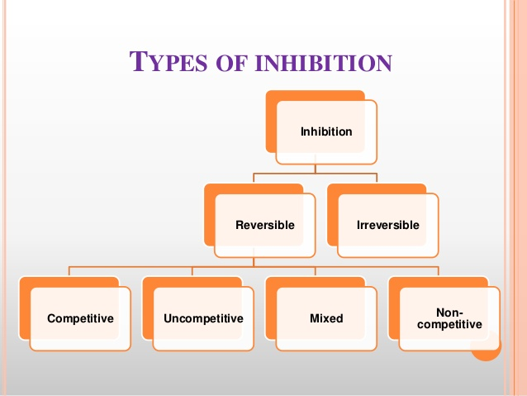

Slide 32
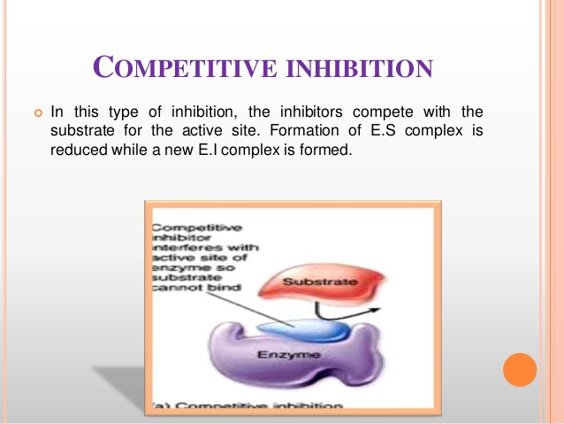
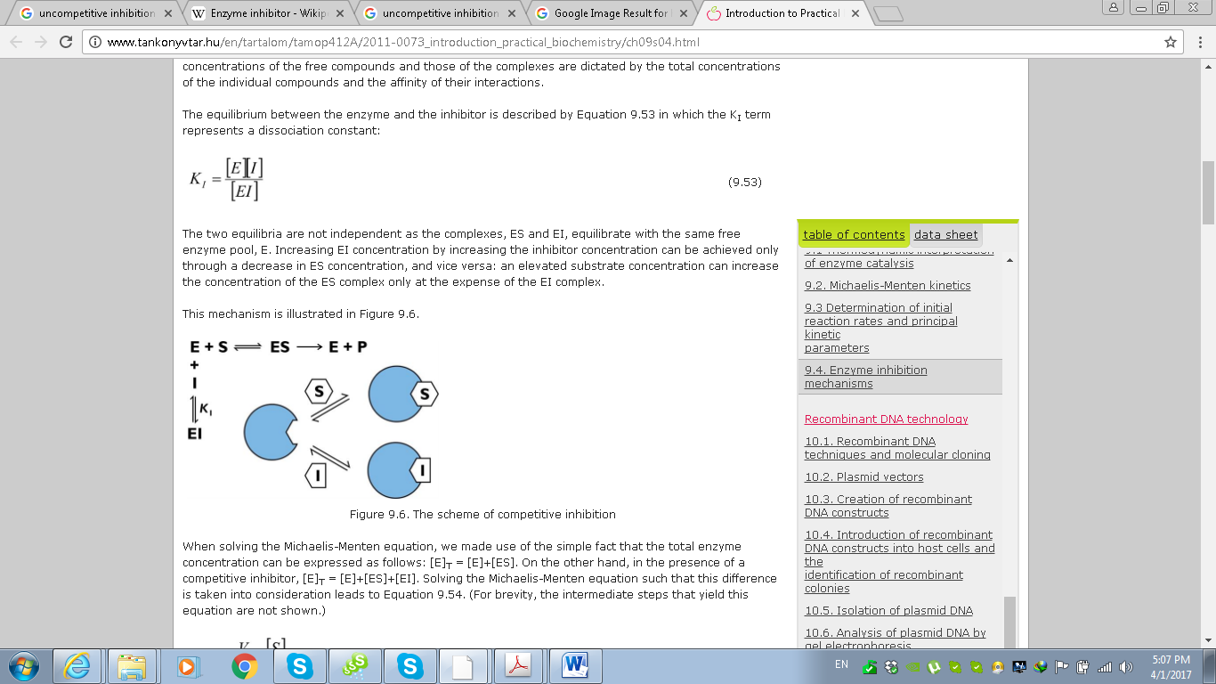

Slide 33
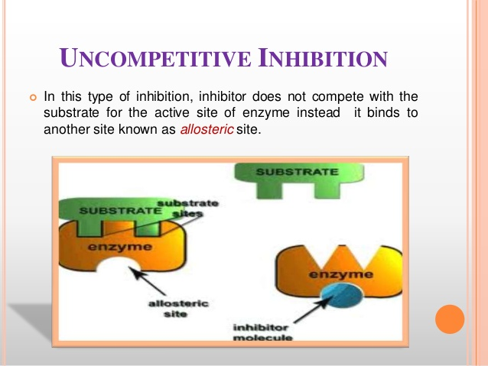
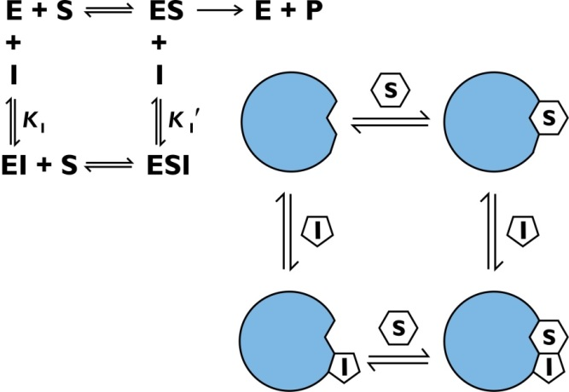

Slide 34
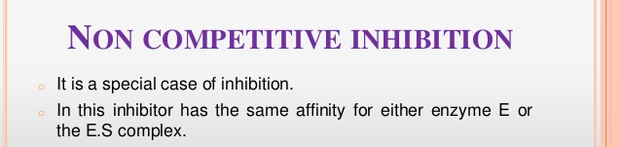
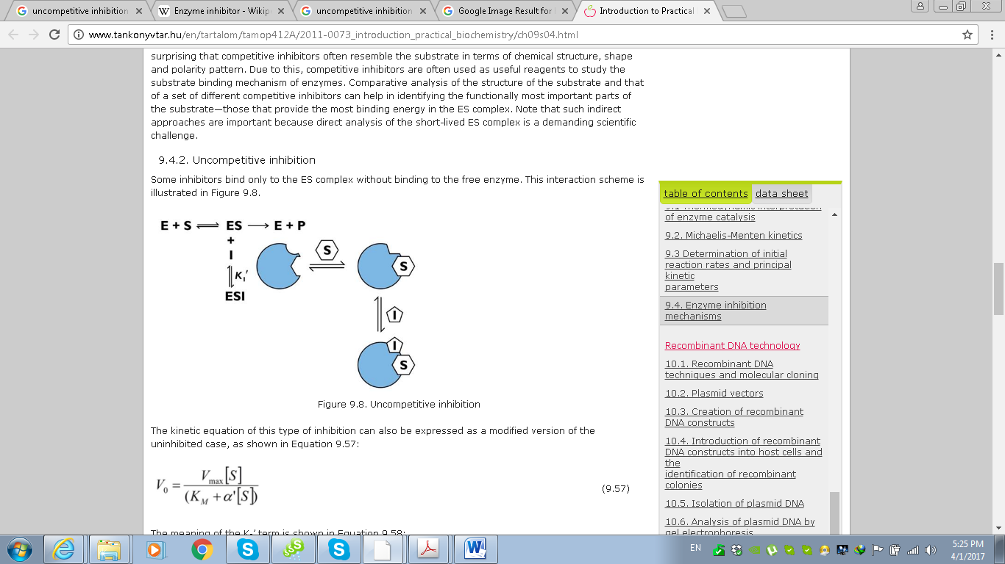

Slide 35
Competitive
Non-Competitive
Un-Competitive

