Slide 1
What are freshwater habitats?
Algae occur in nearly all surface water bodies in every biome across the globe. Many of these environments are freshwater ecosystems. So what is fresh water? The distinction between freshwater and marine systems ,Oceans are clearly saline (~35 g of salts L−1) and most lakes relatively dilute , yet there is enormous variation in physicochemical conditions that freshwater algae occupy. Lakes and rivers vary widely in pH, nutrients, trace elements, dissolved oxygen, buffering , and salinity, with some lakes having greater total salts than the open ocean. Limnologists also use the term “inland” waters to encompass a greater range of aquatic ecosystems. Yet algae occupy many other habitats, such as soils, cave walls, and symbiotic associations .

Slide 2
There are no exclusively freshwater groups of algae, but Cyanobacteria, Chlorophyta, and Charophyta exhibit much greater abundance and diversity in fresh waters . Within the green algae, conjugating filamentous greens and desmids (Conjugatophyceae: Zygnematales, Desmidiales) are a very rich collection of species, and the majority occur in lower pH fresh waters. Other algal groups, such as diatoms (Bacillariophyceae) and chrysophytes (Chrysophyceae), are well represented in both spheres. In contrast, red algae (Rhodophyta), dinoflagellates (Dinophyta), and brown algae (Phaeophyceae) exhibit greater diversity in marine waters .
Lakes, rivers, and wetlands occur on every continent, and so freshwater algae are similarly distributed. This is undoubtedly why most algal taxa are described as universal. However, there is an increasing number of reports of regionally endemic freshwater taxa, including chrysophytes ,green algae ,rhodophytes , synurophytes , diatoms, , and cyanobacteria .

Slide 3
Apparent endemics have been collected from highly specific (e.g., spring , polar, or widely scattered habitats. Some of these species as ecological, rather than geographic specialists. Dispersal must be involved in some of these biogeographic patterns because some highly specialized taxa are universal , while others occur in very few locations, The euglenophyte Colacium is a habitat specialist epizoic on aquatic invertebrates, but it is widely distributed throughout North America and globally.
In contrast, the red alga Sheathia is a specialist of spring-fed streams and apparently occurs in just a few locations in Florida . Geographically isolated habitats, such as desert springs or high alpine habitats, are ideal systems to test theories of dispersal limitation .For example, a new genus of cyanobacterium, Chakia, was recently described from an alkaline marsh and a new diatom genus, Microfissurata, from acidic alpine seepages.

Slide 4
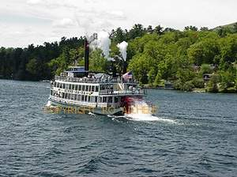
Inland surface waters represent only about 0.02% of all liquid water on earth, and nearly 90% of this total is contained within only about 250 of the world's largest lakes .Nonetheless, it is freshwater that is most important for human consumption and most threatened by human activities. Algal biologists play an important role in understanding the productivity, food web interactions, and water quality of freshwater ecosystems .

Slide 5
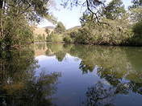
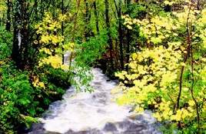
What is the difference between lentic and lotic ecosystem?
Lentic water A lentic ecosystem entails a body of standing water, ranging from ditches, seeps, ponds, seasonal pools, basin marshes and lakes. Deeper waters, such as lakes, may have layers of ecosystems, influenced by light. Ponds, due to their having more light penetration, are able to support a diverse range of water plants.
Lotic water A lotic ecosystem can be any kind of moving water, such as a run, creek, brook, river, spring, channel or stream. The water in a lotic ecosystem, from source to mouth, must have atmospheric gases, turbidity, longitudinal temperature gradation and material dissolved in

Slide 6
LENTIC HABITATS
Lentic environments include standing waters from enormous lakes to the smallest ponds.
Planktonic Habitats and Assemblages in Lakes
Phytoplankton are those algal cells that move mainly at the mercy of water currents and the effects of sinking, They include cells, colonies, and filaments of algae. While the planktonic habitat may be considered as a whole, one can distinguish multiple associations or microhabitats, These include:
pelagic or euplankton (open water)
neustonic (associated with water-air interface)
metalimnetic (associated with the thermocline or metalimnion)
littoral (near shore)
metaphytic (loosely associated with aquatic plants)
tychoplanktonic (attached cells carried into the plankton) associations.

Slide 7
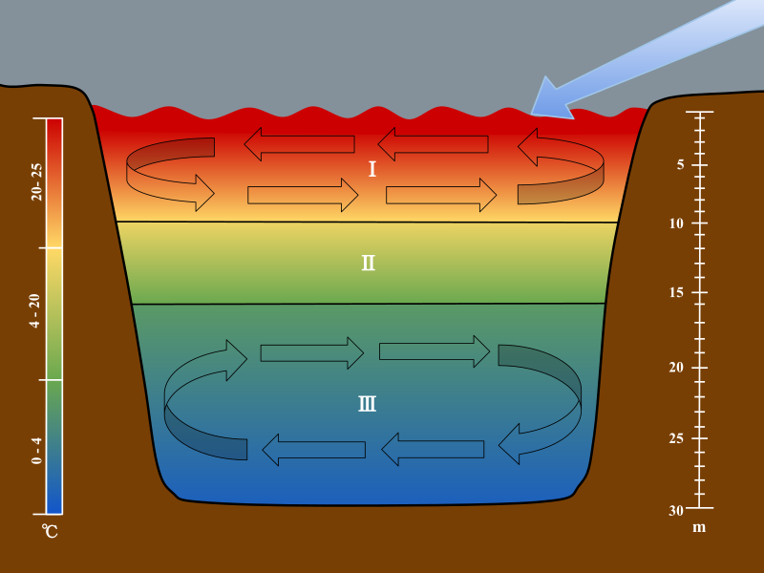
Lakes are stratified into three separate layers: the epilimnion (I), metalimnion (II), and (III) hypolimnion. The scales are used to associate each section of the stratification to their corresponding depths and temperatures. The arrow is used to show the movement of wind over the surface of the water, which initiates the turnover in the epilimnion and hypolimnion.

Slide 8
Diversity and Composition
In every lentic habitat where freshwater phytoplankton occur , Their diversity and biomass vary greatly among different lakes, types of land use, and geographic region. Up to several hundred species can comprise the phytoplankton assemblage in a lake. This competing phytoplankton species coexisting in an apparently uniform habitat was explained by Hutchinson (1961) to be possible through numerous microhabitats in a lake, as well as variation over time, and diverse traits among coexisting species. The microhabitats that contribute to phytoplankton diversity are shaped by differences in depth, nutrient chemistry, light availability, temperature, grazing pressure, hydraulic residence time, and turbulence.
Taxonomic information is important in ecological studies because
many traits that are used to classify algae, such as pigments, storage products, motility, reproduction, cell structure, and even DNA sequence information, have functional importance.

Slide 9
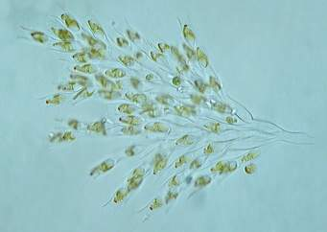
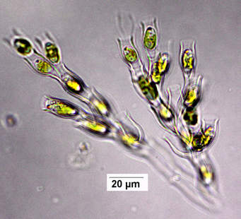
Within freshwater phytoplankton, only cyanobacteria and cryptomonads possess the accessory pigment phycoerythrin, which the photosynthetic capacity of cells and may facilitate growth at greater depths . Only cyanobacteria and a few diatoms with intracellular are able to fix N2.
Some algal flagellates (e.g., Dinobryon, Ochromonas, Euglena) are capable of mixotrophy, the ability to switch from autotrophic nutrition to capturing bacteria or other organic particles. This can be a useful trait under reduced light conditions or as a strategy to eat one's competitor . Rates of bacterivory by Dinobryon spp. may depend more strongly on water temperature than on light availability.
Dinobryon, Ochromonas

Slide 10
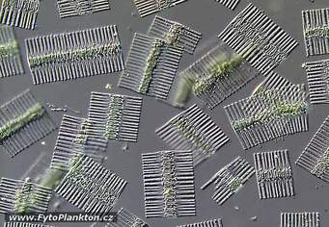
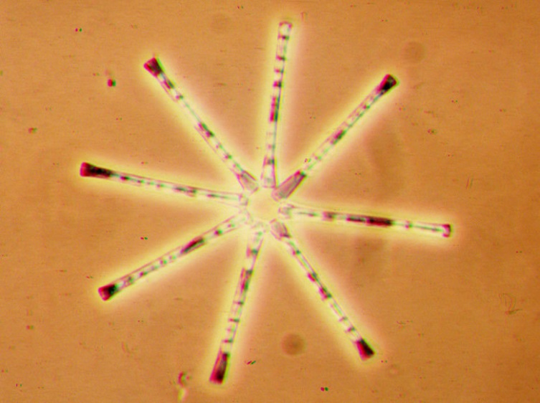
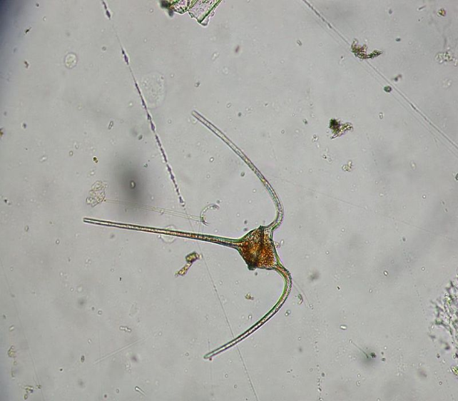
Diversity in size affects the vertical patterns of algal assemblages across microhabitats in lakes.
Smaller cells sink more slowly, while larger forms require elongate or complex shapes, or motility to reduce sinking. The large dinoflagellate Ceratium hirundinella actively regulates its position in the water column by vertical migration and varies the shape and size of horn-like projections over an annual cycle .
Many cyanobacteria maintain their position in the water column using gas vesicles.
Silica walls of diatoms create heavier cell densities, so many colonial diatoms, such as Asterionella formosa and Fragilaria crotonensis, have elongate or elaborate morphologies, which may reduce sinking rates .
Fragilaria crotonensis
Asterionella formosa
Ceratium hirundinella

Slide 11
2 - Factors Regulating Phytoplankton Production in Lakes
that phytoplankton production and biomass in the majority of lakes is controlled by nutrient supply, often by phosphorus .Eutrophic lakes with low N:P ratios favor blooms of N2-fixing cyanobacteria,
This was demonstrated in Lake Washington, which received secondary sewage (a source of P) from the city of Seattle. Blooms of planktonic cyanobacteria, especially Planktothrix (as Oscillatoria) , were common in past decades .Eutrophication in Lake Washington had been largely reversed through sewage diversion, which reduced point-source P inputs to near zero, summertime chlorophyll-a from about 45-5 μg L−1 and the percent of phytoplankton as cyanobacteria from ≈100% to 10% or less .
Diatom dominance in phytoplankton assemblages is dependent on recycled Si ,lakes with lower Si levels may lack a spring time diatom Leads to a decrease. Resource competition and coexistence shapes similar dynamics among other algal species across C:P and N:P supply ratios .

Slide 12
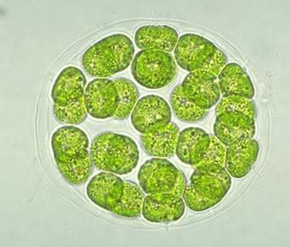
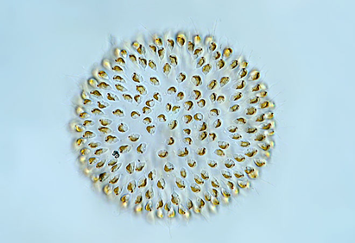
Light availability varies within the water column of lakes and depends on quantities of dissolved substances, suspended matter, algal density, and turbulence. While phytoplankton production in many species is greatest in upper waters where irradiance is greater, some species acclimate to deeper waters .
Under relatively warm and calm conditions in Blelham Tarn, more than 90% of Uroglena sp. colonies and Eudorina elegans aggregated in the upper 2 m, but in October, rachelomonas occupied a narrow band near the thermocline (6-8 m depth).
Eudorina elegans
Uroglena sp.

Slide 13
Variation in these factors over time drive temporal patterns in phytoplankton populations. populations increase after turnover, and peak in spring when light and temperature are increasing and the Si: P ratio is near maximum .Populations decline over the summer and have a second, smaller peak in autumn.
The Plankton Ecology Group (PEG) model describes the relative roles of physical factors, zooplankton grazing, and nutrient limitation for phytoplankton production and succession in lakes . that physical processes (light and stratification) are key initiators of seasonal processes, but nutrients determine the algal carrying capacity. Grazers are effective regulators or phytoplankton, but only under certain conditions.

Slide 14
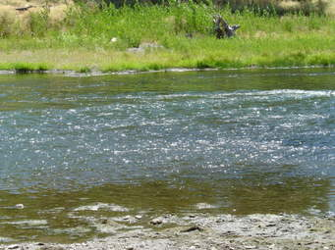
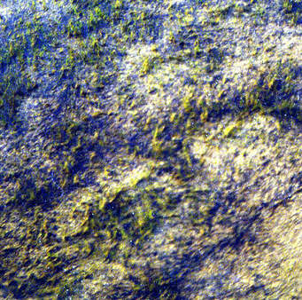
Benthic Habitats and Assemblages in Lakes
Benthic habitats are associated with various substrata or bottom surfaces. There is an enormous diversity of these microhabitats, including macrophytes, stones, sediments, sand grains, logs, and artificial substrata. The importance of benthic habitats for algal production in lakes is influenced by trophic status.
A low mean depth to maximum depth ratio generally results in greater benthic production . However, among shallow lakes, trophic status has a major influence, All divisions of algae have benthic representatives; an association often termed periphyton, even though this may contain a collection of algae and other microorganisms.

Slide 15
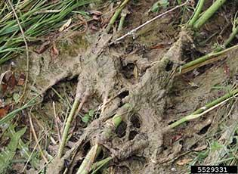
Mode of benthic algal attachment are diverse. Some are firmly attached such as Chamaesiphon and Cocconeis, making them resistant to wave ,but susceptible to competition from canopy-forming morphologies, such as Stigeoclonium or Ulothrix .
Many biraphid diatoms, such as Frustulia, Navicula, Nitzschia, maintain contact with benthic surfaces and glide along a surface by means of a raphe. Other diatoms, such as Cymbella, Gomphonema, attach by means of gelatinous pads.
Benthic assemblages can be diverse and include cyanobacteria, green algae, smaller diatoms, bacteria, ciliates, and other micro- heterotrophs. In some cases, the quantity of stalk material far exceeds that of the
diatom cells, creating massive
biomass, as with Didymosphenia geminata
.

Slide 16
Filamentous green algae, such as Cladophora, Oedogonium, Spirogyra, and Zygnema produce holdfast-like rhizoids to remain attached in turbulent conditions. The range of sizes of benthic algae exceeds that of planktonic forms. The smallest include tiny cells and colonies such as Xenococcus or Characium (a few μm) to macrophytes, such as Chara, Cladophora, and Hydrodictyon, which range from a few cm to more than a meter.
1 Epiphytic and Epixylic Habitats
Algae colonize submersed and emergent plants (epiphytic), as well as logs, fallen branches, roots, and wooden boat docks (epixylic). Larger algal forms, such as Cladophora or Chara, may also serve as substrata for epiphytic diatoms and other microalgae. Epiphytic algae affect macrophytes, as greater densities may cover and shade their hosts. Studies have documented negative correlations between epiphyte and macrophyte biomass and more rapid host senescence with greater epiphyte cover .

Slide 17
Species composition and biomass of epiphytic algae can differ among macrophyte host species. Prowse (1959) recognized that densities of three common epiphytes, Gomphonema gracile, Eunotia pectinalis, and Oedogonium sp., differed among three macrophyte species in one small pond. Many studies report differences in epiphyte biomass or species composition on different plant hosts.
Epiphyte biomass on submersed macrophytes in one shallow lake was 10-40 times greater than on floating-leaved plants, but species diversity was less .It has been suggested that epixylic assemblages develop a climax assemblage of filamentous algae, due to the greater long-term stability of wood, as compared with submersed macrophytes or sediments. Epiphytic algae are important components of lake food webs. In mesotrophic Lake Mann (WI), herbivorous snails consume and regulate benthic algal biomass, and pumpkinseed sunfish exert predatory control on snails, creating a trophic cascade .

Slide 18
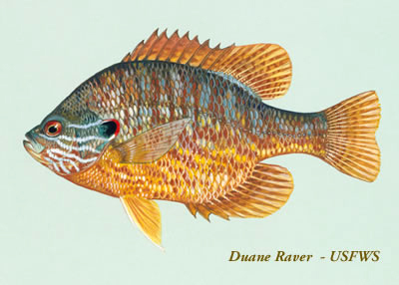
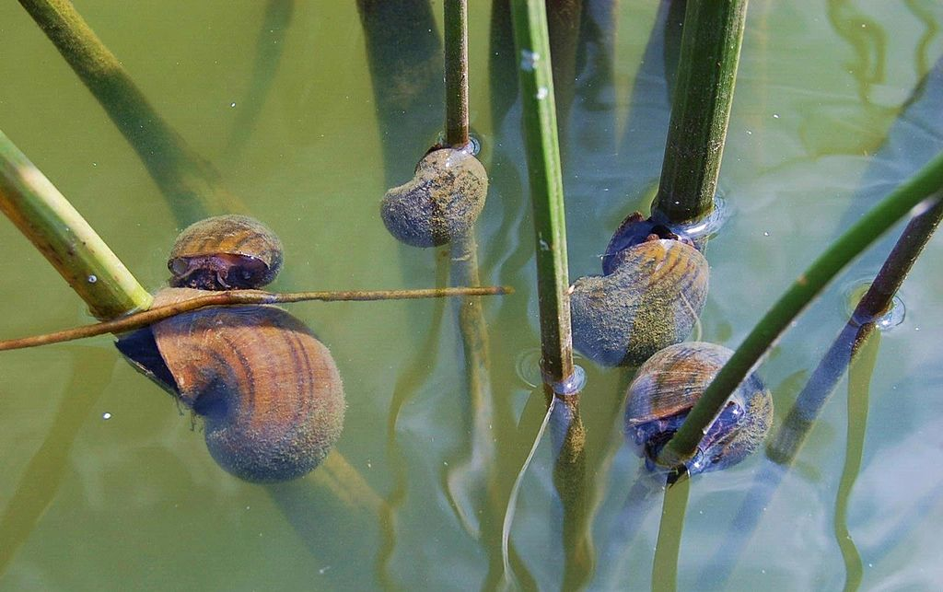
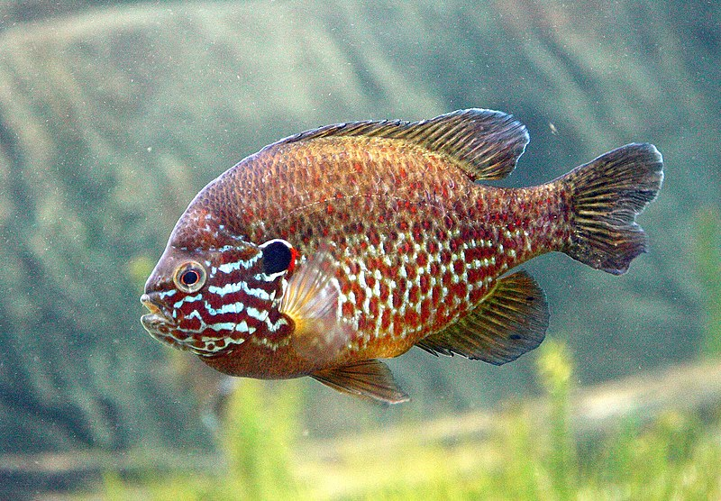

Slide 19
2. Epilithic Habitats
Epilithic habitats include submersed stones, boulders, and bedrock and may dominate wave-swept littoral zones and oligotrophic lakes . Algal taxa such as Chamaesiphon spp., Gongrosira incrustans, Rivularia sp., Tolypothrix distorta, and Heribaudiella fluviatilis, which occur in stony streams, are reported from epilithic habitats of several lakes .
Vertical zonation is common, with some species restricted to the upper littoral zone and others in deeper waters where wave action or desiccation is less severe . In the Great Lakes, Bangia atropurpurea and Ulothrix zonata colonize rocks in the upper splash zone, just above a mat of Phormidium sp., with Cladophora glomerata in deeper water .

Slide 20
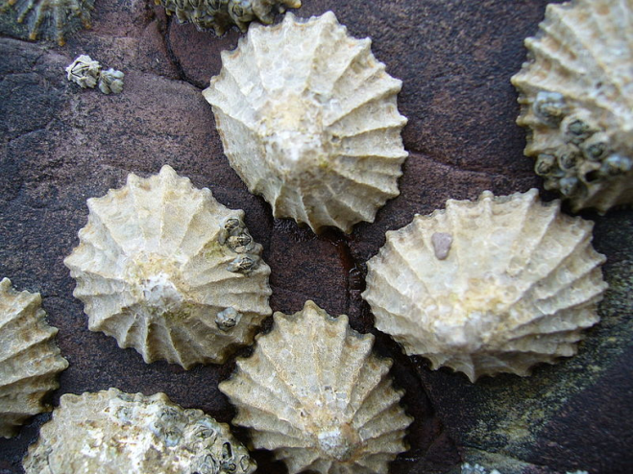
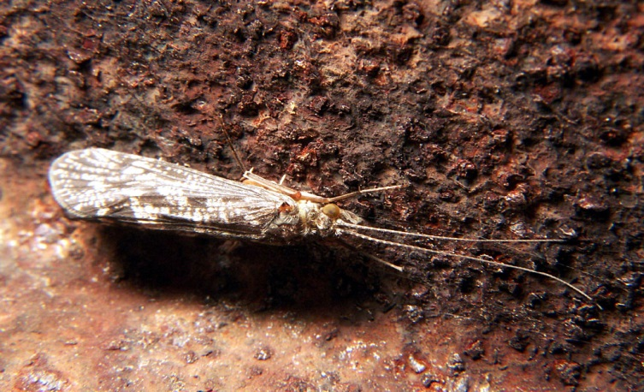
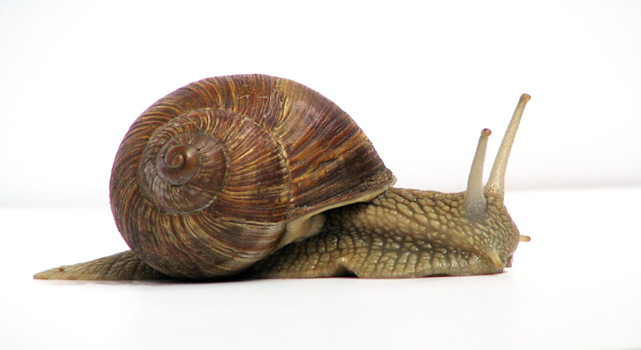
Light and other factors may interact with effects of wave action. An epilithic population of Ulothrix zonata had a greater photosynthetic irradiance optimum than Cladophora glomerata isolated from the same region of Lake Huron ,Temperature tolerances and nutrient requirements may further interact with irradiance optima and affect local and regional distributions.
Grazing by benthic invertebrates is also important to epilithic algae. Snails (Planorbis contortus) and limpets (Ancylus fluviatilis) inhabiting the stony littoral zone lake consume and preferentially graze certain algal species . Selectivity and more intense grazing activity by limpets exerted greater effects on algal species composition than did snails. High densities of caddisfly larvae significantly reduced epilithic algal biomass and elemental C:P ratios .

Slide 21
3- Epipelic and Epipsammic Habitats
Algal species colonizing sediments (epipelic) and sand (epipsammic) are among the least studied of benthic associations. A metaanalysis indicates that epipelic algae function in lakes to stabilize sediments, regulate benthic-pelagic nutrient cycling, and contribute a primary production . It is difficult to separate epipelic from epipsammic habitats because these substrata are often mixed, and due to wave action.
A comparison of two lakes demonstrated that epipelic microalgal production in a clear lake dominated the annual production (77% of total) as compared with a turbid lake of similar size at only 4% .
Epipelic algae represented 50-80% of total primary production in three Michigan .lakes, but fertilization increased phytoplankton production and reduced (through shading) the importance of epipelic production to 10-40% of the total . Epipelic algae may live on or within the first few mm of sediment, thus must be able to tolerate conditions of low light and/or oxygen, making motility a distinct advantage. Nonmotile epipelic and epipsammic forms may employ heterotrophic growth under low light and at the same time utilize the greater supply of nutrients.

Slide 22
4 Benthic Macroalgae
Macroalgae, those that form macroscopic or plant-like morphologies, are important in lake habitats. Some authors restrict this category to taxa attached by means of rhizoids, including only charophytes (Chara, Lamprothamnion, Nitella, Tolypella, Nitellopsis, But there are other algae, such as Cladophora, Hydrodictyon, Lyngbya, Nostoc, and Spirogyra, that form macroscopic growths, and function as structuring elements within the littoral zone and as habitat for epiphytic microalgae
Cladophora is regarded as an ecological engineer, based on its extensive biomass and importance as habitat, a food source, and biogeochemical processor .Accumulations of Cladophora mats that become stranded on recreational beaches may affect human and wildlife health, harboring enteric bacteria such as Escherichia coli, Campylobacter, Salmonella ,and Clostridium botulinum, a cause of avian botulism .
Microalgae colonize macroalgae and vary in density and composition among host taxa. Epiphyte densities in one eutrophic lake were greater on Chara tomentosa, C. globularis, and Nitellopsis obtusa than on Potamogeton pectinatus .

Slide 23

In clear, oligotrophic lakes, charophytes colonize lake bottoms to depths of 30 m or more. Charophyte abundance is often reduced as lake become eutrophic, with some suggesting elevated P is toxic for these species .
Various species of Chara and Nitella differ in their depth distributions, presumably as a function of individual light requirements .Wave action may also limit charophyte growth .The lower depth boundary for Nitella meadows in more productive lakes is influenced by irradiance and the supply of red light; in deep, clear lakes, their distribution is limited by the availability of blue light.
Nitellopsis harbored greatest total densities, but differences in species composition were most pronounced between the two Chara species . Benthic invertebrates in some lakes may utilize charophytes as a habitat more than other macrophyte hosts .
In the Great Lakes, epiphytes on Cladophora can be very diverse, with complex architecture composed of diatoms, filamentous green algae .Spirogyra filaments typically harbor a very low epiphyte load, the result of both allelopathic substances and mucilage production .

