Slide 1
Hormonal assays Sadeq Kaabi
بسم الله الرحمن الرحيم
Fourth grade
First semester
2018-2019

Slide 2
Topics
PRL
TSH
LH
FSH
ELISA Technique

Slide 3
PRL
Prolactin
Lactogenic hormone
Lactogen

Slide 4
PRL assay measure the concentration of the prolactin hormone in the blood.
PRL is a polypeptide hormone secreted by lactotrophs of the anterior pituitary gland, primarily for the development of mammary glands for lactation during pregnancy and for stimulating and maintaining lactation.
Reference values:
Premenopuasal: < 20 ng/ml
Postmenopausal: < 12 ng/ml

Slide 5
Conditions for PRL assay
Patient has to limit physical activity 12 hrs before test.
Fasting for 12 hrs before test.
Patient has to avoid stress, or stimulation for 30 minutes before test.
Sample drawn in the morning (3 - 4 hrs) after awakening.
Handle sample gently to prevent hemolysis.

Slide 6
PRL is under the complex regulatory system of estrogen, progesterone, dopamine, and thyrotropin-releasing hormone (TRH).
The function of PRL in males is unknown.

Slide 7
PRL levels are measured in the workup of galactorrhea, amenorrhea, infertility, impotence, and in cases of suspected pituitary tumor.
An elevated PRL classically presents with the syndrome of galactorrhea-amenorrhea in women, and the syndrome of infertility-impotence in men.
Men with elevated PRL typically have a low serum testosterone. However, testosterone replacement alone will not reverse the symptoms, the PRL must also be reduced.

Slide 8
Clinical significance of PRL level
Hypersecretion | Hyposecretion
Physiologic Pharmacologic Pathologic | Rare, if happened this may be due to pituitary necrosis or infarction

Slide 9
Causes of Hyperprolactinaemia
Pathologic | Pharmacologic | Physiologic
Hypothalamic disease | Methyldopa | Pregnancy
PRL secreting tumor | Reserpine | Lactation
Hypothyroidism | Cimetidine | Excerise
Addison’s disease | Estrogen | Eating
Chronic renal failure | Morphine | Stress
Cirrhosis

Slide 10
PRL & Pituitary tumor
?? 60% pituitary tumor | > 100 ng/ml
?? 90% pituitary tumor | > 200 ng/ml
100% pituitary tumor | > 300 ng/ml
Modest elevation can be associated with pituitary tumor

Slide 11
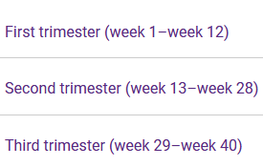
Prolactin (serum) reference values in Nonpregnant and in pregnancy stages
Units | Nonpregnant Female | First Trimester | Second Trimester | Third Trimester
ng/mL | 0 - 20 | 36 - 213 | 110 - 330 | 137 - 372

Slide 12
Hyperprolactinemia may clinically present as:
Amenorrhea
Galactorrhea
Infertility
Osteoprosis
Impotence
Erectil dysfunction
Infertility
Females
Males

Slide 13
PRL
↑↑ High (> 23 ng/ml)
Normal (< 23 ng/ml)
TSH
Normal
High
MRI or CT
Hypothyroidism
Normal
hyperplasia
Microadenoma
Macroadenoma

Slide 14
TSH
Thyroid Stimulating Hormone
Thyrotropin

Slide 15
TSH
Secreted by the thyrotrophic cells of the anterior pituitary.
It stimulates the growth of the thyroid follicular cells & step by step thyroid hormone synthesis

Slide 16
TSH value
The best single test for the thyroid function
I Screening for thyroid dysfunction
a- TSH decreased with hyperthyroidism
b- TSH increased with hypothyroidism
II Monitoring thyroid replacement therapy (eg. Levothyroxine)
III Monitoring anti-thyroid therapy (eg.Propylthiouracil, methimazole or radioactive iodine)

Slide 17
TSH value
The ultra-sensitive assay in contrast to the older TSH assay which was unable to distinguish patient values in the normal range from those which were abnormally low.
It is the feeling of thyroid specialists that measurement of the TSH, complemented by FT4 ( Free T4) measurement, represents the best and most efficient combination of blood tests for the diagnosis and follow-up of most patients with thyroid disorders.

Slide 18
TSH value
There has been a revolution in the approach to thyroid testing as the result of the development of ultra-sensitive TSH assays.
1st generation tests were able to measure levels of TSH to 1 IU/mL.
2nd generation tests were able to measure levels of TSH to 0.1IU/mL
3rd generation tests can measure TSH to 0.01IU/mL, a point at which hyperthyroidism may be diagnosed in ill patients.
4th generation assay able to measure TSH to 0.001IU/mL

Slide 19
Follow up patients on thyroxine supplementation (eg. Thyroxine or Synthroid®) the TSH is an appropriate single test that can be followed and used to determine need for adjusting dosing.
↑↑ TSH is an indication to increase the thyroxine dose.
↓↓ TSH indicates a need to decrease the thyroxine dose.
Normal TSH range is the goal for patients on supplementation.

Slide 20
Clinical conditions associated with thyroid dysfunction
Amenorrhea
Oligomenorhea
Anovulation.
Inadequate corpus luteum.
Subfertility

Slide 21
Thyroid hormones reference values
Thyroid Test | Optimal Reference Range
TSH (thyroid stimulating hormone) | 0.3-4 mU/L
Total T4 (thyroxine) | 4-12 ug/dL
Free T4 (free thyroxine) | 0.7-1.9 ng/dL
Total T3 (triiodothyronine) | 80-180 ng/dL
Free T3 (free triiodothyronine) | 230-619 pg/dL
Free T4, which enters the body tissues where it's needed
Bound T4, which attaches to proteins, preventing it from entering body tissues
A test that measures both free and bound T4 is called a total T4 test
Free T3, which enters the body tissues where it's needed
Bound T3, which attaches to proteins, preventing it from entering body tissues
A test that measures both free and bound T3 is called a total T3 test

Slide 22
Ultra-sensitive TSH
↑↑ High
Normal
Low ↓↓
FT4
Normal Thyroid
FT4
↓↓ Low
Normal
Normal
High ↑↑
FT3
Hypothyroidism
Normal
High
Hyperthyroidism
Subclinical
Hypothyroidism
Subclinical
Hyperthyroidism

Slide 23
LH & FSH

Slide 24
They are secreted by the anterior pituitary.
The alpha subunit is identical for all glycoprotein hormones (TSH, HCG, LH & FSH), but the beta subunit differs.
The peak of FSH is coincident with the peak of LH, but it is of lesser magnitude & briefer duration.
Following the mid-cycle surge of LH & FSH, there is drop in both.

Slide 25
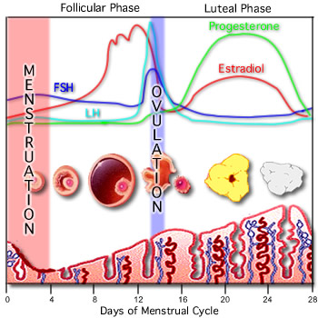

Slide 26
Conditions for the detection of LH & FSH
In female patients, indicate the phase of the menstrual cycle or duration of menopause on the lab request.
Medications containing estrogen and progesterone should be discontinued 4 weeks before test.

Slide 27
The clinical utility of testing LH & FSH levels, includes:
Evaluation of menstrual disorders.
Aids in the diagnosis and treatment of infertility
To evaluate ovarian reserve of egg supply in females
To evaluate low sperm count in males
Assists in the detection of ovulation and monitors therapy to induce ovulation
Evaluation of failure of sexual maturation in adolescence.

Slide 28
The clinical utility of testing LH levels, includes:
Assists in distinguishing between primary (ovarian or testicular) and secondary (pituitary or hypothalamic) gonadal failure or hypogonadism.
Evaluation of impotence in males.

Slide 29
Hormonal assays by
ELISA, ELFA, and ECL
methods

Slide 31
Types of ELISA
1. Direct ELISA: It is the simplest configuration in which the antigen is bound by passive adsorption to the solid phase, washed to remove any unbound molecules and then directly incubated with a conjugated antibody. Following the incubation period and additional washing, substrate is added to produce signal that is allowed to develop. After certain time, the substrate reaction is stopped and the resulting signal quantified. It is commonly used for tittering conjugated secondary antibodies and very useful to estimate antigen cross-reactivity.

Slide 32
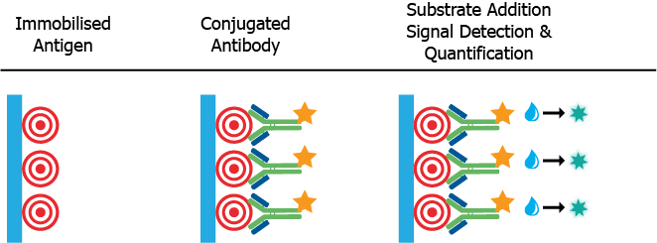

Slide 33
2. Indirect ELISA: In this system, initial antigen binding and washing steps are the same as the direct method. The main difference in this case is the use of unconjugated antibody to bind the immobilized antigen upon incubation at optimal temperature (usually 37⁰C). Following a washing step to remove unbound antibodies, the remaining antigen-bound antibodies are targeted by a conjugated secondary antibody that will generate the readout signal as described for direct ELISA. This system has been widely applied in diagnostics because it allows large number of samples to be screened with a single conjugated secondary antibody.

Slide 34
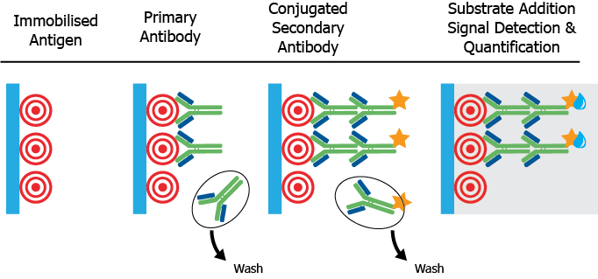

Slide 35
3. Sandwich ELISA: This assay requires a compatible antibody pair that recognize different antigenic targets (epitopes) on the same antigen. The first antibody, called capturing antibody, is coated on the plate and used to immobilize the antigen upon binding during incubation with the sample. Free antigen is removed by a washing step and then a detecting antibody is added to bind the captured antigen and enable subsequent detection. Sandwich ELISA is divided into two main systems:

Slide 36
Direct Sandwich: This assay uses a conjugated detecting antibody to an enzyme or fluorescence tag. Following incubation with the antibody-antigen complex immobilized on the plate well, signal detection is performed upon successive addition of substrate and stopping solution or as described before or appropriate excitation/emission of the fluorescent tag.
Indirect Sandwich: This assay uses either an unconjugated or biotinylated detecting antibody that once is bound to the antibody-antigen complex on the well is subsequently detected by either an anti-species antibody or streptavidin conjugated to an enzyme or fluorescent tag. Detection is then performed as above.

Slide 38
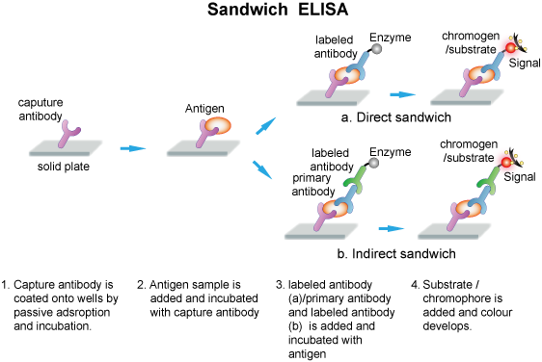

Slide 39
Competitive and Inhibition ELISA
Each of the core systems described above can be further modified to measure molecules based on their ability to interfere with a well-known pre-titrated assay. Such assays can be used to study either antigens or antibodies and they can be competitive or inhibitory based on the specific conditions of each assay. In both types of assays, a pre-titrated system is challenged with the presence of the testing sample whose binding activity is then determined from the degree of the resulting interference in the established system.

Slide 40
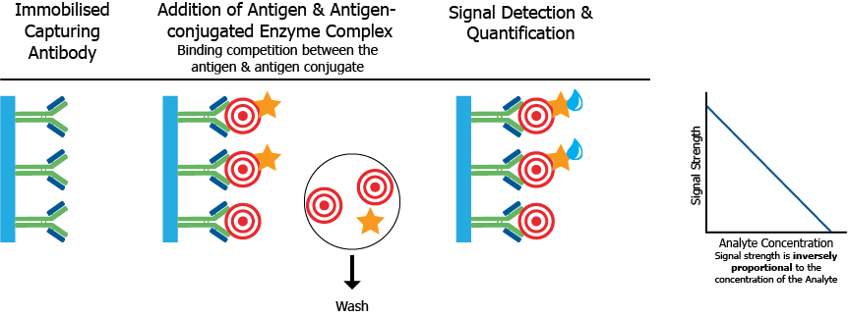

Slide 41
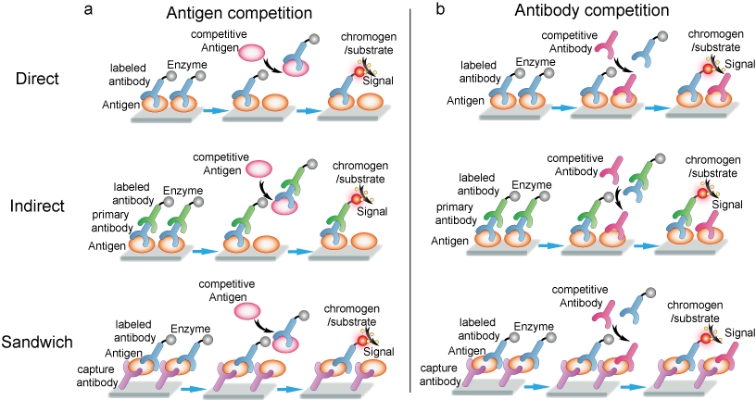

Slide 42
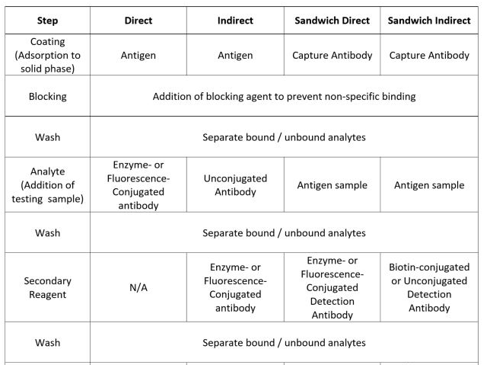
Overview of Steps in Different ELISA Systems

Slide 43
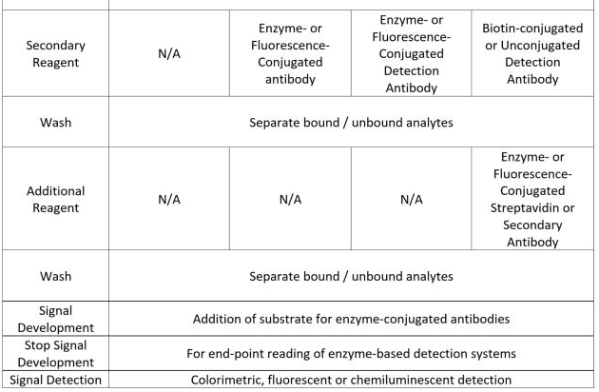

Slide 44
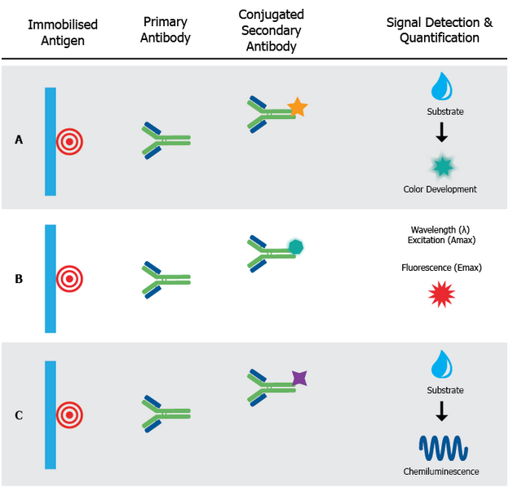

Slide 45
