Slide 1

Sputum Culture
Sadeq Kaabi
بسم الله الرحمن الرحيم
Fourth grade
First semester
2018-2019
Diagnostic Medical Microbiology-Laboratory Manual

Slide 2
Sputum Culture
An etiological diagnosis of lower respiratory tract infection by microscopic examination and culture with identification and susceptibility test of the isolated organism.
Sputum is a thick fluid produced in the lungs and in the airways leading to the lungs.
Sputum can be:
Bloody (often found in tuberculosis) (Hemoptysis).
Rusty colored - usually caused by pneumococcal bacteria (in pneumonia).
Purulent - containing pus:
  a yellow-greenish (mucopurulent) color.
  a white, milky, or opaque (mucoid).
Foamy white - may come from obstruction or even Edema.

Slide 3
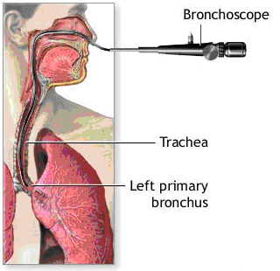
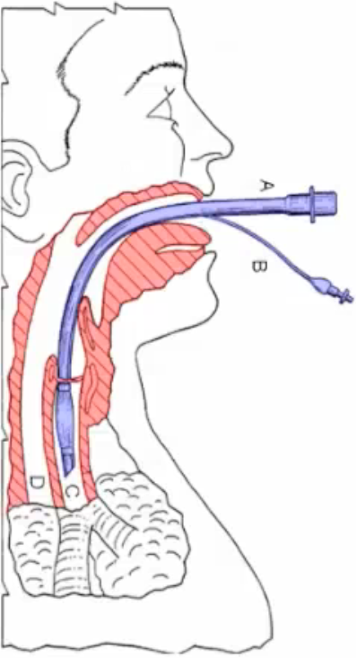
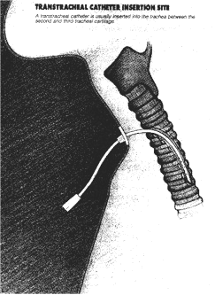
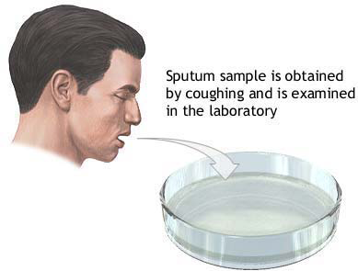
Types of specimen
Expectorated, Transtracheal aspirates, Translaryngeal aspirates, Bronchoalveolar Lavage.

Slide 4
The common bacterial pathogens
Streptococcus pneumoniae | Haemophilus influenzae
Staphylococcus aureus | Klebsiela pneumonia and other Enterobacteriaceae
Moraxella catarrhalis | Mycobacterium tuberculosis, and nontuberculous mycobacerial lung disease ( NTM) like Mycobacterium avium complex (MAC), Mycobacterium kansasii, and Mycobacterium abscessus. (there are 150 of NTM)
Fusobacterium spp (F. nucleatum, F. necrophorum ) | Bordetella spp
Pseudomonas spp | Legionella spp.
Chlamydia pneumoniae
Criteria of specimen rejection
Saliva (report as “Improper specimen, only saliva, please resubmit”)

Slide 5
Expectorated Sputum
All expectorated sputum is contaminated to some degree with secretion of the oropharyngeal cavity, which contain a wide variety of commensals bacteria, some of which are potential pathogens of the lower respiratory tract (Streptococcus pneumonia, Haemophilus influenzae) ,since the sputum reflect the infection in the bronchi and the lung contamination with oropharyngeal secretion should be kept to a minimum.
Early morning sputum samples should be obtained because they contain pooled overnight secretions in which pathogenic bacteria are more likely to be concentrated, twenty four- hour collection should be discouraged because there is not only a greater likelihood of contamination but bacteria pathogens become diluted with the addition of subsequent, more watery specimens.

Slide 6
Instruct the patient to brush his teeth and gargle with water immediately before obtaining the sputum specimen to reduces the number of contaminating oropharyngeal bacteria
To prevent contaminated of the out side of the container the patient should be instructed to press the rim of the container and the lower lip to catch the entire expectorated cough sample.
When a sputum specimen is plated out, it is best to get the portion of the sample that most looks like pus onto the swab. If there is any blood in the sputum, this should also be on the swab.

Slide 7
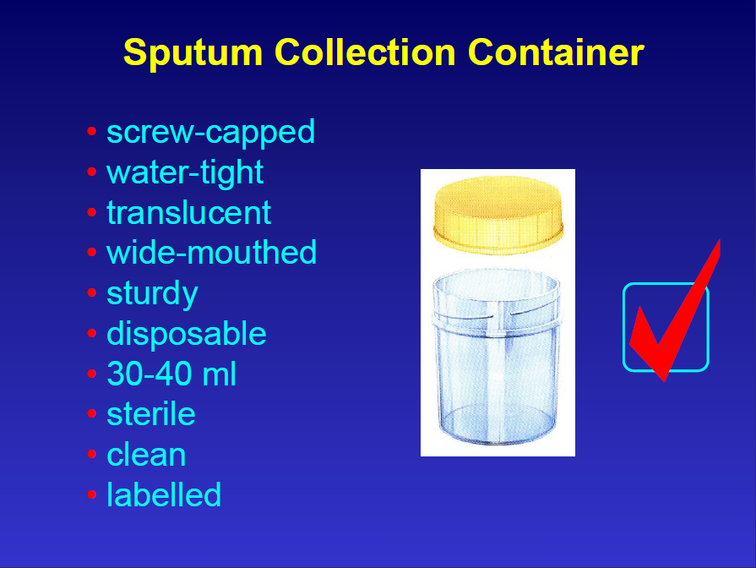

Slide 8
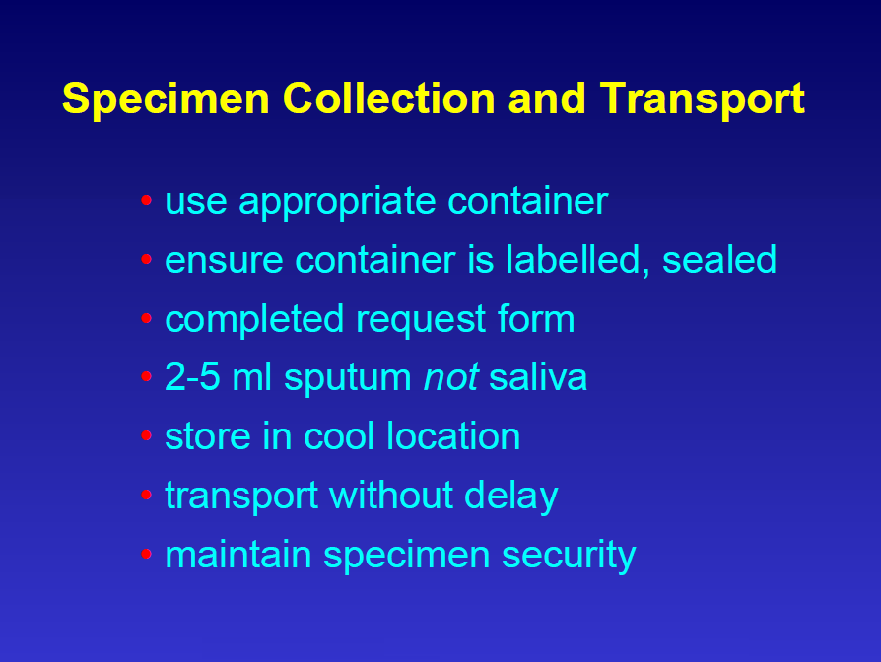

Slide 9
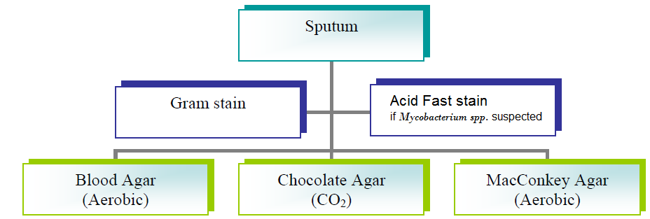
Specimen Processing
Note: Trans-tracheal and percutaneous lung aspiration material maybe inoculated to enrich Thioglycolate and anaerobic blood agar plate.

Slide 10
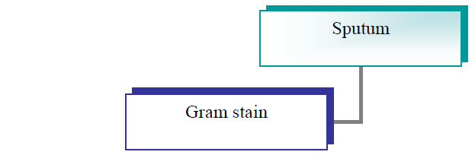
Sputum’s Gram Stain
Gram stain important to evaluate the quality and realty of the sputum specimen, an acceptable specimen yield less than 10 squamous epithelial cells per low power field (100x).
On the other hand the presence of 25 or more polymorphonuclear leukocytes per 100x field, together with few squamous epithelial cells implies an excellent specimen.

Slide 11
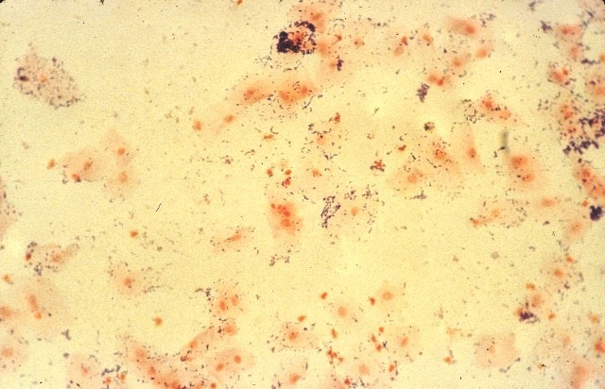
Unacceptable specimen
This low-power (100x) view of a sputum specimen shows many squamous cells, each of which has a single nucleus surrounded by a large volume of cytoplasm.

Slide 12
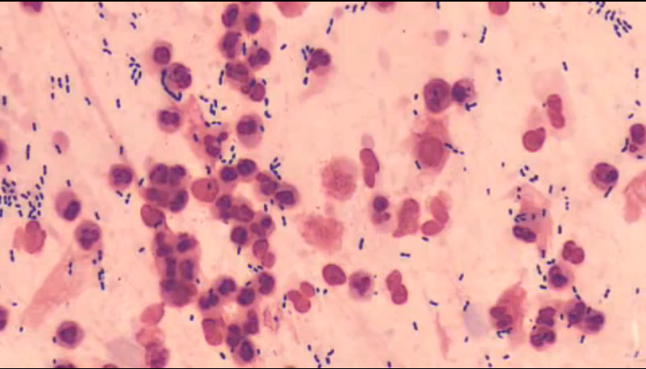
Acceptable specimen

Slide 13
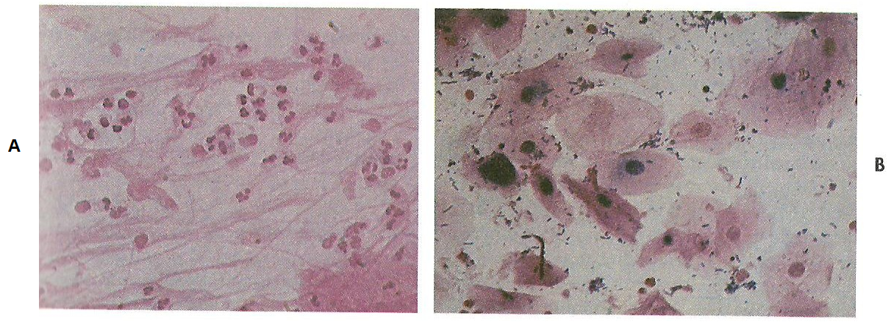
Gram’s Stain of Sputum Specimen
Gram stain of sputum specimen ( 400x)
A, this specimen contains numerous polymorphonuclear leukocytes and no visible squamous epithelial cells, indicating that the specimen is acceptable for routine bacteriological culture .
B, this specimen contains numerous squamous epithelial cells and rare polymorphonuclear leukocytes, indicating an inadequate specimen for routine sputum culture.

Slide 14
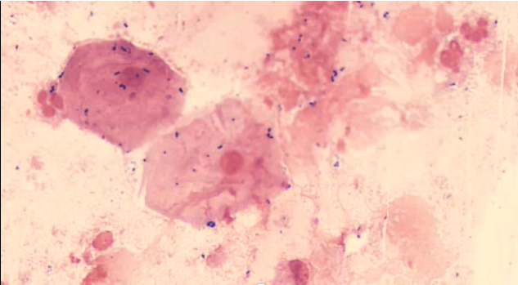
Unacceptable specimen
This high-power (400x) view of a sputum specimen shows many squamous cells, each of which has a single nucleus surrounded by a large volume of cytoplasm.

Slide 15
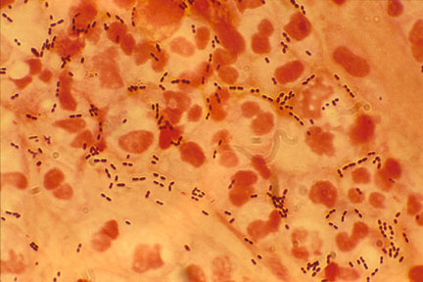
Note: the numerous polymorphonuclear neutrophils and gram-positive, lancet-shaped diplococci.

Slide 16
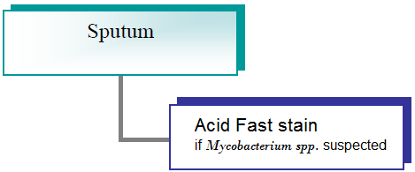
Acid fast stain
Ziehl Neelsen method
Notes:
Phosphate buffer pH 6.8

Slide 17
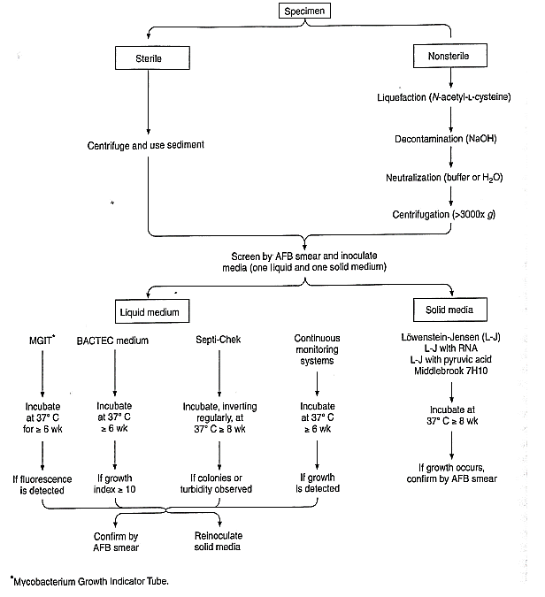
Initial Processing

Slide 18
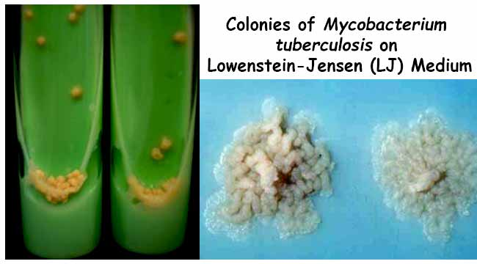

Slide 19
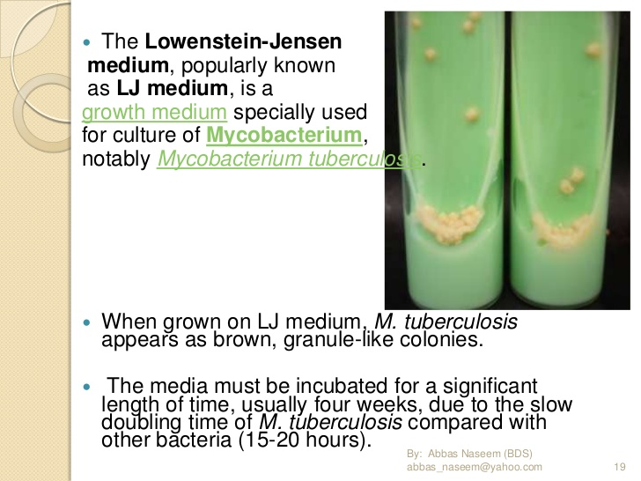

Slide 20
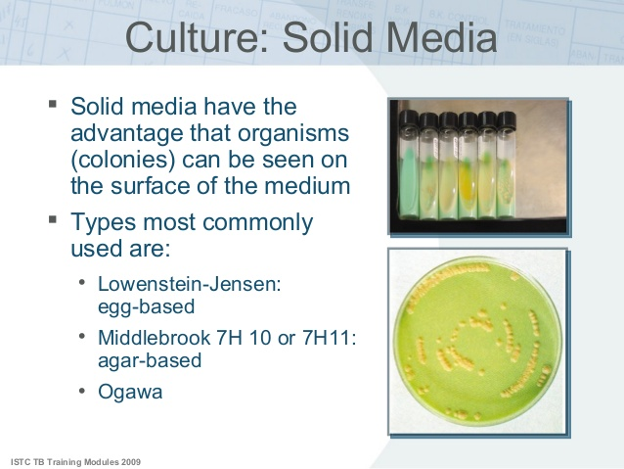

Slide 21
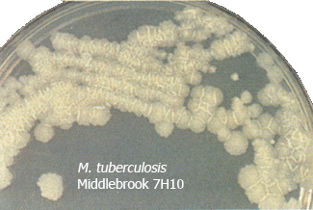

Slide 22
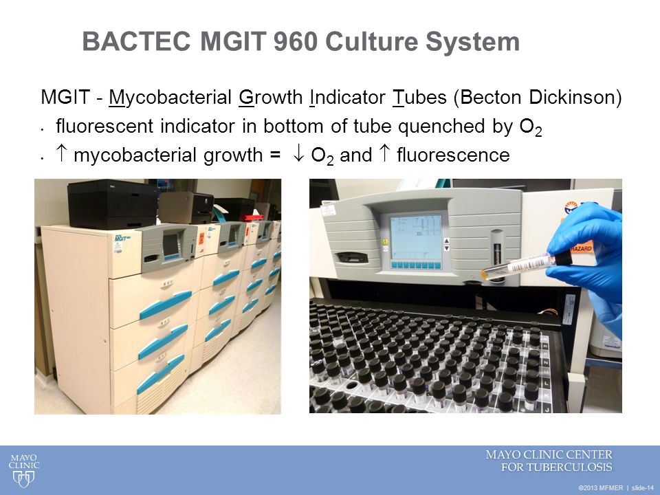

Slide 23
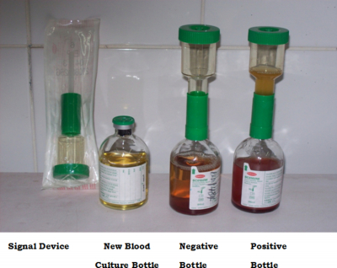
Signal blood culture system

Slide 24
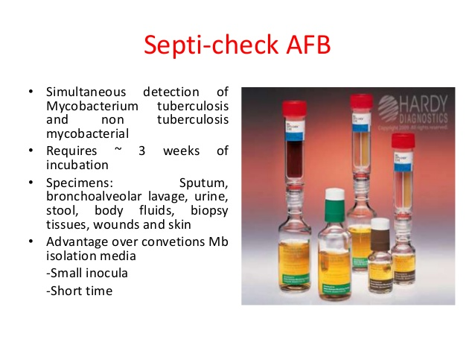

Slide 25
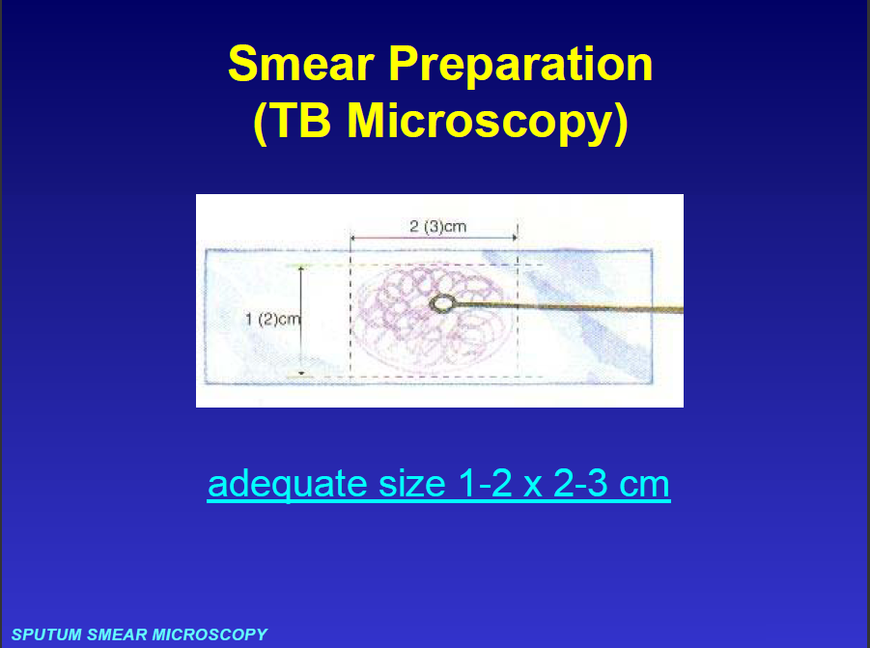

Slide 26
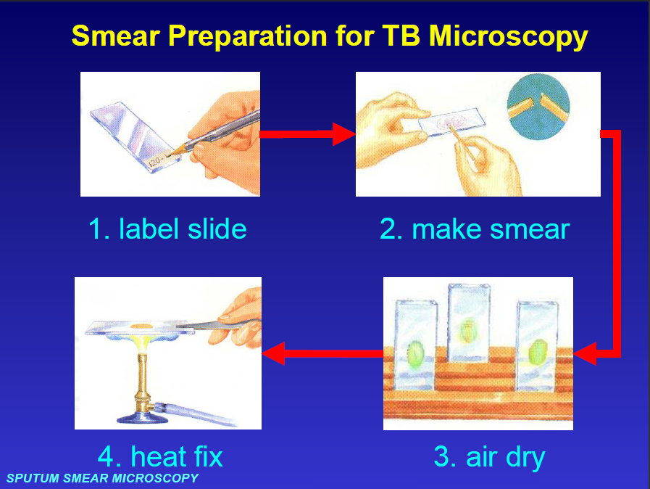

Slide 27
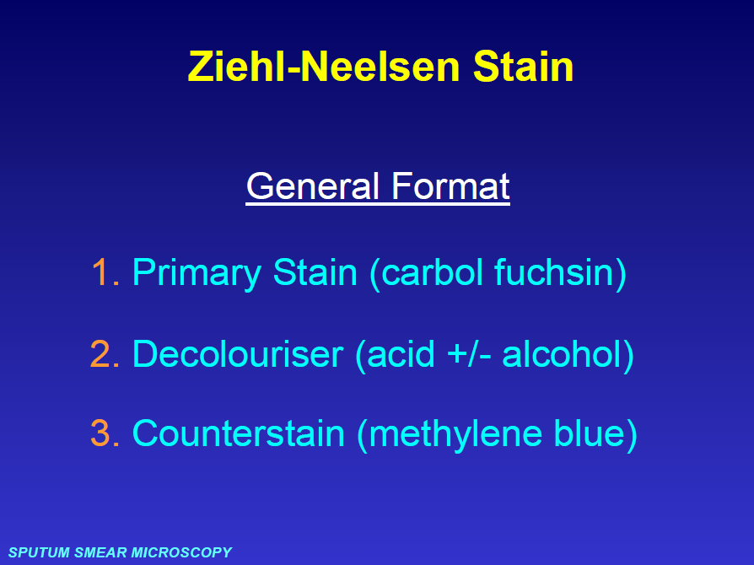

Slide 28
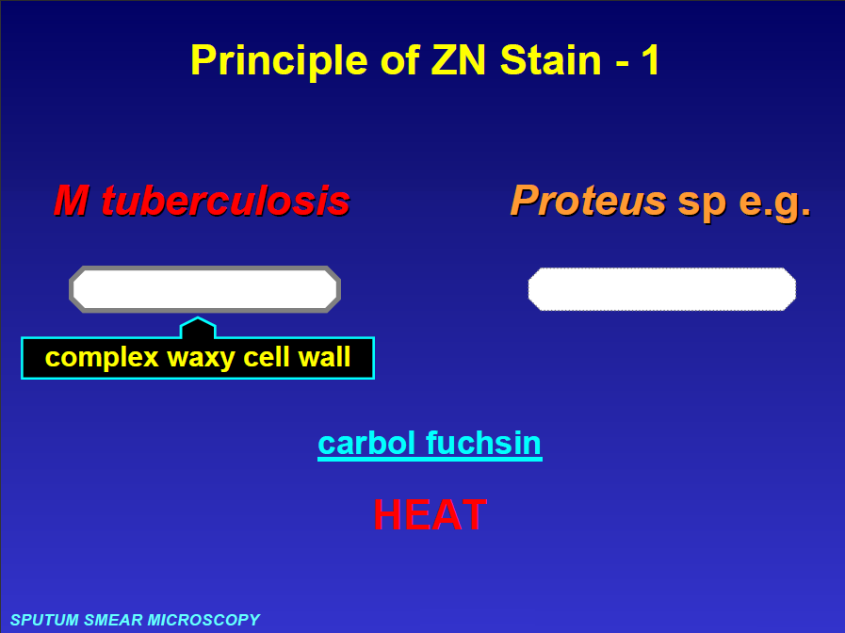

Slide 29
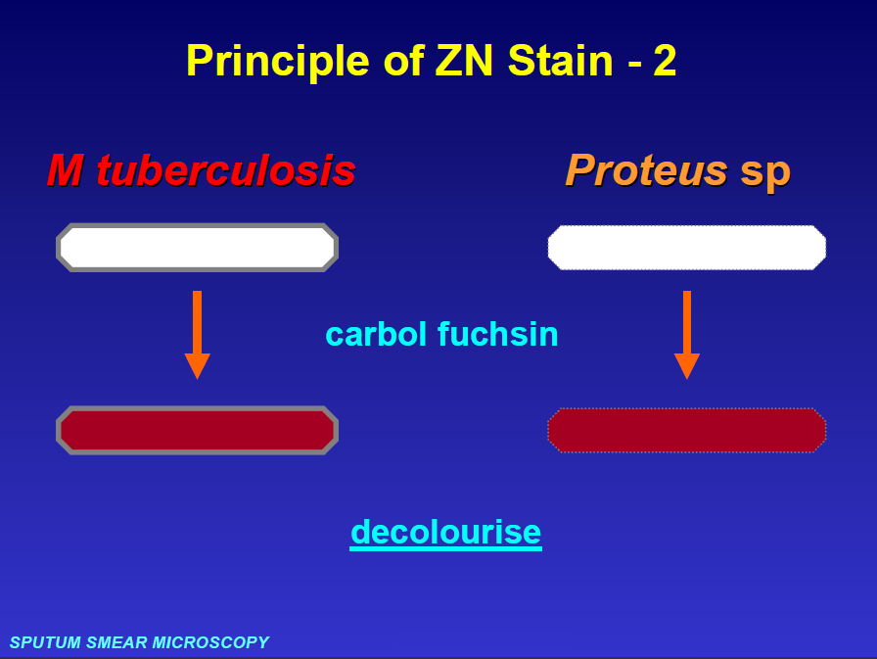

Slide 30
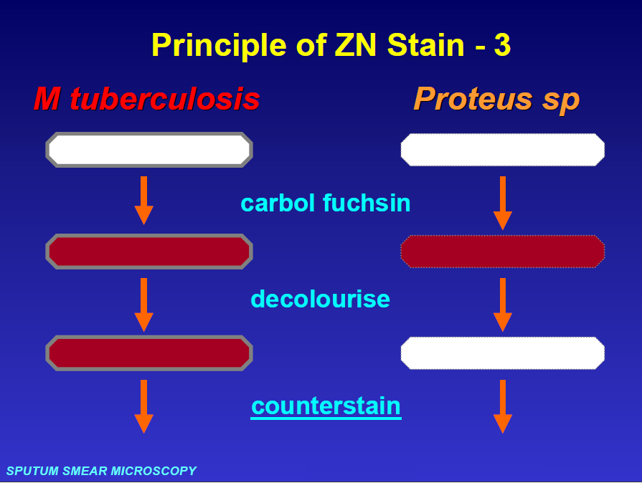

Slide 31
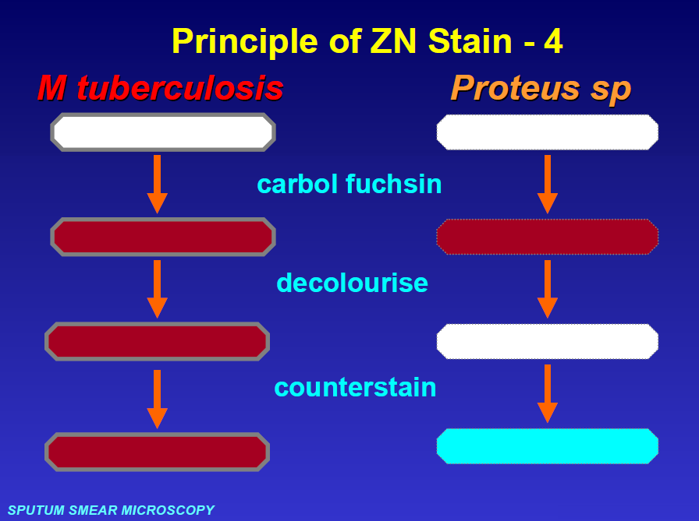

Slide 32
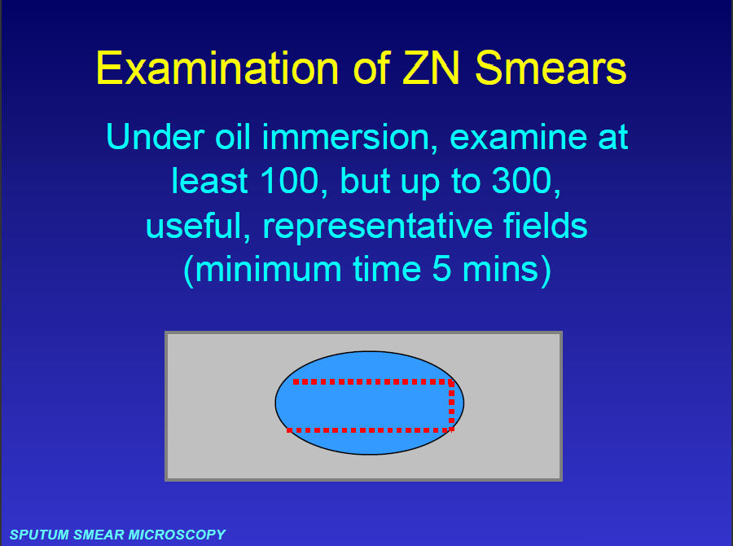

Slide 33
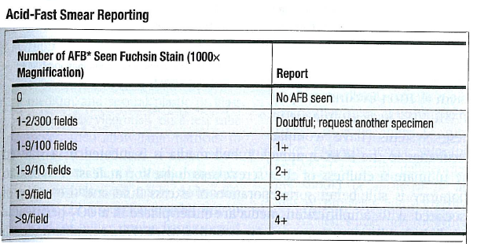
Result Reporting of AFS
AFB* Acid Fast Bacilli

Slide 34
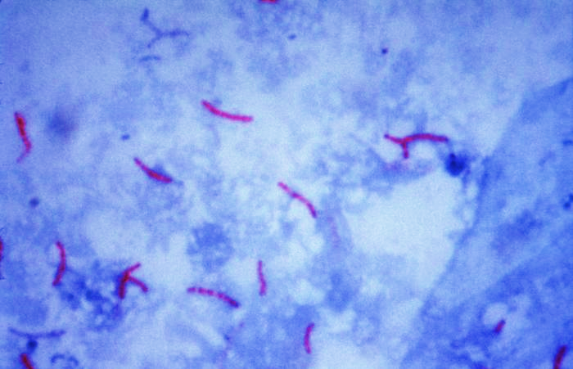
Acid Fast bacilli

Slide 35
Post specimen processing
Interfering factors:
Patient on antibiotic therapy.
Improper sample collection.
Result reporting:
Report Gram stain and AFS finding as an initial report.
Report the isolated and its sensitivity pattern as a final report.
Turn around time:
Gram stain and AFS results should be available an hour after specimen receipt.
Isolation of a possible pathogen can be expected after 2-4 days.
Negative culture will be reported out 1-2 days after the receipt of the specimen.

Slide 36
Throat swab
Culture
Sadeq Kaabi
بسم الله الرحمن الرحيم
Fourth grade
First semester
2018-2019
Diagnostic Medical Microbiology-Laboratory Manual

Slide 37
A throat swab culture is a laboratory test done to isolate and identify organisms that may cause infection in the throat mainly group A beta-hemolytic streptococci.
Collection of Specimen
Who will collect the specimen
Physician Or Medical technologist, Microbiologist, experienced nurse.
Type of specimen
Two Swabs from posterior pharynx, tonsils, or other inflamed area.
Storage
Maintain specimen swab at room temperature.

Slide 38
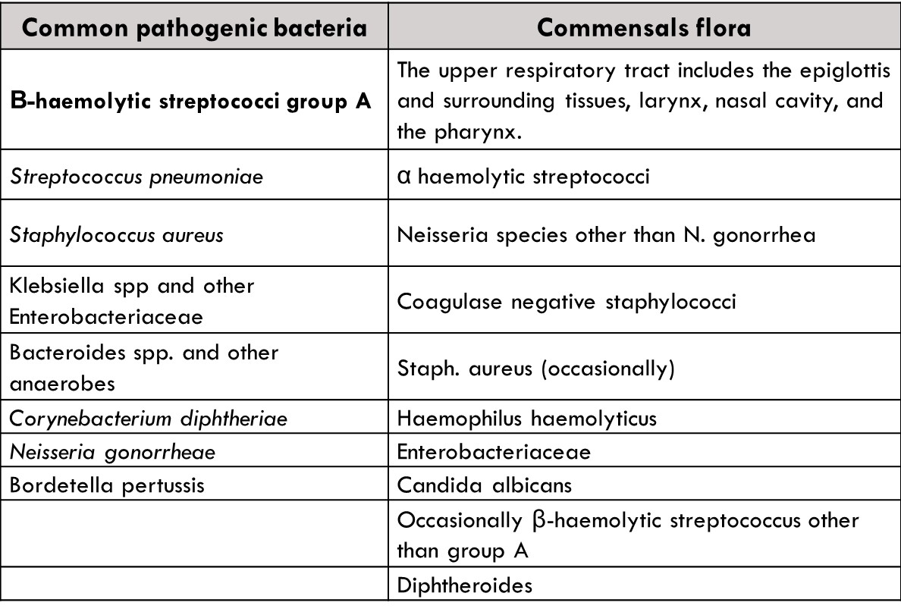
Upper Respiratory Tract Infection
Pathogen and Commensals

Slide 39
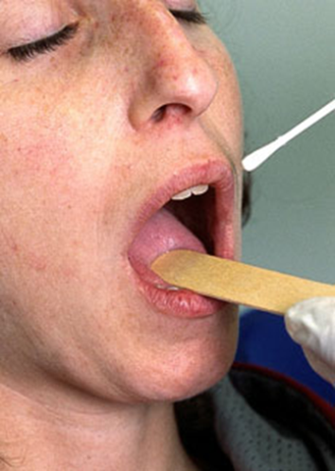
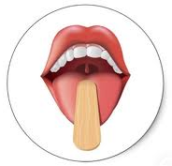
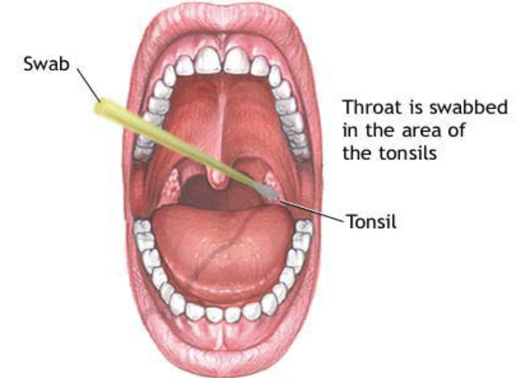
Throat Swabs collection procedure …
Turn the patients face against the light, ask the patient to open his mouth wide and phonate an “ah” gently depress the patients tongue with a tongue blade so that the throat is well exposed and illuminated.
Guide a swab over the tongue into the posterior pharynx.
Rub the swab firmly over the back of the throat, both tonsils and any areas of inflammation, exudation or ulceration. Care should be taken to avoid touching the tongue, cheeks or lips with the swab.
Place the swab in the transport medium and push it down to the bottom.

Slide 40
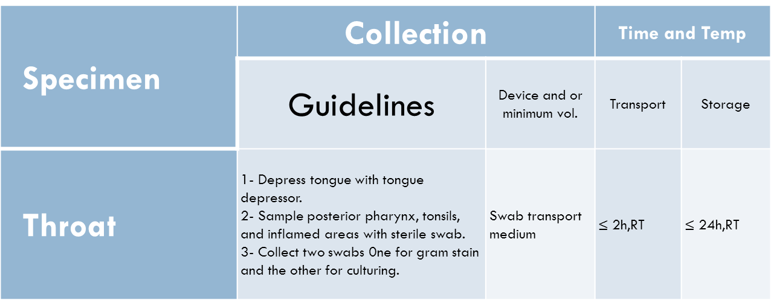
Throat Swabs collection procedure
S. pyogenes is highly resist to desiccation and remains viable on a dry swab for as long as 48 to 72 hours.
Criteria of specimen rejection
Inappropriate specimen transport device.
mislabeled specimen.
Unlabeled specimen.
Dried samples.
Specimen received after prolonged delay (usually more than 2 hours).
Specimen received in expired transport media.

Slide 41
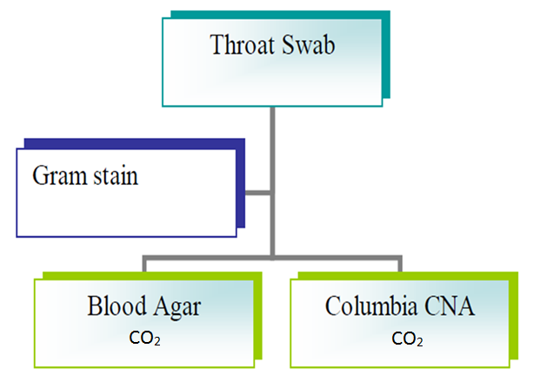
Specimen Processing
Culture plates should be incubated for at least 48 hours before reporting as negative for group A streptococci . In addition, the incubation of plates in 5% to 10% CO_{2.} (also aerobic and anaerobic conditions are used but CO2 condition is perfect)

Slide 42
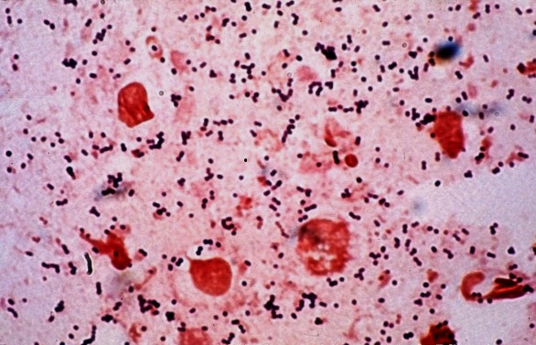
Gram Stain
Direct smear:
A gram stain from the swab noting the predominant organism.

Slide 43
Throat Swab Culturing
Culture
Because Streptococcus pyogenes is the primary case of pharyngitis most laboratories routinely screen throat cultures for this organism.
Classically throat swabs plated on 5% sheep Blood agar plates and Columia C.N.A, streak the swab across first quadrant of blood agar plate and using a sterile loop streak to produce isolated colonies, make few stabs in the agar plates also, Group A Streptococcus (S. pyogenes) are usually ß- hemolytic the activity of hemolysin enzyme will increased by the stabbing.
Note
Inoculate another Chocolate and MacConkey agar plates also are recommended if organisms other than S. pyogenes is suspected.

Slide 44
Columbia C.N.A. agar with Blood
Ingredients :
Peptone | Colistin sulphate
Tryptic digest of beef heart | Nalidixic Acid
Corn starch | Agar
Sodium chloride | Sheep Blood
Nalidixic Acid and Colistin sulphate are the antimicrobics suppressing the growth of Enterobacteriaceae and Pseudomonas spp., and allowing yeast, Staphylococci, Streptococci, and Enterococci to grow.
Certain Gram-negative organisms, such as Gardnerella vaginalis and certain Bacteriodes spp., can grow very well on Columbia CNA Agar with blood.
Colistin disrupts the cell membrane of Gram-negative organisms, particularly effective against Pseudomonas spp.
Nalidixic Acid blocks DNA replication in susceptible bacteria and acts against many Gram-negative bacteria.

Slide 45
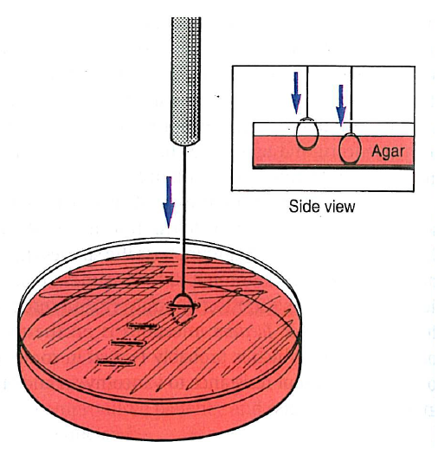
Make few stabs in the agar plates
Note: Make few stabs to increase hemolysin activity of group A Strepto.

Slide 46
Streptococcal Selective agar (SSA)
Ingredients :
Peptone | Colistin sulphate
Peptic Digest of Soybean | crystal violet
Sodium chloride | Trimethoprim-sulfamethoxazole
Agar | Sheep Blood
Streptococcal selective agar (SSA) is available commercially.
A modification of sheep blood agar, this medium contains crystal violet, trimethoprim-sulfamethoxazole, and colistin in concentrations adequate to inhibit most bacteria except for Streptococcus pyogenes and S.agalatiae.
Beta hemolysis is readily observed.
The medium is effective for primary plating of throat swabs for detection of group A streptococci.
Notes:
haemolytic streptococci (BHS) are the most important cause of pharyngitis, next to viruses. Isolation of these organisms is very important. Growth on normal blood agar (BA) is often superimposed by normal flora posing problems in isolation.
Use of selective medium would be a cost-effective and easy method for isolation of BHS. Crystal violet at a concentration of 1:5x104 units inhibits growth of staphylococci and many other commensals of throat, but it facilitates the selective isolation of Group A BHS

Slide 47
Specimen Processing continue…
Direct antigen detection
Identification of group A Streptococcal antigen in throat specimens are available now by using different methods including latex agglutination, enzyme immunoassay and gene probe technology, that allow detection of Streptococcal group A antigen within at little as 10 minutes.
Antistreptolysin O titre (ASOT).

Slide 48
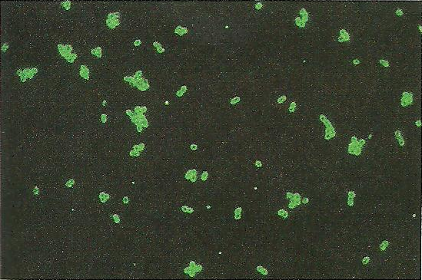
Group A streptococci stained with fluorescein-conjugated anti-group A antibody, examined with ultraviolet light . Notice that the organisms stain as rings, with dark centers.

Slide 49
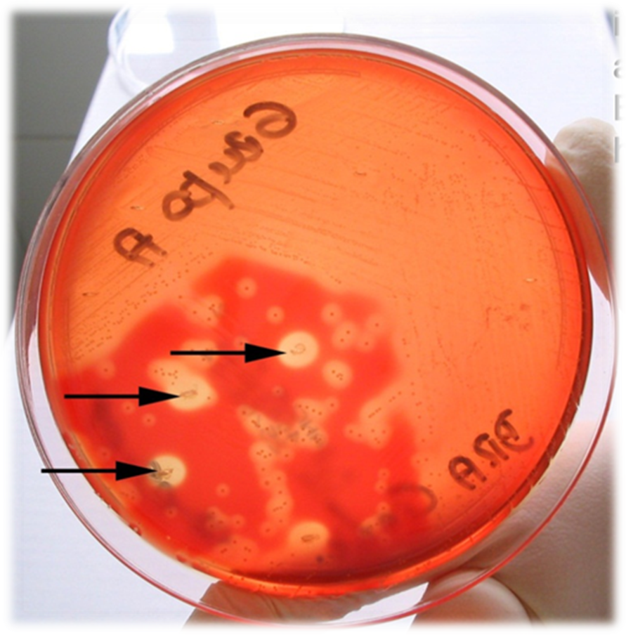
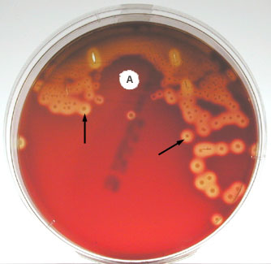
Streptococcus pyogenes
Note small, gray white, transparent to translucent colonies, beta hemolysis (complete lysis of the red blood cells around the colonies; see arrows), and sensitive to the antibiotic bacitracin .

Slide 50
Additional information
Rheumatic fever is an inflammatory disease that occurs following a Group A streptococcal infection, (such as strep throat). Believed to be caused by antibody cross-reactivity that can involve the heart, joints, skin, and brain. The illness typically develops two to three weeks after a streptococcal infection.
Cross-reactivity is the reaction between an antigen and an antibody which was generated against a different but similar antigen.
Autoimmunity is the failure of an organism to recognize its own constituent parts as self, which allows an immune response against its own cells and tissues. Any disease that results from such an aberrant immune response is termed an autoimmune disease.
Notes:
الحمى الروماتيزمية ، حمى الروماتزم
Rheumatic Fever
الحمى الروماتيزمية ‏هي مرض التهابي يمكن أن يهاجم الأنسجة الضامة بالجسم، خاصة أنسجة ‏القلب والمفاصل والجلد وأحياناً المخ.
‏
القلب من الناحية العملية دائماً ما ‏يصاب بالضرر على الأقل بصفة مؤقتة. وقد يحدث تلف دائم بصمامات القلب (مرض القلب الروماتيزمي) الذي
ينشأ بعد حدوث حالة عدوى بالبكتيريا الكروية السبحية تترك دون علاج أو لا تعالج بفاعلية ، مثل الالتهاب السبحي للحلق.
‏
من المعتقد أن تفاعل جهاز المناعة تجاه البكتيريا الكروية السبحية يجعل جهاز المناعة غير الطبيعي يتلف القلب وغيره من أعضاء الجسم كما يحدث في غير ذلك من أمراض المناعة الذاتية .

Slide 51
Post specimen processing
Interfering factors:
Patient on antibiotic therapy.
Improper sample collection.
Result reporting:
Report Gram stain finding as an initial report.
Report the isolated and its sensitivity pattern as a final report.
Turn around time:
Gram stain result should be available half hour after specimen receipt.
Isolation of a possible pathogen can be expected after 2-4 days.
Negative culture will be reported out 1-2 days after the receipt of the specimen.

Slide 52
End of Lecture

