Slide 1
Forensic DNA Sadeq Kaabi
بسم الله الرحمن الرحيم
Fourth grade
First semester
2018-2019
Diagnostic Medical Microbiology-Laboratory Manual

Slide 2
What Is a DNA Fingerprint?
Every individual carries a unique set of genes
Chemical structure of DNA is same, but the order of the base pairs differs
Every cell contains a complete set of DNA that identifies the organism as a whole
Only one tenth of 1% of DNA differs from person to person

Slide 3
Two Main Types of Forensic DNA Testing
RFLP (restriction fragment length polymorphism)
Requires larger amounts of DNA
DNA cannot be degraded
PCR (polymerase chain reaction)
Less DNA and DNA can be partially degraded
Extremely sensitive to contaminating DNA
STRs
Mitochondrial DNA

Slide 4
What Is a DNA Fingerprint?
DNA profiling depends on a small portion of the genome
Exons code proteins
Introns do not code for proteins
The introns contain repeated sequences of between 1 and 100 base pairs
Called variable number tandem repeats (VNTR’s)
Some VNTR’s are inherited from mother and some from father

Slide 5
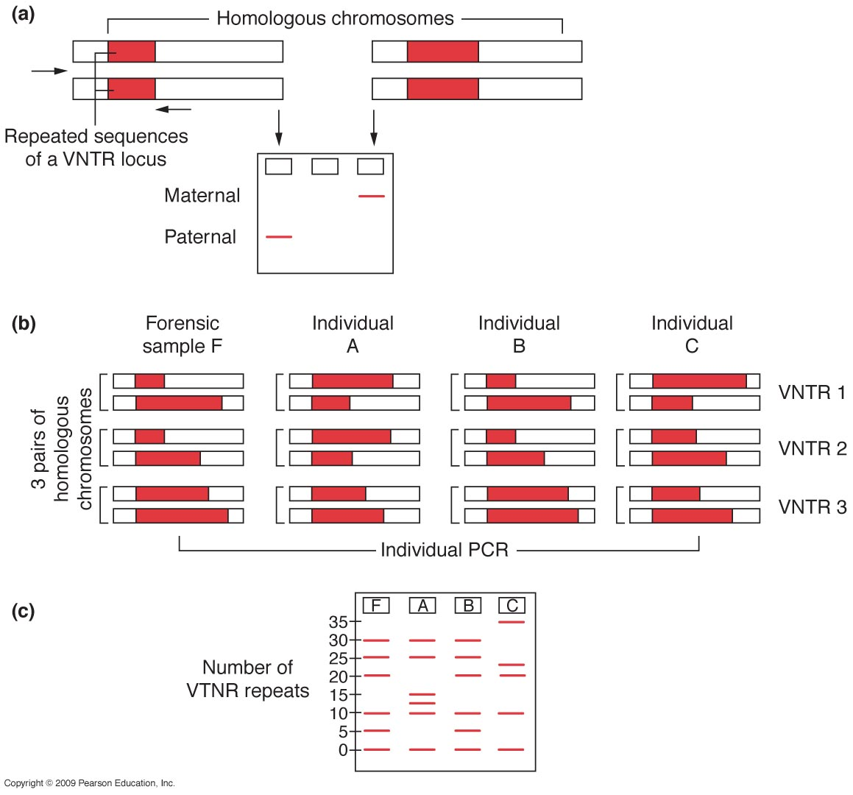

Slide 6
DNA fingerprinting is restricted to the detection of microsatellites
1 to 6 nucleotide repeats dispersed throughout the chromosomes
Probes used to identify the microsatellite surround the specific microsatellite being analyzed
Also called short tandem repeats (STR)
FBI has chosen 13 unique STRs for testing
Combined DNA Index System (CODIS)

Slide 7
Key Difference – Minisatellite vs Microsatellite
Repetitive DNA is the nucleotide sequences repeating over and over again in the genome of organisms. Repetitive DNA accounts for a significant fraction of genomic DNA, and there are three main types named tandem repeats, terminal repeats and interspersed repeats. Tandem repeats are the highly repeated sequences which lie adjacent to each other without interruption. There are three major types of tandem repeats in the vertebrate genome. They are satellite DNA , microsatellite DNA and minisatellite DNA. Minisatellite is a section of highly repeated DNA that consists of a series of a repeating sequence composed of 10 to 100 base pairs. Microsatellite is a section of repetitive DNA that consists of short repeating sequences composed of 1 to 9 base pairs. Therefore, the key difference between minisatellite and microsatellite is the size or the length of the repeating sequence.

Slide 8
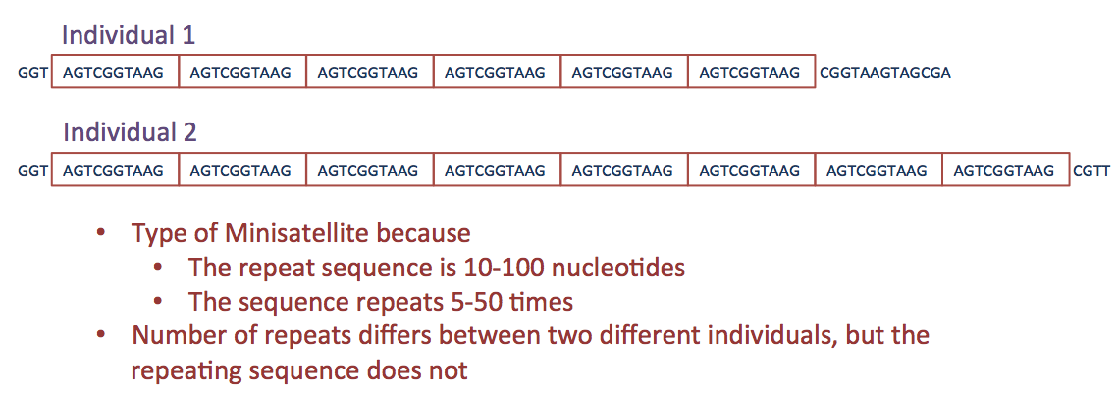
What is a Minisatellite?
Minisatellite DNA is a section of DNA which comprises a series of short DNA repeating sequence which is 10 to 60 base pair length. Minisatellites are also referred as variable number tandem repeats (VNTR). Minisatellites are often with confused with microsatellites. However, minisatellites and microsatellites are now distinguished based on the size of the repeating sequence by scientists.
Minisatellites can be seen in more than 1000 locations in the human genome. These short sequences are rich with G and C. The number of repeats in a given minisatellite widely varies among the individuals.

Slide 9
First human minisatellite was identified by A. R. Wyman and R. White in 1980. Later, Alec Jeffreys discovered the extreme polymorphism of copy number of minisatellites among organisms. Those discoveries made minisatellites as ideal markers for DNA fingerprinting, linkage analysis, and population studies. Minisatellites also contribute to regulation of gene expression, transcription, alternative splicing, etc.
What is a Microsatellite?
Microsatellite is a section of DNA which has simple sequence repeats of 1 to 10 base pair long. Microsatellites are also called short sequence repeats (SSR) or simple tandem repeats (STR). There are two types of microsatellites named simple microsatellites and composite microsatellites. Simple microsatellites consist of only one type of repeat sequences. Composite microsatellites consist of more than one type of repeats. Microsatellites most commonly possess poly A/T regions. Microsatellites are codominant and abundant in eukaryotic genomes.

Slide 10
Similar to minisatellites, microsatellites also show polymorphism among individuals. The number of repeats for a given microsatellite varies among the individuals. Therefore, microsatellites can also be used as genetic markers in DNA fingerprinting. Microsatellite polymorphism can be easily identified by PCR and gel electrophoresis. Flanking region of microsatellite is highly conserved in related species.
What are the Similarities Between Minisatellite and Microsatellite?
Minisatellites and microsatellites are non coding DNA sequences.
Both are tandem repeats.
Both consist of highly repeating sequences.
Both can be used as powerful genetic markers for DNA fingerprinting.

Slide 11
What is the Difference Between Minisatellite and Microsatellite ؟
Minisatellite vs Microsatellite
Minisatellites are tandem repeats with a monomer repeat length of 10 to 100 base pairs. | Microsatellites are short tandem repeats that consist of 1 to 9 base pairs monomer repeating sequences.
Size of the Repeating Sequence
Minisatellite has repeating sequences of 10 to 100 base pairs. | Microsatellite has short sequences of 1 to 9 base pairs.
Common Bases
Minisatellites are rich with G and C bases. | Microsatellites are rich with A and T bases.
Other Names
Minisatellites are also known as variable number tandem repeats (VNTR). | Microsatellites are also known as short sequence repeats (SSR) or simple tandem repeats (STR).

Slide 13
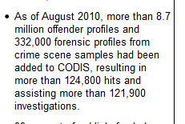
Update of CODIS till August 2010 according to U. S. Department of Justice:

Slide 15
RFLP Analysis
Treat DNA with restriction enzyme
Restriction enzyme cuts DNA at restriction sites
Use several restriction enzymes in sequence or combined
Use agarose gel electrophoresis to separate the pieces
Gel is chemically treated or heated to denature the DNA
Allows the binding of a single-stranded probe

Slide 16
Southern Blot Technique
Transfer DNA fragments from gel to nitrocellulose or nylon membrane
Membrane incubated with a probe
Short strand of complementary DNA with a radioactive or fluorescent tag
Targeted area on the DNA fragment is called a locus
Expose X-ray (photo) film to membrane to obtain permanent record of results

Slide 17
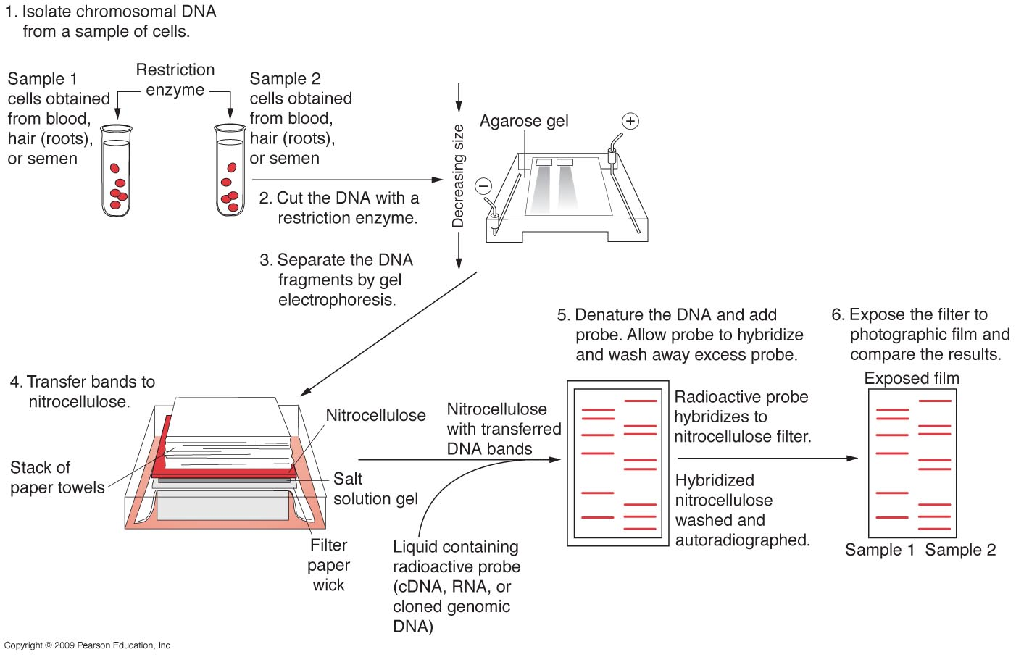

Slide 21
