Slide 1

CSF
Sadeq Kaabi
بسم الله الرحمن الرحيم
Fourth grade
First semester
2018-2019
Diagnostic Medical Microbiology-Laboratory Manual

Slide 2
Cerebrospinal fluid (CSF) culture

Slide 3
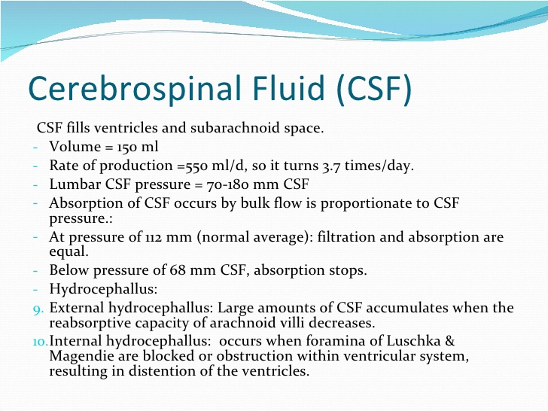
CSF in general

Slide 4
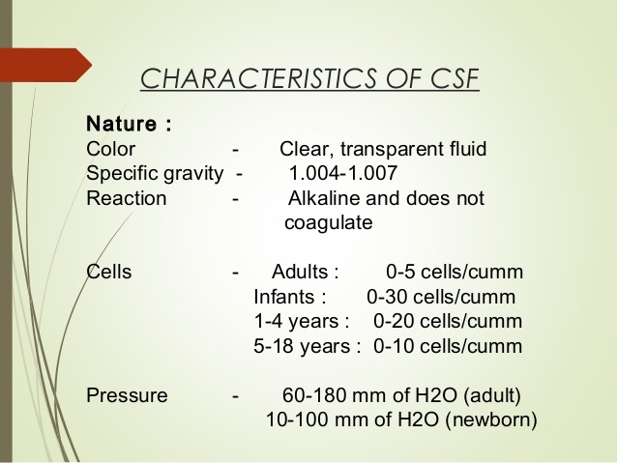

Slide 5
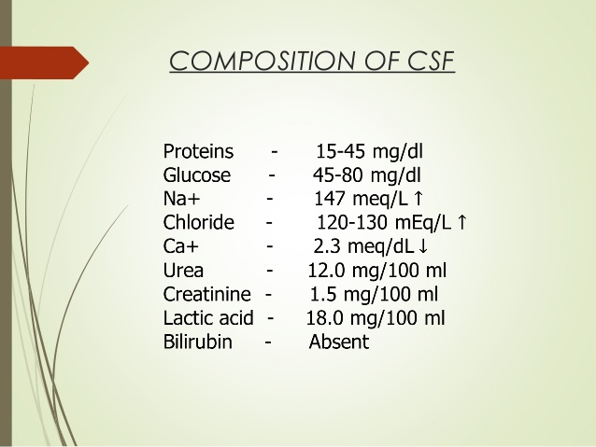

Slide 6
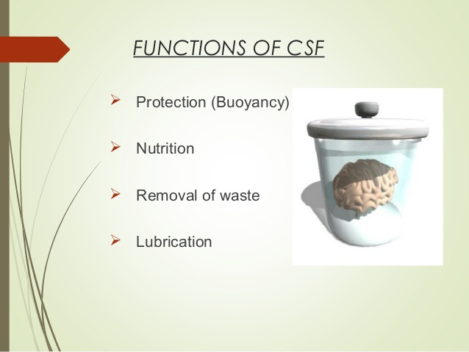

Slide 7
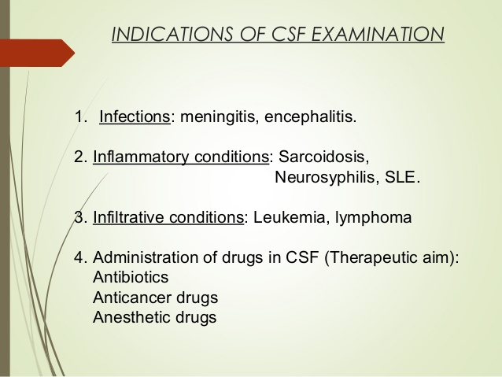

Slide 8
The examination of cerebrospinal fluid (CSF) is an essential step in the diagnosis of bacterial and fungal meningitis and CSF must always be considered as a priority specimen that requires prompt attention by the laboratory staff.
Normal CSF is sterile and clear, and usually contains three leukocytes or fewer per mm³ and no erythrocytes

Slide 9
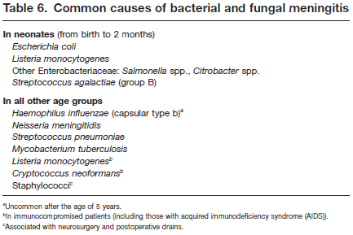

Slide 10
Collection and transportation of specimens
- Approximately 5–10 ml of CSF should be collected in two sterile tubes by lumbar or ventricular puncture performed by a physician.
Part of the CSF specimen will be used for cytological and chemical examination, and the remainder for the microbiological examination.
The specimen should be delivered to the laboratory at once, and processed immediately, since cells disintegrate rapidly. Any delay may produce a cell count that does not reflect the clinical situation of the patient.

Slide 11
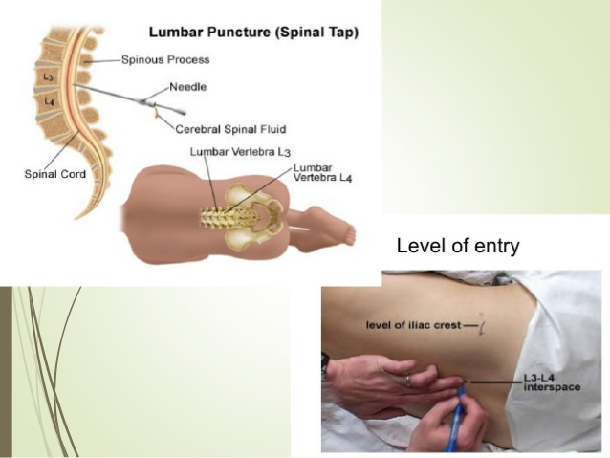

Slide 12
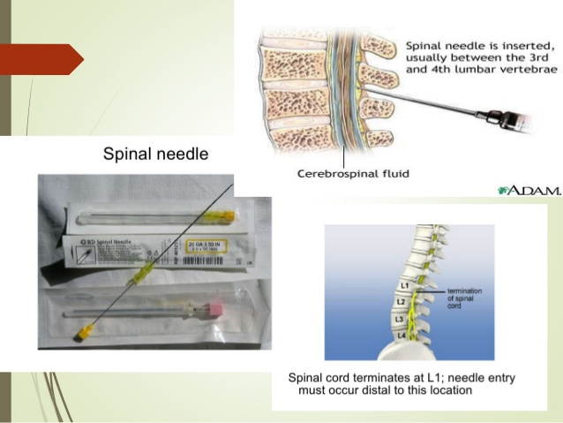

Slide 13
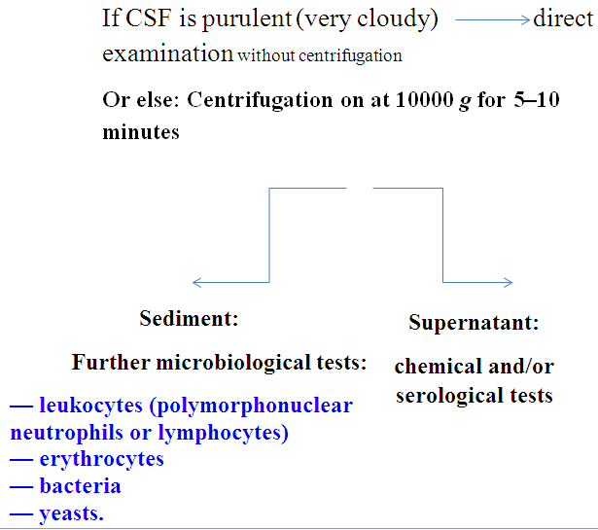
Preparation of specimen

Slide 14
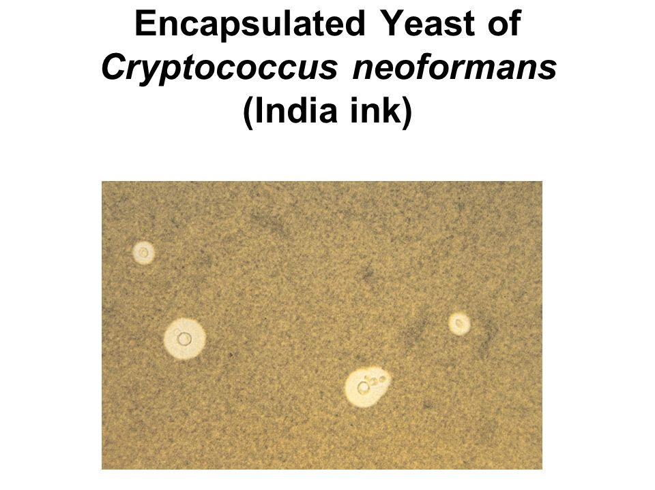

Slide 15
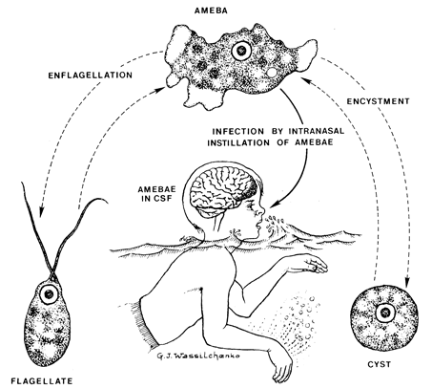
Naegleria fowleri – Brain eating amoeba
Encephalitis- necrosis and homorrhage of brain

Slide 16
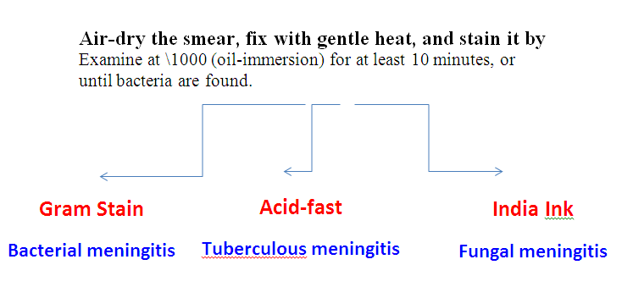
Staining of CSF smear

Slide 17
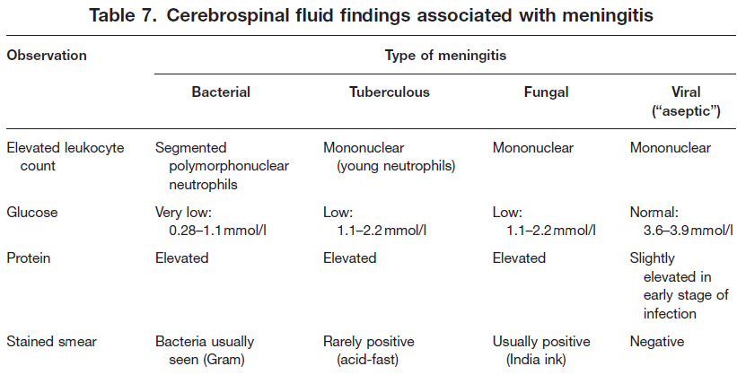

Slide 18
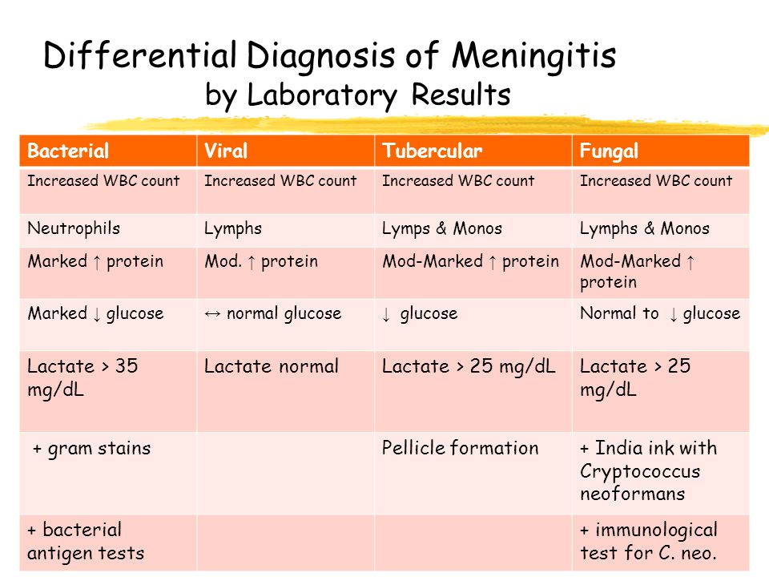

Slide 19
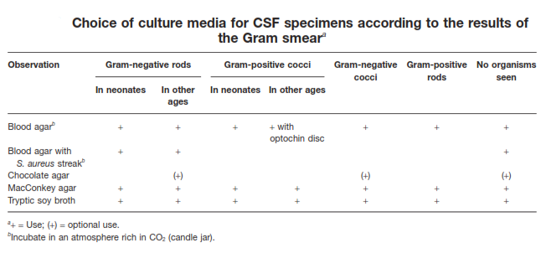
Culture
- If bacteria have been seen in the Gram-stained smear, the appropriate culture media should be inoculated:

Slide 20
Preliminary identification
- Growth on MacConkey agar is suggestive of Enterobacteriaceae and should be further identified using the methods and media recommended for enteric pathogens.
- Colonies of Gram-positive cocci with a narrow zone of β-haemolysis may be S. agalactiae (group B streptococci). This should be confirmed with the reverse CAMP test.
- Flat colonies with a concave centre and a slight green zone of α-haemolysis are probably S. pneumoniae. For confirmation, a 6-mm optochin disc should be placed on a blood agar plate heavily inoculated with a pure culture of the suspected strain. After overnight incubation, pneumococci will exhibit an inhibition zone of 14 mm or more around the optochin disc.

Slide 21
Meningococci and Listeria monocytogenes
- Gram-negative diplococci growing on blood and chocolate agar, and giving a rapidly positive oxidase test, may be considered to be meningococci. Confirmation is accomplished by grouping with appropriate N. meningitidis antisera (A, B, C) in the slide agglutination test.
Colonies of Gram-positive rods with a narrow zone of b-haemolysis on blood agar may be Listeria monocytogenes. The following confirmatory tests are suggested: positive catalase reaction, motility in broth culture or in MIU, growth and black discoloration on bile–aesculin agar.
MIU: Stands for motility- Indole- Urease test.

Slide 22
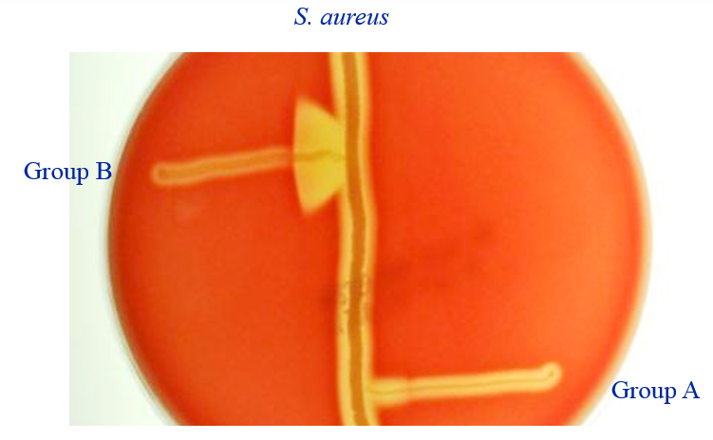
CAMP test
B: Group B streptococci ( Sterptococcus agalactiae )
A: Group A stretptococci ( Streptococcus pyogenes )

Slide 23
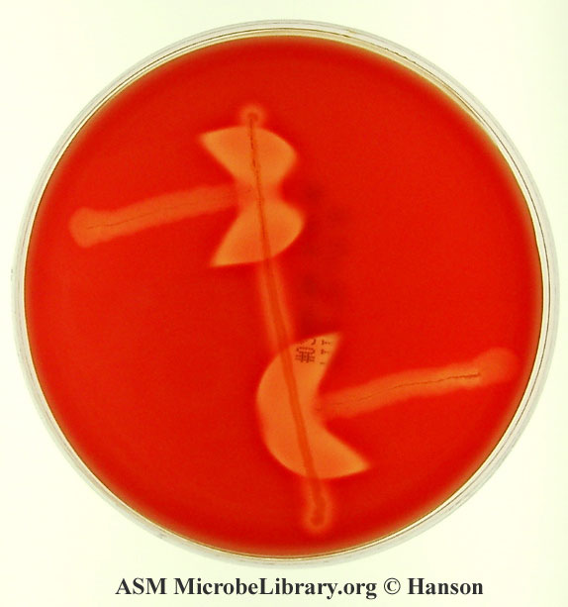
Reverse CAMP test
It can be used for differentiation of Clostridium perfringens from other Clostridium species. Here, a CAMP positive Group B Streptococcus is streaked in the center of sheep blood agar, and Clostridium perfringens is streaked perpendicular to it. Following incubation at 37oC for 24-48 hours in anaerobic conditions, an “arrowhead” hemolysis is seen between the growth of Clostridium perfringens and Group B Streptococcus. This is because of alpha toxin produced by Clostridium perfringens interacts with CAMP factor and produce synergistic hemolysis.

Slide 24
Urine Culture
Sadeq Kaabi
بسم الله الرحمن الرحيم
Fourth grade
First semester
2018-2019
Diagnostic Medical Microbiology-Laboratory Manual

Slide 25
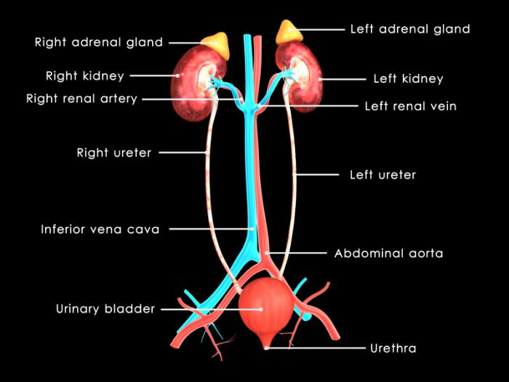
Urine

Slide 26
- The most common sites of urinary tract infection (UTI) are the urinary bladder (cystitis) and the urethra. From these sites the infection may ascend into the ureters (ureteritis) and subsequently involve the kidney (pyelonephritis). Females are more prone to infection of the urinary tract than are males and also present the greater problem in the proper collection of specimens.
- In both males and females, UTI may be asymptomatic, acute, or chronic.

Slide 27
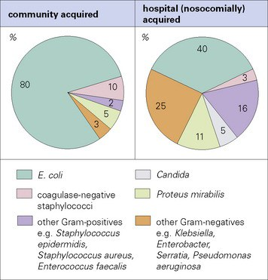

Slide 28
Types of urine specimens
Random sample: Sample which is collected anytime during the day. Usually used only for routine screening because the composition of urine changes throughout the day.
2. First voided specimen: Sample also referred to as a first morning specimen. This sample is collected the first time the patient urinates in the morning. A first voided specimen is the most concentrated and is the preferred specimen for pregnancy testing, bacterial cultures and microscopic examinations.

Slide 29
3. Timed specimens: These specimens are used when the physician requires urine samples to be taken at specific intervals during the day. Twenty-four (24) hour urine specimens are required for creatinine clearance tests and many other hormone studies.
4. Clean-catch midstream specimen: This sample type is collected if the urine is going to be cultured and examined for bacterial growth or used for cytology.
5. “Dirty collection:” This specimen will be used for DNA testing and the FIRST part of the voided stream is collected.
6. Catheterized specimen: These specimens are obtained by inserting a catheter or sterile flexible tube into the bladder via the urethra to withdraw urine. This procedure is done only by specially trained personnel

Slide 30
Culture and interpretation
1- Gram staining for uncentrifuged urine: Using a sterile Pasteur pipette (one for each sample), place one drop of well-mixed, uncentrifuged urine on a slide. Allow the drop to dry without spreading, heat-fix and stain. Examine under an oil-immersion lens (\600 or more) for the presence or absence of bacteria, polymorphonuclear leukocytes, and squamous epithelial cells.
One or more bacterial cells per oil-immersion field usually implies that there are 105 or more bacteria per millilitre in the specimen. The presence of one or more leukocytes per oil-immersion field is a further indication of UTI.

Slide 31
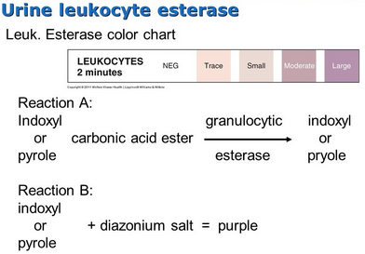
2- Screening method
An alternative simple and effective screening test is the test strip for leukocyte esterase/nitrate reduction. The strip is dipped into the urine specimen as instructed in the package literature. Any pink colour is a positive reaction indicating the presence of leukocyte esterase and/or bacteria in excess of 105 per ml. Urine samples that are positive in the screening test should be cultured as soon as possible to prevent possible overgrowth by non-significant bacteria.

Slide 32
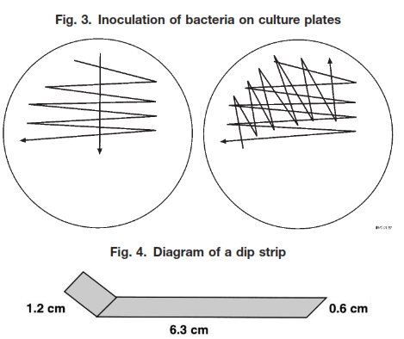
Quantitative culture and presumptive identification
1- Calibrated loop technique
The recommended procedure uses a calibrated plastic or metal loop to transfer 1µ of urine to the culture medium (MacConkey agar with crystal violet and non-selective blood agar).

Slide 33
2- Filter-paper dip-strip method
The strips can be locally prepared using a specific type of blotting-paper and should measure 7.5 cm long by 0.6 cm wide (see Fig. 4). They are marked at 1.2 cm from one end with a pencil.
The area below the mark, which will bend over like the foot of an “L”, should then be placed in contact with a plate of brolacin agar or purple lactose agar for 2–3 seconds.

Slide 34
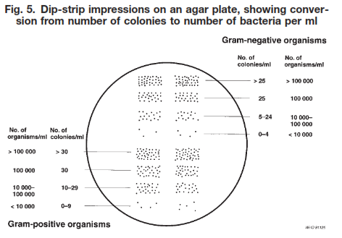

Slide 35
Identification procedures may then be initiated using well-separated colonies of similar appearance. If required, the inoculum for performing the disc-diffusion susceptibility test prepared from either of these plates. In this way, the results of both identification and susceptibility tests will be available on the next day.

Slide 36
Interpretation of quantitative urine culture results
General recommendations for reporting are given below.
Category 1: fewer than 104 CFU per ml. Report as probable absence of UTI. (Exceptions: if fewer than 104 CFU per ml are present in urine taken directly from the bladder by suprapubic puncture or cystoscopy, in; symptomatic women, or in the presence of leukocyturia, report the identification and the result of the susceptibility test.)
Category 2: 104–105 CFU per ml. If the patient is asymptomatic, request a second urine specimen and repeat the count. If the patient has symptoms of UTI, proceed with both identification and susceptibility tests. if one or two different colony types of bacteria are present. Bacterial counts in this range strongly suggest UTI in symptomatic patients, or in the presence of leukocyturia. If the count, the quality of the urine specimen, or the significance of the patient’s symptoms is in doubt, a second urine specimen should be obtained for retesting. Report the number of CFU.

Slide 37
Category 3: More than 105 CFU per ml. Report the count to the physician and proceed with identification and susceptibility tests if one or two different colony types of bacteria are present. These bacterial counts are strongly suggestive of UTI in all patients, including asymptomatic females.
If more than two species of bacteria are present in urine samples in categories 2 and 3, report as “Probably contaminated; please submit a fresh, clean-catch specimen”.

Slide 38
Identification
Identification should be performed as rapidly as possible. Since the vast majority of urinary tract infections are caused by E. coli, a rapid test should be used to identify red colonies from MacConkey agar.
β-Glucuronidase test for rapid identification
This test determines the ability of an organism to produce the enzyme β-glucuronidase. The enzyme hydrolyses the 4-nitrophenyl-β-D-glucopyranosiduronic acid (PGUA) reagent to glucuronic acid and p-nitrophenol. The development of a yellow colour indicates a positive reaction.
Escherichia coli positive (yellow) result
Shigella flexneri negative (clear) result

