Slide 1
Ecology
Ecology is the branch of biology which studies the interactions among organisms and their environment. Objects of study include interactions of organisms with each other and with abiotic components of their environment. include the biodiversity, distribution, biomass, and populations of organisms, as well as cooperation and competition within and between species. Ecosystems are dynamically interacting systems of organisms, the communities they make up, and the non-living components of their environment. Ecosystem processes, such as primary production, pedogenesis, nutrient cycling, and regulate the flux of energy and matter through an environment.

Slide 2
Ecology is the scientific study of interactions of organisms with one another and with the physical and chemical environment.
Environment is the total of all surroundings of a living organism, including natural forces and other living things, which provide conditions for developments and growth as well as of danger and damage.
An ecosystem includes all of the living things (plants, animals and organisms) in a given area, interacting with each other, and also with their non-living environments (weather, earth, sun, soil, climate, atmosphere)

Slide 3
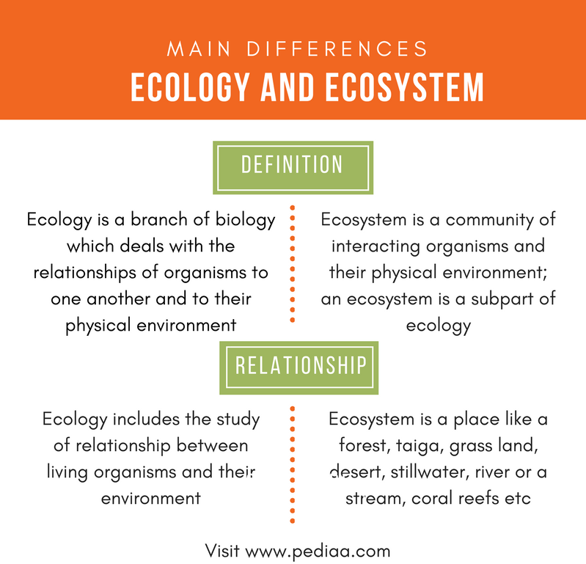

Slide 4
Algae: singular alga, members of a group of predominantly aquatic photosynthetic organisms of the kingdom Protista. Algae have many types of life cycles, and they range in size from microscopic to giant kelps that reach 60 metres (200 feet) in length. Their photosynthetic pigments are more varied than those of plants, and their cells have features not found among plants and animals. In addition to their ecological roles as oxygen producers and as the food base for almost all aquatic life, algae are economically important as a source of crude oil and as sources of food and a number of pharmaceutical and industrial products for humans. The taxonomy of algae is contentious and subject to rapid change as new molecular information is discovered.

Slide 5
Habitat and Habit (Ecology) of Algae
Based on their habitat three types of algae can be recognised, viz.,
1. Aerial and terrestrial algae
2.Aquatic algae—(a) freshwater algae; (b) marine algae
3. Algae of unusual habitat.
1. Aerial and terrestrial algae
These forms are often found epiphytic on trees like Trentepohlia and Protococcus. Some forms are found subterranean in soil which can withstand unfavourable conditions.
2.Aquatic algae
Majority of the algae about 90 per cent are aquatic. They may be fresh water algae or marine algae. In the freshwater algae some are still water forms like Oedogonium, Chara, Zygnema, Rivularia etc. The running water forms among the freshwater algae include forms like Cladophora and Vaucheria. The marine algae are those which live in sea water like Sargassum, Dictyota, Ceramium, Gracilaria, Fucus, Laminaria etc.

Slide 6
3. Algae of unusual habitat.
They are found in different habitats like:
(a) Cryophytes or snow algae, like Haematococcus nivalis, Rapidonema, Chlamydomonas yellowstonensis, Ancyclonema nordenskioldii, Protoderma, etc. Some of these forms impart their own colour to the snow-fed mountains wherever they occur like red, pink, purple, yellow etc.
(b) Thermal algae, which are found at very high temperatures as high as 85°C especially in hot springs.
(c) Halophytic algae are found in water containing high concentrations like Dunaliella, Stephnoptera, Chlamydomonas ehrenbergii etc.
(d) Lithophytes are found attached to stones and rocky areas, like Rivularia, Gloeocapsa, Prasiola, Vaucheria, Diatoms etc.

Slide 7
(e) Epiphytes are algae found attached to other algae or higher plants like Bulbochaete, Oedogonium, Coleochaete, Cephaleuros, Rivularia etc.
( f ) Aerophytes are algae growing on leaves, bark or land animals termed respectively as epiphyllophytes, epiphoeophytes, epizoophytes, like Phormidium and Scytonema.
Algae Ecology
Planktonic algae
The term ‘planktonic algae’ refers to the forms found floating or freely swimming in water. Among the freshwater planktonic algae, forms such as Chlorella, Scenedesmus, Hydrodictyon, Chlamydomonas, Volvox and Eudorina of Chlorophyceae, Euglena and Phacus of Eugleninae; Microcystis, Anabaena, Aphanotheca, Spirulina, Arthrospira, Anabaenopsis and Oscillatoria of Myxophyceae and Melosira, Cyclotella, Pinnularia, Navicula, Fragilaria and Asterionella of Bacillariophyceae are common while among marine planktonic forms Phalacroma, Dinophysis, Exuviaella and Prorocentrum of Desmophyceae;

Slide 8
Benthic algae
The term ‘benthic algae’ refers to aquatic algae found attached to one or the other substratum. Among the freshwater forms, Cladophora, Pithophora, Chara, Nitella etc., and among marine forms most members of Phaeophyceae and Rhodophyceae are the common examples. Cladophora, Enteromorpha, Porphyra, Polysiphonia, Sargassum, Laminaria, Chondrus, Ulva, Ectocarpus, Sphacelaria, & Acetabularia.

Slide 9
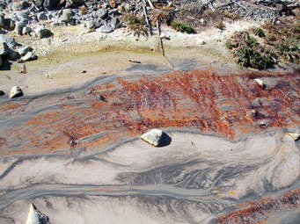
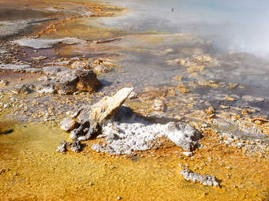
Thermal algae
Some algae withstand or tolerate a very high temperature and these are often called thermal algae. Such forms are known to grow up to 85°C, nearly boiling water. Majority of thermal algae belong to Myxophyceae, e.g., Synechococcus elongatus, Mastigocladus laminosus, Phormidium tennue, Conferva thermalis etc. A few forms belong to Chlorophyceae Zygnematales) and Bacillariophyceae. Thermal algae reproduce by means of cell division and fragmentation and very rarely by spores.

Slide 10
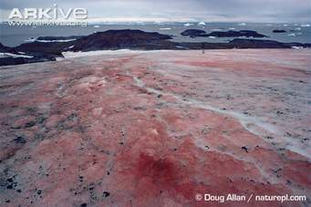
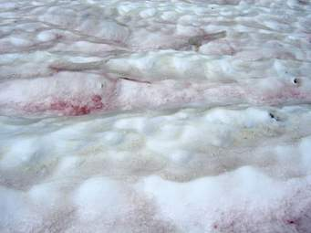
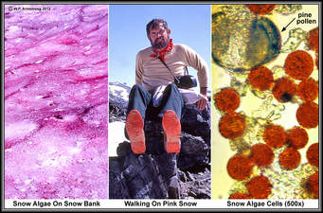
Soil algae
Such forms of algae that grow on or in soil are called soil or terrestrial algae or edaphophytes. Vaucheria, Botrydium, Zygnema, Oedogonium, Microcoleus, Nostoc, Oscillatoria etc. occur on soils.
Crypophytes
Certain algae are found growing on snow covered peaks of high mountains imparting attractive colours to snow. Common examples are—Haematococcus nivalis, Chlamydornonas yellowstonensis, Raphidonema, Cylindrocystis, Protoderma, Scotiella. Ancyclonema nordenskioldii imparts brownish to purple colour to snow.

Slide 11
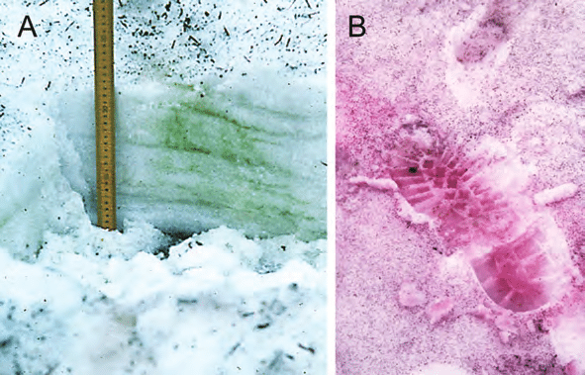

Slide 12
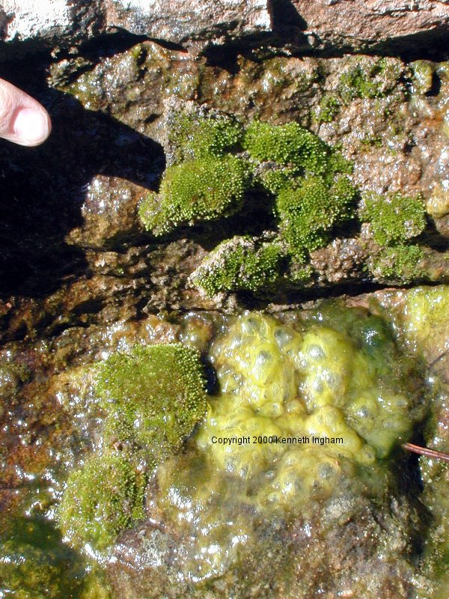
Lithophtes
The algae growing attached to stones and rocky surfaces are called lithophytes. These may be of two types:
(i) Epilithic. These include algae living on surface of rocks, e.g., Calothrix, Rivularia, Gloeocapsa, Pleurocapsa, Ectocarpus, Polysiphonia etc.
(ii) Endolithic. These include algae which live inside the rocks e.g., Dalmatella and Podocapsa.

Slide 13
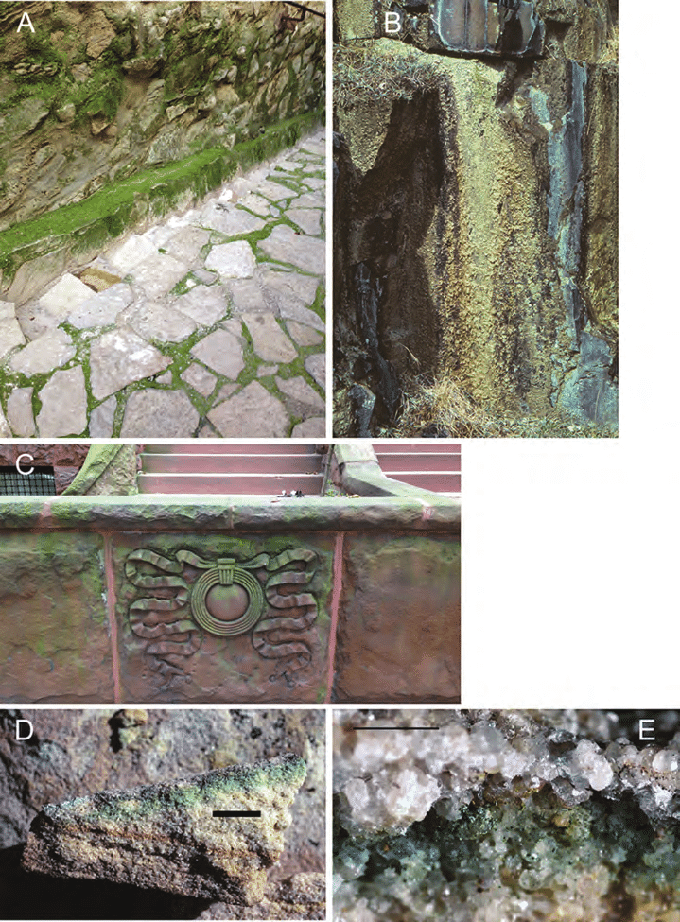

Slide 14
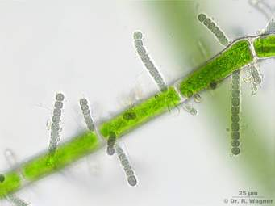
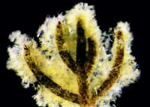
Epiphytic
Some algae grow attached on the other plants and are called epiphytes. Such algae do not obtain the food from the plants on which they grow rather require support only. Bulbochaete, Oedogonium, Ulothrix etc., grow on other larger algae, besides, Coleochaete in association with Chara and Nitella, Chaetophora on leaves of Vallisnaria and Nelumbo and Oedogonium on Hydrilla.
Fragillaria diatoms on aquatic plant surfaces
Halophytes
Certain algae inhabit in water with high percentage of salt, as Dunaliella and Stephanophora. However, Chlamydomonas ehrenbergii and Ulothrix flacca have also been reported to grow in salt water.

Slide 15
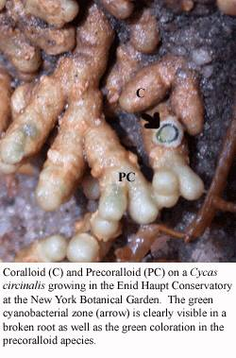
Symbionts
large number of algae live in association with dissimilar organisms for their mutual advantage and are called symbiotic algae. Nostoc in Anthoceros, Anabaena cycadae in the coralloid root of Cycas, Anabaena species in Azolla etc. However, lichens are the best examples of symbiosis where the association lies in between algae and fungi. Trebauxia, Calothrix, Chlorella, Gloeocapsa, Nostoc etc.
Cycad roots have a mutually beneficial relationship with blue green algae. The large taproot sends out secondary roots that resemble coral. These coralloid roots form nodules in which blue green algae grow. Cycad roots grow up out of the soil, and the blue green algae fixes nitrogen from the air. The cycad uses the nitrogen, and the blue green algae have a safe habitat.
.

Slide 16
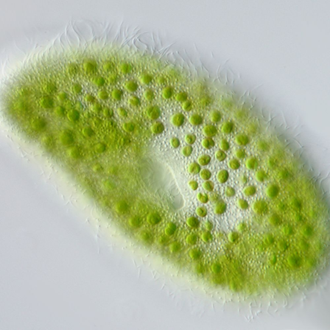
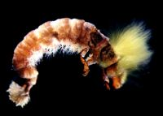
Endozoic algae
Endozoic algae inhabit the protoplasm of other organisms, e.g., Euglenomorpha, Zoochlorellae, Zooxanthellae, Carteria etc. Chlorella like algae are found living within Paramecium, Hydra and certain molluscs and sponges .Zooxanthellae live in intimate association with coral community.
Paramecium bursaria, relationship with algae
Parasitic algae
Some algae, for their food, are dependent on other plants and are termed as parasitic forms. The common intercellular parasite Cephaleuros (Chlorophyceae) grows on the leaves of angiosperms like Magnolia, Rhododendron. Some blue green algae Oscillatoria and Simonosiella are found as parasite on man and in the intestines of animals.

Slide 18
Factors affecting Algal Ecology
During photosynthesis, using only light and nutrients, algae produce lipids, proteins, and carbohydrates. The relative amounts of these metabolic products are tightly linked to environmental and nutrient conditions including: the amount and intensity of sunlight; CO2 levels; pH; temperature; available nutrients; and, the presence (or absence) of other organisms. Carbon, hydrogen, and oxygen are required non-mineral nutrients for algal growth

Slide 19
Macronutrients include nitrogen, phosphorus, sulfur, potassium and magnesium. Micronutrients such as iron and manganese are also required in small amounts (30–2.5 ppm) while other elements such as cobalt, zinc, boron, copper and molybdenum are essential trace elements (4.5–2.5 ppm).
Collectively, environmental conditions (especially light and temperature) and the availability of non-mineral nutrients, macronutrients, and micronutrients, greatly influence the biochemical composition of microalgae . Other factors such as pH and the present toxic metals are also important factors impacting algal growth and metabolism.

Slide 20
Temperature
Temperature is perhaps one of the most important environmental factors that influences algal growth rate, cell size, biochemical composition and nutrient requirements. More of algae grow under a broad range of temperatures (from 15 to 40 °C), depending upon strain, region, and season.
Below optimal growth temperatures, growth rate (μ) increases with increasing temperature but But growth decreases when the temperature declines depended on species . algae Growth result in minimal cell size and the efficiency of carbon and nitrogen utilization decreases at non-optimal temperatures . It has been suggested that changes in cytoplasmic viscosity under sub-optimal temperature conditions is responsible for less efficient carbon and nitrogen utilization .

Slide 21
Temperature may also play a key role in photoinhibition, which is known to impact algal growth rate. Several mechanisms of temperature-dependent photoinhibition have been postulated. These include mechanisms under which:
(i) low temperature results slower rate of CO2 fixation
(ii) low temperature inhibits the active oxygen, which results in reducing photoinhibition by protecting PSII
(iii) low temperature inhibits the synthesis of the D1 protein degraded during photoinhibition, consequently impeding the PSII repair cycle.

Slide 22
One of the most commonly observed changes with temperature shift is the alteration in the level of unsaturation of fatty acids in the lipid membrane
Dunaliella salina that increase in fatty acid unsaturation in response to decrease in temperature from 30 to 12 °C . Lower temperatures decrease the fluidity in the cell membrane. Cells then compensate by increasing levels of unsaturated fatty acids to increase fluidity.
Along with greater fluidity, increased levels of unsaturated fatty acids tend to enhance the stability of the cellular membranes (particularly the thylakoid membrane). This, in turn, protects the photosynthetic machinery from photoinhibition at low temperatures .

Slide 23
Also showed that Botryococcus braunii, a green alga that secretes extracellular lipids, differences in lipid composition were observed at three different growth temperatures (18 °C, 25 °C, and 32 °C). Intracellular lipid synthesis was found to be inhibited at supra-optimal temperature (32 °C); consequently, lipid content decreased to 5% dry weight at 32 °C in comparison with 22% at 25 °C. The decrease in lipid content led to an accumulation of polysaccharides.
Increasing temperature led to reduces protein synthesis and consequently results in decreased growth rates . Also showed the growth of alga, Phaeodactylum tricornutum, a marine diatom, and reported a considerable increase in protein synthesis rates at night with lower the temperatures.
An increase in temperature from 20 to 30 °C in cultures of Ulva pertusa resulted in higher intercellular free amino acid concentrations from approximately 840 to 1810 mg/100 g dry weight .An increase in free amino acid concentration is an indicator of lower protein content.

Slide 24
Temperature is also impact starch content in the algal cell. Starches are synthesized by phosphorylated metabolites in the dark reactions of the photosynthesis cycle using energy-rich phosphate bonds (i.e., ATP) formed in the light reactions . Increased temperature leads to degradation of the starch produced . Enzymes that have been suggested to play a critical role in the temperature dependent degradation of starch are α-amylase and α-glucan phosphorylase .
Temperature has a significant effect on the formation of carotenoids. Carotenoids absorb light energy for use in photosynthesis. They also protect chlorophyll from photodamage . Furthermore, they play a vital role in the photosynthetic reaction center by either participating in the energy-transfer process or protecting the reaction center from auto-oxidation. Carotenoid accumulation in algal species increases with temperature because of the increased oxidative and photodamaging effects noted at elevated temperatures

Slide 25
Also showed the a three-fold increase in astaxanthin formation in the green alga Haematococcus pluvialis with an increase in cultivation temperature from 20 to 30 °C.
also showed the green alga, Chlorococcum sp., in which a two fold increase in total carotenoid content was observed by raising the temperature from 20 to 35 °C under conditions of nitrogen deprivation . Increase in carotenoid formation with increasing temperature is generally attributed to cellular response to enhanced active free oxygen radical formation or increased biosynthetic enzyme activity .

