Slide 1
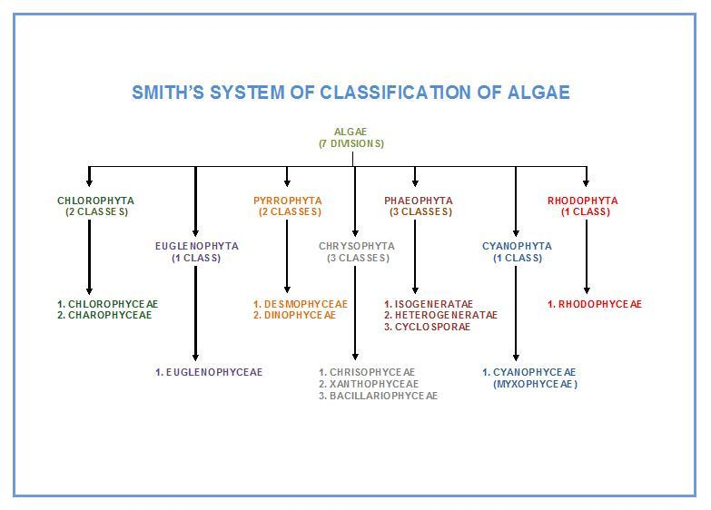

Slide 2
phylum:Cyanobacteria or Cyanophyta (Blue green algae)
Called blue-green bacteria( Cyanobacteria) because there are similarities between Cyanobacteria and bacteria, including:
Prokaryotic nucleus
Covered by mucilage sheath
Absent sexual reproduction
Bacteria are unicellular forms and some cyanobacteria are unicellular forms.
Motile spores are not seen in both groups .
The principal Characteristics of the Cyanophyta
1-there are unicellular ,colonial , filamentous and simple paranchymatous form .
2- Flagellate cells never at any stage in the life cycle .
3- lack a nucleus and organelles (chloroplast, mitochondria)
4-The DNA lie bundled up in the center of the protoplasm .
5-cell wall consists of peptidoglycan , the cell are often embedded in sheaths of mucilage .

Slide 3
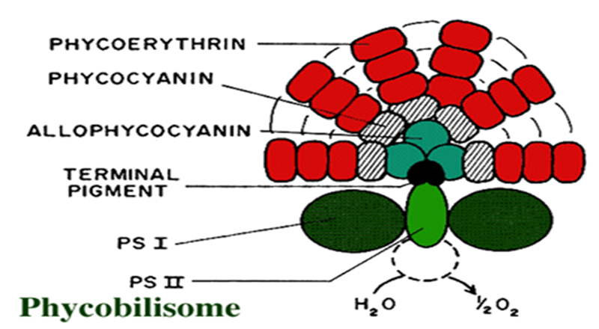
6-The photosynthetic pigments are located in thylakoids , which lie free in the cytoplasm . Each outer facing into the cytosol of each thylakoid is studded with particles called phycobilisomes , which consist of Chlorophyll a and accessory pigments, called phycobiliproteins , such as phycoerythrin (red) , phycocyanin and allophycocyanin . The accessory pigments protect the chlorophyll from damaging UV light and also trap photons and funnel them to the chlorophyll, acting as antennae.

Slide 4
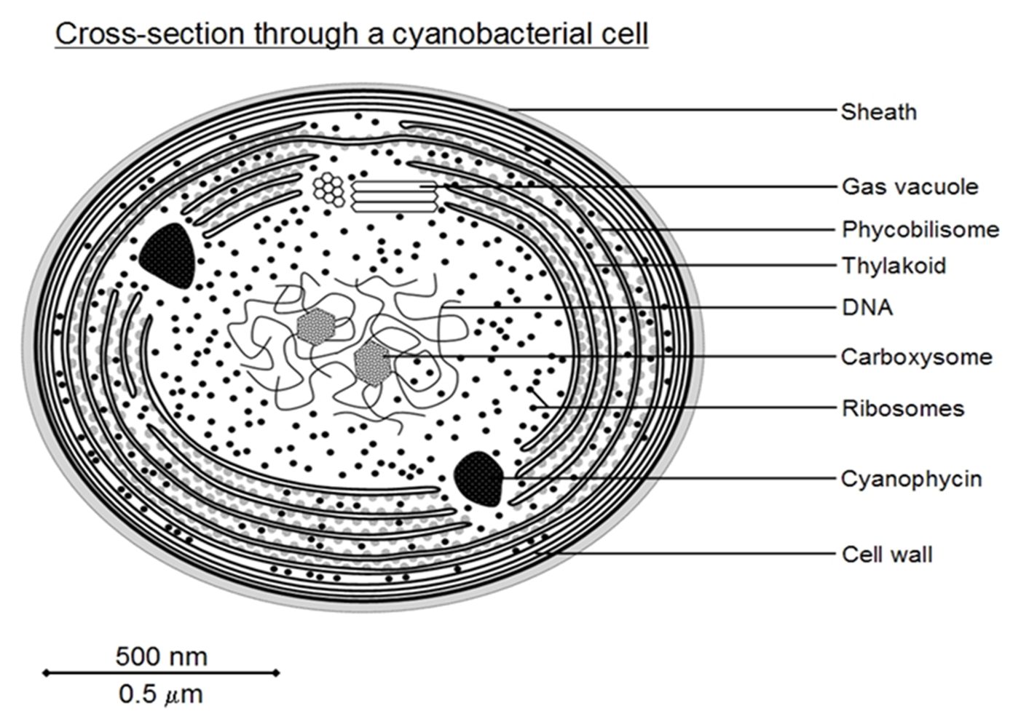
7-Reproduce asexually ,sexual reproduction is absent.
8-Reserve food is Cyanophycin.
9- Gas vacuoles are often present in aquatic forms. These act to
regulate buoyancy.

Slide 5
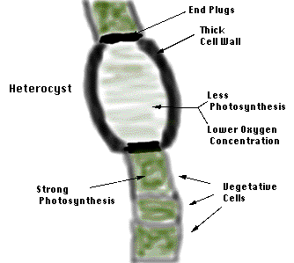
Heterocysts and nitrogen fixation
Heterocysts: specialized cells containing nitrogenase enzyme able to convert gaseous nitrogen (N₂) to ammonium (NH₄+)
- They are mostly found along the filaments of some algae such as Nostocales and Stigonematales.
- Heterocysts : thick cell wall, low oxygen concentration, photosystem II (light reaction) inactive but photosystem I active to provide ATP; and absent of granular reserve materials and gas vacuoles, connected to vegetative cells by cell wall pores

Slide 6
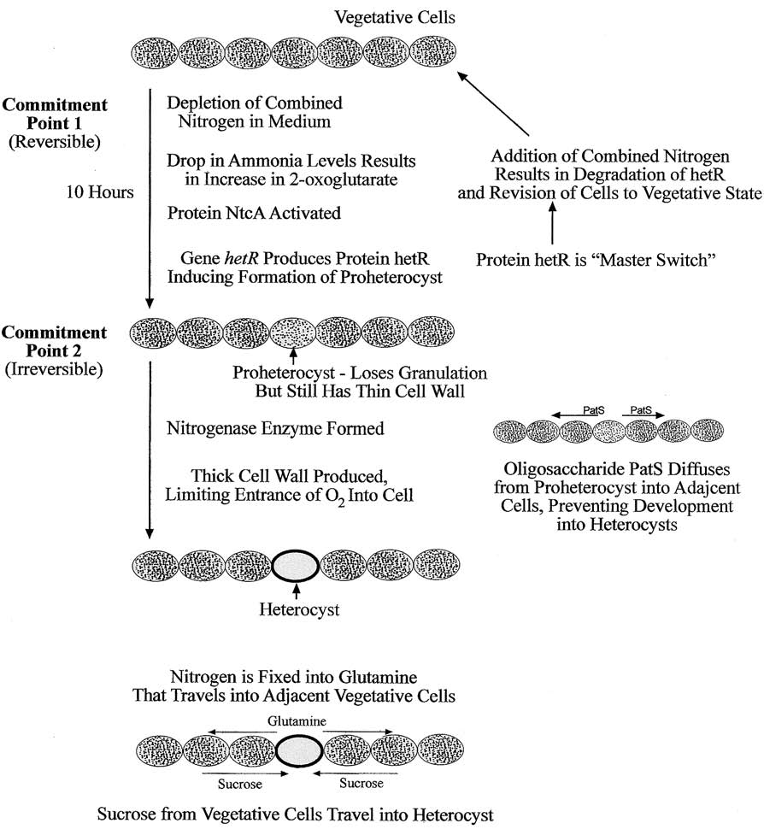
Summation of events leading to the formation of
heterocysts.

Slide 7
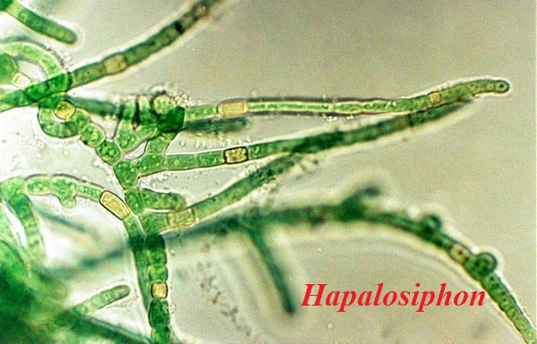
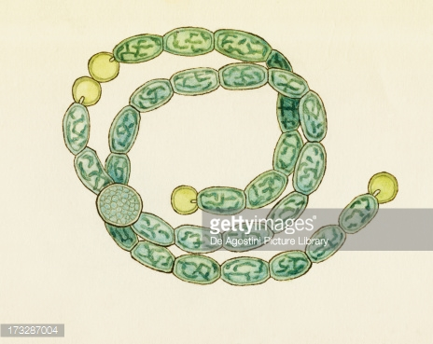
Shape of Heterocysts
1- They are identical to the vegetative cells.
2- They are also round Nostoc, anabena , Rivularia
3- Some time rectangular in Scytonema.

Slide 8
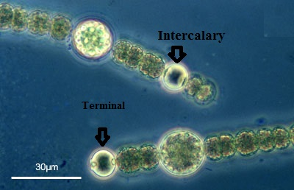
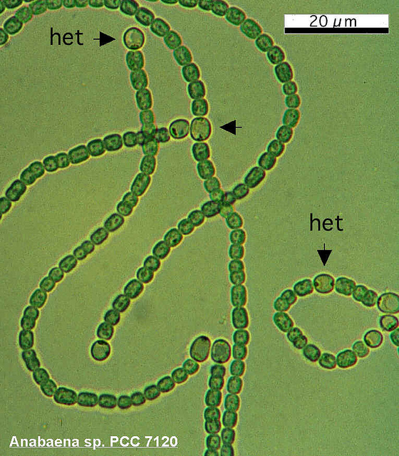
Position of Heterocysts in the trichomes :
The Heterocysts usually occur singly.
1- Terminal in position ( Gloeotricia).
2- Intercalary in position( Nostoc).
3- Lateral in position (Nostochopsis).
4- In some genera they occur in pairs( Anabaenopsis ).

Slide 10
Reproduction
They are tow type for reproduction :
1-Vegetative reproduction
a-Binary fission (order Chroococcales)
b-Fragmentation
c- Hormogonia
Hermogonia :a multicellular fragment of a filament, which serves in vegetative reproduction and often performs active gliding movements
Hormogonia (or hormogones), which are characteristic of all truly filamentous cyanobacteria, are short pieces of trichome that become detached from the parent filament and move away by gliding, eventually developing into a separate filament(many Nostocales.).

Slide 12
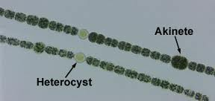
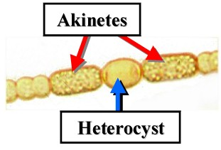
2-Asexual reproduction
a-Akinetes : are large thick walled cells , full large amount of cyanophycin , which enable the algae to survive periods when environmental conditions are not favorable to growth (drought ,cold, nutrient deficiency etc...) they develop from vegetative cells.
b-Endospores: spores that form following division of the protoplast , enclosed within the parent cell wall.
c-Exospores: spores produced by budding
d-Nannocysts; cells may divide into many parts without any change in shape., e.g., Microcystis.
..

Slide 13
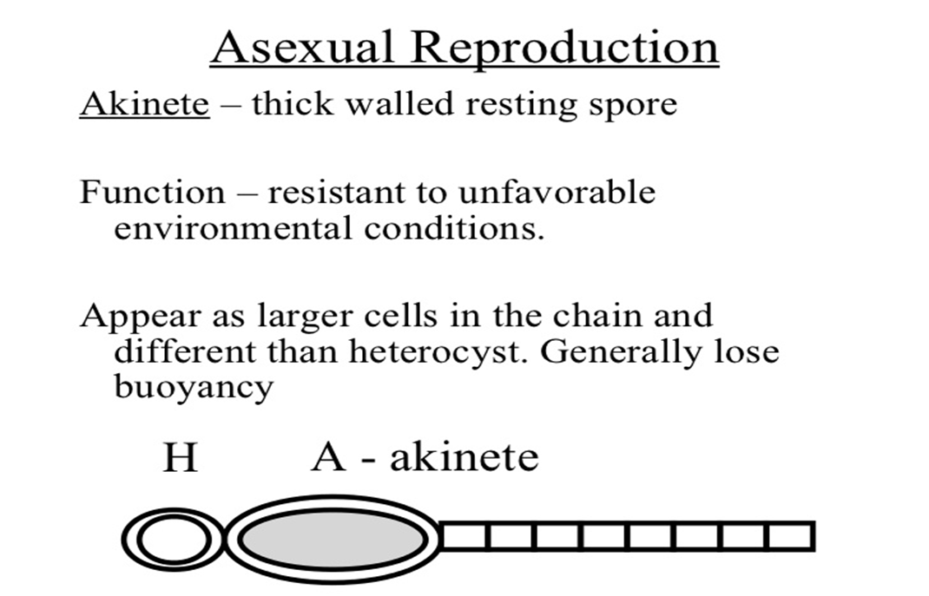

Slide 14
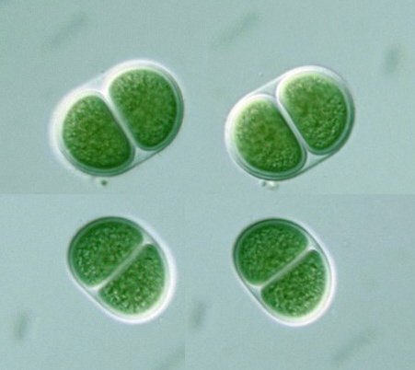
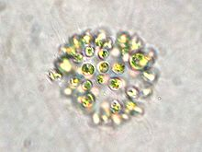
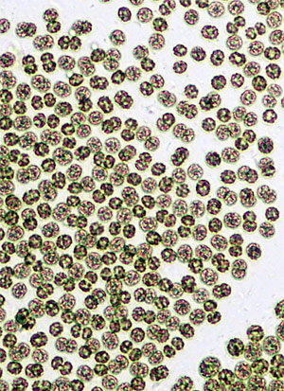
Taxonomic diversity
Freshwater cyanophyta can be divided into four main groups in relation to general morphology :
1- Chroococcales
- solitary cells (no filaments form ).
-enclosed by a thin layer of mucilage .
the cells may remain as single cells or be aggregated into plate like or globular colonies. .ex: Chroococcus , Gloeocapsa , microcytis-

Slide 15
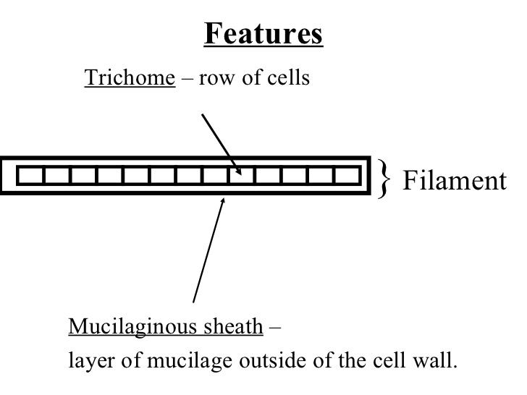
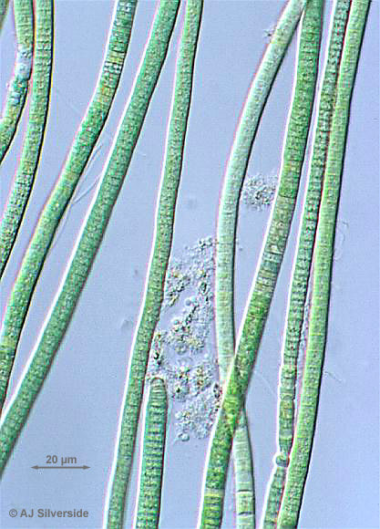
2- Oscillatoriales
single filamentous forms consisting of a trichome . is a chain of vegetative cells; a cyanobacterial trichome is often surrounded by a slimy sheath.
lacking heterocysts and akinetes .
these relatively simple algae occur as planktonic or benthic aggregations.
In some cases they form dense mats on mud or rocky substrata. Ex ; Oscilatoria sp.

Slide 16
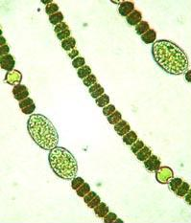
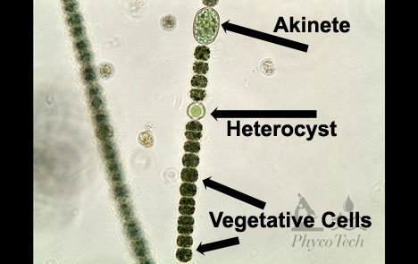
trichome: a row of cells without the sheath in the cyanobacteria.
filament: one or more trichomes enclosed in a sheath.
3-Nostocales
-filamentous algae . planktonic or benthic.
uniseriate trichomes, with akinetes or heterocysts unbranched or false-braching .ex. Anabaena sp.
. Anabaena sp.

Slide 17
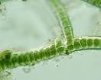
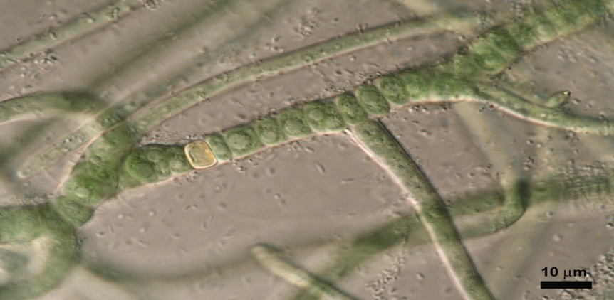
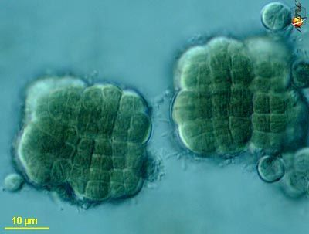
4-Stigonematales;
- Uni or multiseriate trichomes,
with akinetes and heterocysts, True branching
- such stigonema
stigonema
5-Pleurocapsales: coccoidal cells (clusters of cells) via 3-dimensional divisions.

Slide 18
1-Order Chroococcales
Unicells, as individual cells or colonies. Spores may occur, never akinetes or heterocysts
2. Order Oscillatoriales
Uniseriate trichomes, never akinetes and heterocysts. Unbranched or false-braching
Uniseriate trichomes, with akinetes or heterocysts unbranched or false-braching
3. Order Nostocales
Uni- or multiseriate trichomes, with akinetes and heterocysts. True branching
4. Order Stigonematales

Slide 19
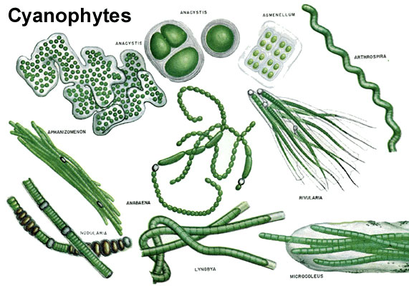

Slide 20
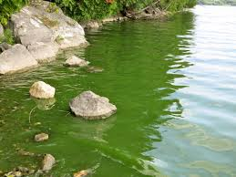
Blue-green algae as bio-indicators
The presence or absence of particular species can be a useful indicator of ecological statue .the dominant presence of colonial blue-green forming dense summer blooms .has been useful as an indicator of high nutrient status .

Slide 21
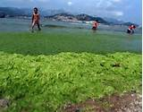
Algae blooms An algal bloom is a rapid increase in the density of algae in an aquatic system. Algal blooms sometimes are natural phenomena, but their frequency, duration and intensity are increased by nutrient pollution.
Why The ability of blue greens to out compete other fresh water algae has been attributed to arrange of characteristics including;
Optimum growth at high temperatures
Low light tolerance
Tolerance of low N/P ratios
Depth regulation by buoyancy
Resistance to zooplankton grazing
Tolerance of high pH and low co2 concentration
Symbiotic association with aerobic bacteria

Slide 22
Eutrophication: is a major problem that is associated with algal blooms in lakes. A direct result of human interference, eutrophication is caused by the addition of excess nutrients (runoffs of phosphate and nitrate from chemical fertilizers and sewage disposal) to the water that encourage algae to grow abundantly. As the algae die and sink to the bottom, most of the water's oxygen is consumed in breaking down the decaying plant matter. Fish and other animals that require large amounts of oxygen can no longer survive and are replaced by organisms with lower oxygen demands.

Slide 23
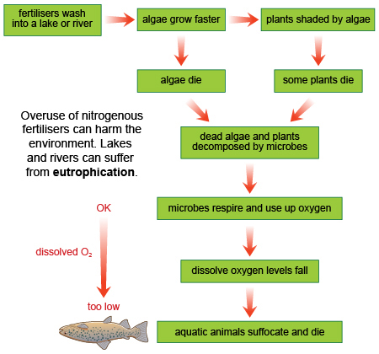
.

Slide 24
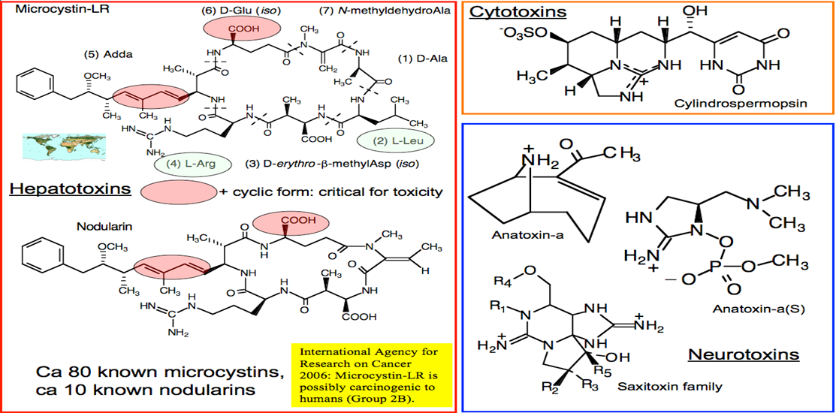
Cyanotoxins
Some of the cyanobacteria produce toxins (cyanotoxins).
there are two types of cyanotoxins: Neurotoxins and Hepatotoxins
Neurotoxins – (toxins that affect the nervous system) which can cause lethargy, muscle pain , confusion, memory impairment, and at high concentrations leading to death.
The neurotoxins are alkaloids(nitrogen-containing compounds of low molecular weight)The two neurotoxins produced by cyanobacteria are anatoxin and saxitoxin
Excreted by : anabaena , aphanizomenon , oscillatoria ,…

Slide 26
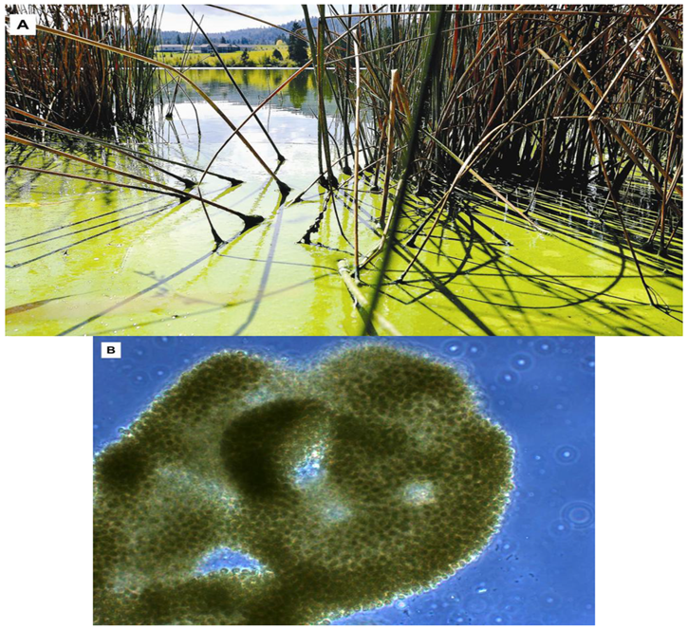
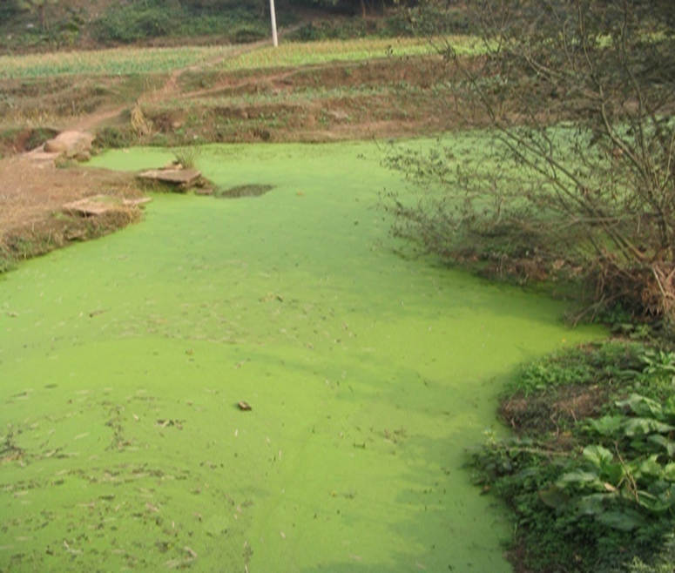
Hepatotoxins – (toxins that affect the liver). The heptatotoxins are inhibitors of protein phosphatases. which can cause weakness, vomiting, diarrhea, and cold extremities.
The two neurotoxins produced by cyanobacteria are
Microcystins and Nodularins
Microcystis(Excreted by :Anabaena , Nostoc, Oscillatoria) Nodularins (Excreted by : Nodularia).

