Slide 1
Lecture 10 for molecular biology by Dr. Sawsan Saijd
      1-Post replication events
      2- DNA repair and proofreading activity
      While DNA replication errors are rare, they must be corrected by various DNA repair pathways.

Slide 2
Post replication events : DNA methylation
DNA methylation: is a biochemical process involving the addition of a methyl group (CH3) to the cytosine or adenine DNA nucleotides. The main function of DNA methylation in bacteria is to provide a mechanism, which protects the cell from the effect of foreign DNA introduction. Restriction endonucleases differentiated between endogenous and foreign DNA by its methylation pattern. The extensive research on methylation was conducted on bacteria. both adenine and cytosine can be methylated, and this modification is involved in DNA replication and arrangement . These specific nucleases, however, would not cleave at these specific Palindromic sequences if the DNA was methylated

Slide 3
    DNA methylation is observed in most of the organisms at the different stages of evolution, in such a distinct species as E.coli and Homo sapiens. However some species, like Drosophilae melanogaster lack DNA methylation. transfer of the methyl group from S-adenosyl methionin to 5 position of the pyrimidine ring of cytosine. A series of DNA methyltransferases (DNA-MTases) which can catalyse cytosine methylation in different sequence context were identified

Slide 4
Function of DNA methylation in prokaryotes
1- The main function of DNA methylation in bacteria is to provide a mechanism, which protects the cell from the effect of foreign DNA introduction .Restriction endonucleases between endogenous differentiated and foreign DNA by its methylation pattern. Introduced DNA which is not protected by methylation is then eliminated by cleavage .
2-Another function of DNA methylation in prokaryotes is the involvement in the control of replication fidelity دقة العمل . During DNA replication the newly synthesized strand does not get methylated immediately, but analyzed for mismatches by the mismatch repair system. When a mutation is found the correction takes place on the non methylated strand . Methylation of Adenine nucleotide is most predominant in prokaryotic cell .The restriction/modification system in bacteria is a small-scale immune system for protection from infection by foreign DNA

Slide 5
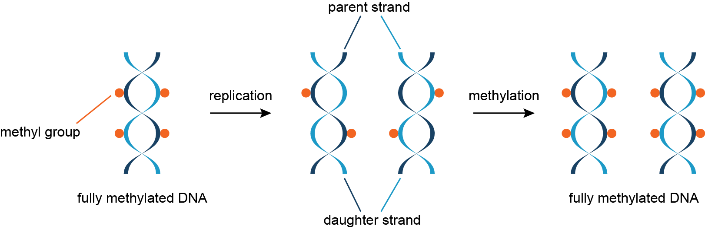
The newly synthesized complementary strand must be methylated as the parent strand.

Slide 6
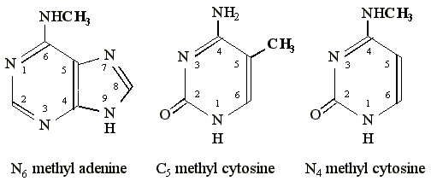
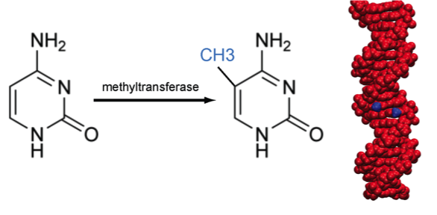
The methylation occur at specific site at specific DNA sequences (5 c position in cytosine and N6 nitrogen position in adenine ) .the responsible enzyme is Methytransferase .

Slide 7
In the bacteria(E.coli )the sequence GAATTC(palindrom: read the same sequence from the two direction ) will be methylated at the internal adenine base by the EcoR1 methylase. The EcoR1 endonuclease within the same bacteria will not cleave the methylated DNA. Foreign viral DNA, which is not methylated at the sequence "GAATTC" will therefore be recognized as "foreign" DNA and will be cleaved by the EcoR1 endonuclease.Cleavage of the viral DNA renders it non-functional.Such endonucleases are referred to as "restriction endonucleases" because they restrict the DNA within the Cell to being "self“. so specific nucleases would not cleave at these specific palindromic sequences after methylation thus, this combination of a specific methylase and endonuclease function as a type of immune system for individual bacterial strains, protecting them from infection by foreign DNA (e.g. viruses) . The combination of restriction endonuclease and methylase is termed the
(restriction-modification )

Slide 8
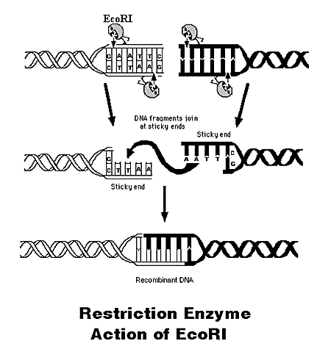
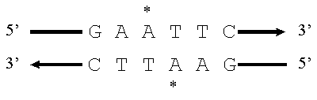

Slide 9
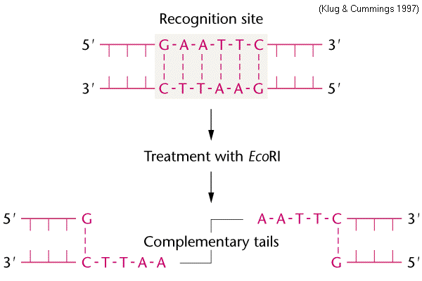

Slide 10
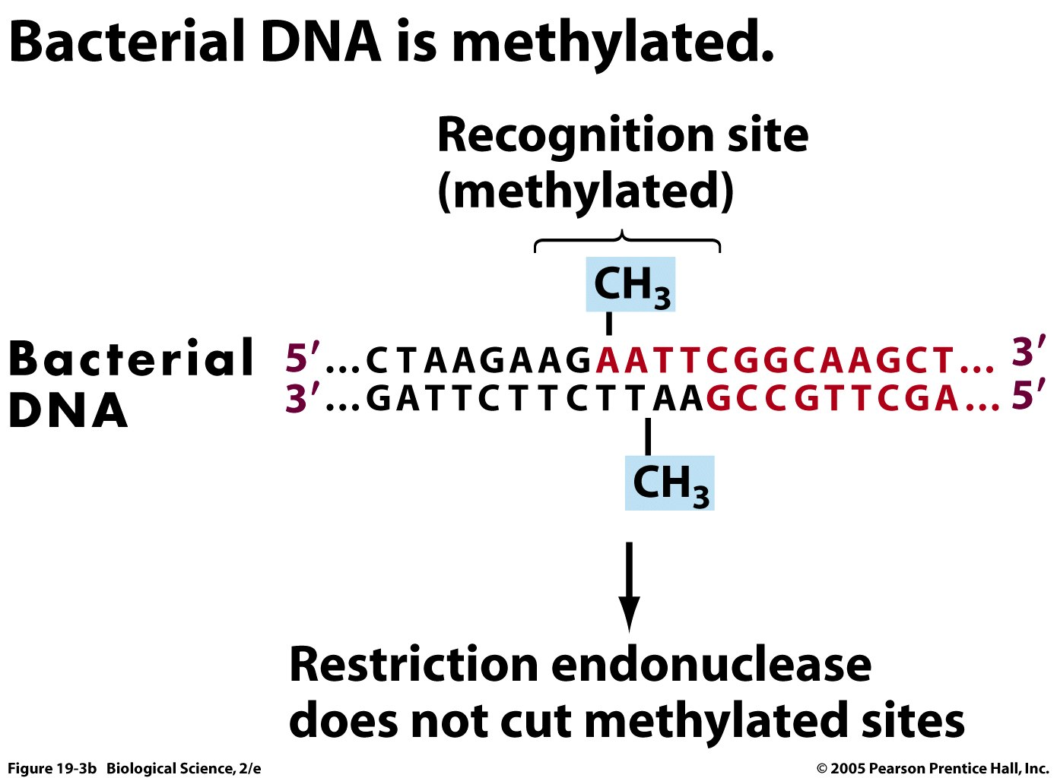

Slide 11
E. coli DNA adenine methyltransferase(Dam) is an enzyme of ~32 kDa(not belong to restriction \modification system) . The target recognition sequence for E. coli Dam is GATC( not GAATTC) as the methylation occurs at the N6 position of the adenine in this sequence (G meATC). The three base pairs flankingتحيط الجانبين each side also influence with DNA–Dam binding. Dam plays several key roles in bacterial processes, including mismatch repair, the timing of DNA replication, and gene expression.

Slide 12
Eukaryotic DNA methylation affects only cytosine residues and specific for CpG sequence. However, the protective function of DNA methylation is similar in eukaryotes and prokaryotes. In humans and rodents inserted viral sequences can become methylated in association with silencing of the introduced genes . Thus function of DNA methylation machinery for recognition and/or eliminating of foreign DNA seem to be conserved in evolution. DNA methylation at the 5 position of cytosine has the specific effect of reducing gene expression and has been found in every examined vertebrates . In adult somatic cells (cells in the body, not used for reproduction), DNA methylation typically occurs in a CpG dinucleotide context; Between 60% and 90% of all CpGs are methylated in mammals

Slide 13
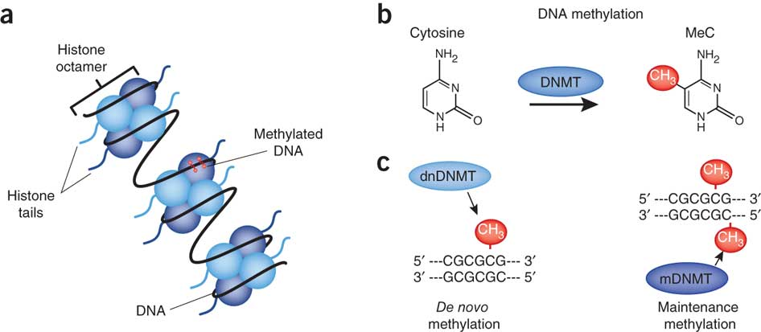
Two ways for methylation in Eukaryotic cell , De novo methylation and maintenance methylation

Slide 14
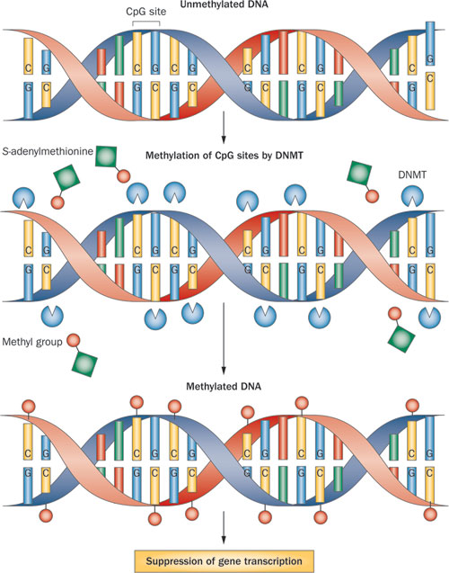

Slide 15

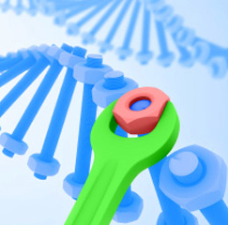

Slide 16
DNA replication is not error-proof; replicated DNA molecules have an error rate of one nucleotide for every 10 billion (1010) nucleotides added.
During replication, a polymerase can excise يزيل an incorrect base via its exonuclease activityبفاعليته المحللة and then continue the process of replication. Replicated DNA molecules have an error rate of one nucleotide for every 10 billion (10¹⁰) nucleotides added. However, the initial addition of nucleotides by DNA polymerase has an error rate of one per 10⁵ (100,000) nucleotides added.عادة احتمالية الخطأ تزداد في بداية التضاعف
Proof reading occurs during DNA replication because some DNA polymerases have 3'->5' exonuclease activity that allows an incorrect base to be excised. In bacteria, all three DNA polymerases (I, II, and III) have the ability to proofread, using 3'->5' exonuclease activity. In eukaryotes only the polymerases that deal with the elongation (γ, δ, and ε) have the proofreading ability (3'->5' exonuclease activity).

Slide 17
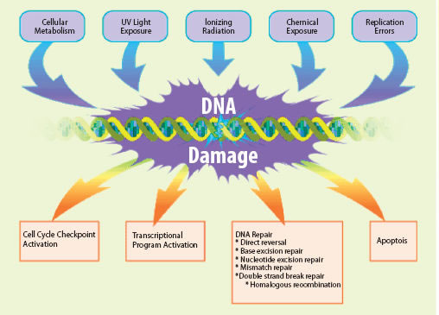

Slide 18
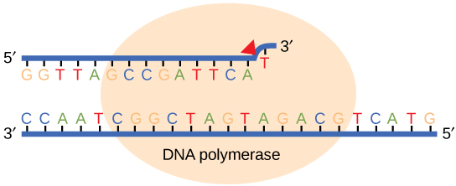
1
1-In the Base Excision Repair Pathway ( BER) a single lesion in the DNA molecule is recognized by a glycosylase specific to that lesion. The incorrect base is flipped out of the DNA strand, cleaved, and the DNA polymerase then repairs the strand either with a single base (short-patch) or several bases the damages either caused by chemical factors such as hydrolysis,methylation,and,..oxidation.

Slide 19
2- Nucleotide Excision Repair Pathway(NER) is another mechanism by which the cell can prevent unwanted mutations and recognize bulky distortions in the shape of the DNA double helix. It involves removing the damaged DNA by an enzyme called a nuclease and filling of the gap by DNA pol and ligase ---- the steps
1-UV light causes thymine dimers that bend the DNA and need to be fixed. (2.) the damaged section is cut and removed by an enzyme called nuclease (3-) The gap is filled with the corrected nucleotides by DNA polymerase (4- ) The newly filled gap is sealed with the rest of the strand by DNA ligasenucleotide excision repair : DNA repair mechanism that corrects damage done by UV radiation, including thymine dimers and 6,4 photoproducts that cause bulky distortions in the DNA

Slide 20
3-mismatch repair : a system for recognizing and repairing some forms of DNA damage and erroneous insertion, deletion, or mis incorporation of bases that can arise during DNA replication and recombination
Occasionally mismatched nucleotides are not caught by proofreading and require a process called mismatch repair to remove and replace the incorrectly inserted nucleotide. DNA mismatch repair can recognize and repair insertions, deletions, and substitutions that may arise during replication.

Slide 21
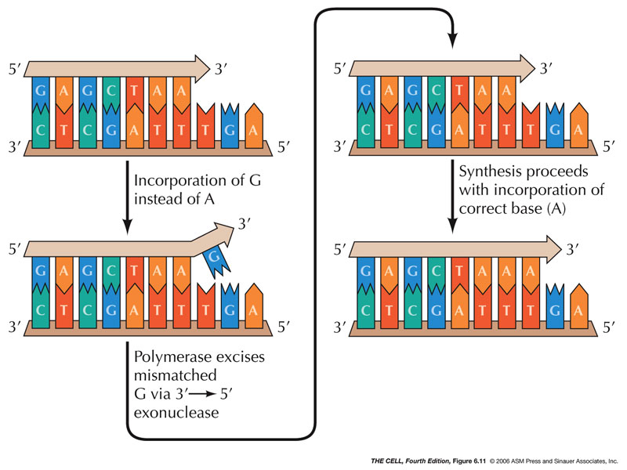

Slide 22
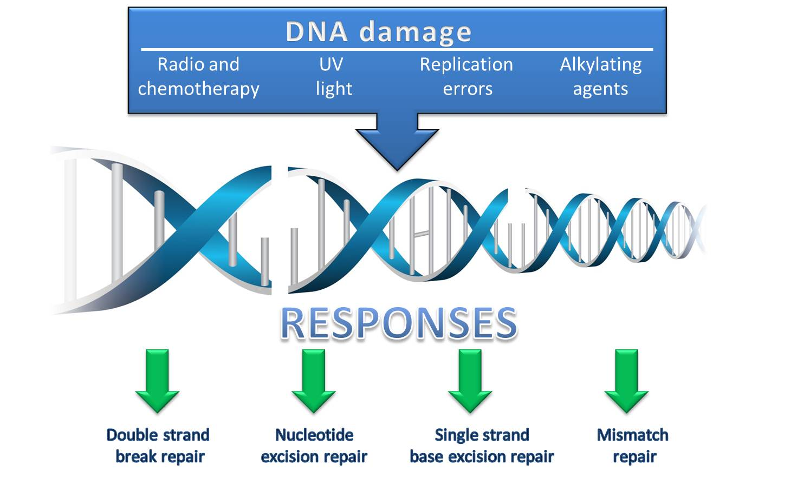

Slide 23
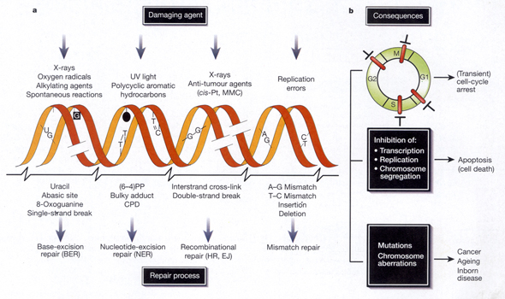
Several method have been proposed for repairing DNA damages and they depend on the causative agent

Slide 24
