Slide 1
The 11th lecture in MOLECULAR BIOLOGY

Slide 2
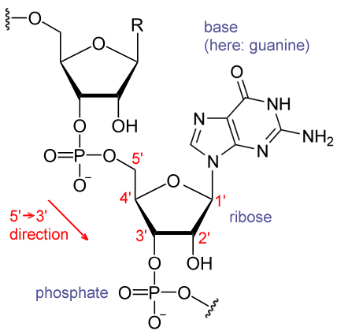
RNA molecules represent the second macromolecules in the cell, and they present in cytoplasm. RNA represents the genetic material for some viruses like HIV, polioviruses, and influenza virus
RNA contains:
Ribose sugar.
Nitrogen base is attached to the 1' position of sugar, these bases are adenine (A) and guanine (G) as purines, as well cytosine (C) and uracil (U) as pyrimidines.
Phosphate group is attached to the 3' position of one ribose and the 5' position of the next.

Slide 3
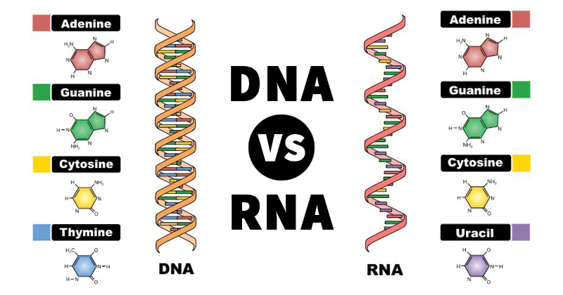

Slide 4
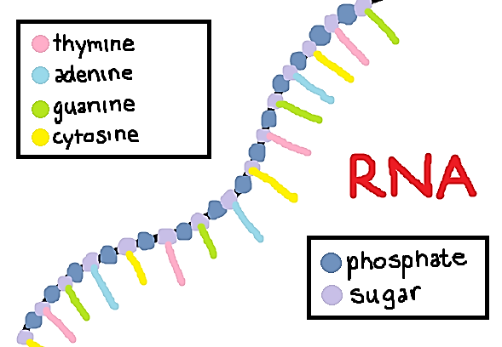

Slide 5
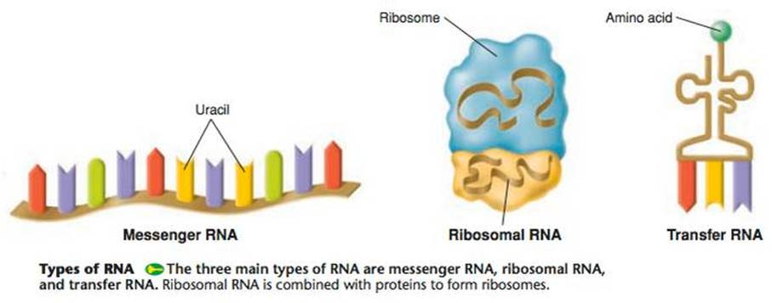
rRNA: Stable RNA. It represent 85% of total RNA. It is the main component of ribosome with polypeptide protein.
Types of RNA...
tRNA: Stable RNA. It represent 10% of the total RNA.
There are three types of RNA which are synthesized via transcription process, which may be stable and unstable.
mRNA: not stable type. It represent 5% of total RNA.

Slide 6
mRNA
Messenger RNA carries information from DNA to the ribosome, which represents the sites of protein synthesis in the cell. The coding sequence of the mRNA determines the amino acid sequence in the protein.
mRNA represents a large family of RNA that convey genetic information from DNA to the ribosome.
As in DNA, mRNA genetic information is in the sequence of nucleotides (A, G, C, and U), which are arranged into codons consisting of three base pairs each. Each codon encodes for a specific amino acid.

Slide 7
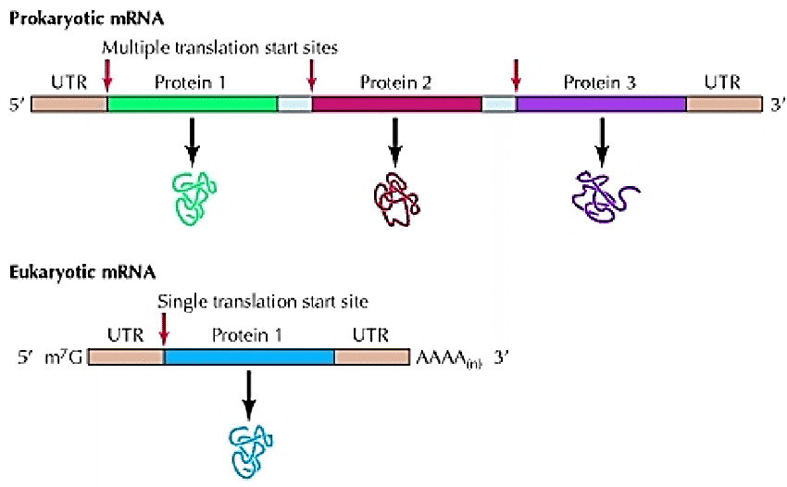
Differences in mRNA structure in prokaryotic and Eukaryotic
1) The mRNAs of many bacteria and bacteriophage are polycistronic. A polycistronic mRNA sharing several structural genes of an operon with one operator and one terminator. It contains several sites for initiating and terminating for more than a polypeptide product. On the other hand all known eukaryotes have only one site for initiation one protein synthesis, and their mRNA called monocistronic.
Note: there is a cap structure in 5 end (Eukaryotic )and poly A at 3 end this will protect m RNA from degradation at lest few days

Slide 8
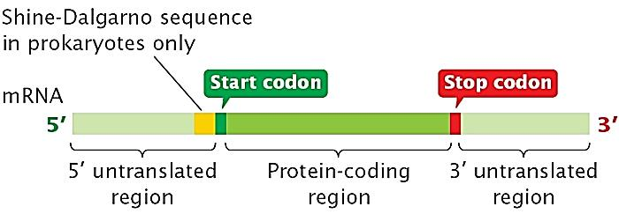
2- mRNA in prokaryotic cell start (5́ end) with leader sequence (upstream region) contain the ribosomal binding proteins called (Shine –Dalgarno sequence) which has a complementary sequence in 16s rRNA (anti shine –Dalgarno sequence) followed by start codon AUG (in the down stream region ( then the coding region then stop codon and the terminate region at 3́ end , in Eukaryotic cell there will be CAP structure at 5́ end then the leader sequence (untranslated region ) followed by start codon then the coding region and then poly A tail (250-300 Adenine residue ) at 3́ end
Prokaryotic
Eukaryotic

Slide 9
The Shine-Dalgarno sequence (SD) is a ribosomal binding site in prokaryotic mRNA, generally located around 8 bases upstream of the start codon AUG. The Shine-Dalgarno sequence exists both in bacteria and archaea, being also present in some chloroplast and mitochondrial transcripts.
The six-base consensus sequence is AGGAGG; in E. coli, for example, the sequence is AGGAGGU.
Shine-Dalgarno sequence helps recruit the ribosome to the mRNA to initiate protein synthesis by aligning it with the start codon.
For the mRNA in Eukaryotic cell it start with cap structure at 5 end then the leader sequence (untranslated region ) followed by start codon then the coding region , at the 3 end there is the poly A tail (250-300 Adenine residue )

Slide 10
(3) In most bacterial mRNAs translation begins while the mRNA is still being transcribed on DNA. In eukaryotes the mRNA transcribed on the chromosomes passes through the nuclear pores into the cytoplasm. Thus translation usually begins only after transcription is completed.
(5) In prokaryotes the mRNAs undergo very little processing after being transcribed. There is a very short time interval between transcription and translation. In fact considerable translation may already take place before completion of transcription. In eukaryotes the transcribed mRNA undergoes considerable processing before mature mRNA is formed.

Slide 11
4) Prokaryote mRNA is very short lived. It is constantly under going breakdown to its constituent ribonucleotides by ribonucleases. In E. coli the average half life of some mRNAs is about two minutes. In bacteria mRNA may be so short lived that while one end is translating proteins the other end may be undergoing breakdown, while in eukaryote, mRNAs have longer half lives than bacterial mRNA. So eukaryote mRNAs are metabolically stable.
Note: The short life of bacterial mRNAs has been explained on the grounds that it provides greater flexibility to the bacteria by adjusting to changing environmental conditions. The short life of its mRNAs enables a bacterium to synthesize different enzymes in response to environmental changes.

Slide 12
In molecular genetics, an untranslated region (UTR) refers to either of two sections, one on each side of a coding sequence on a strand of mRNA. If it is found on the 5' side, it is called the 5' UTR (or leader sequence), or if it is found on the 3' side, it is called the 3' UTR (or tailer sequence).

Slide 13
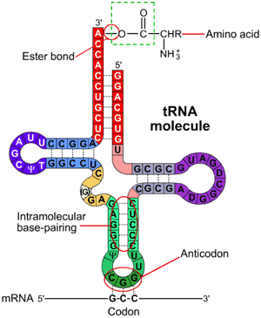
tRNA
Transfer RNA is a small RNA chain of about 80 nucleotides that transfers a specific amino acid to a growing polypeptide chain at the ribosomal site of protein synthesis during translation.
It serves as the physical link between the mRNA and the amino acid sequence of proteins. tRNA does this by carrying an amino acid to the ribosome as directed by a codon (3-nucleotide sequence) in a mRNA.

Slide 14
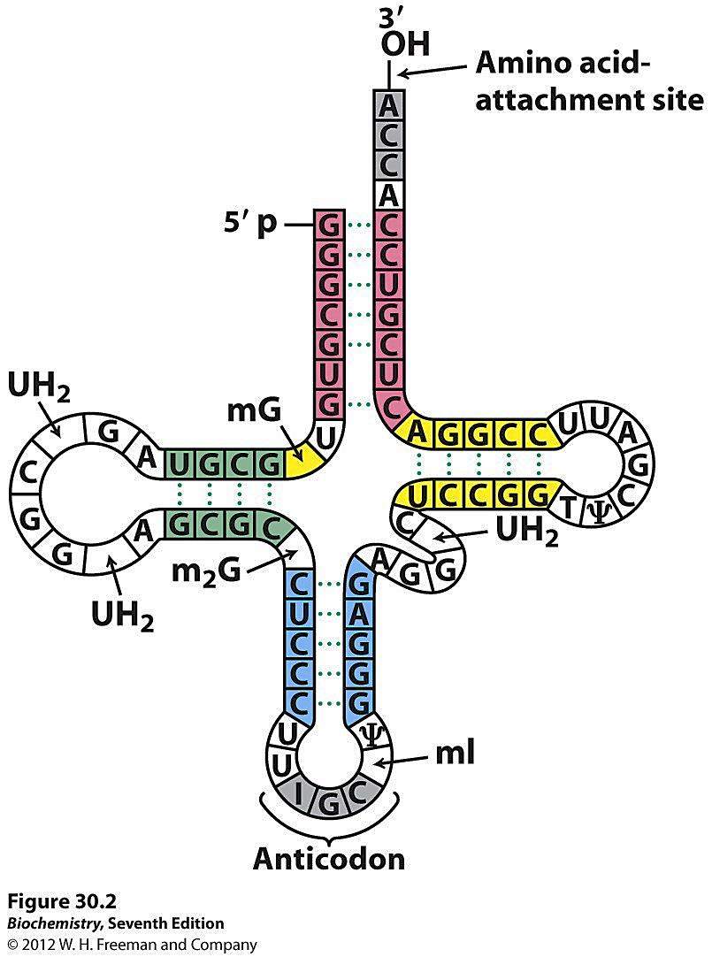
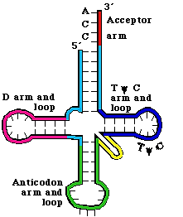
tRNA contain three loops (T loop, D loop, and anticodon loop) as well as three arms, on arm of each loop. some of unusual nitrogen base (modified base), like Pseudouridine (Ψ) and Ribothymidine (T) which are found in (TΨC loop) T loop. As well as Dihydroxyuracil base in (DUH2 loop) D loop. The third loop is the anti-codon loop that contain the complementary sequences to m RNA triplet codon .

Slide 15
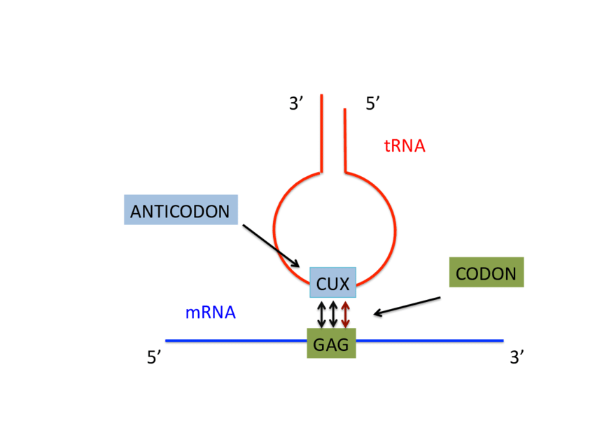
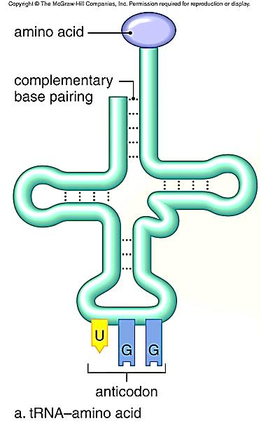
the function of tRNA (uncharged) is to attached to amino acids (aa) via Aminoacyl tRNA transferase and the reaction require ATP, and when the attachment complete the tRNA become charged.
tRNA (uncharged) + aa → aa-tRNA complex (charged or acylated tRNA)

Slide 16
rRNA
Ribosomal RNA (rRNA) is the RNA component of the ribosome, and is essential for protein synthesis in all living organisms. It constitutes the predominant material within the ribosome, the ribosome consist of 60% rRNA and 40% protein.
Eukaryotic ribosome contains a small ribosomal subunit (40S) contains 18S rRNA, while the large ribosomal subunit (60S) contains 5.8S, 28S and 5S .
Prokaryotic ribosome contains a small ribosomal subunit (30S) contains the 16S, while the large ribosomal subunit (50S) contains 5S and 23S.

Slide 17
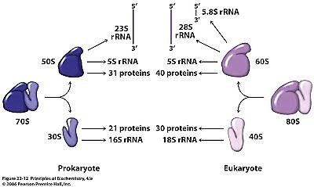

Slide 19
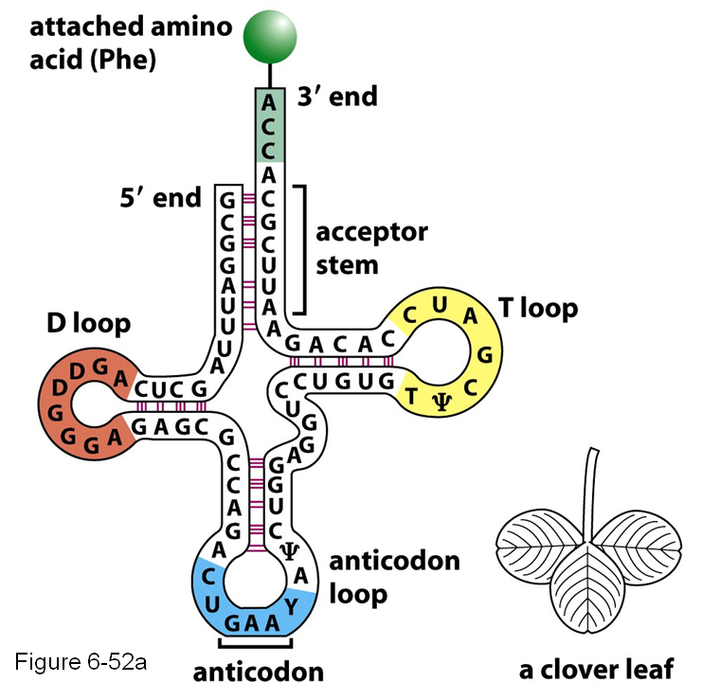
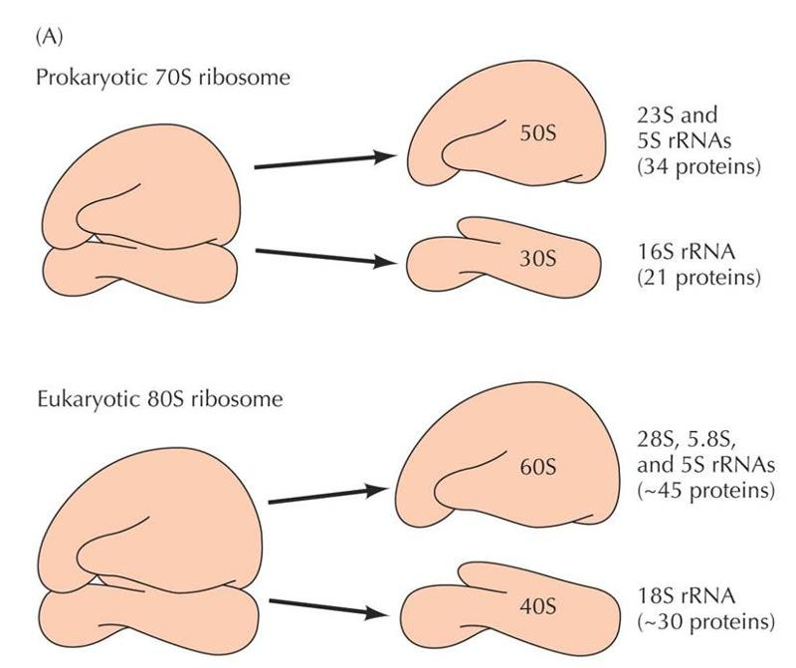
non-coding RNAs are transfer RNA (tRNA ) and ribosomal RNA (rRNA), both of which are involved in the process of translation

