Slide 1
8th and 9th lectures in molecular biology DNA REPLICATION

Slide 2
DNA replication …
It is the process of producing two identical copies from one original DNA molecule. This biological process occurs in all living organisms and it represents the basis for biological inheritance.
DNA is composed from two strands and each strand of the original DNA molecule serves as template for the production of the complementary strand, a process referred to as semiconservative replication and the process followed by proofreading or error-checking mechanisms to ensure correct reading to the genetic code, the process involve 3 stages :
1- Initiation 2-Elongation and 3- Termination.

Slide 3
Prokaryotic and eukaryotic DNA replication is bidirectional
The experiment of John Cairns in 1963 demonstrated by autoradiography that the DNA of E. coli is a single circular not linear molecule that is replicated from a point or moving locus forming the (replicating fork) at which both new DNA strands are being synthesized.
The movement of this fork is bidirectional in another world there are two moving forks, traveling in opposite directions around the chromosome forming θ theta shape which look like a bubble . It start from one point called ori c (origin of replication) and replication continue till reaching the opposite direction in one point called Ter i (from terminus). Also the shape is called the (A-butter fly replication)

Slide 4
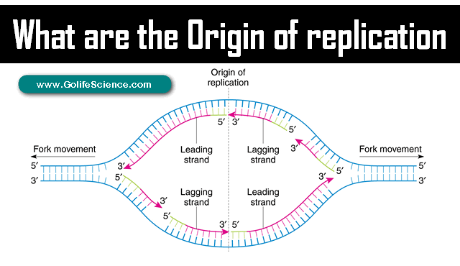
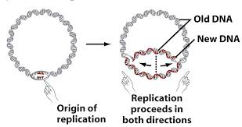

Slide 5
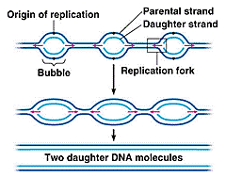
Replication in eukaryotic cell start from more than one ori c (each 300bp there is ori c) so multiple replication bubbles will form thus replication here is faster than prokaryotic cell

Slide 6
Enzymes involve in DNA replication
DNA Helicase Also known as helix destabilizing enzyme cases formation of Replication Fork due to broken hydrogen bonds. So it will break hydrogen bond between the two strand.
Topoisomerase I : Relaxes the DNA from its super-coiled nature by break the 3́́ 5́ phosphodiester bond converting super coiled to relax form which opposite to ligase.
DNA Gyrase (and Topoisomerase IV) ; this is a specific type of topoisomerase II convert relaxed form to super coiled
Single-Strand Binding Proteins (SSBP) Proteins bind to ssDNA and prevent the DNA double helix from re-annealing after DNA helicase unwinds it thus maintaining the strand separation.

Slide 7
Enzymes involve in DNA replication
DNA clamp: A protein (unit from polymerase which prevents DNA polymerase III from dissociating from the DNA parent strand.
Primase (one of the RNA polymerase enzymes) Provides a starting point for DNA polymerase to begin synthesis of the new DNA strand. In fact it is RNA polymerase thus the formed primer is RNA rather than DNA and it will removed latter by DNA polymerase I.
DNA Ligase Re-anneals the semi-conservative strands and joins Okazak’i Fragments of the lagging strand.
Telomerase Lengthens telomeric DNA by adding repetitive nucleotide sequences to the ends of eukaryotic chromosomes

Slide 8
Enzymes involve in DNA replication
DNA polymerase an enzyme responsible for carrying out synthesis, adds nucleotides to an existing DNA strand in the opposite direction of that strand's orientation, and this enzyme differ from RNA enzyme (primase) because it needs free 3-OH end to add new nucleotides, while it like primase enzyme in the direction of polymerization (add new nucleotides) in the direction 5́ →3́́ . This enzyme has many types in both prokaryotic and eukaryotic cells.
So DNA Polymerase Builds a new duplex DNA strand by adding nucleotides in the 5' to 3' direction. performs proof-reading and error correction.

Slide 9
Types of DNA polymerase in Prokaryotic cell
Types of enzyme | Initiation activity | Polymerization 5́́→3́ | Exonuclease activity 3́→5́ | Exonuclease activity 5́́→3́
DNA polymerase I | - | + | + | +
DNA polymerase II | - | + | + | -
DNA polymerase III | - | + | + | -

Slide 10
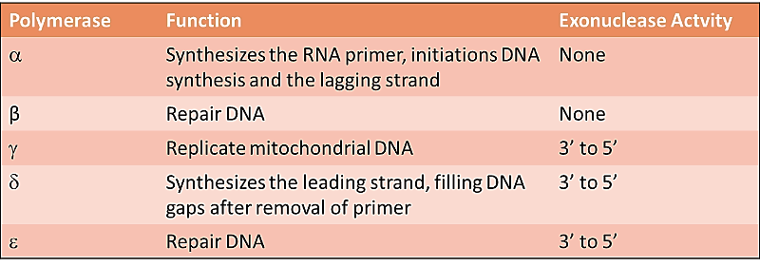
Types of DNA polymerase in Eukaryotic cell

Slide 13
Types of DNA polymerase in Eukaryotic cell
Pol α polymerase: it is the only enzyme has primase activity beside DNA polymerase so it is self- primed it will form short primer 12-20 nts called the initiator RNA (iRNA).
Pol β polymerase: excision repair and it is not highly active and is not very processive.
Pol γ polymerase: polymerization the mitochondrial DNA beside repairing by its exonuclease activity 3́→5́
Pol δ and Pol ε polymerase: polymerization lagging (δ) and leading (ε) strand respectively 5 ́→3́. In eukaryotes, the low-possessivity initiating enzyme, Pol α, has intrinsic primase activity. The high-processivity extension enzymes are Pol δ and Pol ε.

Slide 14
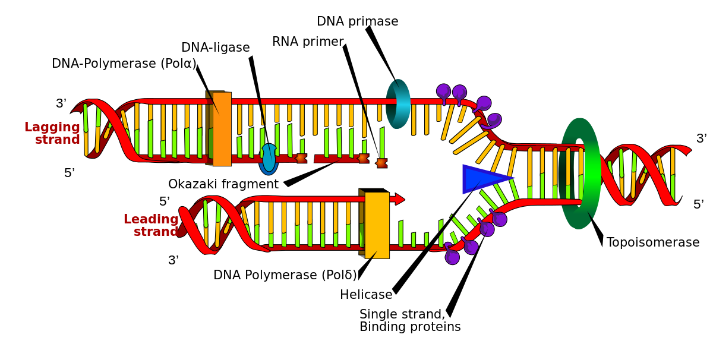

Slide 15
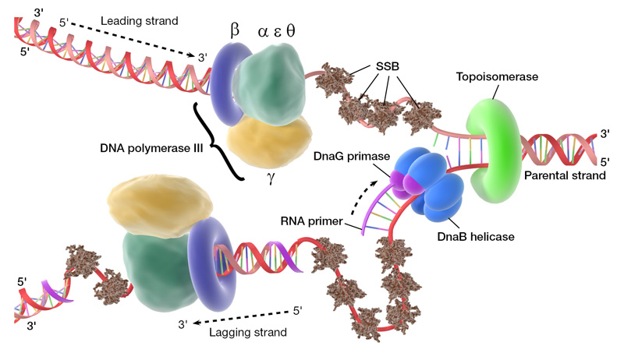

Slide 16
The movement of replication fork 5́ →3́́ which is the same direction of polymerization and direction of Leading strand, while the direction of lagging strand is 3́́ →5́ ,
Polymerization in leading strand is continuously but it is un continuously in lagging strand thus okazaki fragment will form
Okazaki fragments …
They are between 1,000 to 2,000 nucleotides long in E. coli and are between 100 and 200 nucleotides long in eukaryotes. They are separated by ~10-nucleotide RNA primers and are un ligated until RNA primers are removed, followed by enzyme ligase connecting (ligating) the two Okazaki fragments into one continuous newly synthesized complementary strand

Slide 17
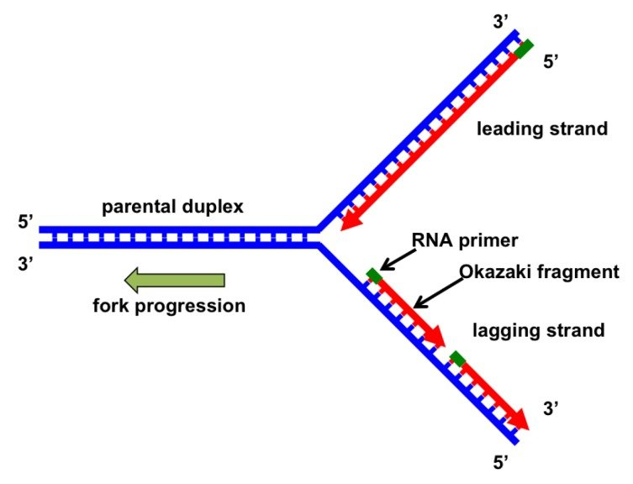
Replication fork

Slide 19
DNA molecule consist of two strands, the leading strand is oriented 3' to 5', meaning new nucleotides can readily be added in the opposite 5' to 3' direction without interruption.
In the case of the lagging strand, which is oriented 5' to 3', DNA polymerase must add new nucleotides in the direction facing away from the replication fork.
As replication continues, this fork continues to open more along the strand, so DNA polymerase must continually reorient itself, causing replication to occur in fragments. DNA polymerase has 5'-3' activity.
All known DNA replication systems require a free 3' hydroxyl group before synthesis can be initiated (note: the DNA template is read in 3' to 5' direction whereas a new strand is synthesized in the 5' to 3' direction—this is often confused).

Slide 21
Differences between leading and lagging strand replication

Slide 22
A new DNA strand is always synthesized in a 5’ to 3’ manner, thus the replication of both the strands goes in two different ways.
1- Leading strand. . A leading strand is the strand which is run from 5’-3’direction or the direction the same as the replication fork movement. It is synthesized continuously; there are no breaks in-between. This strand is formed as nucleotides are continuously added to the 3’ end of the strand after polymerase reads the original DNA template . Only one primer will require here .no Okazaki fragment will formed.

Slide 23
Lagging strand:
It is synthesized in short, separated segments. On the lagging strand template, a primase "reads" the template DNA and initiates synthesis of a short complementary RNA primer.
A DNA polymerase III extends the primed segments, forming Okazaki fragments. DNA polymerase will add the four nucleotides in the 5' to 3' direction; however, one of the parent strands (lagging) of DNA is 3' to 5' while the other (leading) is 5' to 3'. To solve this problem, replication occurs in opposite directions. lagging strand run away from the replication fork, and synthesized a series of short fragments known as Okazaki fragments, consequently requiring many primers. The RNA primers of Okazaki fragments are degraded by Rnase H and DNA Polymerase I

Slide 24
2- lagging strand: . A lagging strand is the strand which is oriented in the 3’-5’ direction or opposite direction as to the movement of the replication fork. It grows or is synthesized away from the fork. Its movement in the opposite direction is the cause why it is discontinuous; it is synthesized in fragments. The primase, which is responsible for adding an RNA primer, has to wait for the fork to open before putting in the primer. The lagging strands have fragments of DNA which are called Okazaki fragments.
More than one primer will be necessary here and it will be removed latter by the exonuclease activity of DNA polymerase (I) which will fill the gap between two adjacent okazaki fragments. The final binding will done by the activity of ligase enzyme who will add a phosphodiester bond continuously ; this is the reason why the synthesis of the lagging strand is more complicated than the leading strand.

Slide 25
DNA polymerase molecules are required for polymerization the two strands which run together in the same machine binding together but still the replication happened in opposite direction The polymerase involved in leading strand synthesis is DNA polymerase III (DNA Pol III) in prokaryotes and presumably Pol ε in yeasts. In human cells the leading and lagging strands are synthesized by Pol ε and Pol δ, respectively, within the nucleus and Pol γ in the mitochondria.

Slide 26
The DNA replication machinery
The Replisome is composed of the following:
2 DNA Pol III enzymes molecules , each has a core subunits composed from 3 sub units α, ε and θ subunits.
- the α subunit has the polymerase activity.
- the ε subunit has 3'→5' exonuclease activity.
- the θ subunit stimulates the ε subunit's proofreading.
2 β units which act as sliding clamp keeping the polymerase bound to the DNA template .
2 τ units which acts to dimerism two of the core enzymes (α, ε, and θ subunits).

Slide 27
The gamma γ complex which acts as a clamp loader for the lagging strand helping the two β subunits to form one unit and bind to DNA. The γ unit is made up of 5 subunits which include 3 γ subunits, 1 δ subunit , and 1 δ' subunit .
The δ is involved in copying of the lagging strand. Beside that there are Χ and Ψ which complete the complex and bind to γ
DNA polymerase III synthesizes base pairs at a rate of around 1000 nucleotides per second. DNA Pol III activity begins after strand separation at the origin of replication. Because DNA synthesis cannot start replication , an RNA primer, complementary to part of the single-stranded DNA, is synthesized by primase (an RNA polymerase)

Slide 28
Structure and sub units of 2 DNA polymerase III (replisome)

Slide 29
Steps of DNA replication
1- Initiation…
The process require replictor and intiator protein (DnaA protein ). For a cell to divide, it must first replicate its DNA.This process is initiated at particular points in the DNA, known as replicator (200-300 bp) which contain specific area called "origin of replication ori c or Dna A box) ", which will opened by initiator proteins. In E. coli this protein is called DnaA protein ; in yeast, is called origin recognition complex.
Sequences opened by initiator proteins tend to be "AT-rich" (rich in adenine and thymine bases), because A-T base pairs have two hydrogen bonds (rather than the three bond in a C-G pair).

Slide 30
Once the origin has been recognized, the initiators proteins (DnaA protein) start forming a complex is called the pre-replication complex, which unwind the double-stranded DNA. All known DNA replication systems require a free 3' hydroxyl group before synthesis can be initiated . use a primase enzyme (RNApolymerase) to synthesize a short RNA primer(10-20 bp) with a free 3′ OH group which is subsequently elongated by a DNA polymerase in this mechanism,
In eukaryotes, primase is produce by Pol α DNA polymerase and Pol δ/Pol ε are responsible for extension of the primed segments

Slide 32
:
Replication fork …
The replication fork is a structure that forms during DNA replication. Many enzymes are involved in the DNA replication fork in order to stabilize initiation step .
helicases, which break the hydrogen bonds holding the two DNA strands together. The resulting structure has two branching "prongs", each one made up of a single strand of DNA. These two strands serve as the template for the leading and lagging strands, which will be created as DNA polymerase matches complementary nucleotides to the templates; the templates may be properly referred to as the leading strand template and the lagging strand templates. SSBPs also required here.

Slide 33
Steps of DNA replication
2- Elongation step.
DNA is always synthesized in the 5' to 3' direction.
Since the leading and lagging strand templates are oriented in opposite directions at the replication fork, a major issue is how to achieve synthesis of nascent (new) lagging strand DNA, whose direction of synthesis is opposite to the direction of the growing replication fork.
The leading strand receives one RNA primer while the lagging strand receives several

Slide 34
The leading strand is continuously extended from the primer by a high processivity (متنامي ,متقدم وعامل ), replicative DNA polymerase, while the lagging strand is extended discontinuously from each primer, forming Okazaki fragments As DNA synthesis continues, the original DNA strands continue to unwind on each side of the bubble, forming a replication fork with two prongs (شوكة)
β Clamp proteins : it form a sliding clamp around DNA, helping the DNA polymerase maintain contact with its template, thereby assisting with processivity. The inner face of the clamp enables DNA to be threaded through it. Once the polymerase reaches the end of the template or detects double-stranded DNA, the sliding clamp undergoes a conformational change that releases the DNA polymerase. Clamp-loading proteins are used to initially load the clamp, recognizing the junction between template and RNA primers
.

Slide 36
Termination in Eukaryotic cell
Primer removal in eukaryotes is performed by RNase I that remove all the primer leaving only one nucleotide in the junction between 2 nucleotide and the remained one will removed by FenI enzyme . Eukaryote cell initiate DNA replication at multiple points in the chromosome, so replication forks meet and terminate at many points in the chromosome; these are not known to be regulated in any particular way. Because eukaryotes have linear chromosomes, DNA replication is unable to reach the very end of the chromosomes, but ends at the Telomere region of repetitive DNA close to the end.

Slide 37
This shortens the telomere of the daughter DNA strand. Shortening of the telomeres is a normal process in Somatic cells. As a result, cells can only divide a certain number of times before the DNA loss prevents further division. Within the Germ cell line, which passes DNA to the next generation, Telomerase extends the repetitive sequences of the telomere region to prevent degradation. Telomerase can become mistakenly active in somatic cells, sometimes leading to Cancer formation. in the end of the replication the DNA will warp around the basic hiatons to form the chromatin

Slide 38
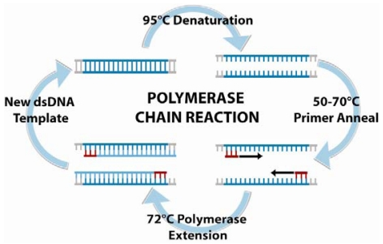
DNA COULD BE SYNTHESISED IN LAB
The dream become true for synthesizing part of the genome in lab after 3 decade from discovering DNA polymerase enzyme precisely in 1983 by Kary mullis who found a genious way to amplify (تكثير ) any part of the genomic DNA by PCR process (polymerase chain reaction)the process require the following:

Slide 39
Template DNA (genomic animal or plant cell , plasmid, cosmid, bacterial/yeast colony, etc.)
primers :usually forward and reverse DNA primers(17-25bp) forwarded from 5 ́→ OH 3́ with free end thus DNA polymerase will use this end to add nucleotide to the newly formed strand .in nature this segment is synthesized by primase enzyme (RNA rather than DNA as will discussed latter)
buffer for DNA polymerase enzyme
To enhance enzyme activity we add MgCl2 or MgCl2
dNTPs :The four type is used (dATP, d TTP, d GTP, d CTP) .
Taq DNA polymerase: heat stable enzyme is used here . Cos of its stability in heat during denarturation step (95Cº)

Slide 40
Polymerase chain reaction
Polymerase chain reaction
Researchers commonly replicate DNA in vitro using the polymerase chain reaction (PCR). PCR uses a pair of primers to span a target region in template DNA, and then polymerizes partner strands in each direction from these primers using a thermostable Taq DNA polymerase. Repeating this process through multiple cycles produces amplification of the targeted DNA region. At the start of each cycle, the mixture of template and primers is heated, separating the newly synthesized molecule and template. Then, as the mixture cools, both of these become templates for annealing of new primers, and the polymerase extends from these. As a result, the number of copies of the target region doubles each round, increasing exponentially

Slide 41
Properties of Taq DNA polymerase
Taq polymerase is a thermostable DNA polymerase named after the thermophilic bacterium Thermus aquaticus from which it was originally isolated by Thomas D. Brock. It is often abbreviated to "Taq Pol" and is frequently used in polymerase chain reaction(PCR), a method for greatly amplifying short segments of DNA .
Thermus aquaticus represents as a bacterium that lives in hot springs and hydrothermal vents, and Taq polymerase was identified as an enzyme able to withstand the protein-denaturing conditions (high temperature) required during PCR. Therefore it replaced the DNA polymerase from E. coli originally used in PCR.

Slide 42
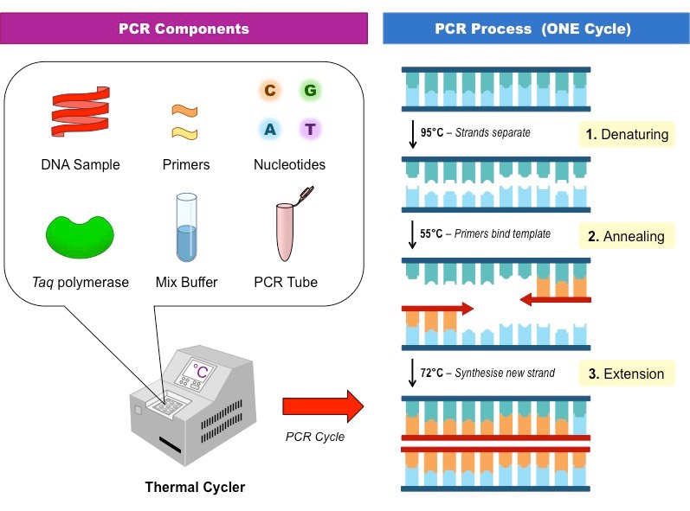

Slide 43
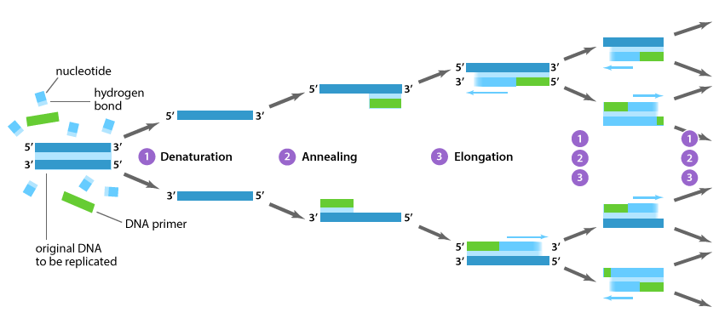

Slide 44
Taq's optimum temperature for activity is 75–80°C, with a half-life of greater than 2 hours at 92.5°C , and can replicate a 1000 base pair strand of DNA in less than 10 seconds at 72°C. One of Taq's drawbacks is its relatively low replication fidelity It lacks a 3' to 5' exonuclease proofreading activity, and has an error rate measured at about 1 in 9,000 nucleotides.[ The remaining two domains however may act in coordination, via coupled domain motion.
Some thermostable DNA polymerases have been isolated from other thermophilic bacteria and archaea, such as vent and Pfu DNA polymerase, possessing a proofreading activity, and are being used instead of (or in combination with) Taq for high-fidelity amplification.

