Slide 1
Nucleic Acids
DNA & RNA

Slide 2
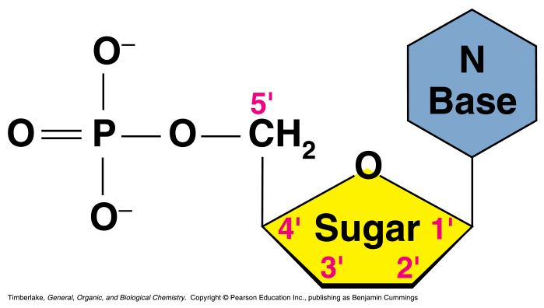
Nucleic Acids
Nucleic acids are molecules that store information for cellular growth and reproduction
There are two types of nucleic acids:
- deoxyribonucleic acid (DNA) and ribonucleic acid (RNA)
These are polymers consisting of long chains of monomers called nucleotides
A nucleotide consists of a nitrogenous base, a pentose sugar and a phosphate group:

Slide 3
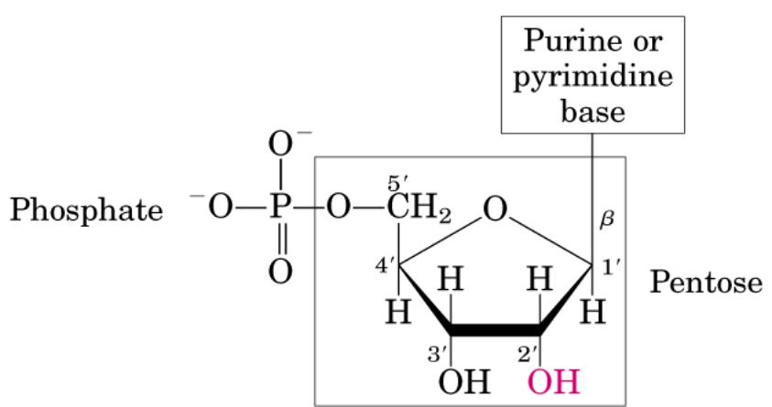
Nucleic Acids
DNA and RNA are nucleic acids, long, thread-like polymers
made up of a linear array of monomers called nucleotides
All nucleotides contain three components:
1. A nitrogen heterocyclic base
2. A pentose sugar
3. A phosphate residue

Slide 4

Chemical Structure of DNA vs RNA
Ribonucleotides have a 2’-OH
Deoxyribonucleotides have a 2’-H

Slide 5
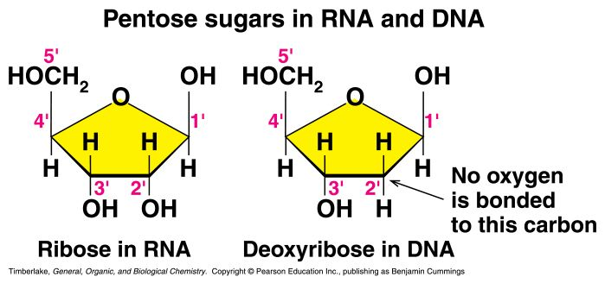
Pentose Sugars
There are two related pentose sugars:
- RNA contains ribose
- DNA contains deoxyribose
The sugars have their carbon atoms numbered with primes to distinguish them from the nitrogen bases

Slide 6
Nucleotide Function
Building blocks for DNA and RNA
Intracellular source of energy - Adenosine triphosphate (ATP)
Second messengers - Involved in intracellular signaling (e.g. cyclic adenosine monophosphate [cAMP])
Intracellular signaling switches (e.g. G-proteins)

Slide 7
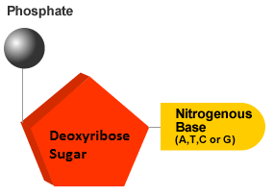
It is the order of these base pairs that determines genetic makeup
One phosphate + one sugar + one base = one nucleotide
Nucleotides are the building blocks of DNA – thus, each strand of DNA is a string of nucleotides

Slide 8
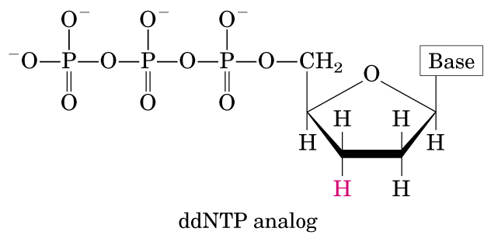
Sanger dideoxy sequencing incorporates dideoxy nucleotides, preventing further synthesis of the DNA strand

Slide 9
base（purine、pyrimdine）+ribose（deoxyribos
N-glycosyl linkage
nucleoside+phosphate
phosphoester linkage
nucleotide
phosphodiester linkage
nucleic acid

Slide 10
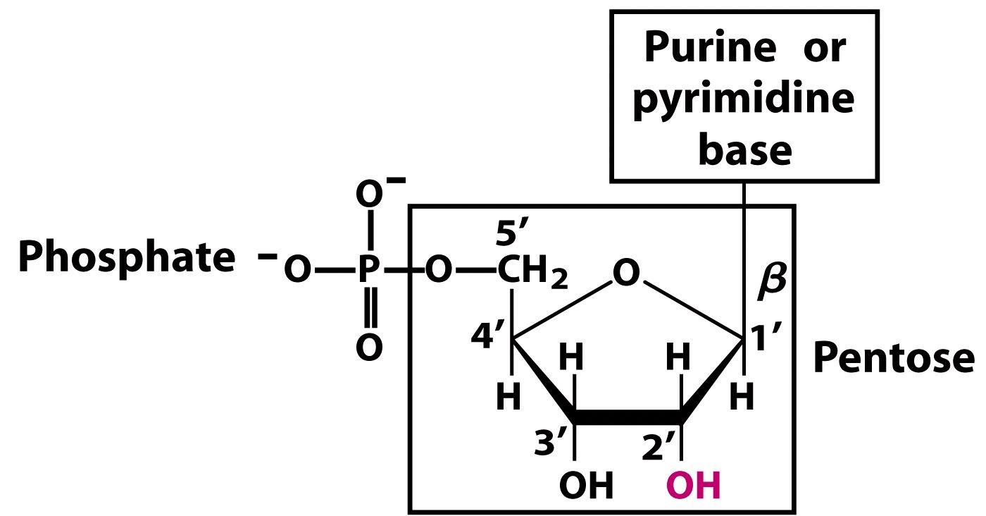
Notes:
FIGURE 8-1a Structure of nucleotides. (a) General structure showing the numbering convention for the pentose ring. This is a ribonucleotide. In deoxyribonucleotides the —OH group on the 2′ carbon (in red) is replaced with —H.

Slide 11
Nucleotide Structure - 1
Sugars
HOCH₂
OH
O
Generic Ribose Structure
Ribose
5’
HOCH₂
O
OH
OH
4’
1’
3’
2’
HOCH₂
OH
O
N.B. Carbons are given numberings as a prime
Deoxyribose
OH
H

Slide 12
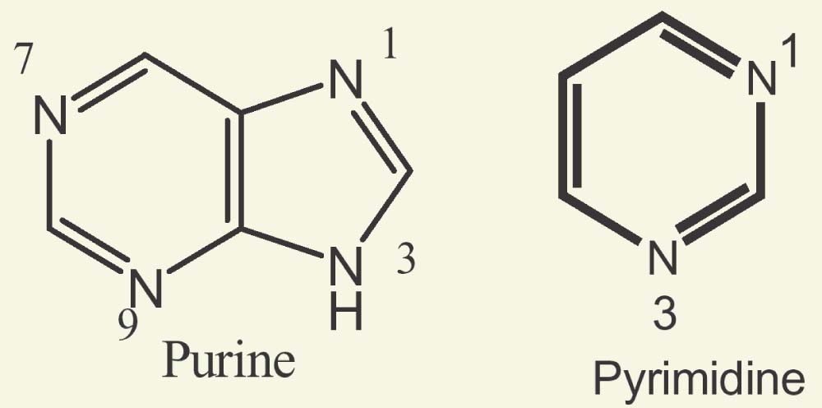
Purine and Pyrimidine
Pyrimidine contains two pyridine-like nitrogens in a six-membered aromatic ring
Purine has 4 N’s in a fused-ring structure. Three are basic like pyridine-like and one is like that in pyrrole

Slide 13
Nucleotide Structure - 2
Bases - Purines
NH₂
Adenine
N
N
A
N
N
N
6
N
H
7
5
1
8
9
4
2
O
N
3
N
N
N
H
G
Guanine
N
N
NH₂
H

Slide 14
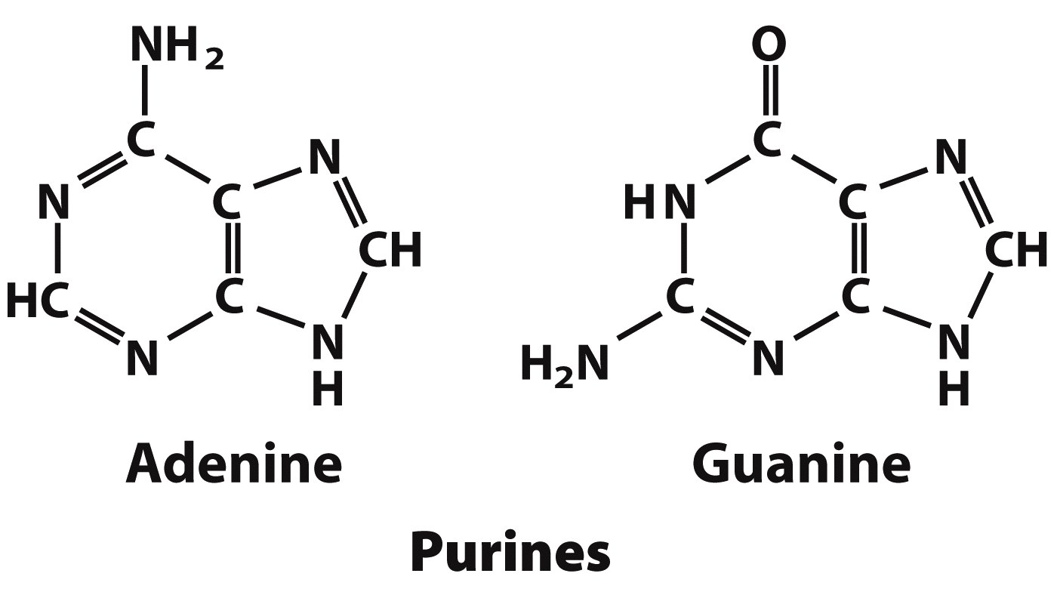
Notes:
FIGURE 8-2 (part 1) Major purine and pyrimidine bases of nucleic acids. Some of the common names of these bases reflect the circumstances of their discovery. Guanine, for example, was first isolated from guano (bird manure), and thymine was first isolated from thymus tissue.

Slide 15
Nucleotide Structure - 3
Bases - Pyrimidines
O
H₃C
Thymine
NH
T
N
O
4
N
H
3
5
2
6
NH₂
1
N
N
C
Cytosine
N
O
H

Slide 16
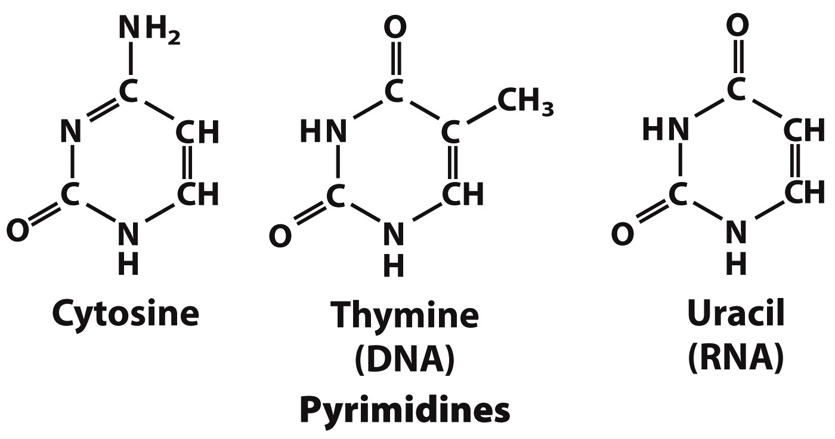
Notes:
FIGURE 8-2 (part 2) Major purine and pyrimidine bases of nucleic acids. Some of the common names of these bases reflect the circumstances of their discovery. Guanine, for example, was first isolated from guano (bird manure), and thymine was first isolated from thymus tissue.

Slide 17
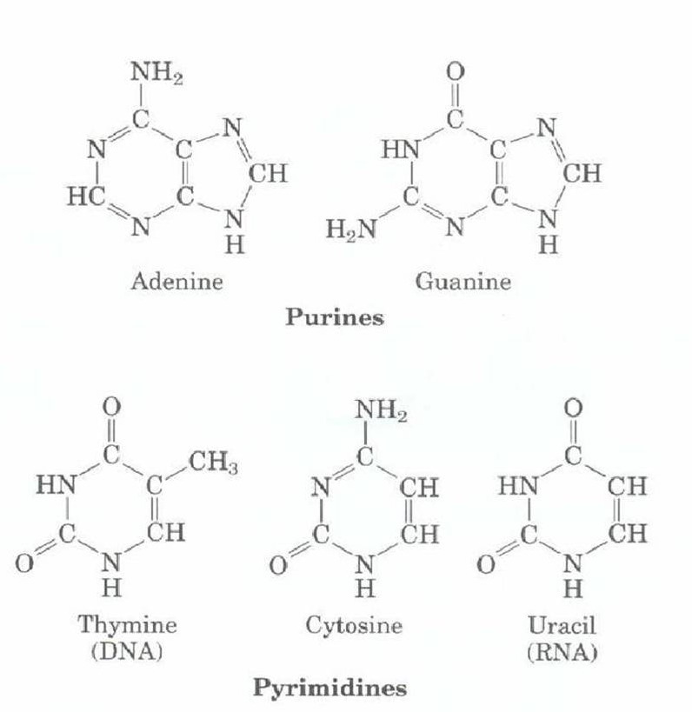

Slide 18
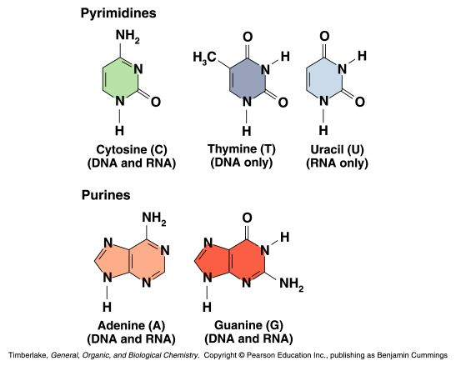
Nitrogen Bases
The nitrogen bases in nucleotides consist of two general types:
- purines: adenine (A) and guanine (G)
- pyrimidines: cytosine (C), thymine (T) and Uracil (U)

Slide 19
Nucleotide Structure - 4
Bases - Pyrimidines
Thymine is found ONLY in DNA.
In RNA, thymine is replaced by uracil
Uracil and Thymine are structurally similar
Uracil
O
4
N
NH
3
5
U
2
6
1
N
N
O
H

Slide 20
Nucleotide Structure - 4
Base-Sugar-PO₄²⁻
4
N
3
5
O
2
6
1
N
O
P
O
C
5’
O
O
4’
1’
3’
2’
OH
Monophosphate

Slide 21
Nucleotide Structure - 4
Phosphate Groups
Phosphate groups are what makes a nucleoside a nucleotide
Phosphate groups are essential for nucleotide polymerization
Basic structure:
O
O
P
O
X
O

Slide 22
Nucleotide Structure - 4
Phosphate Groups
Number of phosphate groups determines nomenclature
Monophosphate
e.g. AMP
O
O
P
O
CH₂
Free = inorganic phosphate (Pi)
O
Diphosphate
e.g. ADP
O
O
O
P
O
P
O
CH₂
Free = Pyro- phosphate (PPi)
O
O

Slide 23
Nucleotide Structure - 4
Phosphate Groups
Triphosphate
e.g. ATP
O
O
O
O
P
O
P
O
P
O
CH₂
No Free form exists
O
O
O

Slide 24
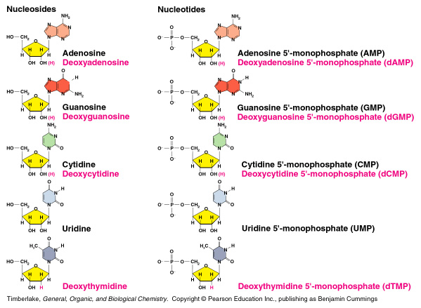
Nucleosides and Nucleotides
A nucleoside consists of a nitrogen base linked by a glycosidic bond to C1’ of a ribose or deoxyribose
Nucleosides are named by changing the the nitrogen base ending to -osine for purines and –idine for pyrimidines
A nucleotide is a nucleoside that forms a phosphate ester with the C5’ OH group of ribose or deoxyribose
Nucleotides are named using the name of the nucleoside followed by 5’-monophosphate

Slide 25
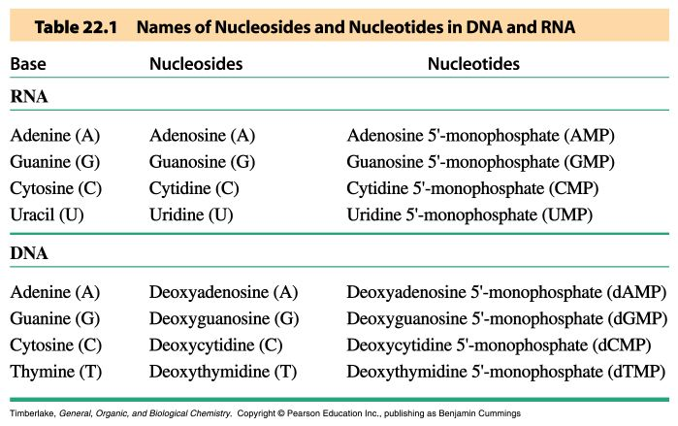
Names of Nucleosides and Nucleotides

Slide 26
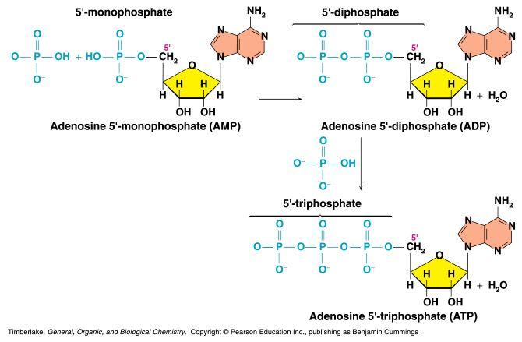
AMP, ADP and ATP
Additional phosphate groups can be added to the nucleoside 5’-monophosphates to form diphosphates and triphosphates
ATP is the major energy source for cellular activity

