Slide 1
اعدادات انشاء محاضرة فديوية عبر البروفايل الاكاديمي
م.د. مرتضى فائز سلطان
أ.م.د. فاتن عزت محي الدين
م.م. روناك عبد السلام عبد الكريم

Slide 2
Outlines
Education 4.0
(what is ED 4.0 ?)
4th industrial revolution
4th industrial revolution and Education
Gen Z
Lecturers and Gen Z
Academic profile as a 1st step on the road
The videoing lectures
Advantages and Disadvantages
Tools to prepare and upload videoing lectures
Suggestions

Slide 3
What is Education 4.0 ???
To understand more and then to get a clear definition we need to understand the following subject …….

Slide 4
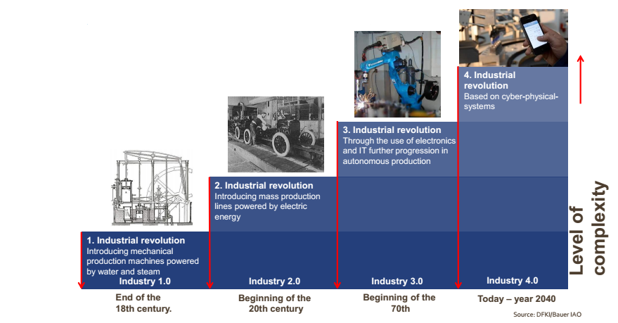
From the 1st to the 4th Industrial Revolutions
Cyber physical system Robots as colleagues instead of work tools
In the last 250 years, society has experienced four Industrial Revolutions, which have entirely changed the face of industry and change most stuff around us as we know.

Slide 5
Transformation from the 1st to the 2nd Information Revolution

Slide 6
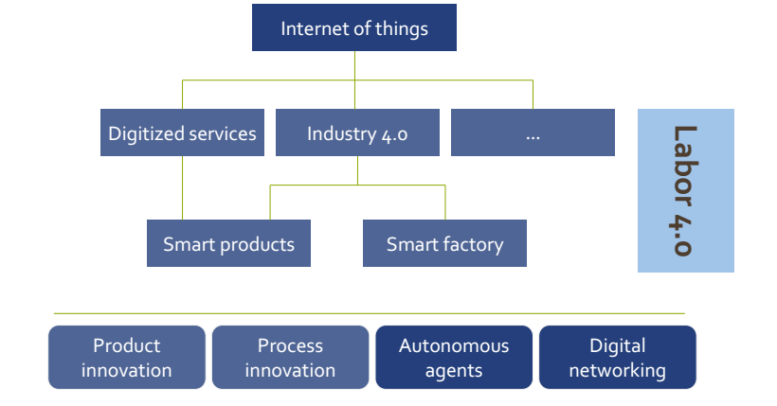

Slide 7
4th industrial revolution and Education
We believe that the changes in industry should and must have a direct impact on the way we build the education system for today’s students.

Slide 8
Gen Z and Education
Gen Z (generation z) : A cohort of a group of people born form Generation X. The demographic boom of Generation Y took place between about 1980-1994. Therefore anyone born in 1994 or after, the most common ending date being 2010, is a member of Generation Z.
Generation Z is the first cohort to have Internet technology readily available at a young age.
With the web revolution that occurred throughout the 1990s, they have been exposed to an unprecedented amount of technology in their upbringing.
This generation is very different in their aspirations and how they perceive the world around them.

Slide 9
Today, we understand that the knowledge that formed the basis of progress in the 19th and 20th centuries is insufficient in the modern world (the 21st century)
… We must have more and more education skills that keep up with the progress of the new industry revolution (4.0) …this type of education that based on these skills named as:
Education 4.0

Slide 10
Gen Z and lecturers
The generational divide between teachers and students, combined with the need to develop core competencies education (especially digital competence), adapt to new social skills related to the use of technologies and address the new learning needs of a changing society, raise questions about the preparation of current teachers for leading the teaching-learning processes that Generation Z students will use

Slide 11
Academic profile as a 1st step on the road
Smart board
Using pc with desktop recorder
Traditional recording of video
Videoing lectures
The academic profile in our college witnessed remarkable development and managed to find a level of advancement but at the same time still needs many skills.
One of these skills is videoing lectures

Slide 12
Some advantages of videoing lecture
The possibility of preparing an integrated lectures supported by intelligent illustrations.
Addressing students' inability to listen or to attention.
Addressing the inability to attend the lecture.
Gives opportunity to repeat the lecture to those who need to repetition.

Slide 13
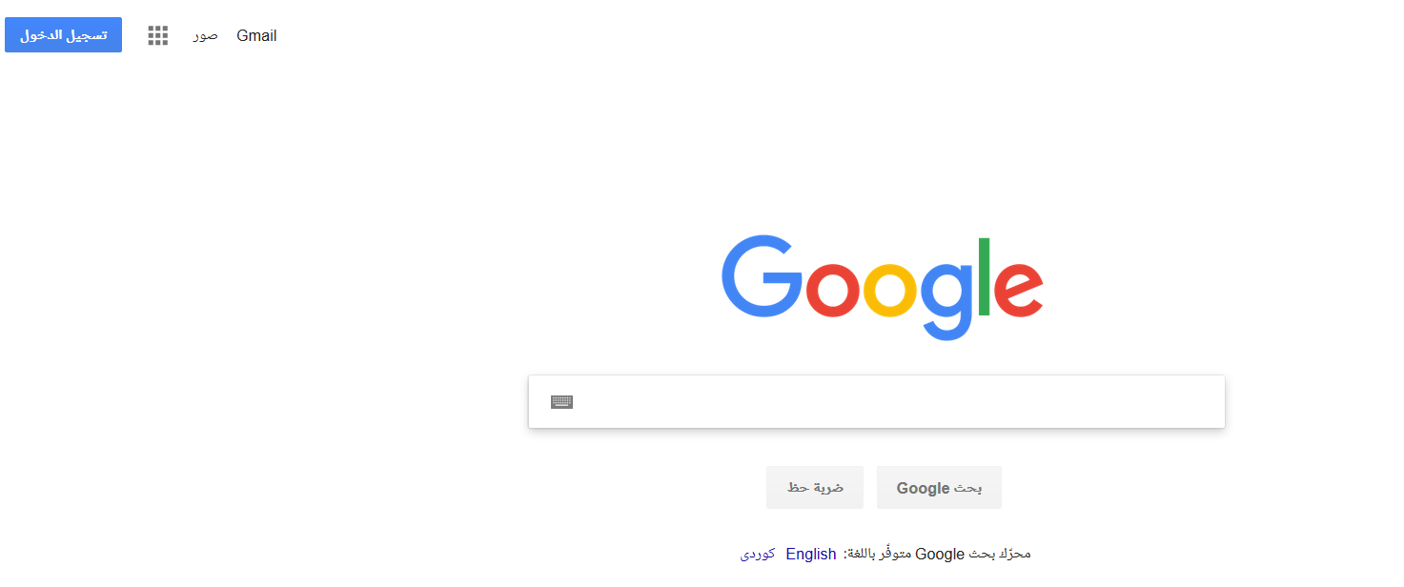

Slide 14
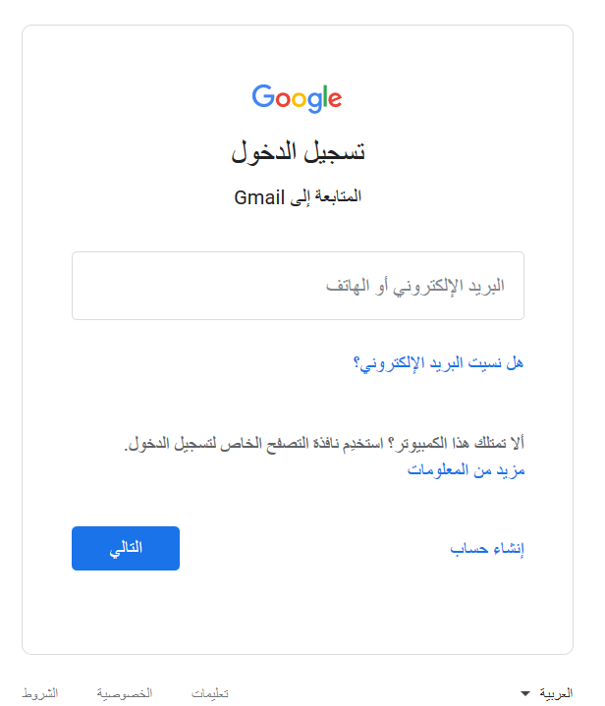

Slide 15
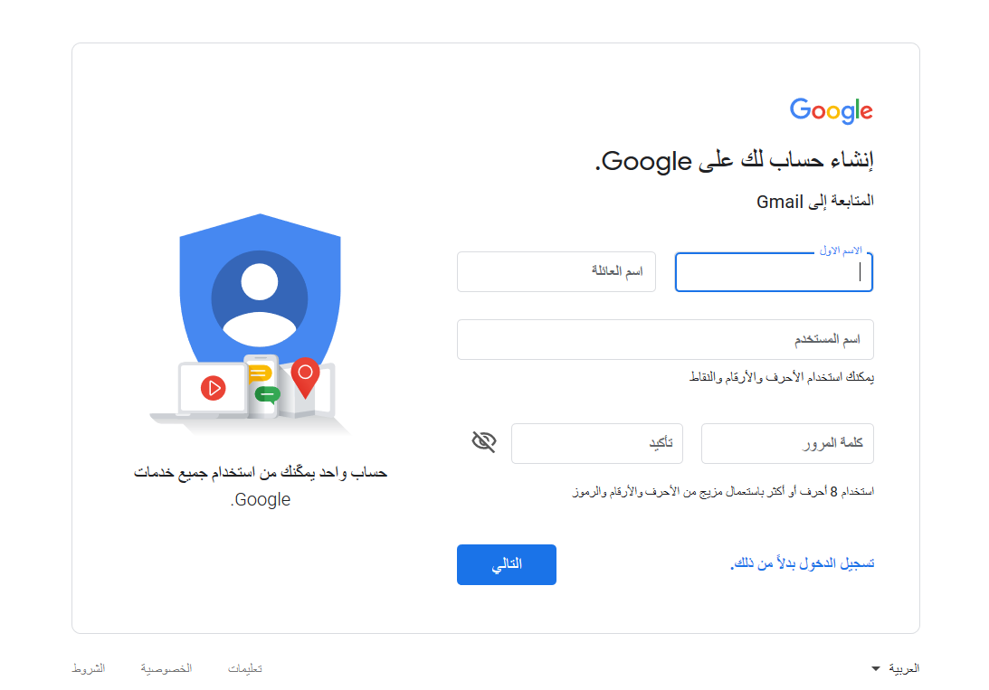

Slide 16
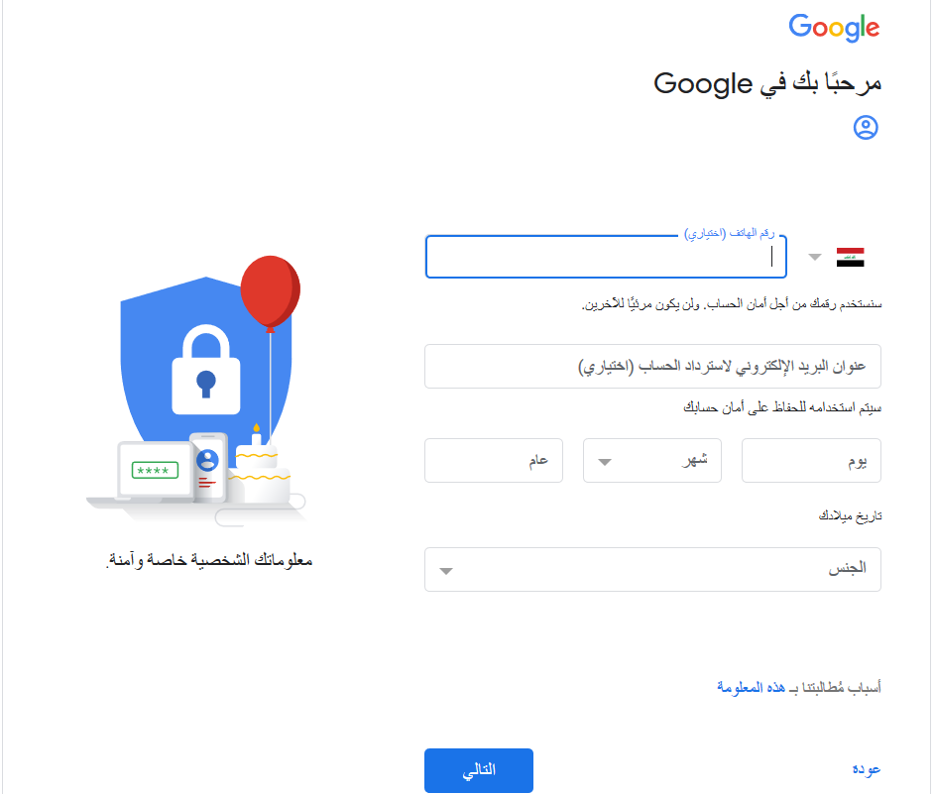

Slide 17
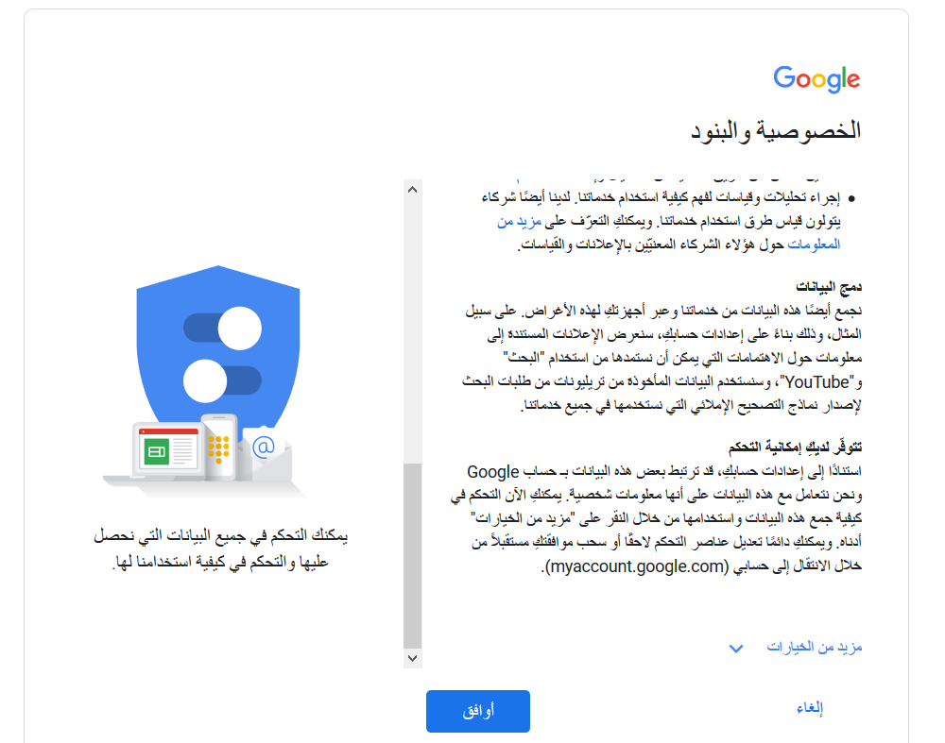

Slide 18
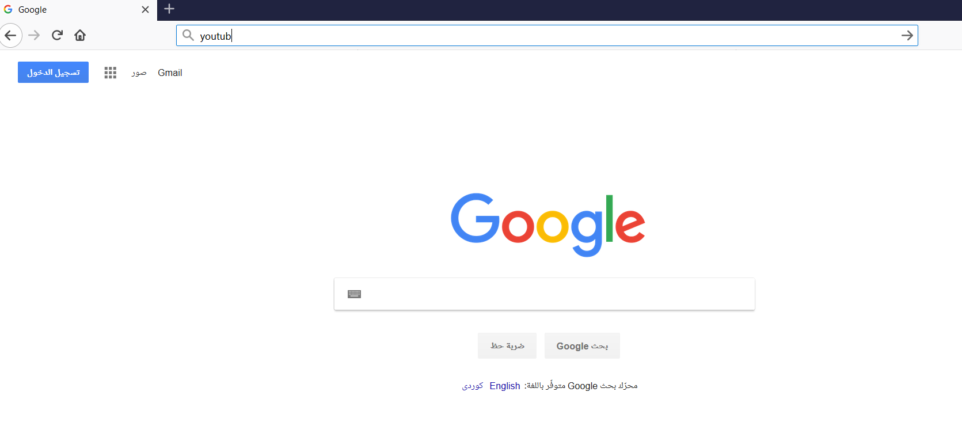

Slide 19
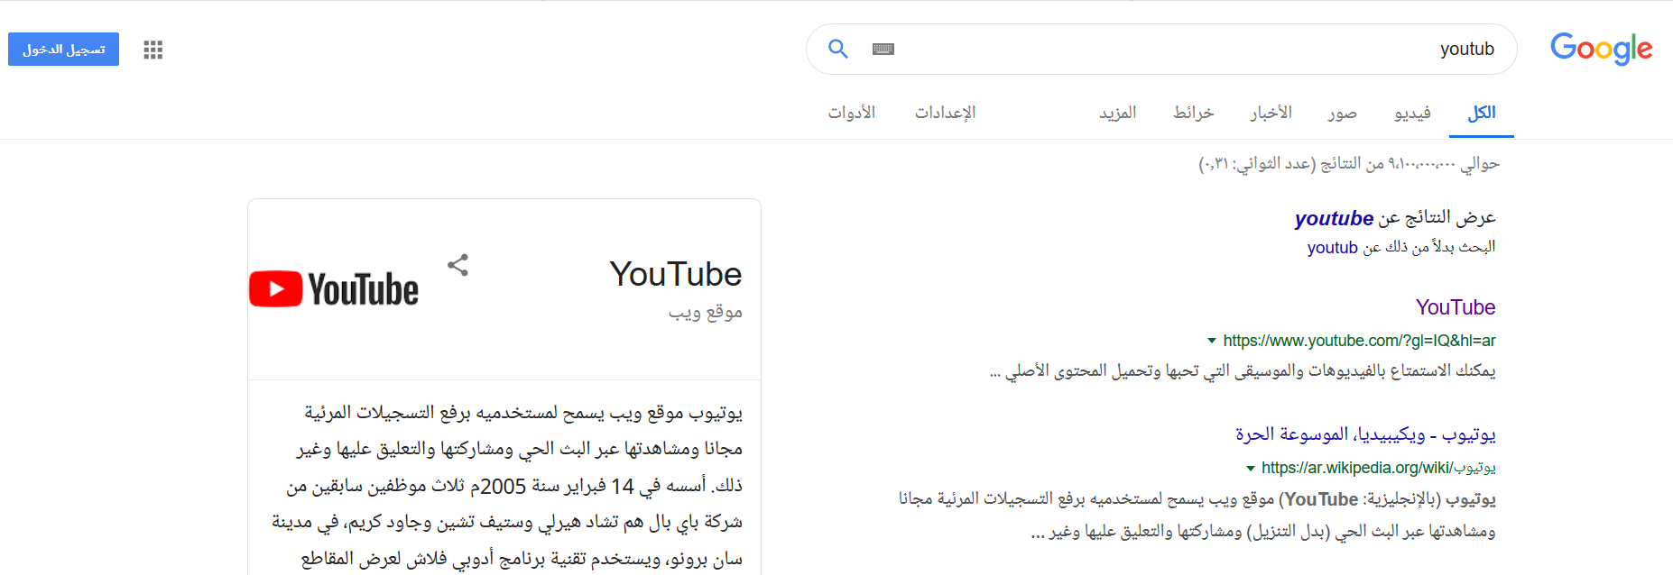

Slide 21
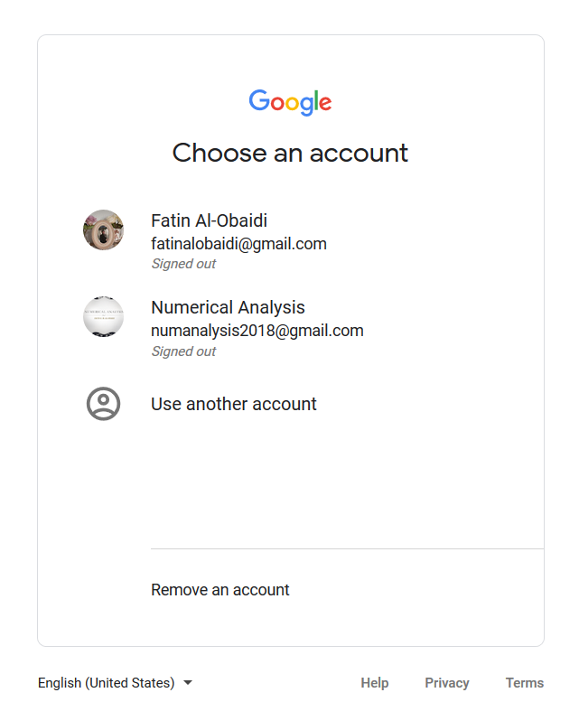

Slide 22
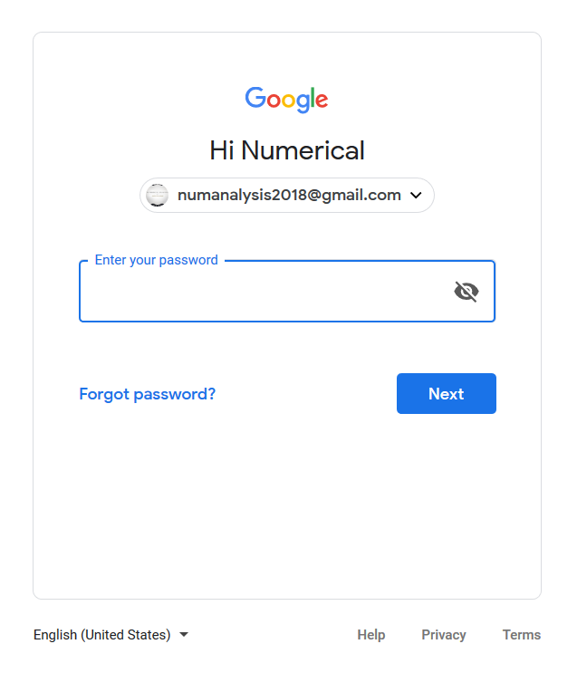

Slide 23
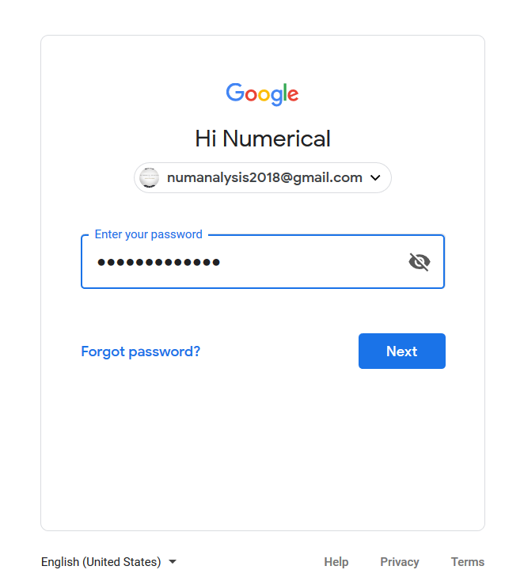

Slide 25
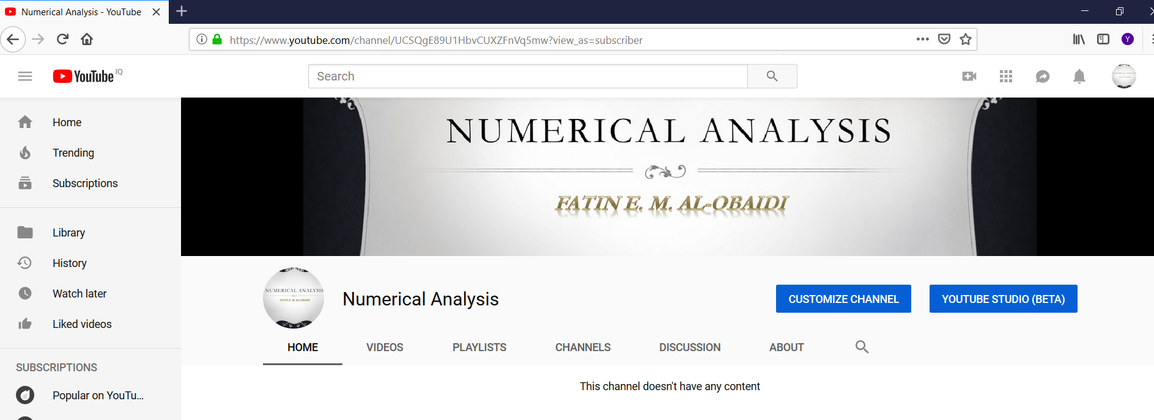

Slide 26
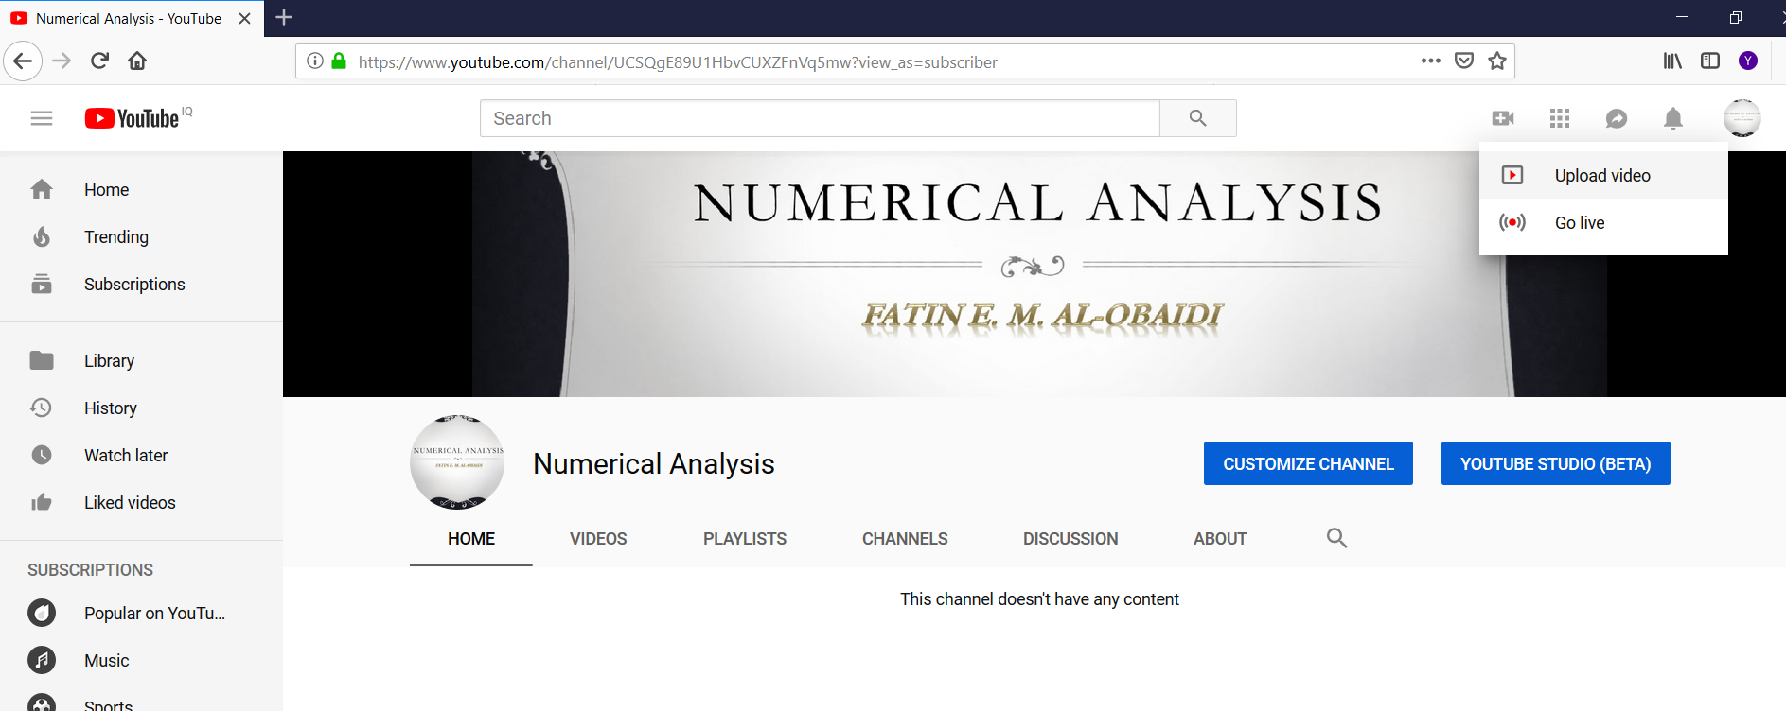

Slide 27
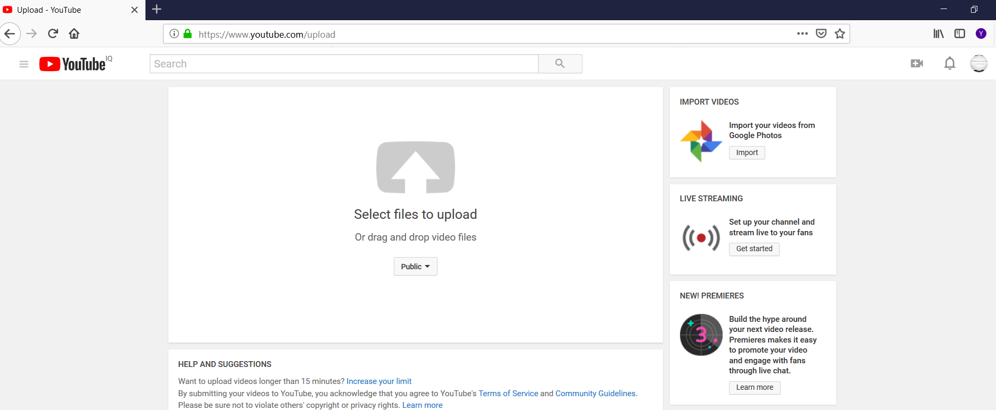

Slide 28
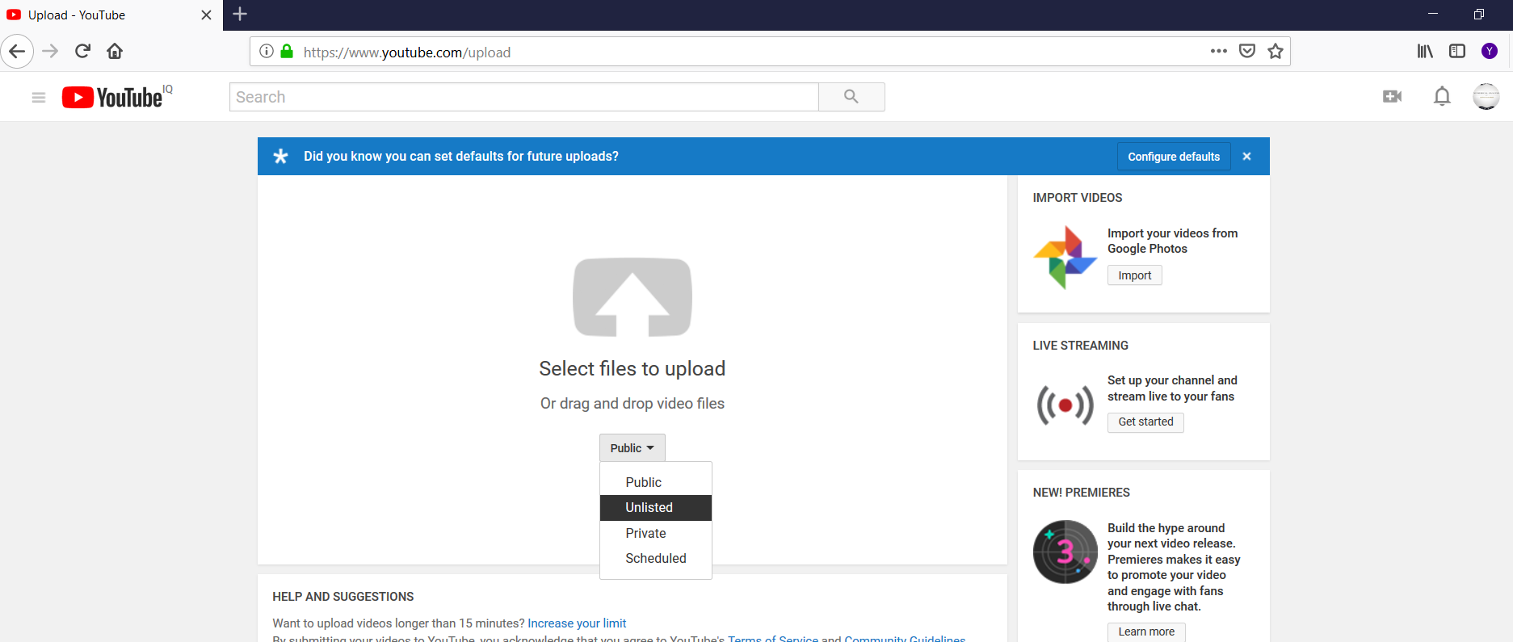

Slide 29
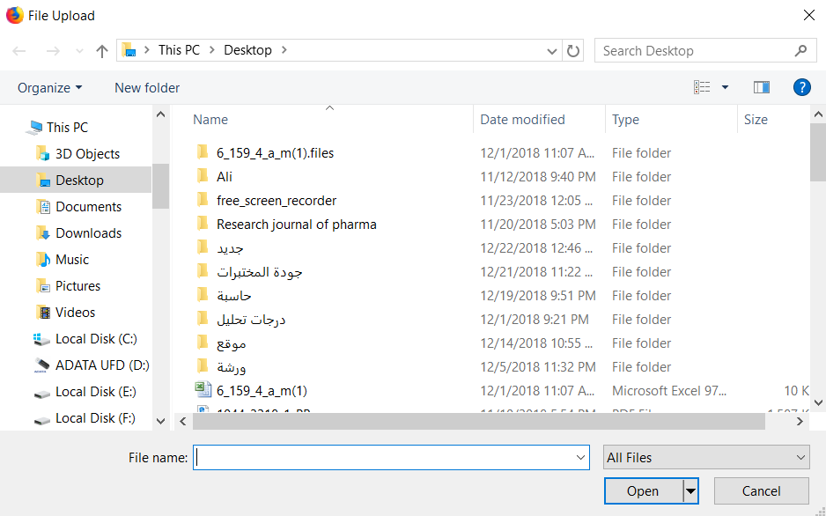

Slide 30
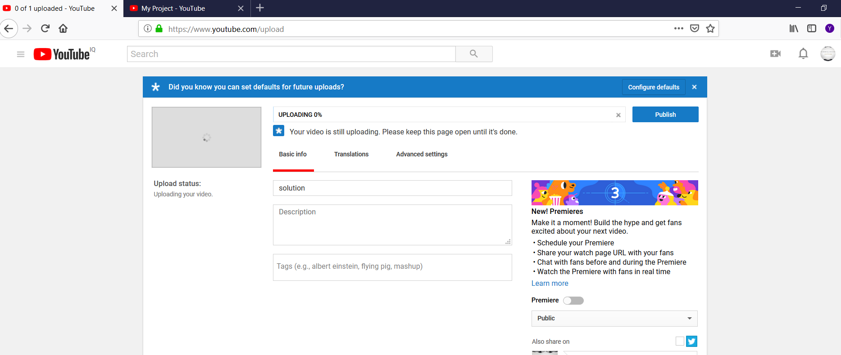

Slide 31
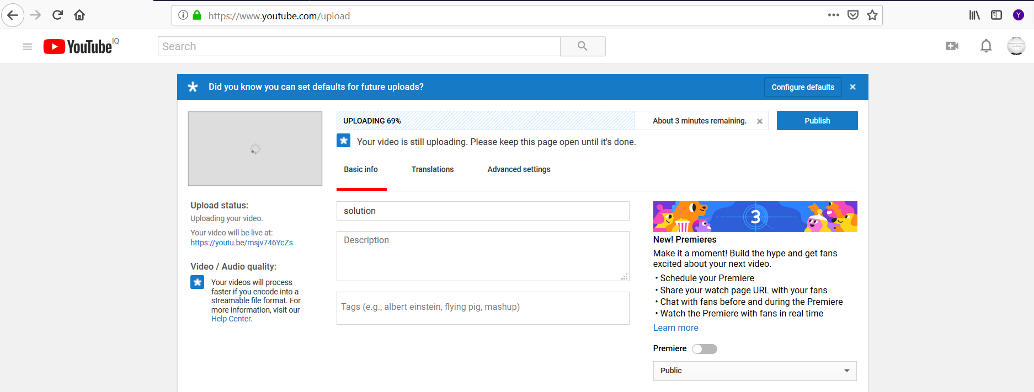

Slide 32
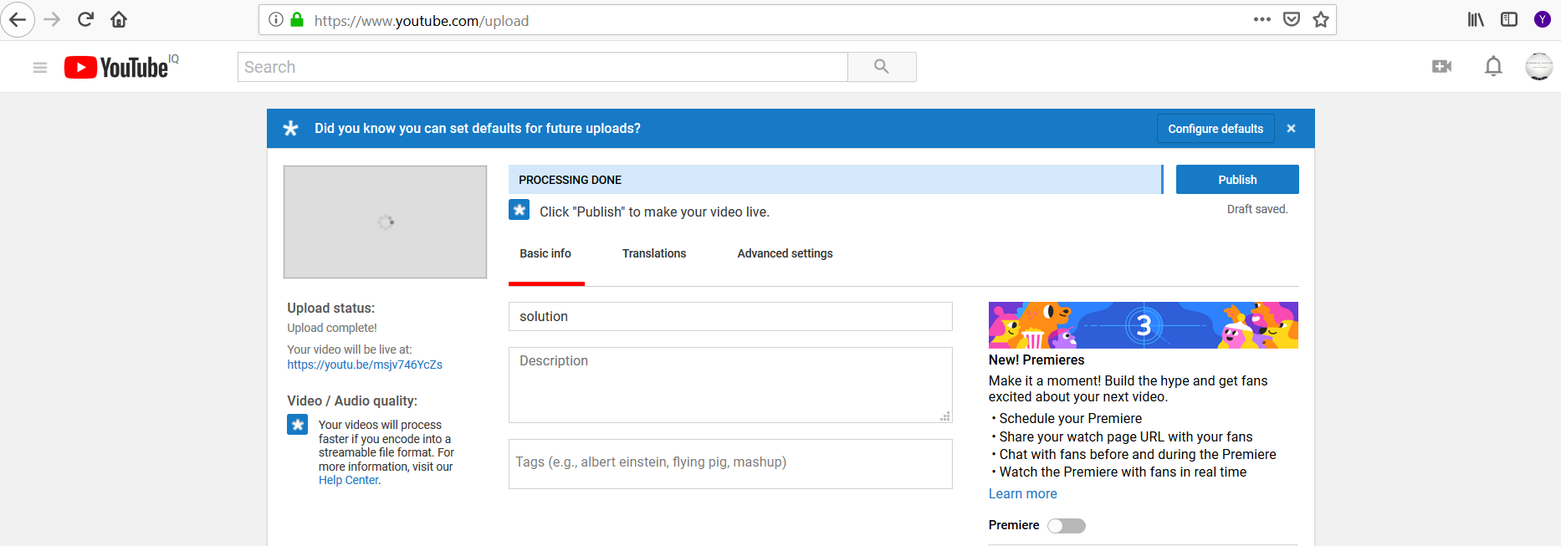

Slide 35
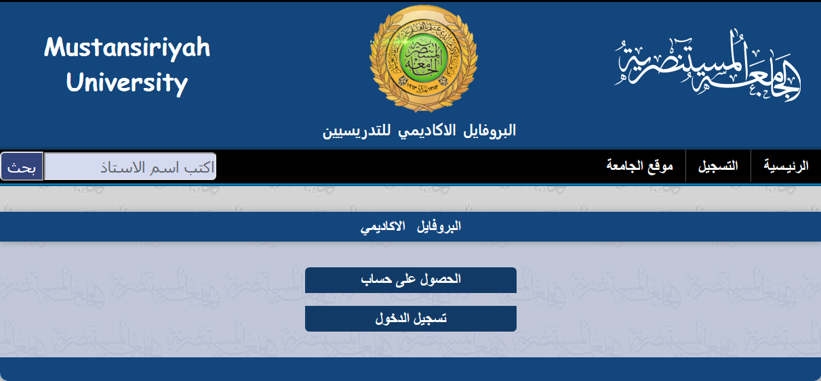
رفع المحاضرة الفديوية عبر صفحة البروفايل الأكاديمي

Slide 36
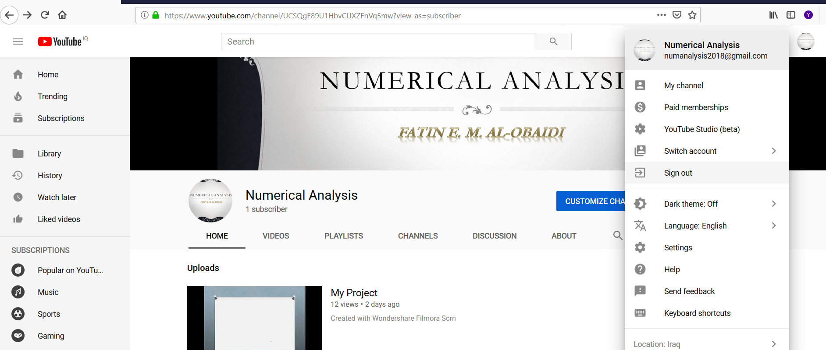

Slide 37
التوصيات
البدء برفع المحاضرات الفديوية المعدة من قبل التدريسي وتجنب استخدام الفديوهات الجاهزة من قناة اليوتيوب على ان يضع التدريسي بصمته في اعداد المحاضرة لضمان حقوق ملكية المحاضرة
استخدام حساب Gmail خاص لأستخدامه في معلومات تسجيل قناة اليوتيوب
من الممكن ان يكون اسم القناة يشير الى المادة الدراسية التي يقوم التدريسي بتدريسها مع امكانية ادراج اسم التدريسي في حال رغبته اضافة اسمه في صورة القناة
تنوع المادة المعروضة كمحاضرة فديوية من حيث الفكرة واسلوب العرض للمساعدة على شد انتباه الطالب والقيام بتحميلها. من الممكن ان تكون المادة المعروضة عرض تقديمي مثلا" للأجوبة النموذجية أو لشرح طريقة ربط دائرة كهربائية معقدة في احدى التجارب.

Slide 38
تغيير كلمة السر بين فترة واخرى في معلومات تسجيل قناة اليوتيوب لضمان امن حساب القناة
ابلاغ الطلبة عبر حقل تبليغات الطلبة بوجود محاضرة فديوية جديدة تم رفعها عبر البروفايل الاكاديمي
الحفاظ على معلومات التسجيل الخاصة بحساب Gmail & Youtub
وتسجيل الخروج بعد كل استخدام للموقعين

Slide 39
شكرا لإصغائكم

