Slide 1

Inorganic Chemistry
Practical II
The Second Course
By
Lecturer Sinan Midhat Al-Bayati
Asst. Prof. Anaam Majeed Rasheed
Asst. Lecturer Al-Ameen Bariz Omar
Supervised by:
Dr. Rehab AbdulMahdi Al-Hassan

Slide 2
Experiment No. (2)
Calculate the Equivalent Weight of Unknown Solid Acid

Slide 4
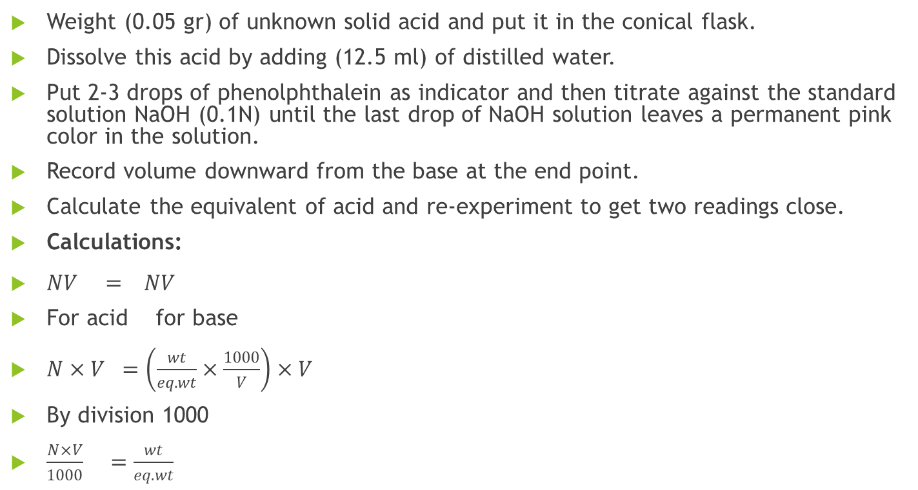
Procedure:
Weight (0.05 gr) of unknown solid acid and put it in the conical flask.
Dissolve this acid by adding (12.5 ml) of distilled water.
Put 2-3 drops of phenolphthalein as indicator and then titrate against the standard solution NaOH (0.1N) until the last drop of NaOH solution leaves a permanent pink color in the solution.
Record volume downward from the base at the end point.
Calculate the equivalent of acid and re-experiment to get two readings close.
Calculations:
$NV = NV$
For acid for base
$N×V =\left(\frac{wt}{eq.wt}×\frac{1000}{V}\right)×V$
By division 1000
$\frac{N×V}{1000} =\frac{wt}{eq.wt}$

Slide 5
Questions:
Define titration and give the tools of it.
Define the detector and give the nature of this work mechanism.
The weight of oxalic acid H₂C₂O₄ was (0.5 gr) titrate against NaOH (0.1 N), calculate the volume of NaOH needed to calibrate acid.
What is the end pont and equivalent point? Explain.
Give some examples of solid acids.

