Slide 1

Inorganic Chemistry
Practical II
The First Course
By
Lecturer Sinan Midhat Al-Bayati
Asst. Prof. Anaam Majeed Rasheed
Asst. Lecturer Al-Ameen Bariz Omar
Supervised by:
Dr. Rehab AbdulMahdi Al-Hassan

Slide 2
Experiment No. (6)
Determination of Magnesium Oxide Formula
Magnesium is a moderately reactive alkaline earth metal. (The alkaline earth’s represents the second group IIA of the periodic table of elements. They are referred to as alkaline because their oxides are basic in water. The term “earth” was used by early alchemists to describe non-metals, the oxides in this case that did not melt in their furnaces. At room temperature, only Magnesium reacts very slowly with oxygen and can be kept for long periods of time without appreciable oxide build up. At elevated temperatures, however, Magnesium will ignite in an excess of oxygen gas, burning with an intensely white flame and producing Magnesium oxide. Because of the brightness of its flame, Magnesium is used in flares and in photographic flashbulbs.

Slide 4
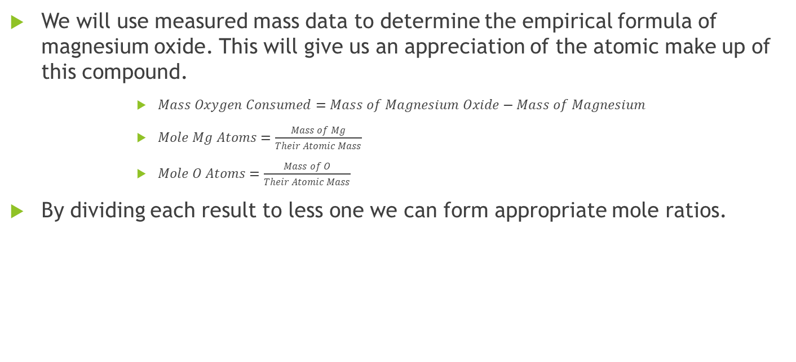
Calculations:
We will use measured mass data to determine the empirical formula of magnesium oxide. This will give us an appreciation of the atomic make up of this compound.
      $Mass Oxygen Consumed=Mass of Magnesium Oxide−Mass of Magnesium$
      $Mole Mg Atoms=\frac{Mass of Mg}{Their Atomic Mass}$
      $Mole O Atoms=\frac{Mass of O}{Their Atomic Mass}$
By dividing each result to less one we can form appropriate mole ratios.

Slide 5
Questions:
In our synthesis of magnesium oxide, why we donot count the mass of ammonia when considering the mass of final product? And how?
Give the reason why we add several drops of water to the crucible then heat it?
You have (59.95 g) of titanium and (40.05 g) of oxygen, give the mole ratio of each element and then give the formula of titanium oxide.
The atom mass of Ti=47.87 g/mole
O=16 g/mole
Write the equation of the reaction.

