Slide 1

Inorganic Chemistry
Practical II
The First Course
By
Lecturer Sinan Midhat Al-Bayati
Asst. Prof. Anaam Majeed Rasheed
Asst. Lecturer Al-Ameen Bariz Omar
Supervised by:
Dr. Rehab AbdulMahdi Al-Hassan

Slide 2
Laboratory Reports:
Each report should include the following:
The title (Name of the Experiment).
Your name, student participating.
Data.
The theoretical part of experiment.
Experiment procedure: describe the steps taken the synthesis and isolate your products. Sometimes these steps, which you have actually taken, might be different from the laboratory procedures given to you. You have to express everything in your own words.
Results and calculations.
Discussion.

Slide 3
The First Group IA (1) Elements (Alkali Metals)
Electronic Structure | Symbol | The Elements
₃[He] 2S¹ | ₃Li | Lithium
₁₀[Ne] 3S¹ | ₁₁Na | Sodium
₁₃[Ar] 4S¹ | ₁₉K | Potassium
₃₆[Kr] 5S¹ | ₃₇Rb | Rubidium
₅₄[Xe] 6S¹ | ₅₅Cs | Cesium
₈₆[Rn] 7S¹ | ₈₇Fr | Francium

Slide 4
Questions:
Why the alkali metals are soft and volatile?
Why they are highly electropositive?
Write down the electronic structure of Francium?
Why the first ionization energies of the group (IA) (1) are low atoms?
Why the chemical reactivity of the metals increases from Li to Cs?
How the charge-radius ratio of Li⁺ differs from those of the other group IA (1) ions?

Slide 5
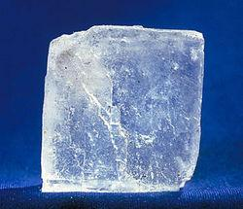
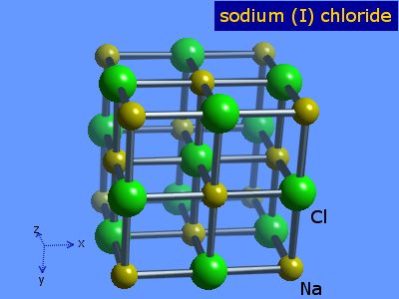

Experiment No. (1)
Purification of Sodium ChlorideNaCl
$$2Na−2e^{−}→2Na^{+}$$
$${Cl}_{2}+2e→2Cl^{−}$$
$$2Na+{Cl}_{2}→2NaCl$$

Slide 6
The Reagents Required:
Crude salt (1g)
BaCl₂ solution 2%
Na₂CO₃ solution 5%
HCl solution (0.2M)

Slide 7
Procedure

Slide 9
Question:
Why BaCl₂ and Na₂CO₃ are used? Explain with chemical equation.
Potassium carbonate cannot be used instead of sodium carbonate? Why? Explain with chemical equation.
Explain why the percentage of pure NaCl increases in the last step, with equation.
Give the properties of NaCl.
Write the equations of this reaction.

