Slide 2
Weight:- Weight:
Is the force generated by the gravitational attraction of the earth on the airplane.
A force is a vector quantity having both a magnitude and a direction associated with it.

Slide 3
For an airplane,
weight is always directed towards the center of the earth
The magnitude of the weight depends on the mass of all the airplane parts, plus the amount of fuel, plus any payload on board (people, baggage, freight, etc.).
The weight is distributed throughout the airplane. But we can often think of it as collected and acting, the airplane rotates about the center of gravity

Slide 4
The dream remains that, if we could really understand gravity, we could create anti-gravity devices which would revolutionize travel through the sky.
Unfortunately, anti-gravity devices only exist in science fiction.
Machines like airplanes, or magnetic levitation devices, create forces opposed to the gravitational force, but they do not block out or eliminate the gravitational force.

Slide 5
Flying encompasses two major problems;
1-Overcoming the weight of an object by some opposing force.
2- Controlling the object in flight.
Both of these problems are related to the object's weight and the location of the center of gravity.

Slide 6
During a flight,
an airplane's weight constantly changes as the aircraft consumes fuel.
The distribution of the weight and the center of gravity also changes.
So the pilot must constantly adjust the controls to keep the airplane balanced, or trimmed.

Slide 8
But weight, the gravitational force, is fundamentally different from the aerodynamic forces, lift and drag .
Aerodynamic forces are mechanical forces and the airplane has to be in physical contact with the air, which generates the force.
The gravitational force is a field force; the source of the force does not have to be in physical contact with the object to generate a pull on the object.
.

Slide 9
Newton developed his theory of gravitation when he was only 23 years old and published the theories with his laws of motion some years later.
The gravitational force between two objects depends on the mass of the objects and the inverse of the square of the distance between the objects.
Newton was able to express the relationship in a single weight equation.

Slide 10
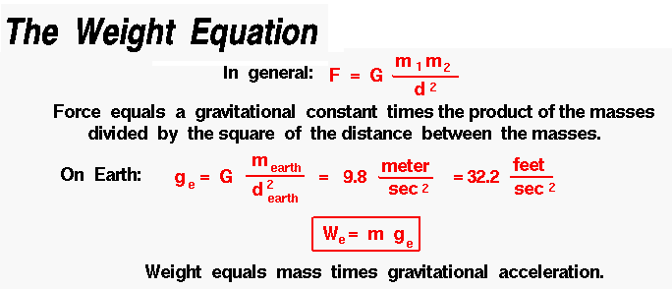

Slide 11
2-Lift To overcome the weight force, airplanes generate an opposing force called lift.
Lift is the:
force that directly opposes the weight of an airplane and holds the airplane in the air. Is directed perpendicular to the flight direction .

Slide 12
Lift is a mechanical aerodynamic force produced by the motion of the airplane through the air.
Lift is generated by every part of the airplane, but most of the lift on a normal airliner is generated by the wings.

Slide 13
Because lift is a force,
it is a vector quantity, having both a magnitude and a direction associated with it.
magnitude of the lift depend on several factors including the shape, size, and velocity of the aircraft

Slide 14
As with weight,
Each part of the aircraft contributes to the aircraft lift force.
Most of the lift is generated by the wings.
Aircraft lift acts through a single point called the center of pressure.
Lift acts through the center of pressure of the object and is directed perpendicular to the flow direction.

Slide 15
The center of pressure is defined:
Just like the center of gravity, but using the pressure distribution around the body instead of the weight distribution.
The amount of lift generated by an object depends on how much the flow is turned, which depends on the shape of the greater the flow turning, the greater the lift .

Slide 18
HOW IS LIFT GENERATED?
Lift occurs when a moving flow of gas is turned by a solid object.
The flow is turned in one direction, and the lift is generated in the opposite direction, according to Newton's Third Law of action and reaction.
Because air is a gas and the molecules are free to move about, any solid surface can deflect a flow.

Slide 19
For an aircraft wing, both the upper and lower surfaces contribute to the flow turning.
Neglecting the upper surface's part in turning the flow leads to an incorrect theory of lift.

Slide 21
NO FLUID, NO LIFT
Lift is a mechanical force It is generated by:
The interaction and contact of a solid body with a fluid (liquid or gas).
It is not generated by a force field, in the sense of a gravitational field,
or an electromagnetic field,
where one object can affect another object without being in physical contact.

Slide 22
For lift to be generated,
The solid body must be in contact with the fluid: no fluid, no lift.
The Space Shuttle does not stay in space because of lift from its wings but because of orbital mechanics related to its speed.
Space is nearly a vacuum. Without air, there is no lift generated by the wings.

Slide 23
NO MOTION, NO LIFT
Lift is generated by the difference in velocity between the solid object and the fluid.
There must be motion between the object and the fluid: no motion, no lift.
It makes no difference whether the object moves through a static fluid, or the fluid moves past a static solid object.
Lift acts perpendicular to the motion.

Slide 25
Lift depends on
The density of the air.
The square of the velocity.
The air's viscosity and compressibility.
The surface area over which the air flows.
The shape of the body,
The body's inclination to the flow.

Slide 26
In general,
The dependence on body
shape,
inclination,
air viscosity,
compressibility
Is very complex.
One way to deal with complex dependencies is to characterize the dependence by a single variable.

Slide 27
For lift, this variable is called:
The lift coefficient designated "Cl."
This allows us to collect all the effects, simple and complex, into a single equation.

Slide 28
The lift equation states that lift L
is equal to the lift coefficient Cl times the density ρ times half of the velocity V squared times the wing area A.
L = Cl x A x 0.5 x ρ x V ²

Slide 29
The lift coefficient:
Is a number that aerodynamicists use to model all of the complex dependencies of
Shape.
Inclination.
Some flow conditions on lift.
This equation is simply a rearrangement of the lift equation where we solve for the lift coefficient in terms of the other variables.

Slide 30
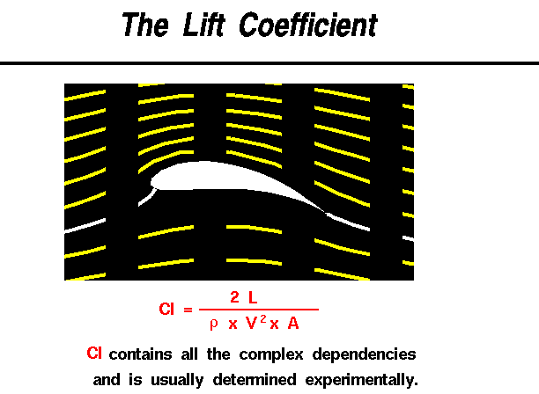

Slide 31
The lift coefficient Cl is equal to
the lift L divided by the quantity: density ρ times half the velocity V squared times the wing area A.
Cl = L / (A x 0 .5 x ρ x V ²)

Slide 32
The quantity :
One half the density times the velocity squared is called the dynamic pressure q.
So Cl = L / (q x A)
The lift coefficient then expresses the ratio of the lift force to the force produced by the dynamic pressure times the area.

Slide 33
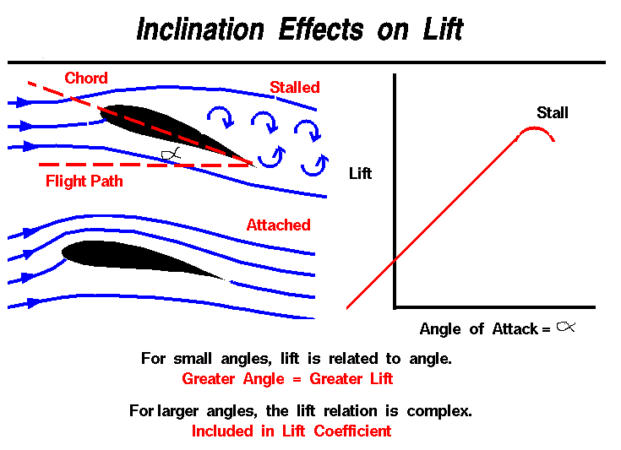

Slide 38
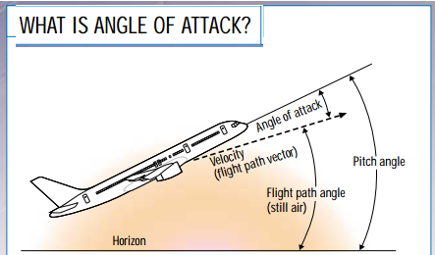

Slide 39
As a wing moves through the air, the wing is inclined to the flight direction at some angle.
The angle between the chord line and the flight direction is called
the Angle of Attack has a large effect on the lift generated by a wing.

Slide 40
But just before lifting off, the pilot "rotates" the aircraft.
The nose of the airplane rises, increasing the angle of attack and producing the increased lift needed for takeoff.

Slide 41
The magnitude of the lift generated by an object depends on the shape of the object and how it moves through the air.
For thin airfoils, the lift is directly proportional to the angle of attack for small angles (within +/- 10 degrees).
For higher angles, however, the dependence is quite complex.

Slide 42
As an object moves through the air, air molecules stick to the surface.
This creates a layer of air near the surface called a boundary layer that, in effect, changes the shape of the object.
The flow turning reacts to the edge of the boundary layer just as it would to the physical surface of the object.

Slide 43
To make things more confusing ,the boundary layer may lift off or "separate" from the body and create an effective shape much different from the physical shape.
The separation of the boundary layer explains why aircraft wings will abruptly lose lift at high angles to the flow.
This condition is called a wing stall.

Slide 44
Drag
As the airplane moves through the air, there is another aerodynamic force present
The air resists the motion of the aircraft and the resistance force is called drag
Drag is the Aerodynamic force that opposes an aircraft's motion through the air.

Slide 45
Drag
Drag is generated by every part of the airplane (even the engines!).
Drag acts in the direction opposed to the motion.
And directed along and opposed to the flight direction.

Slide 46
Like lift:
There are many factors that affect the magnitude of the drag force including the shape of the aircraft, the "stickiness" of the air, and the velocity of the aircraft.
We collect all of the individual components‘ drags and combine them into a single aircraft drag magnitude.
drag acts through the aircraft center of pressure.

Slide 47
Factors that affect drag
As with aircraft lift, there are many factors that affect drag. We can group these factors into:
(a) Those associated with the object,
(b) Those associated with the motion of the object through the air,
(c) Those associated with the air itself

Slide 48
A :The Object
Geometry has a large effect on the amount of drag generated by an object.
As with lift, the drag depends linearly on the size of the object moving through the air.
The cross-sectional shape of an object determines the form drag created by the pressure variation around the object.

Slide 49
The three dimensional plan form shape affects the induced drag of a lifting wing.
If we think of drag as aerodynamic friction,
The amount of drag depends on the;
1-surface roughness of the object.
2- A smooth, waxed surface produces less drag than a roughened surface.
This effect is called skin friction and is usually included in the measured drag coefficient of the object.

Slide 50
B: Motion of the Air
Drag is associated: with the movement of the aircraft through the air,
So drag depends on the velocity of the air.
Like lift,
drag actually varies with the square of the relative velocity between the object and the air.

Slide 51
The inclination of the object to the flow also affects the amount of drag generated by a given shaped object.
If the object moves through the air at speeds near the speed of sound, shock waves are formed on the object which create an additional drag component called wave drag.

Slide 52
The motion of the object through the air also causes boundary layers to form on the object.
A boundary layer is a region of very low speed flow near the surface which contributes to the skin friction.

Slide 53
C: Properties of the Air
Drag depends directly on the mass of the flow going past the aircraft.
The drag also depends in a complex way on two other properties of the air: its viscosity and its compressibility.

Slide 54
We can gather all of this information on the factors that affect drag into a single mathematical equation called the
Drag Equation.
With the drag equation we can predict how much drag force is generated by a given body moving at a given speed through a given fluid.

Slide 55
D = Cd x A x 0.5 x ρ x V ²

Slide 56
Thrust
Is the force, which moves an aircraft through the air.
Thrust is used to overcome the drag of an airplane, and to overcome the weight of a rocket.
Thrust generated by the engines of the aircraft through some kind of propulsion system.

Slide 57
Thrust is a mechanical force, so the propulsion system must be in physical contact with a working fluid to produce thrust.
Thrust generated most often through the reaction of accelerating a mass of gas.
Since thrust is a force, it is a vector quantity having both a magnitude and a direction.

Slide 58
The engine does work on the gas and accelerates the gas to the rear of the engine; the thrust generated in the opposite direction from the accelerated gas.
The magnitude of the thrust depends on the amount of gas that accelerated and on the difference in velocity of the gas through the engine.

Slide 59
Thrust
To overcome drag, airplanes use a propulsion system to generate a force called thrust.
The direction of the thrust force depends on how the engines are attached to the aircraft.

Slide 60
In the figure shown above, two turbine engines are located under the wings, parallel to the body, with thrust acting along the body centerline.
On some aircraft, such as the Harrier, the thrust direction can be varied to help the airplane take off in a very short distance.

Slide 61
The magnitude of the thrust depends on:
Many factors associated with the propulsion system including the type of engine, the number of engines, and the throttle setting
.

Slide 62
For jet engines, it is often confusing to remember that aircraft thrust is a reaction to the hot gas rushing out of the nozzle.
The hot gas goes out the back, but the thrust pushes towards the front.
Action <--> reaction is explained by Newton's Third Law of Motion.

Slide 63
The motion of the airplane through the air depends on the relative strength and direction of the forces shown above.
If the forces are balanced, the aircraft cruises at constant velocity.
If the forces are unbalanced, the aircraft accelerates in the direction of the largest force.

Slide 65
Aviation Weather Hazards
1- Wind Shear and Its Impact on Flight
For business aircraft operators, wind shear has the potential to cause flight turbulence and sudden increases/decreases in both ground and air speed, as well as other associated violent air movements.

Slide 66
It’s always best to talk with your aviation meteorologist to confirm the potential impact of any expected wind shear for your trip.

Slide 67
1. Importance of wind shear
Wind shear is important as it can affect the safety of your flight.
In the upper atmosphere, the main concern is turbulence,
while at lower altitudes – particularly during landing/takeoff – the primary consideration is avoidance of accidents caused by increases in wind shear.

Slide 68
2. Defining wind shear
Wind shear:
A variation in wind speed and direction or both.
over a relatively short distance in the atmosphere is also known, as "wind gradient."
Wind shear refers to variations in wind over either horizontal or vertical distances or both.
Turbulence may also be associated with wind shear, and this is an additional hazard

Slide 69
3. Vertical and horizontal wind shear
Wind shear can occur horizontally or vertically although the most common type is vertical.
Horizontal wind shear usually involves directional changes, particularly when crossing a front.
While vertical wind shear, may involve both directional and speed changes.
Vertical wind shear typically has a greater impact on airspeeds.

Slide 70
4. Where this occurs
Wind shear conditions can occur at low or high altitudes – anywhere there is wind.
Horizontal wind shear is most frequently experienced, when:
crossing fronts or flying near mountainous areas.
Vertical wind shear
can be experienced anywhere from the surface to upper Flight Levels (FLs) – particularly with associated thunderstorm conditions.

Slide 71
The most dangerous conditions are when flying at lower levels, due to proximity of the surface and potential for accidents.
At higher altitudes, the negative effects of wind shear are mostly related to turbulence.

Slide 72
5. Measuring wind shear
Wind shear is always measured in knots, with the values being either positive or negative. Increases in wind shear value are positive numbers,
while decreases are noted as negative values.
When operating in the upper atmosphere, wind shear value is almost always positive.
Closer to the surface, you may experience negative wind shear values.

Slide 73
TURBULENCE AND WINDSHEAR
Wind shear can be defined as:
‘layers or columns of air, flowing with different velocities (i.e. speed and/or direction)
to adjacent layers or columns’.
Wind shear is a major hazard for aviation especially when operating at low levels.

Slide 74
Even when flying within a layer with a laminar flow and the flight is smooth and uneventful, the sudden crossing of the boundaries between different laminar streams will accelerate the aircraft to a greater or lesser degree.
Depending on the flight direction relative to the velocity changes, shear may be felt as turbulence, but also as a sudden tail or head wind with respective consequences

Slide 77
Crosswind
Is wind blowing from the side of
aircraft.
Large changes in crosswind during landing might cause an aircraft to deviate from the runway centerline.

Slide 79
The Relationship Between
Wind Shear and Turbulence
Turbulence is the direct result of wind shear.
The stronger the shear the greater the tendency for the laminar flow of the air to break down into eddies resulting in turbulence.
However, not all shear zones are turbulent, so the absence of turbulence does not infer that there is no shear.

Slide 80
Thunderstorms
No other weather encountered by a pilot can be as violent or threatening as a thunderstorm.
Thunderstorms produce many hazards to the aviation community , it is important that pilots understand their nature and how to deal with them.

Slide 81
To produce a thunderstorm, there are several ingredients which must be in place.
These include:
• An unstable air mass
• Moisture in the low levels
• Daytime heating, upper level cooling
• For severe thunderstorms, wind shear.

Slide 82
The Life Cycle of a Thunderstorm
The thunderstorm, which may cover an area ranging from 5 miles in diameter to, in the extreme case, as much as 50 miles, usually consists of two or more cells in different stages of their life cycle.

Slide 83
The stages of life of individual cells are:
Cumulus Stage :
The cumulus stage is marked by updrafts only.
These updrafts can reach values of up to 3,000 feet per minute and cause the cloud to build rapidly upwards, carrying super cooled water droplets well above the freezing level.
.

Slide 84
Near the end of this stage, the cloud may well have a base more than 5 miles across and a vertical extent in excess of 20,000 feet.
The average life of this stage is about 20 minutes

Slide 85
(b) Mature Stage
The appearance of precipitation beneath the base of the cell and the development of the downdraft mark the transition to this stage.
The downdraft is caused by water drops which have become too heavy for the updraft to support and now begin to fall.

Slide 86
At the same time, the drops begin to evaporate as they draw in dry air from the edge of the cloud, and then fall through the drier air beneath the base of the cloud.
This evaporation causes the air to cool and become denser, resulting in a downwash of accelerating cold air.
Typical downdraft speeds can reach values of 2,500 feet per minute

Slide 88
(c) Dissipating Stage
The dissipating stage of a cell is marked by the presence of downdrafts only.
With no additional flow of moisture into the cloud from an updraft, the rain gradually tapers off and the downdrafts weaken.
The cell may dissipate completely in 15 to 30 minutes, leaving clear skies or patchy cloud layers.
At this stage the anvil, which is formed almost exclusively of ice crystals, often detaches
and drifts off downwind.

Slide 89
Types of Thunderstorms
(a) Air Mass Thunderstorms
These thunderstorms form within a warm, moist air mass and are non-frontal in nature.
They are usually a product of diurnal heating, tend to be isolated, reach maximum strength in the late afternoon, are seldom(نادر) violent((عنيف, and usually dissipate quickly after the setting of the sun.

Slide 90
There is also:
a second form of air mass thunderstorm
that is created by cold advection.
In this case, cold air moves across warm land or water and becomes unstable.
Of these two, it is the movement of cold air over warm water that results in the most frequent occurrence of this type of thunderstorm.
Since the heating is constant, these thunderstorms can form at any time of day or night.

Slide 91
(b )Frontal Thunderstorms
These thunderstorms form either as the result of a frontal surface lifting an unstable air mass or a stable air mass becoming unstable, as a result of the lifting.
Frontal thunderstorms can be found along cold fronts and warm fronts .

Slide 92
These thunderstorms tend to be numerous((متعددة in the area, often form in lines, are frequently embedded in other cloud layers, and tend to be active during the afternoon and well into the evening.
Cold frontal thunderstorms are normally more severe than warm frontal thunderstorms

Slide 93
(c) Squall Line Thunderstorms
A squall line (or line squall) is a line of thunderstorms.
Squall lines can be several hundred miles long and have lower bases and higher tops than the average thunderstorm.
Violent combinations of strong winds, hail, rain and lightning make them an extreme hazard not only to aircraft in the air, but also to those parked uncovered on the ground.

Slide 94
Squall line thunderstorms are most often found 50 to 300 miles ahead of a fast-moving cold front but can also be found in accompanying low pressure troughs, in areas of convergence, along mountain ranges and even along sea breeze fronts.

Slide 95
(d) Orographic Thunderstorms
Orographic thunderstorms occur when moist, unstable air is forced up a mountain slope.
These are common in the foothills of the Rocky Mountains where, on a typical summer day, they form due to a combination of upslope flow and daytime heating .
When they get high enough, the prevailing west southwest flow aloft carries them eastwards.

Slide 96
If conditions are favorable, they can persist
for several hours, otherwise they dissipate fairly rapidly.
Typically, they will begin to develop in mid-morning and can continue to form well into the afternoon.
In such situations, these storms frequently produce copious amounts of hail.

Slide 97
(e )Nocturnal Thunderstorms
Nocturnal(نشط ليلاً)thunderstorms are those that develop during or persist all night.
Usually, they are associated with an upper level weather feature moving through the area, are generally isolated, and tend to produce considerable lightning.

Slide 98
Severe Thunderstorms
The discussion of the life cycle of a thunderstorm does not fit the case of those that seem to last for extended periods of time and are most prolific in producing tornadoes and large hail.
A particular type of severe thunderstorm is known as a “Super cell”.

Slide 99
The Super cell storm typically begins as a multi-cellular thunderstorm.
However, because the upper winds increase strongly with height, the cell begins to tilt.
This causes the descending precipitation to fall through only a portion of the cell, allowing the updraft to persist.

Slide 100
The environment in and around a thunderstorm can be the most hazardous encountered by an aircraft.
In addition to the usual risks such as severe turbulence, severe clear icing, large hail, heavy precipitation, low visibility and electrical discharges within and near the cell, there are other hazards that occur in the surrounding environment.

Slide 102
In flight, the airplane rotates about the center of gravity, but the direction of the weight force always remains toward the center of the earth. During a flight the aircraft burns up its fuel, so the weight of the airplane constantly changes. Also, the distribution of the weight and the center of gravity can change, so the pilot must constantly adjust the controls to keep the airplane balanced.

Slide 103
https://www.grc.nasa.gov/www/K12/airplane/guided.htm
http://www.plusnetwork.com
https://en.wikipedia.org/wiki/Lift_(force)#cite_note-17

Slide 104
Note that the job of the engine is just to overcome the drag of the airplane, not to lift the airplane.
WHY DOES A WING HAVE A ROUNDED FRONT?
WHY DOES A WING HAVE A SHARP REAR EDGE?
HOW DOES TILTING A WING AFFECT THE AIR FLOWING OVER IT?

