Slide 1
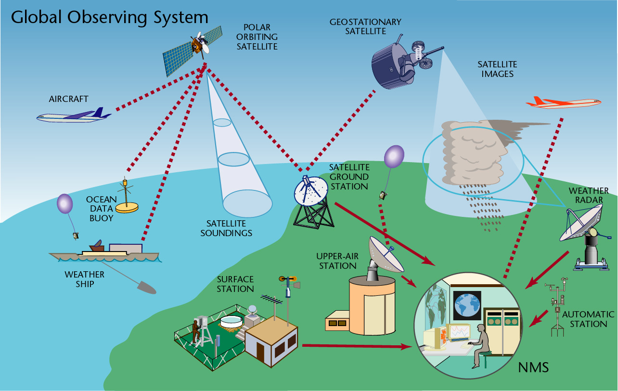
The Course of
Meteorological Instrumentation and Observations
MUSTANSIRIYAH UNIVERSITY
COLLEGE OF SCIENCES
ATMOSPHERIC SCIENCES DEPARTMENT
2018-2019
Dr. Sama Khalid Mohammed
SECOND STAGE

Slide 2

Welcome Students! ☺
To LECTURE six
Surface Observation

Slide 3
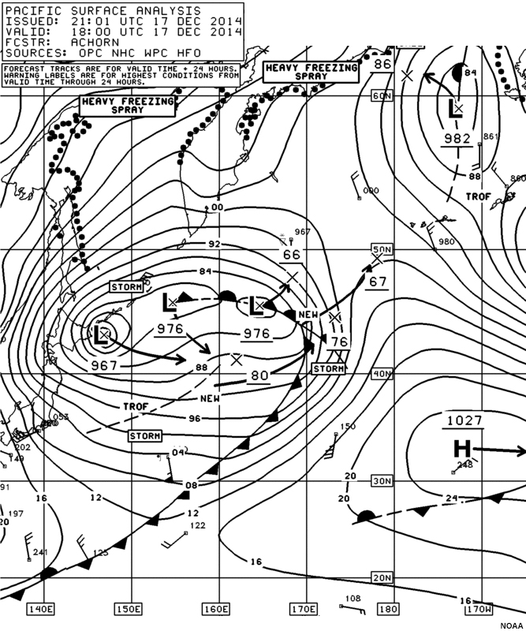
Overview of Weather Maps and Symbols
Weather affects marine and aviation operations as well as activities across other domains. Forecasters and consumers of weather information need a way to be able to anticipate how conditions are changing and what situations might be expected in near-term or longer time frames.
To help find those answers, weather maps or charts provide a view of conditions and patterns across larger spatial scales.
Mapping the changes in pressure, temperature, winds, and other weather parameters across areas provides information about weather systems and how they move or evolve.
The ability to accurately read and interpret these charts is integral to the weather forecasting process.

Slide 4
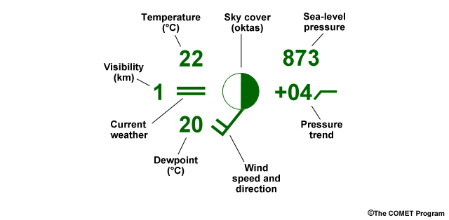
The Weather Station Model
Oftentimes, weather maps will display observation information using a "station model" format. Station models are a way to show information in a small space without words. Instead, specific symbols are used to represent cloud cover, wind speed, and other meteorological variables. Here is a guide to decoding a simplified station model.

Slide 5
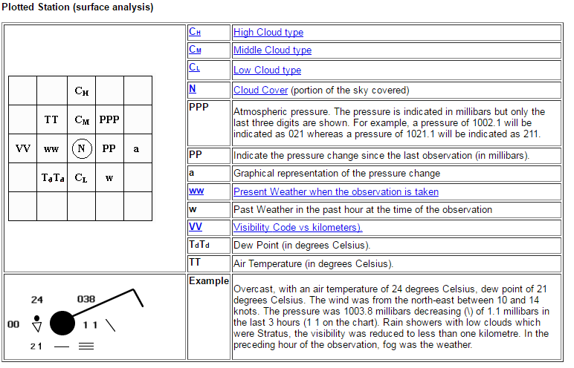

Slide 6

FM SYSTEM OF CODE FORMS - Traditional Alphanumeric Codes (TAC)
FM 12–XII Ext. SYNOP Report of surface observation from a fixed land station
FM 13–XII Ext. SHIP Report of surface observation from a sea station
FM 14–XII Ext. SYNOP MOBIL Report of surface observation from a mobile land station
FM 15–XIII Ext. METAR Aerodrome routine meteorological report (with or without trend forecast)
FM 16–XIII Ext. SPECI Aerodrome special meteorological report (with or without trend forecast)
FM 18–XII BUOY Report of a buoy observation
FM 20–VIII RADOB Report of ground radar weather observation
FM 22–IX Ext. RADREP Radiological data report (monitored on a routine basis and/or in case of accident)
FM 32–XI Ext. PILOT Upper-wind report from a fixed land station
FM 33–XI Ext. PILOT SHIP Upper-wind report from a sea station
FM 34–XI Ext. PILOT MOBIL Upper-wind report from a mobile land station
Rec. 22 (CBS-89), approved by the President of WMO and Res. 8 (EC-LI)
FM 35–XI Ext. TEMP Upper-level pressure, temperature, humidity and wind report from a fixed land station
FM 36–XI Ext. TEMP SHIP Upper-level pressure, temperature, humidity and wind report from a sea station

Slide 7
FM SYSTEM OF CODE FORMS - Traditional Alphanumeric Codes (TAC)
FM 37–XI Ext. TEMP DROP Upper-level pressure, temperature, humidity and wind report from a sonde released by carrier balloons or aircraft
FM 38–XI Ext. TEMP MOBIL Upper-level pressure, temperature, humidity and wind report from a mobile land station
FM 39–VI ROCOB Upper-level temperature, wind and air density report from a land
rocketsonde station
FM 40–VI ROCOB SHIP Upper-level temperature, wind and air density report from a rocketsonde station on a ship
FM 41–IV CODAR Upper-air report from an aircraft (other than weather reconnaissance aircraft)
FM 42–XI Ext. AMDAR Aircraft report (aircraft meteorological data relay)
FM 44–V ICEAN Ice analysis
FM 45–IV IAC Analysis in full form
FM 46–IV IAC FLEET Analysis in abbreviated form
FM 47–IX Ext. GRID Processed data in the form of grid-point values
FM 49–IX Ext. GRAF Processed data in the form of grid-point values (abbreviated code form)
FM 50–XIII WINTEM Forecast upper wind and temperature for aviation
FM 51–XIII Ext. TAF Aerodrome forecast
FM 53–X Ext. ARFOR Area forecast for aviation
FM 54–X Ext. ROFOR Route forecast for aviation

Slide 8
FM SYSTEM OF CODE FORMS - Traditional Alphanumeric Codes (TAC)
FM 57–IX Ext. RADOF Radiological trajectory dose forecast (defined time of arrival and location)
FM 61–IV MAFOR Forecast for shipping
FM 62–VIII Ext. TRACKOB Report of marine surface observation along a ship’s track
FM 63–XI Ext. BATHY Report of bathythermal observation
FM 64–XI Ext. TESAC Temperature, salinity and current report from a sea station
FM 65-XI Ext. WAVEOB Report of spectral wave information from a sea station or from a remote platform (aircraft or satellite)
FM 67–VI HYDRA Report of hydrological observation from a hydrological station
FM 68–VI HYFOR Hydrological forecast
FM 71–XII CLIMAT Report of monthly values from a land station
FM 72–XII CLIMAT SHIP Report of monthly means and totals from an ocean weather station
FM 73–VI NACLI CLINP SPCLI CLISA INCLI Report of monthly means for an oceanic area
FM 75–XII Ext. CLIMAT TEMP Report of monthly aerological means from a land station
FM 76–XII Ext. CLIMAT TEMP SHIP Report of monthly aerological means from an ocean weather station

Slide 9
FM SYSTEM OF CODE FORMS - Traditional Alphanumeric Codes (TAC)
FM 81–I SFAZI Synoptic report of bearings of sources of atmospherics
FM 82–I SFLOC Synoptic report of the geographical location of sources of atmospherics
FM 83–I SFAZU Detailed report of the distribution of sources of atmospherics by
bearings for any period up to and including 24 hours
FM 85–IX SAREP Report of synoptic interpretation of cloud data obtained by a meteorological satellite
FM 86–XI SATEM Report of satellite remote upper-air soundings of pressure, temperature and humidity
FM 87–XI SARAD Report of satellite clear radiance observations
FM 88–XI SATOB Report of satellite observations of wind, surface temperature, cloud, humidity and radiation
FM SYSTEM OF CODE FORMS – Table Driven Code Forms (TDCF)
FM 92–XI Ext. GRIB edition 1 Processed data in the form of grid-point values
(gridded binary) expressed in binary form
FM 92–XIII Ext. GRIB edition 2 General regularly-distributed information in binary form
FM 94–XIII Ext. BUFR Binary universal form for the representation of meteorological data
FM 95–XIII Ext. CREX Character form for the representation and exchange of data

Slide 10
The code of surface observation
The code of surface observation has three codes forms:
The code form FM 12 SYNOP is used for reporting synoptic surface observations from a fixed land station, manned or automatic.
The code form FM 13 SHIP is used for the same kind of observations from a sea station, manned or automatic.
The code form FM 14 SYNOP MOBIL is used for surface observations from an automatic or manned land station not at a fixed location.
The code of surface observation consists of 6 sections (0-5), and each section contains many groups, each group consist of 5 numbers, the first number called the group identifier as it will be explained later.

Slide 11
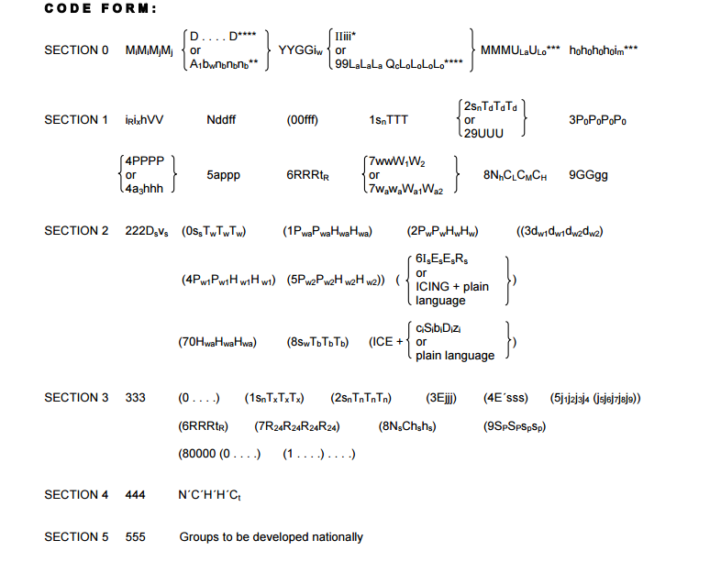

Slide 12
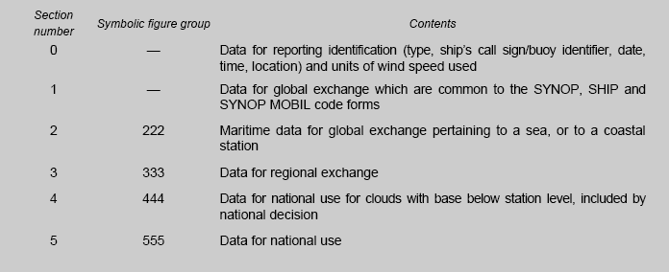

Slide 13
Section 0: contains information about the station characteristics ( the ship’s call sign, date and time of the observation, and ship’s position at the time of the observation.
M_{i}M_{i}M_{j}M_{j} | The type of the station
AAXX | A SYNOP report from a fixed land station
BBXX | A SHIP report from a sea station
OOXX | A SYNOP MOBIL report from a mobile land station
YY -- The day of the month
GG -- The hour of the observation (UTC)
i_{w} -- Wind type indicator
0 -- m/s (estimated)
1 -- m/s (from anemometer)
2 -- knots (estimated)
3 -- knots (from anemometer)
/ -- wind speed not available
YYGGi_{w}

Slide 14
In a bulletin of SYNOP reports from fixed land stations, the groups M_{i}M_{i}M_{j}M_{j} YYGGi_{w} shall be included only as the first line of the text, provided all the reports of the bulletin were taken at the same time and use the same unit for reporting wind speed.
The identification of a mobile land station or sea station shall be indicated by the group D . . . . D.
The identification of stations located at sea on a drilling rig or an oil- or gas production platform shall be indicated by the group A₁b_{w}n_{b}n_{b}n_{b}.
In reports of sea stations other than buoys, drilling rigs and oil- or gas-production platforms, and in the absence of a ship's call sign, the word SHIP shall be used for D . . . . D.
In reports from a mobile land station, only in the absence of a suitable call sign, the word MOBIL shall be used for D . . . . D.

Slide 15
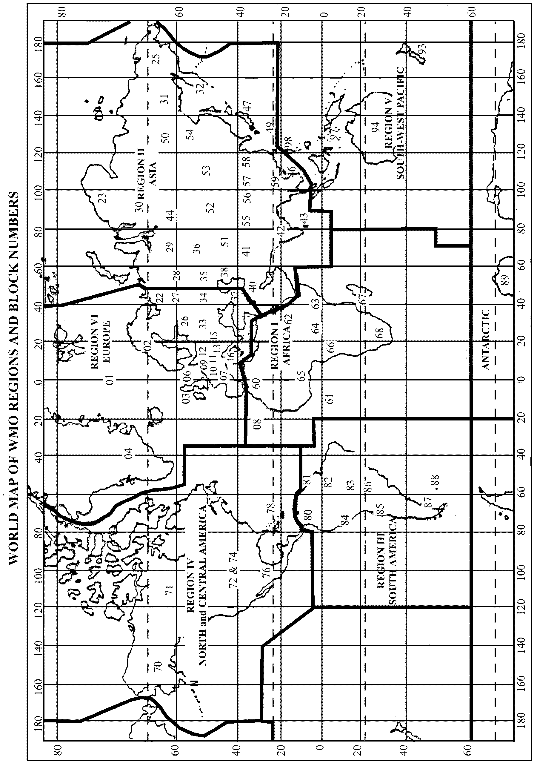
IIiii - International Index Number
II - Block number. Block numbers are allocated to one country, part of a country, or several countries in the same region. Not all block numbers are listed on the map, especially for small countries.
iii - Station number . These are assigned to individual stations within each country as station identifiers

Slide 16
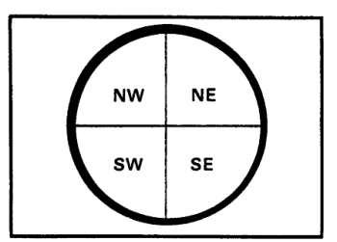
For sea station, its position shall be indicated by the groups:
99LaLaLa QcLoLoLoLo.
for mobile land stations, its position shall be indicated by the groups: 99LaLaLa QcLoLoLoLo MMMU_{La}U_{Lo} and include the group h₀h₀h₀h₀i_{m} to indicate the elevation of the station, including the units of measure for the elevation and the accuracy of the elevation.
99LaLaLa QcLoLoLoLo MMMU_{La}U_{Lo} h₀h₀h₀h₀i_{m}
LaLaLa -- Latitude of observation to .1 degrees
Qc -- Quadrant of observation
0 - - at the equator
1 -- North east
3 -- South east
5 -- South west
7 -- North west

Slide 17
LoLoLoLo -- Longitude of observation to .1 degrees
MMM: Number of Marsden squares in which the station is situated at the time of observation
ULaULo : Unit digit in the reported latitude and latitude respectively.
h₀h₀h₀h₀ Elevation of a mobile land station making surface or upper-air observations, in either metres or feet as indicated by i_{m}.

Slide 18
Land Observations
i_{R}i_{X}hVV
i_{R} -- Precipitation indicator
0 ,1,2 --Precipitation reported
3,4 -- Precipitation omitted, no precipitation, no observation
i_{x} -- Station type and present and past weather indicator as shown in the following figure:

Slide 19
Table of Station type i_{x} and present and past weather indicator
Code | Type of station | Group 7wwW1W1
1 | Manned | Included
2 | Manned | Omitted (no significant phenomenon to report)
3 | Manned | Omitted( no observation, data not available)
4 | Automatic | Included
5 | Automatic | Omitted (no significant phenomenon to report)
6 | Automatic | Omitted (no observation, data not available)
7 | Automatic | Included
h : Height above the surface of the base of the lowest cloud seen.

Slide 20
Code figure | Feet | Meters
0 | 0-100 | 0-50
1 | 100-300 | 50-100
2 | 300-600 | 100-200
3 | 600-900 | 200-300
4 | 900-1900 | 300- 600
5 | 1900-3200 | 600-1000
6 | 3200-4900 | 1000-1500
7 | 4900-6500 | 1500-2000
8 | 6500-8000 | 2000-2500
9 | 8,000 or higher or no cloud | 2500 or higher or no cloud
/ | Height of base of cloud is not known.
VV : Horizontal surface visibility ( how far you can see)
The code is direct reading in units of 100 m from 0 to 50.
The code figures 51 to 55 are not used.
For code figures 56 to 80, 50 is subtracted and the remaining figure is direct reading in units of km.
Code figures 90 to 99 are used to report visibility in the ship synoptic code.
03

Slide 21
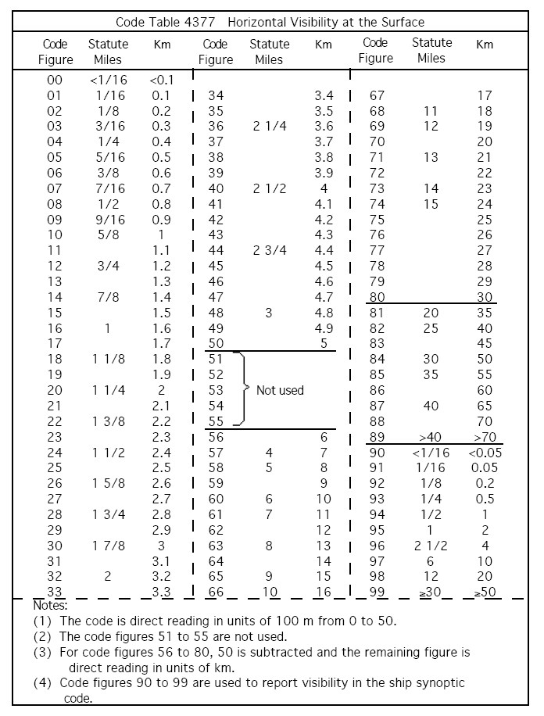

Slide 22
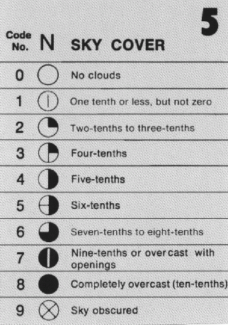
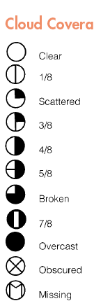
Nddff - Total Cloud Cover and Wind Group
N : Total cloud cover.
Code figure | Cloud amount (oktas) | Cloud amount (tenths)
0 | 0 | 0
1 | 1/8 or less, not zero | 1/10 or less, not zero
2 | 2/8 | 2/10 - 3/10
3 | 3/8 | 4/10
4 | 4/8 | 5/10
5 | 5/8 | 6/10
6 | 6/8 | 7/10 – 8/10
7 | 7/8 or more but not 8/8 | 9/10 or more, but not 10/10
8 | 8/8 | 10/10
9 | Sky obscured, or cannot be estimated.
/ | No measurement made

Slide 23
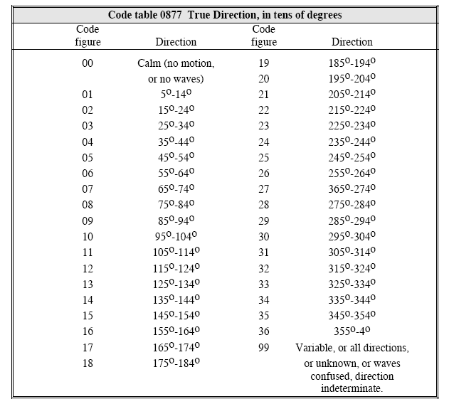
dd :True wind direction in tens of degrees, from which the wind is blowing.
ff : Wind speed in units indicated by i_{w}.
In the northern hemisphere, the lines and flags are on the clockwise side of the barb.

Slide 24
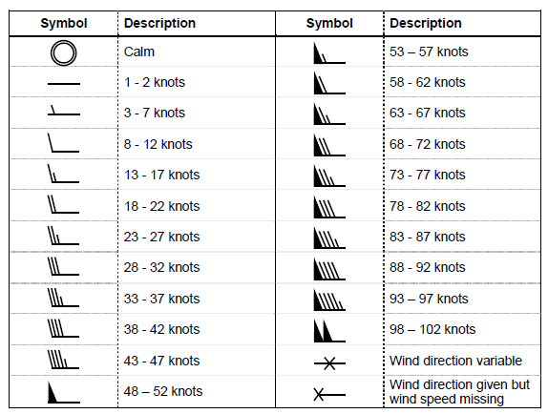
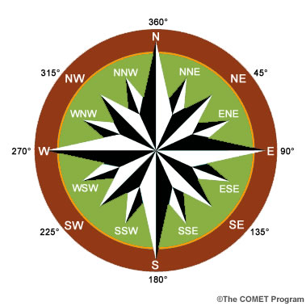

Slide 25
1s_{n}TTT - Air Temperature Group
1 : Identifier for the air temperature group.
s_{n} : Sign of the temperature.
0 = temperature is positive or zero,
1 = temperature is negative.
TTT : Air temperature in tenths of degrees Celsius.
28
12
2s_{n}T_{d}T_{d}T_{d} - Dew Point Temperature Group or Relative Humidity.
2 : Identifier for the dew point temperature group.
s_{n} : Sign of the dew point temperature.
0 = dew point temperature is positive or zero,
1 = dew point temperature is negative,
9 = relative humidity follows.
T_{d}T_{d}T_{d} : Dew point temperature in tenths of degrees Celsius.
3P₀P₀P₀P₀ - Station Pressure Group
3 : Identifier for the station pressure group.
P₀P₀P₀P₀ : Pressure at station level, in tenths of a hPa.
If the station pressure is more than 999.9 hPa, drop the thousands digit of the pressure. Example: station pressure = 1016.7 hPa
P₀P₀P₀P₀= 0167

Slide 26
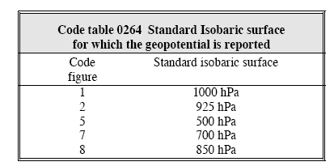
4PPPP : Sea Level Pressure Group
4 : Identifier for sea level pressure group.
PPPP : Sea level pressure. This is the station pressure “reduced” to mean sea level in tenths of a hPa. Pressure is abbreviated as a three-number code, with the last digit representing the decimal.
996
4a3hhh
The standard isobaric surface for which the following height is reported.
See code table The group 4a3hhh is used, by regional decision, by a high-level station which cannot give pressure at mean sea-level to a satisfactory degree of accuracy. The standard height of an agreed standard isobaric surface shall be reported.
hhh - Geopotential of an agreed standard isobaric surface given by a3, reported in standard geopotential meters, omitting the thousands digit.

Slide 27
Note: for the Sea level pressure 4PPPP
If the first number of the pressure reported on the station model is less than 500 the sea level pressure is the number provided by placing a "10" in front of the three-number code and putting the decimal point in front of the last digit (e.g., 415 corresponds to 1041.5 mb).
If the first number on the model is more than 500, the sea level pressure is the number provided by placing a "9" in front of the three-number code (697 corresponds to a sea level pressure of 969.7 mb). Likewise, 119 denotes a sea level pressure of 1011.9 hPa (1011.9 mb) and 873 denotes a pressure of 987.3 hPa (987.3 mb).
If the first digit is 1,2,5,7,8 this indicates that the is not a sea level pressure and it is instead a geopotential height value

Slide 28
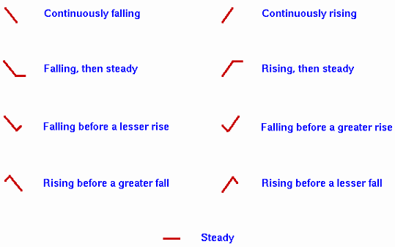
5appp - Pressure tendency over 3 hours Group
5 : Identifier for the group reporting pressure tendency and pressure change for the three hours preceding the time of observation.
a : Characteristic of the pressure tendency during the three hours preceding the time of the observation. See the following table.
ppp : Actual change in the pressure during the three hours ending at the actual time of the observation, expressed in tenths of hPa.
+19/
The pressure trend reports the three-hour pressure change in tenths of millibars. The value can be expressed as either one or two digits. A value of -18 for the pressure trend means that the pressure has fallen 1.8 hPa (or 1.8 mb). A pressure decrease of 0.5 hPa (or 0.5 mb) can be written as -5 or -05 on the station model.

Slide 29
Characteristic of Pressure Tendency (a)
0 | Increasing, then decreasing; atmospheric pressure the same or higher than 3 hours ago.
1 | Increasing, then steady; or increasing, then increasing more slowly. | Atmospheric pressure now higher than 3 hours ago.
2 | Increasing (steadily or unsteadily).
3 | Decreasing or steady, then increasing; or increasing, then increasing more rapidly.
4 | Steady; atmospheric pressure the same as 3 hours ago.
5 | Decreasing, then increasing; atmospheric pressure the same or lower than 3 hours ago.
6 | Decreasing, then steady; or decreasing, then decreasing more slowly. | Atmospheric pressure now lower than 3 hours ago.
7 | Decreasing (steadily or unsteadily)
8 | Steady or increasing, then decreasing; or decreasing, then decreasing more rapidly.

Slide 30
6RRRt_{R} - Identifier for the precipitation group
RRR : Total amount of precipitation fallen during the period preceding the time of observation, as indicated by t_{R}.
t_{R} : Length of time covered by the group.
Amount of precipitation
Code figure | Amount (mm) | Code figure | Amount (mm)
000 | Not used | 990 | Trace
001 | 1 | 991 | 0.1
002 | 2 | 992 | 0.2
003 | 3 | 993 | 0.3
004 | 4 | 994 | 0.4
Etc. | Etc. | 995 | 0.5
987 | 987 | 996 | 0.6
988 | 988 | 997 | 0.7
989 | 989 | 998 | 0.8
 |  | 999 | 0.9
Code figure | Duration of period of precipitation
1 | 6 hours preceding time of observation
2 | 12 hours preceding time of observation
3 | 18 hours preceding time of observation
4 | 24 hours preceding time of observation
5 | 1 hour preceding time of observation.
6 | 2 hour preceding time of observation.
7 | 3 hour preceding time of observation.
8 | 9 hour preceding time of observation.
9 | 15 hour preceding time of observation.

Slide 31
7wwW₁W₂ - Present and Past Weather Group reported from a manned weather station.
7 : Identifier for the present and past weather group
ww : Present weather at the time of the observation.
W₁W₂ : Past weather. The most significant and the second most significant past weather during the period.
*
Code | Past weather
0 | Cloud covering 1/2 or less of the sky throughout the appropriate period.
1 | Cloud covering more than 1/2 of the sky during part of the appropriate period and covering 1/2 or less during part of the period.
2 | Cloud covering more than 1/2 of the sky throughout the appropriate period.
3 | Sandstorm, dust storm, or blowing snow.
4 | Fog or ice fog or thick haze. | 7 | Snow, or rain and snow mixed.
5 | Drizzle. | 8 | Shower(s).
6 | Rain. | 9 | Thunderstorm(s) with or without precipitation.

Slide 32
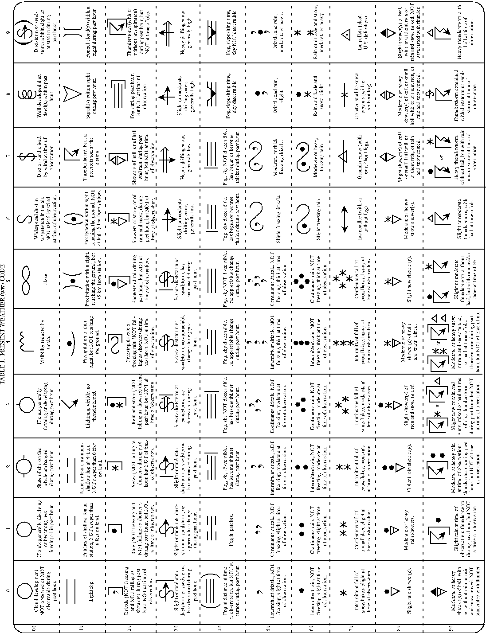

Slide 33
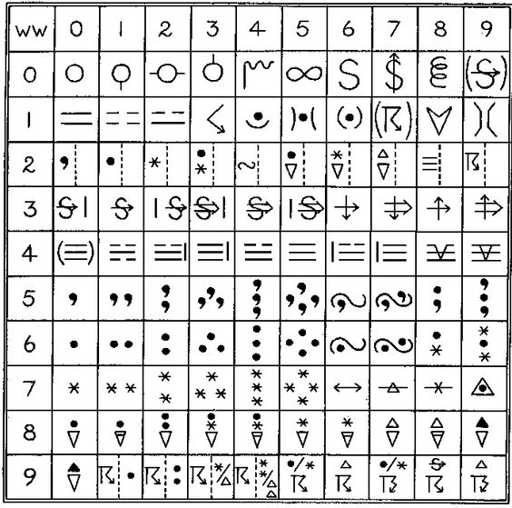

Slide 34
8N_{h}C_{L}C_{M}C_{H} - Cloud Type Group
8 : Identifier of the type of cloud group.
N_{h} : Amount of low cloud present, if no low clouds, the amount of the middle clouds
CL : Clouds of the genera stratocumulus, stratus, cumulus, and cumulonimbus.
C_{M} : Clouds of the genera Altocumulus, Altostratus, and Nimbostratus.
C_{H} : Clouds of the genera Cirrus, Cirrocumulus, and Cirrostratus.

Slide 35
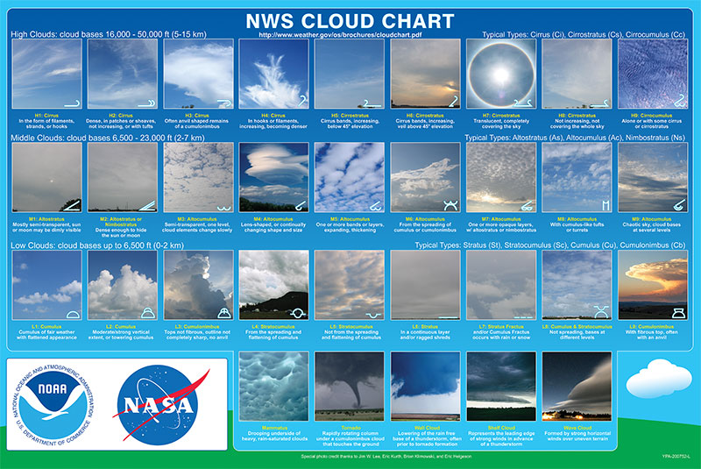

Slide 36
C_{L}
Code | Discription
0 | No C_{L} clouds
1 | Cumulus humilis or cumulus fractus other than of bad weather,* or both.
2 | Cumulus mediocris or congestus, with or without cumulus of species fractus or humilis or stratocumulus, all having their bases at the same level.
3 | Cumulonimbus calvus, with or without cumulus, stratocumulus or stratus.
4 | Stratocumulus cumulogenitus.
5 | Stratocumulus other than stratocumulus cumulogenitus.
6 | Stratus nebulosus or stratus fractus other than of bad weather, or both.
7 | Stratus fractus or cumulus fractus of bad weather.
8 | Cumulus and stratocumulus other than stratocumulus cumulogenitus, with bases at different levels.
9 | Cumulonimbus capillatus (often with an anvil), with or without cumulonimbus calvus, cumulus, stratocumulus, stratus or pannus.
/ | CL clouds invisible owing to darkness, fog, blowing dust or sand, or … .
3 hour pressure change in 0.1 mb

Slide 37
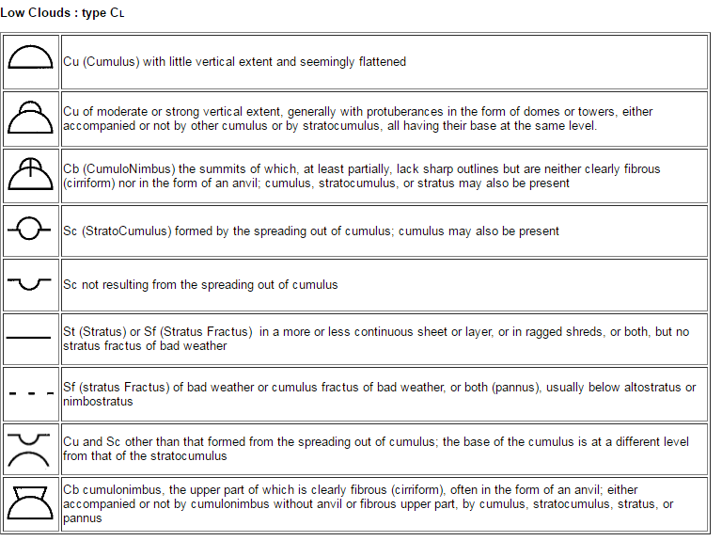

Slide 38
C_{M}
Code | Discription
0 | No C_{M} clouds
1 | Altostratus translucidus
2 | Altostratus opacus or nimbostratus
3 | Altocumulus translucidus at a single level.
4 | Patches (often lenticular) of altocumulus translucidus, continually changing and occurring at one or more levels.
5 | Altocumulus translucidus in bands.
6 | Altocumulus cumulogenitus (or cumulonimbogenitus)
7 | Altocumulus translucidus or opacus in two or more layers.
8 | Altocumulus castellanus or floccus.
9 | Altocumulus of a chaotic sky, generally at several levels.
/ | CM clouds invisible owing to darkness, fog, blowing dust or sand, or other similar phenomena, or because of continuous layer of lower clouds.

Slide 39
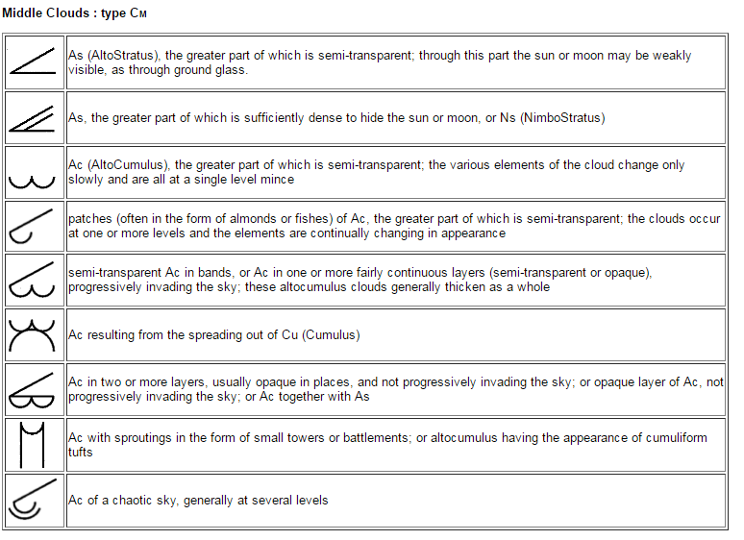

Slide 40
C_{H}
Code | Discription
0 | No C_{H} clouds
1 | Cirrus fibratus, sometimes uncinus, not progressively invading the sky.
2 | Cirrus spissatus, in patches or entangled sheaves.
3 | Cirrus spissatus cumulonimbogenitus.
4 | Cirrus uncinus or fibratus, or both, progressively invading the sky.
5 | Cirrus (often in bands) and cirrostratus, or cirrostratus alone, progressively invading the sky.
6 | Cirrus (often in bands) and cirrostratus, or cirrostratus alone, progressively invading the sky; they generally thicken as a whole;.
7 | Cirrostratus covering the whole sky.
8 | Cirrostratus not progressively invading the sky and not entirely covering it.
9 | Cirrocumulus alone, or cirrocumulus predominant among the C_{H} clouds.
/ | C_{H} clouds invisible owing to darkness, fog, blowing dust or sand, or other similar phenomena, or because of a continuous layer of lower clouds.

Slide 41
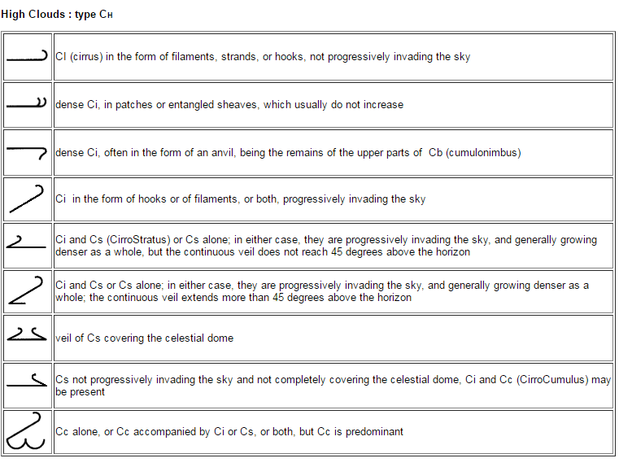

Slide 42
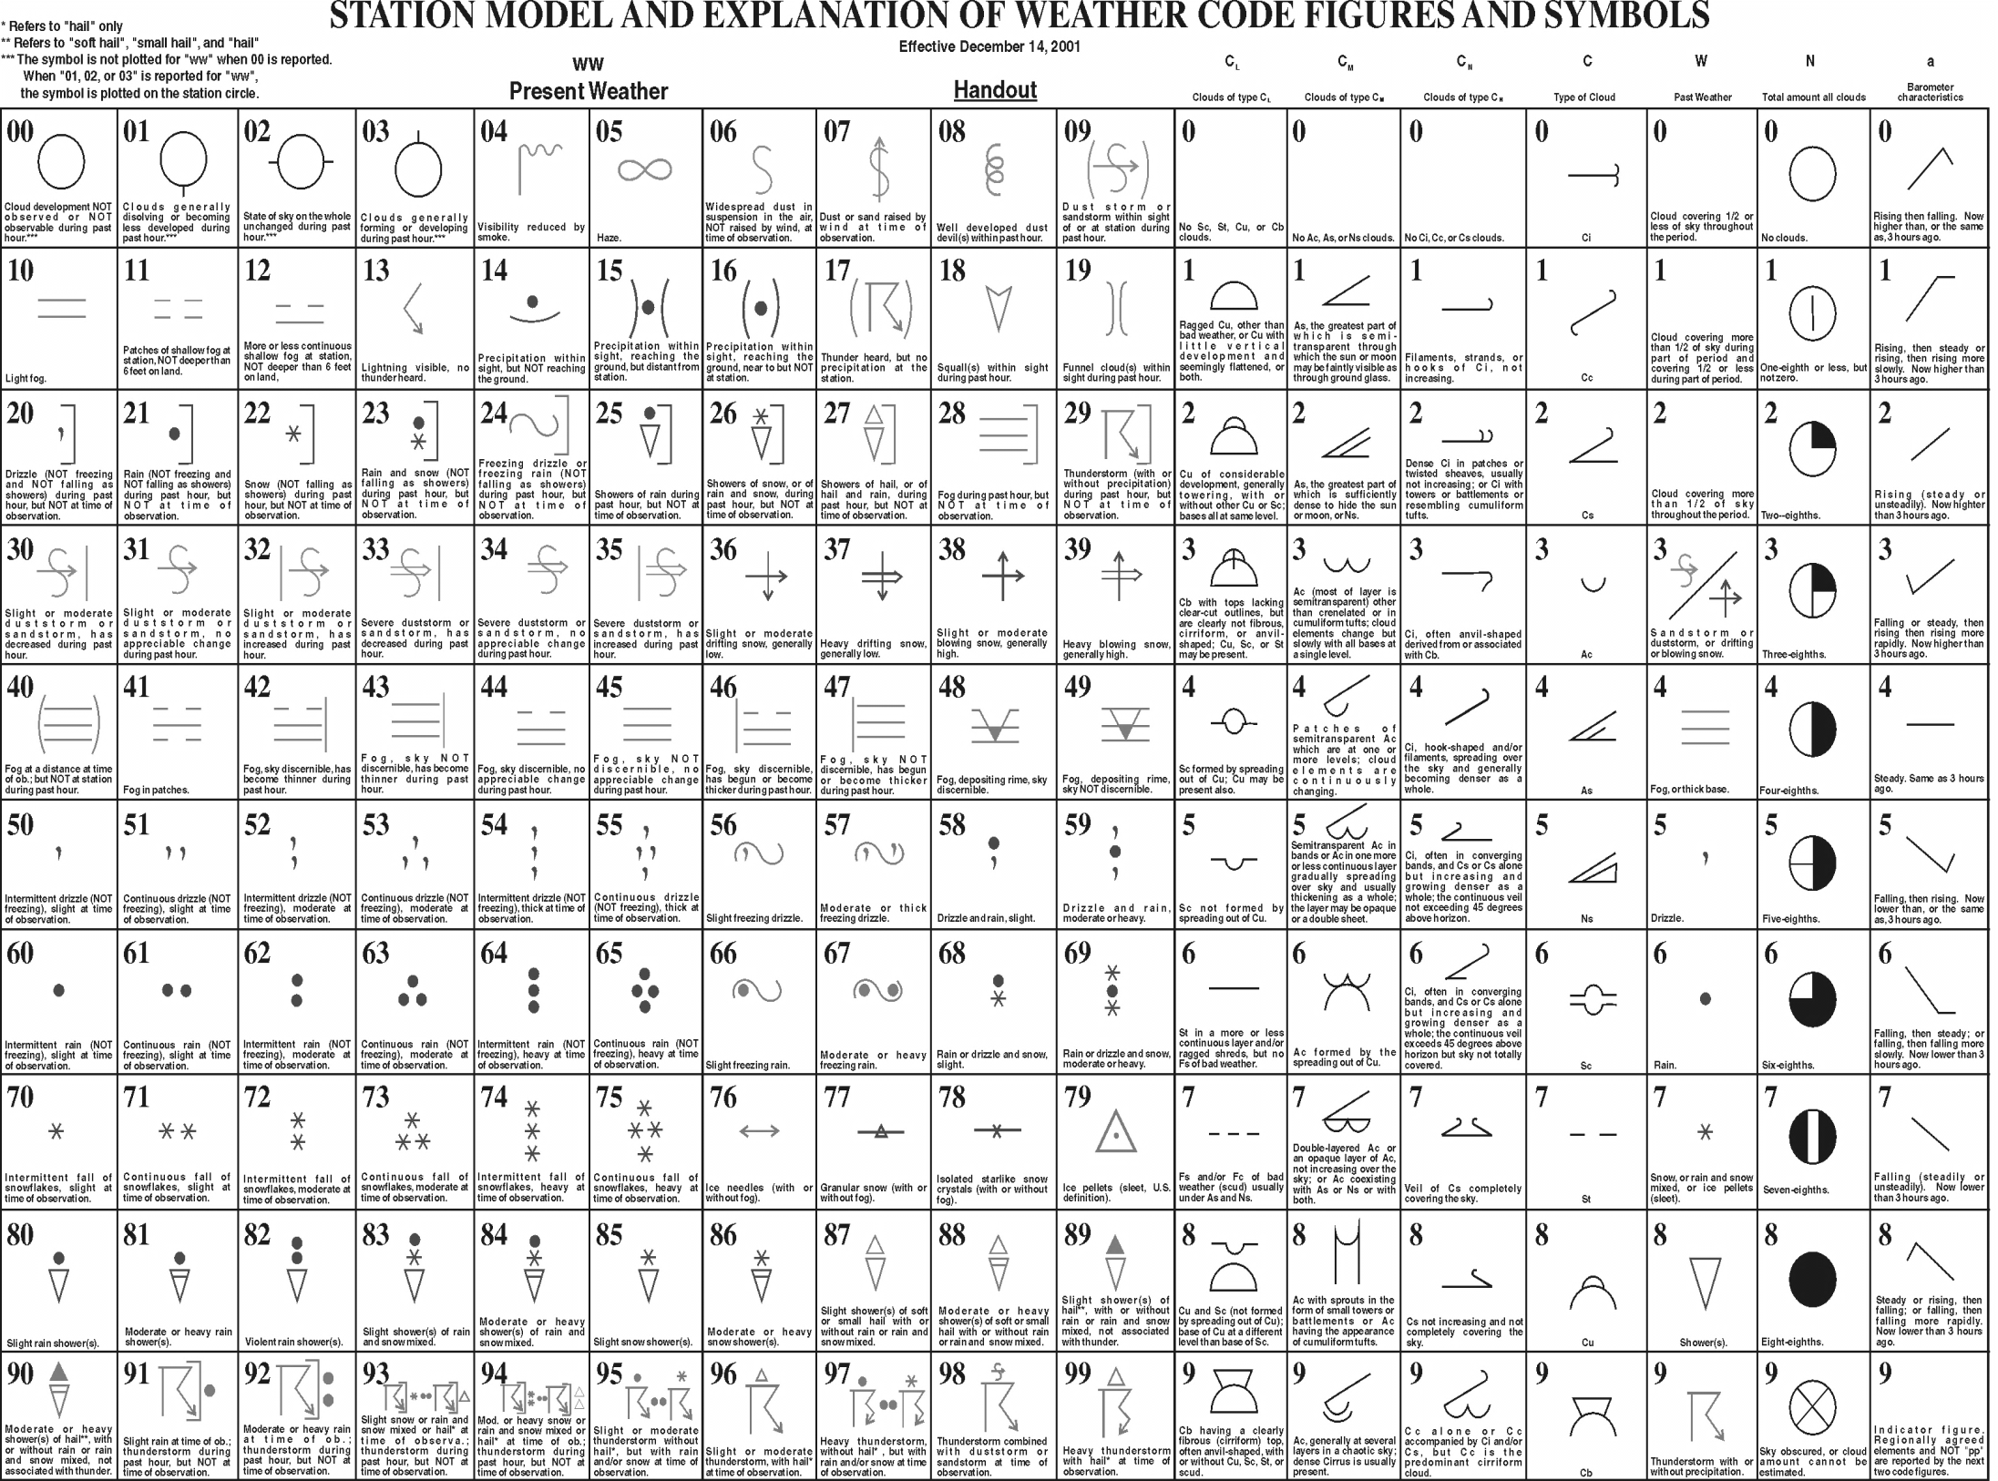

Slide 43
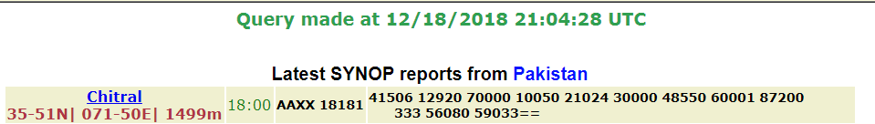
http://www.ogimet.com/usynops.phtml.en

