Slide 1
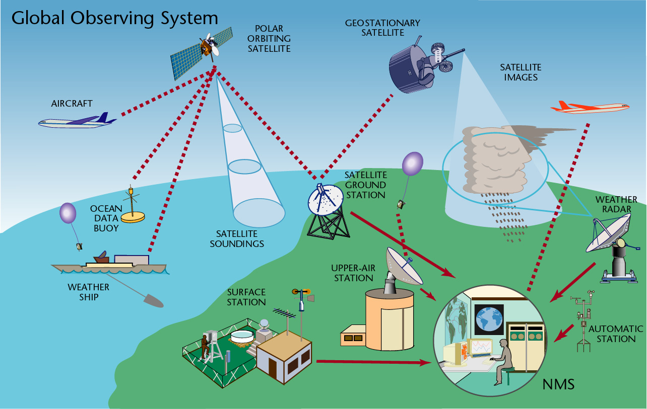
The Course of
Meteorological Instrumentation and Observations
MUSTANSIRIYAH UNIVERSITY
COLLEGE OF SCIENCES
ATMOSPHERIC SCIENCES DEPARTMENT
2018-2019
Dr. Sama Khalid Mohammed
SECOND STAGE

Slide 2

Welcome Students! ☺
To LECTURE FIVE-part2
Cloud Measurement

Slide 3
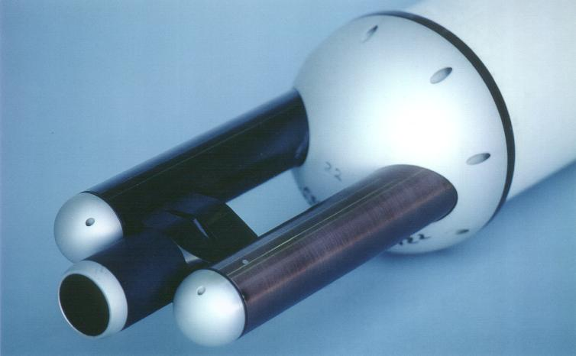
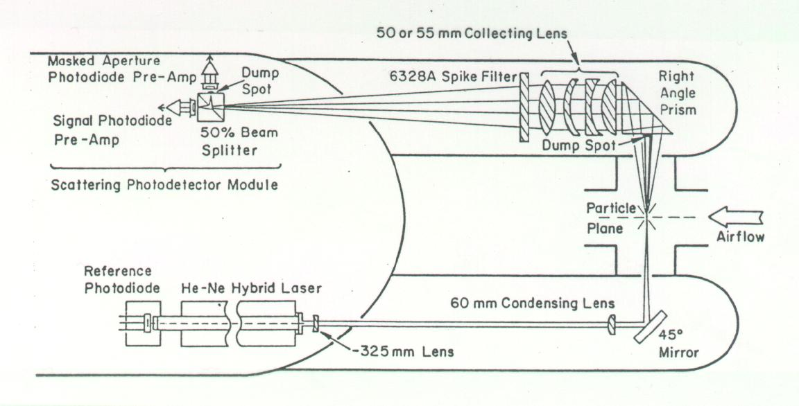
FSSP (forward scattering spectrometer probe)
The FSSP is of the general class of instruments called optical particle counters (OPCs) that detect single particles and size them by measuring the intensity of light that the particle scatters when passing through a light beam.
A Helium Neon laser is focused to a concentrated beam at the center of an inlet that faces into the oncoming airstream. This laser beam is blocked on the opposite side of the inlet with an optical stop, a "dump spot" to prevent the beam from entering the collection optics.

Slide 4
Particles that encounter this beam scatter light in all directions and some of that scattered in the forward direction is directed by a right angle prism though a condensing lens and onto a Scattering Photo-detector Module.
The size of the particle is determined by measuring the light scattering intensity and using Mie scattering theory to relate this intensity to the particle size.
The size is categorized into one of 15 channels and this information sent to the data system where the number of particles in each channel is accumulated over a preselected time period.
Probes for liquid water measurements are usually made from aircraft and usually gives the number of droplets in a certain size bin.

Slide 5
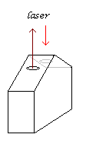
Laser ceilometer
is an instrument for the measurement of cloud base. It has a transmitter and a receiver, and it measures the time of return from scattering of the laser off from the cloud; it’s ideal because it can work during the day and night, but it only gives cloud observations from overhead (principle: light detection and ranging, LIDAR).
The returns are much stronger for water droplets than for aerosol, allowing the cloud base to be distinguished from other particles present in the lower atmosphere
Low power laser ceilometer
It uses an eye-safe, low-power laser to transmit light pulses to
the cloud base, up to 40,000 feet (13 km).

Slide 6
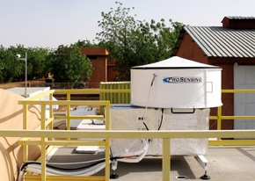
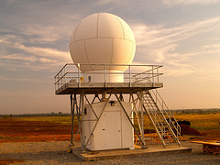
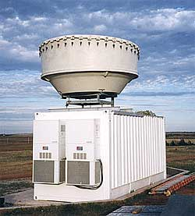
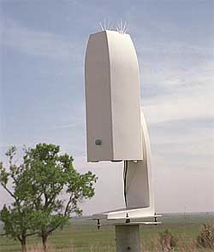
Latest version W-band (95 GHz)cloud radar
X-band scanning ARM precipitation radar
Millimeter Wave Cloud Radar (35 GHz)
Vaisala Ceilometer

Slide 7
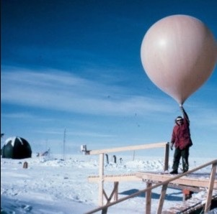
Measurement of cloud height using a balloon
Cloud height may be measured in daylight by determining the time taken by a small rubber balloon, inflated with hydrogen or helium, to rise from ground level to the base of the cloud.
The base of the cloud should be taken as the point at which the balloon appears to enter a misty layer before finally disappearing.
The rate of ascent of the balloon is determined mainly by the free lift of the balloon and can be adjusted by controlling the amount of the gas in the balloon.
The time of travel between the release of the balloon and its entry into the cloud is measured by means of a stop‑watch. If the rate of ascent is n metres per minute and the time of travel is t minutes, the height of the cloud above ground is n * t metres, but this rule must not be strictly followed.
Care should be taken if there is eddies, precipitation.
This method can be used at night by attaching an electric light to the balloon.

Slide 8
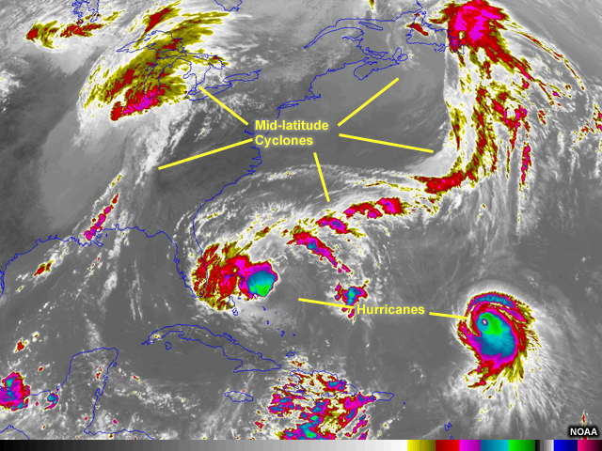
Cloud Height and Remote Sensing
Weather satellites orbiting Earth carry instruments that sense radiation in the infrared wavelengths (10.2 to 11.2 micrometers). This radiation is essentially heat radiated back to space from Earth’s surface, atmosphere, and clouds. Clouds typically have the coldest temperatures compared to the surface and the atmosphere.
Because infrared measurements are based on sensing heat, the infrared imagery is a useful tool for estimating the temperatures of cloud tops. These temperatures can then be translated to cloud height. High altitude clouds have colder cloud-top temperatures than lower altitude clouds. These different cloud-top temperatures mean that low and high clouds appear differently in the infrared imagery.

