Slide 1
Plantae Kingdom:

Slide 2
Monocotyledon (monocot) Clade :
One of the two great groups of flowering plants. There are approximately 60,000 species of monocots, including the most economically important of all plant families, Poaceae , Orchidaceae , Liliaceae.

Slide 3
.Characteristics of monocot
1- The roots are adventitious
2- The leaves are parallel-veined
3- Flowers of monocots most often have the parts in sets of three or four of the sepals and petal , but almost never five.
4- It has single cotyledon in the seed.

Slide 4
Order : Poales Family:(poaceae) Gramineae
The Poaceae ( Gramineae or true grasses) are the second larger family in Iraq and constitute the most economically important plant family in modern times, providing forage, building materials and fuel (ethanol), as well as food.

Slide 5
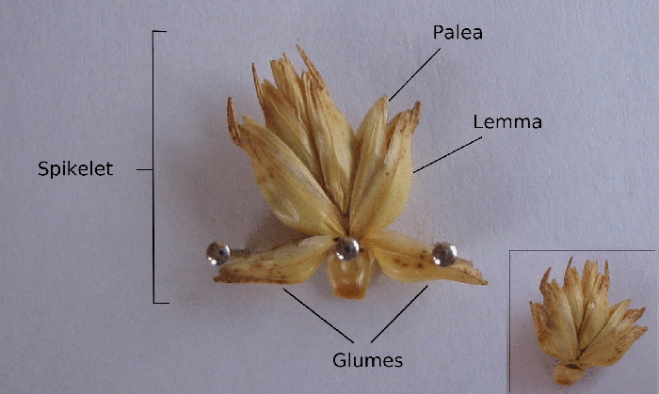
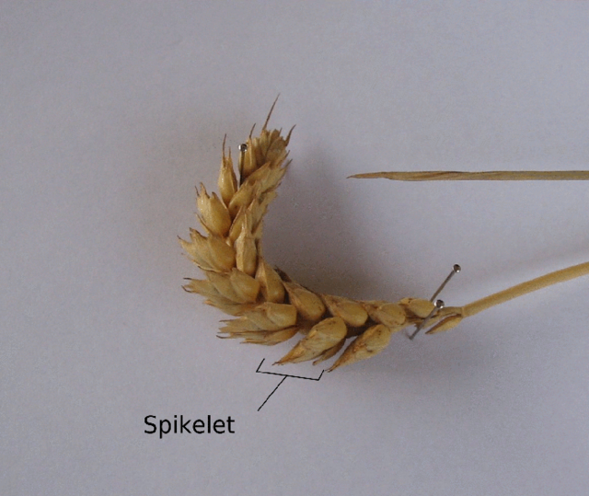

Slide 6
Order: Cyperales Family: Cyperaceae
The Cyperaceae is one of monocots families which known also as sedges, this family is represented with some 5,500 species described in about 109 genera and 13 genera with 57 species in Iraq.
sedges may be found growing in almost all environments, many are associated with wetlands, or with poor soils. Ecological communities dominated by sedges are known as sedgelands.

Slide 7
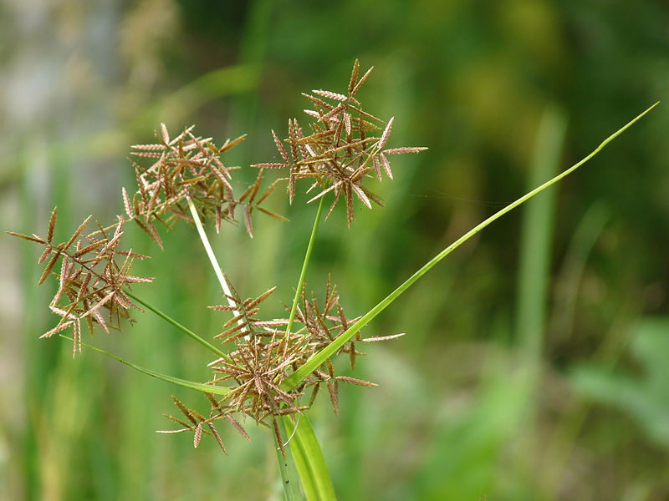
Cyperus rotundus,

