Slide 1
Fruits
the mature ovaries or pistils of flowering plants plus any associated accessory parts.

Slide 2
Pericarp
is the fruit wall, derived from the mature ovary, sometimes pericarp divided into layers:
1- endocarp
2- mesocarp
3- exocarp

Slide 3
Simple fruits
Urticle Capsules Follicle Legume Silicles and siliques Scizocarp Berry Drupe Hesperidium Pepo | Achene Grain (or caryopsis) Nut. Samara Urticle Capsules Grain (or caryopsis) Nut. Samara

Slide 4
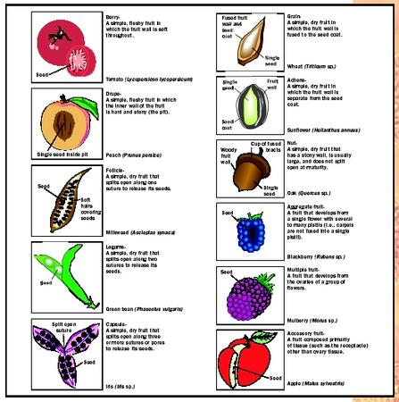

Slide 5
Aggregate fruits
A/ Achenecetum
B/ Drupecetum
C/ Syncarp

Slide 6
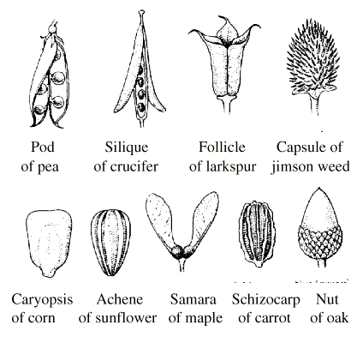
Multiple fruits
Sorosis
Syconium

Slide 7
Seeds
Seed coat
Hilum
Raphe
Embryo: is the immature sporophyte, it consist of:
A/ Epicotyl.
B/ Radical.
C/ Hypocotyl.
D/ Cotyledon

Slide 8
