Slide 1
Gynoecium

Slide 2
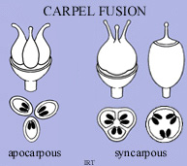
Gynoecial fusion
1- Apocarpous
2- Syncarpous
3- Unicarpellous

Slide 3
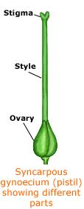
Gynoecium component
A/ Ovary
B/ Style
C/ Stigma

Slide 4
Ovary position
1- Superior
2- Inferior
3-Half inferior

Slide 5
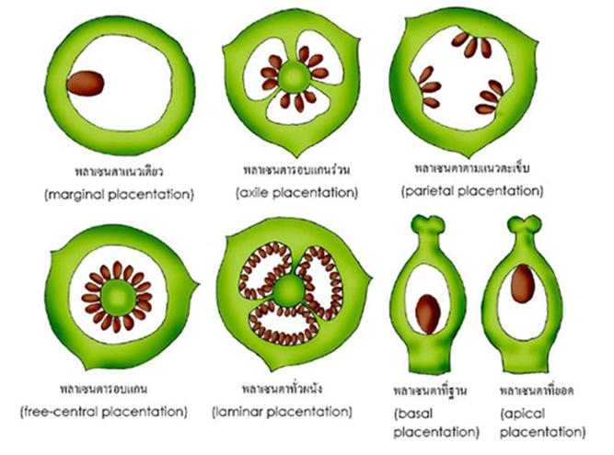
Placentation
1- Marginal
2-Parietal
3- Axile.
4-Free-central
5- Basal
6- Superficial.
7- Apical

Slide 6
Inflorescence
Inflorescence parts
1- Inflorescence bract
2- Peduncle
3- compound receptacle(torus)
4- Rachis

Slide 7
Inflorescence development

Slide 9
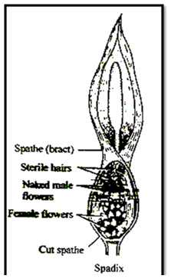

Slide 10
