Slide 1
Corolla :
It’s the second part of perianth composed of petals and usually colored, the main function of corolla is to assist pollination and therefore increase the chance of successful reproduction of the flower.

Slide 2
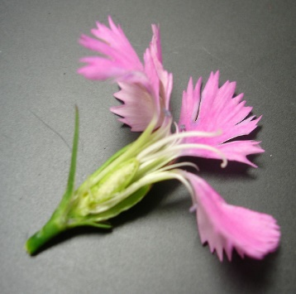
Types of Corolla :-
1- Polypetalous : Corolla composed of separate petals. This type could be in different shapes:-
A/ Cruciform
B/ Caryophyllaceous : Five free clawed petals with limb at right angles to the claw.
**Claw:.
**Limb

Slide 3
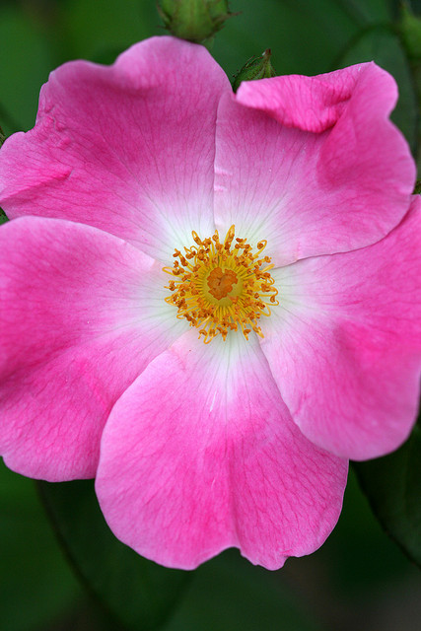
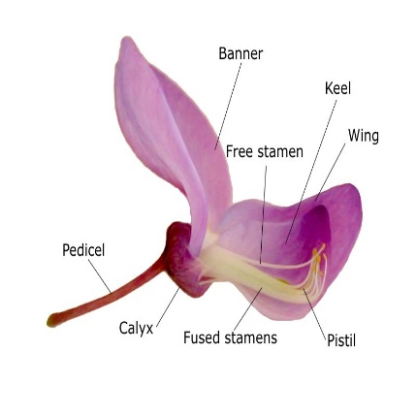
C/ Rosaceous
D/ Papillionaceous

Slide 4
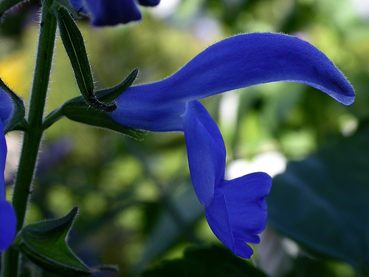
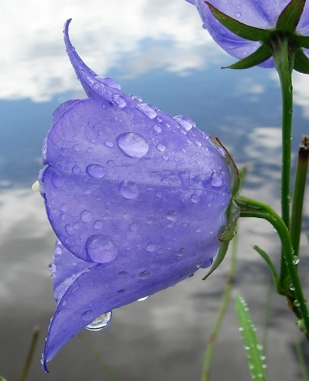
2- Gamopetalous
A/ Bilabiate
B/ Campanulate

Slide 5
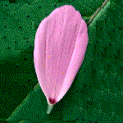
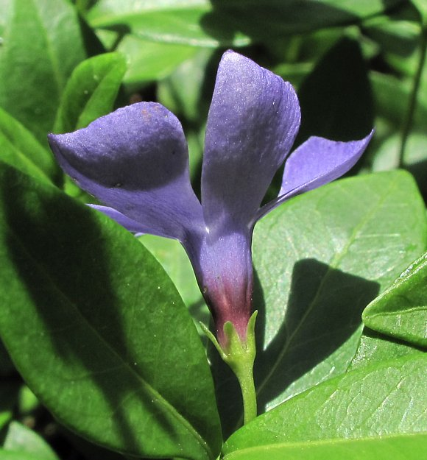
C/ Ligulate or ray
D/ Salverform

Slide 6
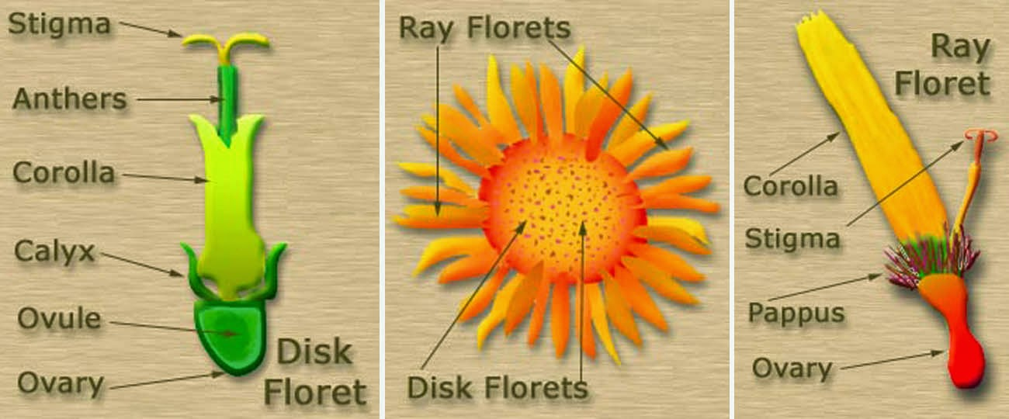
E/ Tubular

Slide 7
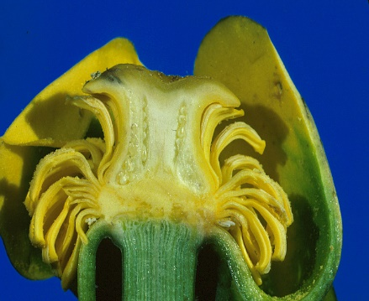
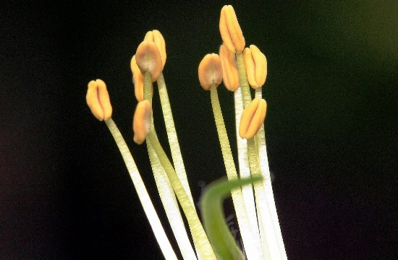
Androecium
Stamen type: There are two types of stamens:
1- Laminar S.
2- Filamentous S.

Slide 8
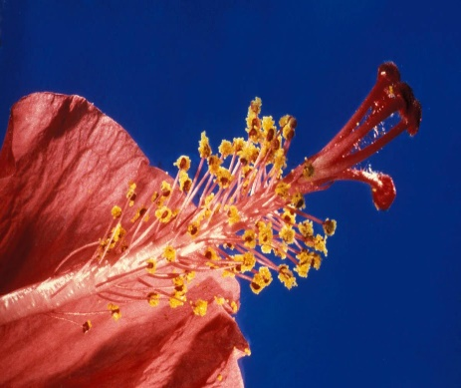
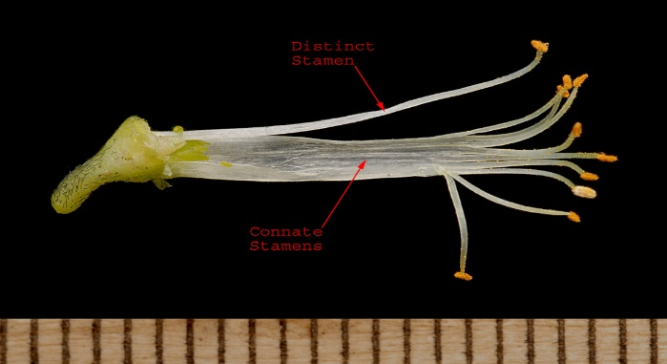
Stamen function : It refers to whether and how stamens are fused, it could be generally in two forms:
1- Filament fusion: In this form, filaments are united but anthers are free and may be in the following types;
A/ Monadelphous
B/ Diadelphous

Slide 9
C/ Polyadelphous
2- Syngenesious

Slide 10
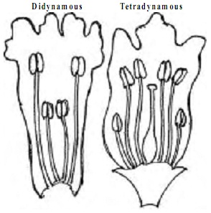
Stamens lengths
1- Didymous
2- Didynamous
3- Ttetradynamous

