Slide 1
Life span

Slide 2
Plants can be divided to many aspects according to their life cycle :-
1- Annual.
2- Biennial.
3- Perennial

Slide 3
Plant habitat
It refers to the general environment where plant is growing, these include the following:
1/ Terrestial
2/ Aquatic

Slide 4
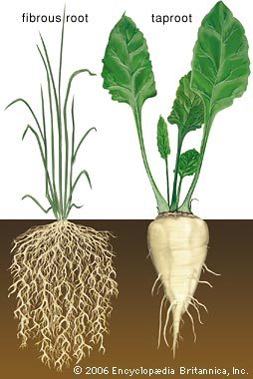
Vegetative organs
Roots:
Classification of roots according to origin:-
1/ Primary roots
2/ Adventitious roots

Slide 5
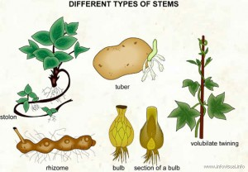
Stems
1- Aerial stem
2- Subterranean stems (underground)

Slide 6
Modification of Aerial stems
1- Phylloclades or cladodes
2- Spiny
3- Tendriller

Slide 7
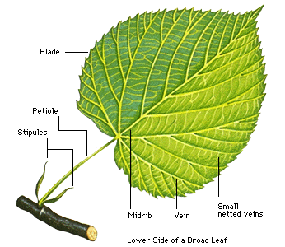
Leaves
They are the primary photosynthetic organs of plants, functioning also as the main site of transpiration. Leaves are usually arising from nodes. A leaf can be gametophytic as in the leafy liverworts and mosses or sporophytic, in the vascular plants.
leaf parts:
1* Blade or lamina
2* Petiole
3* Leaf sheath
4* Pseudo petiole
5* Stipules

Slide 8
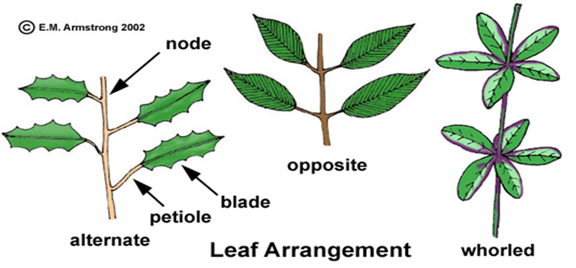
Phyllotaxy
It’s the pattern of arrangement of leaves on the stem, there are three main types of phyllotaxy:-
1* Alternate
2* Opposite
3* Whorled

Slide 9
Leaf duration :
Leaves may stay and function for few days to many year, largely determined by the adaptation to climatic conditions:
A/ Ever green
B/ Deciduous
C/ Caducuous

