Slide 1
Transformation

Slide 2
Transformation : is one of three processes by which exogenous genetic material may be introduced into a bacterial cell, the other two being conjugation and transduction .
Transformation is the genetic alteration of a cell resulting from the direct uptake and incorporation of exogenous genetic material (exogenous DNA) from its surroundings and taken up through the cell membrane(s).

Slide 3
Transformation occurs naturally in some species of bacteria, but it can also be affected by artificial means in other cells. For transformation to happen, bacteria must be in a state of competence, which might occur as a time-limited response to environmental conditions such as starvation and cell density.
competence refers to the state of being able to take up exogenous DNA from the environment. There are two forms of transformation and competence: natural and artificial.

Slide 4
Transformation occurs naturally in many bacteria (e.g. Bacillus, Streptomyces and Haemophillus spp.) although competence (ability to take up exogenous DNA) is usually transient, being associated with a particular physiological state and requiring the expression of specific competence factors

Slide 5
Transformation was first demonstrated in 1928 by British bacteriologist Frederick Griffith. Griffith discovered that a strain of Streptococcus pneumoniae could be made virulent after being exposed to heat-killed virulent strains.
It was originally thought that Escherichia coli a commonly used laboratory organism, was refractory to transformation. However, in 1970, Morton Mandel and Akiko Higa showed that E. coli may be induced to take up DNA from bacteriophage λ after treatment with calcium chloride solution.

Slide 6
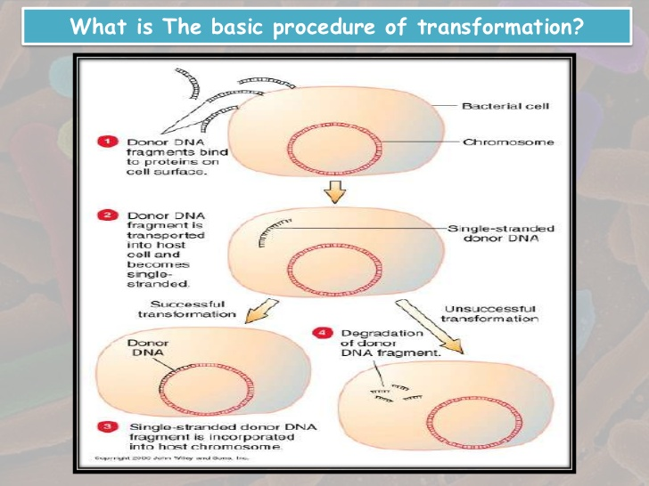

Slide 7
Natural transformation
Natural transformation is a bacterial adaptation for DNA transfer that depends on the expression of numerous bacterial genes whose products appear to be designed to carry out this process. In general, transformation is a complex, energy requiring developmental process. In order for a bacterium to bind, take up and recombine exogenous DNA into its chromosome it must become competent, that is, enter a special physiological state. Competence development in Bacillus subtilis requires expression of about 40 genes. The DNA integrated into the host chromosome is usually (but with rare exceptions) derived from another bacterium of the same species, and is thus homologous to the resident chromosome.

Slide 8
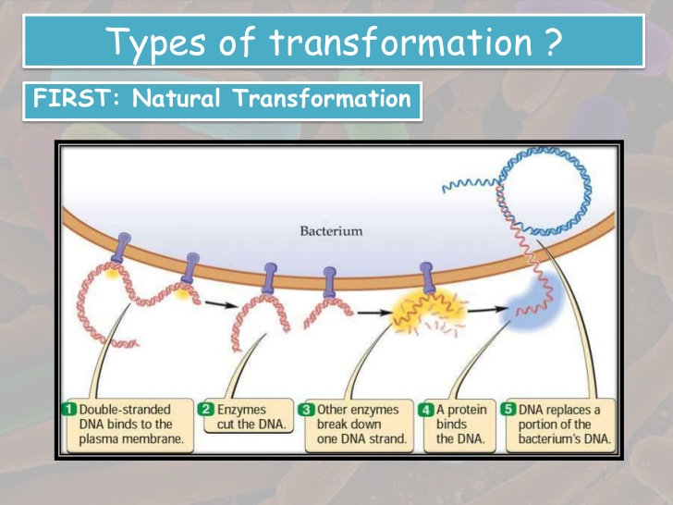

Slide 11
Natural competence
About 1% of bacterial species are capable of naturally taking up DNA under laboratory conditions; more may be able to take it up in their natural environments. DNA material can be transferred between different strains of bacteria, in a process that is called horizontal gene transfer. Some species upon cell death release their DNA to be taken up by other cells, however transformation works best with DNA from closely related species.
Due to the differences in structure of the cell envelope between Gram-positive and Gram-negative bacteria , there are some differences in the mechanisms of DNA uptake in these cells, however most of them share common features that involve related proteins. The DNA first binds to the surface of the competent cells on a DNA receptor, and passes through the cytoplasmic membrane via DNA translocase. Only single-stranded DNA may pass through, one strand is therefore degraded by nucleases in the process, and the translocated single-stranded DNA may then be integrated into the bacterial chromosomes by a RecA-dependent process. In Gram-negative cells, due to the presence of an extra membrane, the DNA requires the presence of a channel formed by secretin (PilQ) on the outer membrane. The uptake of DNA is generally non-sequence specific, although in some species the presence of specific DNA uptake sequences may facilitate efficient DNA uptake.

Slide 12
Artificial competence
Natural transformation is of limited usefulness for artificial genetic modification of bacteria, mainly because it works best with linear DNA fragments rather than the circular plasmid DNA that is used in genetic modification
Artificial competence can be induced in laboratory procedures that involve making the cell passively permeable to DNA by exposing it to conditions that do not normally occur in nature. Typically the cells are incubated in a solution containing divalent cations (often calcium chloride) under cold conditions, before being exposed to a heat pulse (heat shock). Electroporation is another method of promoting competence. In this method the cells are briefly shocked with an electric field of 10-20 kV/cm which is thought to create holes in the cell membrane through which the plasmid DNA may enter. After the electric shock the holes are rapidly closed by the cell's membrane-repair mechanisms.

Slide 13
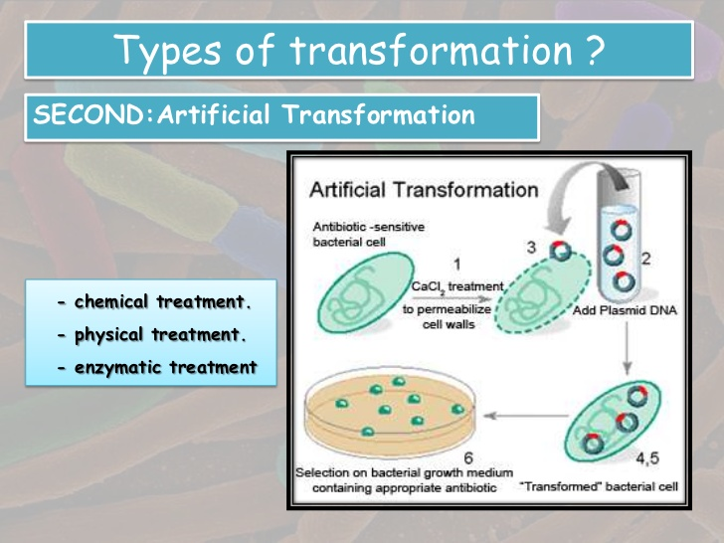

Slide 14
With the pneumococcus, cells spontaneously become competent to take up DNA. Such naturally-occurring transformation has been most studied in Bacillus subtilis and Haemophilus influenzae (as well as S. pneumoniae) and was for some time thought to be limited to these and related species. It is now known to be much more widespread. In particular, transformation contributes extensively to the antigenic variation observed in the gonococcus (Neisseria gonorrhoeae) through the transfer of pil genes coding for the major protein subunit of the surface appendages (pili) by which the bacteria attach to epithelial cells. Although the number of species in which natural transformation has been demonstrated is still quite limited, it is likely that it occurs, albeit at a low level, in many other bacteria. The details of the process vary between species, but some generalizations are possible. Competence generally occurs at a specific stage of growth, most commonly in late log phase, just as the cells are entering stationary phase. This may be a response to cell density rather than (or as well as) growth phase. For example, in Bacillus subtilis, some of the genes involved in the development of competence are also involved in the early stages of sporulation.

Slide 15
The development of competence at this stage is associated not only with nutrient depletion but also with the accumulation of specific secreted products (competence factors) which act via a two component regulatory system to stimulate the expression of other genes required for competence. Since the level of these competence factors is dependent on cell concentration, competence will only develop at high cell density. This is a form of quorum sensing, in which the response of an individual cell is governed by the concentration of bacteria in the surrounding medium.

Slide 16
Following the development of competence, double-stranded DNA fragments bind to receptors on the cell surface, but only one of the strands enters the cell. In some species, the process is selective for DNA from the same species, through a requirement for short species-specific sequences. For example, the uptake of DNA by the meningococcus (Neisseria meningitidis) is dependent on the presence of a specific 10-bp uptake sequence. The genome of N. meningitidis contains nearly 2000 copies of this sequence, which will only occur infrequently and by chance, in other genomes. Similarly, transformation of Haemophilus influenzae is facilitated by the presence of a 29-bp uptake sequence which occurs approximately 1500 times in the genome of H. influenzae. These organisms will therefore only be transformed efficiently with DNA from the same species.

Slide 17
On the other hand, B. subtilis and S. pneumoniae can take up virtually any linear DNA molecule. But taking up the DNA is only the start. If the cell is to become transformed in a stable manner, the new DNA has to be replicated and inherited. As here fragments of chromosomal DNA (rather than plasmids) are being considered, replication of the DNA will only happen if the incoming DNA is recombined with the host chromosome. This requires homology between the transforming DNA and the recipient chromosome. This does not constitute an absolute barrier to transformation with DNA from other species. Provided there is enough similarity in some regions of the chromosome, those segments of DNA can still undergo recombination with the recipient chromosome. The closer the taxonomic relationship, the more likely it is that they will be sufficiently similar.

Slide 18
One example of this, with considerable practical significance, is the development of resistance to penicillin in S. pneumoniae. This appears to have occurred by the replacement of part of the genes coding for the penicillin target enzymes with corresponding DNA from naturally-resistant oral streptococci.

