Slide 1
Dry mount of plant

Slide 2
The steps of plant preserving:
1- Collecting of plant materials
2- Pressing and Drying plant specimens
3- Writing label (Voucher specimen)

Slide 3
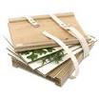
Collecting of plant materials
1- A field press with newspapers for plant pressing

Slide 4
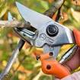
2- Secateurs to cut and trim specimens

Slide 5
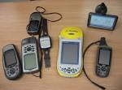
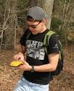
3- GPS for recording an accurate latitude and longitude. Alternatively, mark the position on a topographic map.

Slide 6
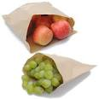
4- Small brown paper bags for collecting fruits, seeds, bryophytes and lichens.

Slide 7
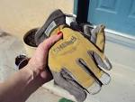
5- Hand lens.
6- Gloves, for handling prickly plant material or plants with corrosive sap.

Slide 8
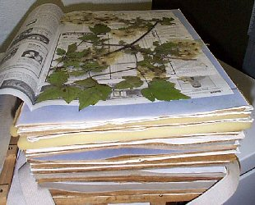
2- Pressing and Drying plant specimens

Slide 9
3- Writing label (Voucher specimen)
Collector’s name
Collector's number
Date of collection:
Botanical name
Locality
Habitat
Habit
Abundance

Slide 10
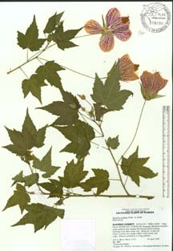
Label

