Slide 1
Staining of Slides

Slide 2
Staining
is a technique used in microscopy to enhance contrast in the microscopic image in biology and medicine to highlight structures in cell populations or organelles within individual cells.

Slide 3
The dyes used in bacteriology have two features in common
1- They have chromophore groups, groups with double bonds that give the dye its color
2- They can bind with cells by ionic, covalent or hydrophobic bonding.

Slide 4
In vivo staining and In vitro staining
In vivo staining ( Intra Vital Staining ) is the process of dyeing living tissues in vivo means "in life"
In vitro staining involves coloring cells or structures that have been removed from their biological context

Slide 5
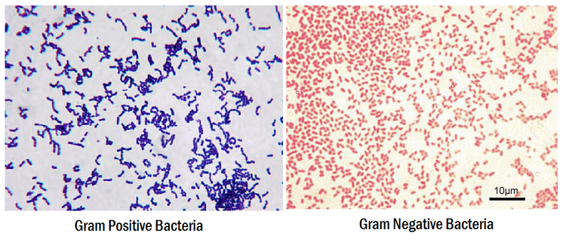
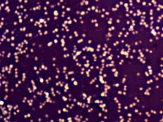
Common biological stain
Gram staining
Negative staining
Ziehl-Neelsen stain
Haematoxylin and Eosin (H&E) staining

Slide 6
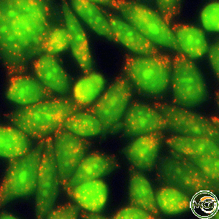
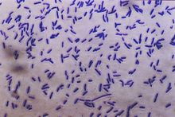
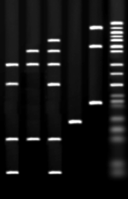
5- Acridine orange
Crystal violet
Ethidium bromide
Acid fuchsine
Iodine
Malachite green
- Methylene blue
Neutral red
Safranin

Slide 7
Electron microscopy Stains
1-Phosphotungstic acid
2-Osmium tetroxide

