Slide 1
MICROSCOPIC TECHINIQUE
ا

Slide 2
Introduction to the Microscope
What Is Microscope?
It is an instrument which deals with too small organisms that they cannot be seen distinctly with the naked eye.

Slide 3
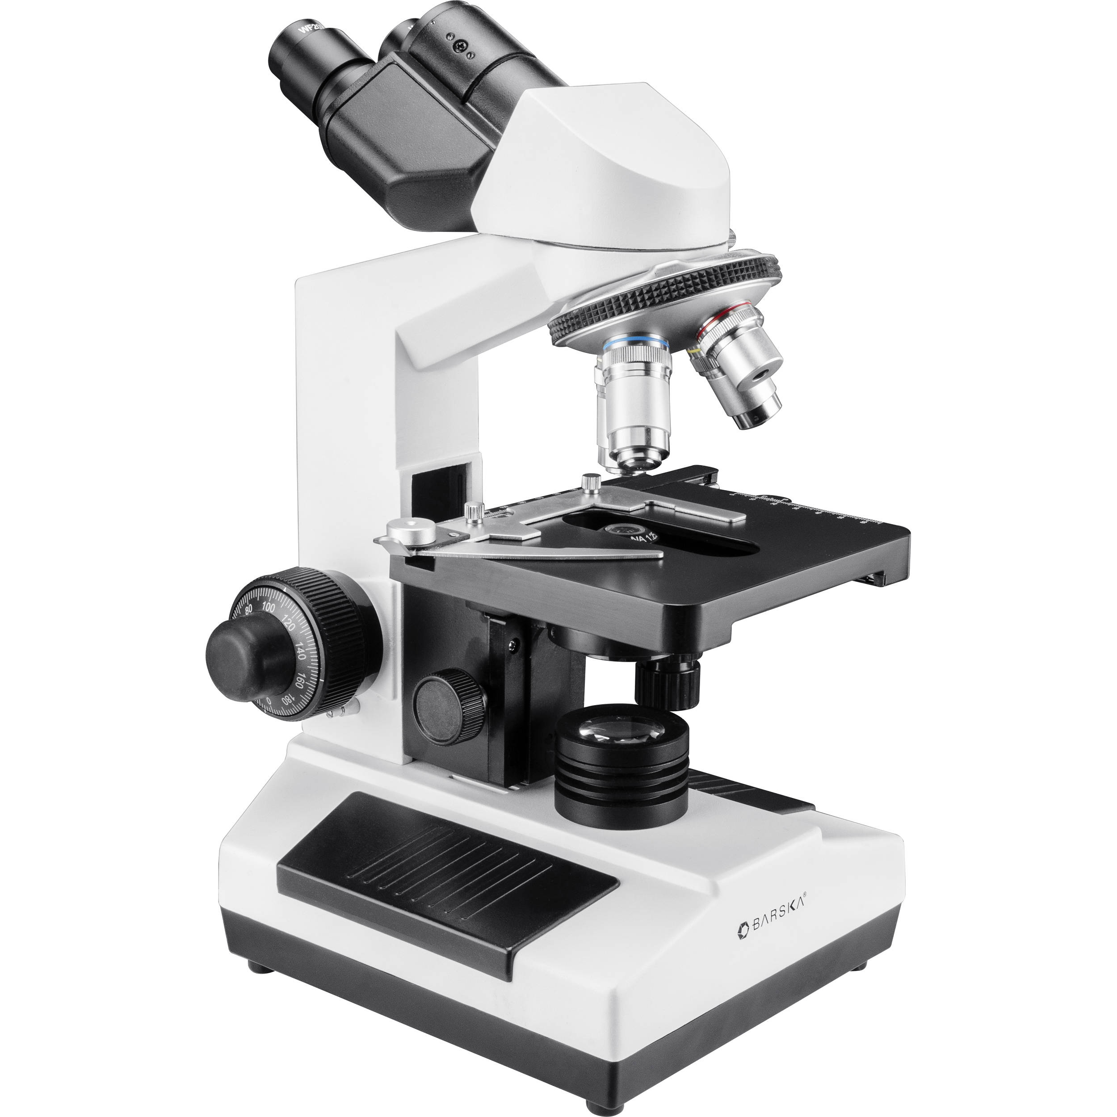
Microscope Types
1. Compound Microscope

Slide 4
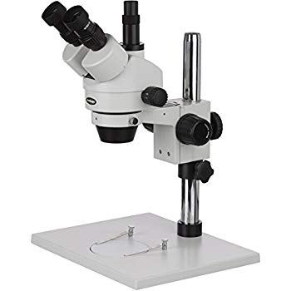
2. Dissecting Microscope (also called stereo microscope
)

Slide 5
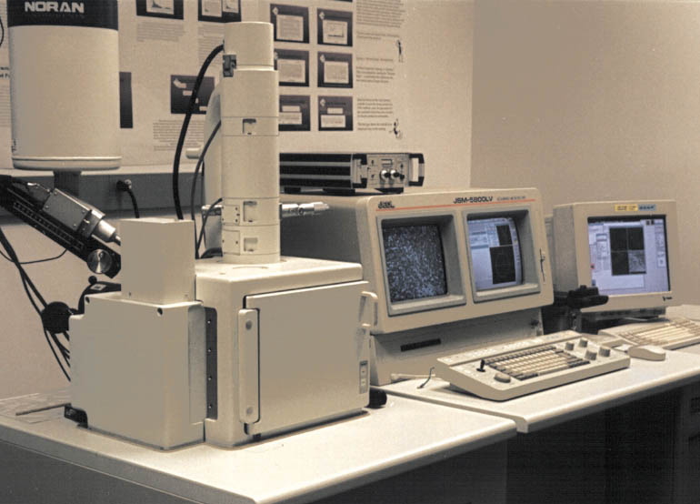
3. Scanning Electron Microscope (SEM)

Slide 6
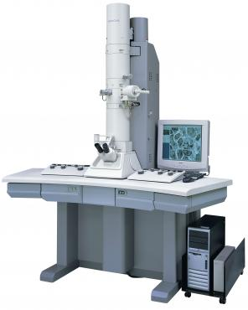
4. Transmission Electron Microscope (TEM)

Slide 7
The Light Microscope (Optical Microscope)

Slide 8
Types of Light Microscope
Bright-field
Dark-field
Phase-contrast
Fluorescence

Slide 9
Three factors determine the quality of an optical image:
a. Magnification
b. Resolution
c. Contrast

