Slide 1




Carbohydrates
Assistant professor
Dr. Zyad Hussein Jawad

Slide 2
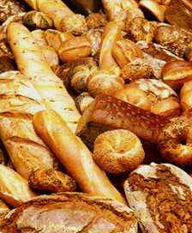
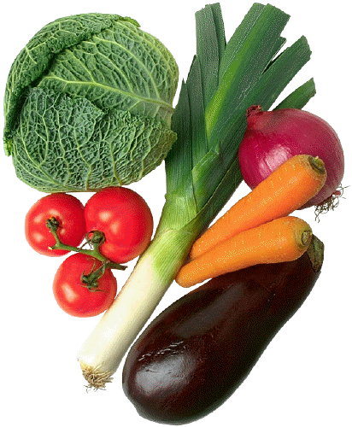
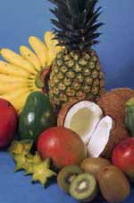
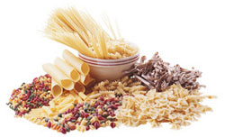
Carbohydrates

Slide 3
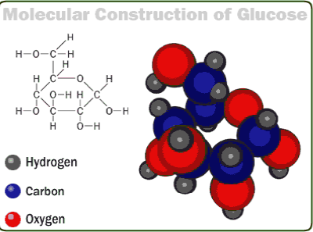
DEFINITION
Carbohydrates are polyhydroxy aldehydes or ketones or compounds which yield these on hydrolysis.

Slide 4
Functions
sources of energy
intermediates in the biosynthesis of other basic biochemical entities (fats and proteins)
associated with other entities such as glycosides, vitamins and antibiotics)
form structural tissues in plants and in microorganisms (cellulose, lignin, murein)
participate in biological transport, cell-cell recognition, activation of growth factors, modulation of the immune system

Slide 5
Glucose (a monosaccharide)
Plants:
photosynthesis
chlorophyll
6 CO₂ + 6 H₂O C₆H₁₂O₆ + 6 O₂
sunlight (+)-glucose
(+)-glucose starch or cellulose
respiration
C₆H₁₂O₆ + 6 O₂ 6 CO₂ + 6 H₂O + energy

Slide 6
Carbohydrates
glucose provides energy for the brain and ½ of energy for muscles and tissues
glycogen is stored glucose
glucose is immediate energy
glycogen is reserve energy

Slide 7
Classification of carbohydrates
Carbohydrates – polyhydroxyaldehydes or polyhydroxy-ketones of formula (CH₂O)_{n}, or compounds that can be hydrolyzed to them. (aka sugars or saccharides)
Monosaccharides – carbohydrates that cannot be hydrolyzed to simpler carbohydrates; eg. Glucose or fructose.
Disaccharides – carbohydrates that can be hydrolyzed into two monosaccharide units; eg. Sucrose, which is hydrolyzed into glucose and fructose.
Oligosaccharides – carbohydrates that can be hydrolyzed into a few monosaccharide units.
Polysaccharides – carbohydrates that are are polymeric sugars; eg Starch or cellulose.

Slide 8
Monosaccharides
also known as simple sugars
classified by 1. the number of carbons and 2. whether aldoses or ketoses
most (99%) are straight chain compounds
D-glyceraldehyde is the simplest of the aldoses (aldotriose)
all other sugars have the ending ose (glucose, galactose, ribose, lactose, etc…)

Slide 9
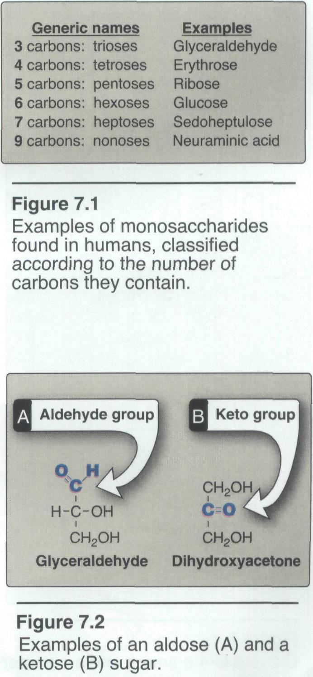

Slide 10
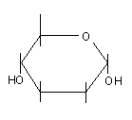
Glucose
The chemical formula for glucose is C₆H₁₂O_{6.}
It is a six sided ring.
The structure on the left is a simplified structure of glucose

Slide 11
Monosaccharides
Aldoses (e.g., glucose) have an aldehyde group at one end.
Ketoses (e.g., fructose) have a keto group, usually at C2.

Slide 12
chiral centers by definition are C atoms which have 4 DIFFERENT atoms bonded to it
Compounds having same structural formula, but differ in spatial configuration.
Asymmetric Carbon atom:Attached to four different atoms or groups.
Vant Hoff’s rule: The possible isomers (2n) of a given compound is determined by the number of asymmetric carbon atoms (n).
Reference C atom: Penultimate C atom, around which mirror images are formed.

Slide 13
Sugar Nomenclature
For sugars with more than one chiral center, D or L refers to the asymmetric C farthest from the aldehyde or keto group.
Most naturally occurring sugars are D isomers.

Slide 14
D & L sugars are mirror
images of one another.
They have the same
name, e.g., D-glucose
& L-glucose.
Other stereoisomers
have unique names,
e.g., glucose, mannose,
galactose, etc.
The number of stereoisomers is 2^{n}, where n is the number of asymmetric centers.
The 6-C aldoses have 4 asymmetric centers. Thus there are 16 stereoisomers (8 D-sugars and 8 L-sugars).

Slide 15
D vs L Designation
D & L designations are based on the configuration about the single asymmetric C in glyceraldehyde.
The lower representations are Fischer Projections.

Slide 16
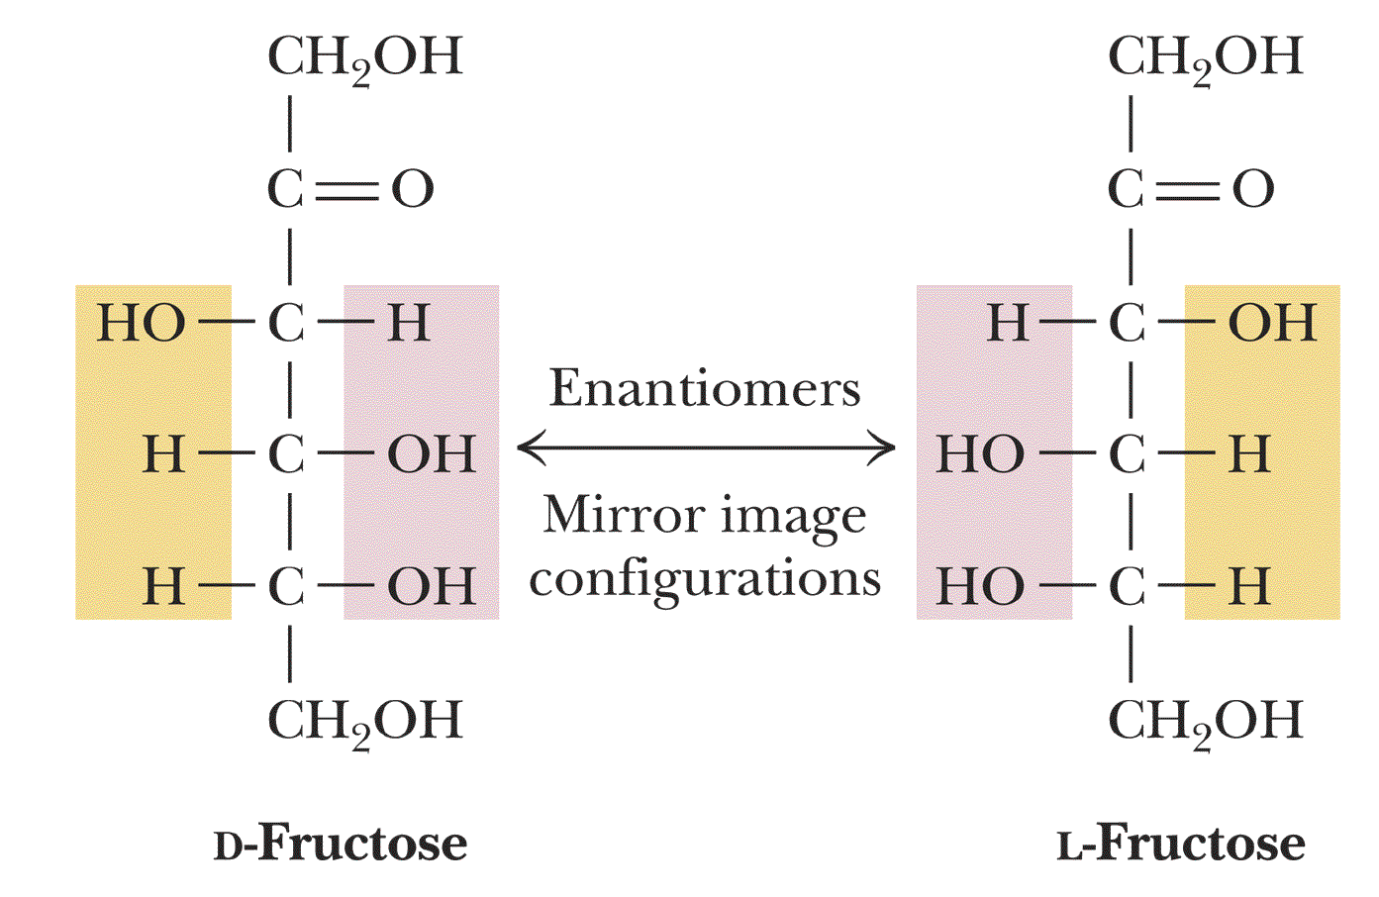

Slide 17
Enantiomres
A special type of isomerism is found in the pairs of structures that are mirror images of each other. These mirror images are called enantiomers, and the two members of the pair are designated as a D- and an L-sugar
two monosaccharides differ in configuration around only one specific carbon atom (with the exception of the carbonyl carbon, see below), they are defined as epimers of each other.

Slide 18
(+)-glucose? An aldohexose
Emil Fischer (1902)
Four chiral centers, 2⁴ = 16 stereoisomers

Slide 19
Fructose forms either
a 6-member pyranose ring, by reaction of the C2 keto group with the OH on C6, or
a 5-member furanose ring, by reaction of the C2 keto group with the OH on C5.

Slide 20
Epimers – stereoisomers that differ only in configuration about one chiral center.
Sugars are different from one another, only in configuration with regard to a single C atom (other than the reference C atom).

Slide 21
Enantiomers and epimers

Slide 22
OPTICAL ACTIVITY
Dextrorotatory (+) :If the sugar solution turns the plane of polarized light to right.
. Levorotatory (–) :If the sugar solution turns the plane of polarized light to left.
Racemic mixture:Equimolar mixture of optical isomers has no net rotation.

Slide 23
Hemiacetal & hemiketal formation
An aldehyde can react with an alcohol to form a hemiacetal.
A ketone can react with an alcohol to form a hemiketal.

Slide 24
3. Fructose (levulsoe) --- Rotation in polarimeter is left
D-Fructose β-D-Fructose α-D-Fructose

Slide 25
Anomers: Stereoisomers formed when ring is formed (α, β).
α is same side with ring

Slide 26
Rules for drawing Haworth projections
next number the ring clockwise starting next to the oxygen
if the substituent is to the right in the Fisher projection, it will be drawn down in the Haworth projection (Down-Right Rule)

Slide 27
Rules for drawing Haworth projections
draw either a six or 5-membered ring including oxygen as one atom
most aldohexoses are six-membered
aldotetroses, aldopentoses, ketohexoses are 5-membered

Slide 28
Pentoses and hexoses can cyclize as the ketone or aldehyde reacts with a distal OH.
Glucose forms an intra-molecular hemiacetal, as the C1 aldehyde & C5 OH react, to form a 6-member pyranose ring, named after pyran.
These representations of the cyclic sugars are called Haworth projections.

Slide 29
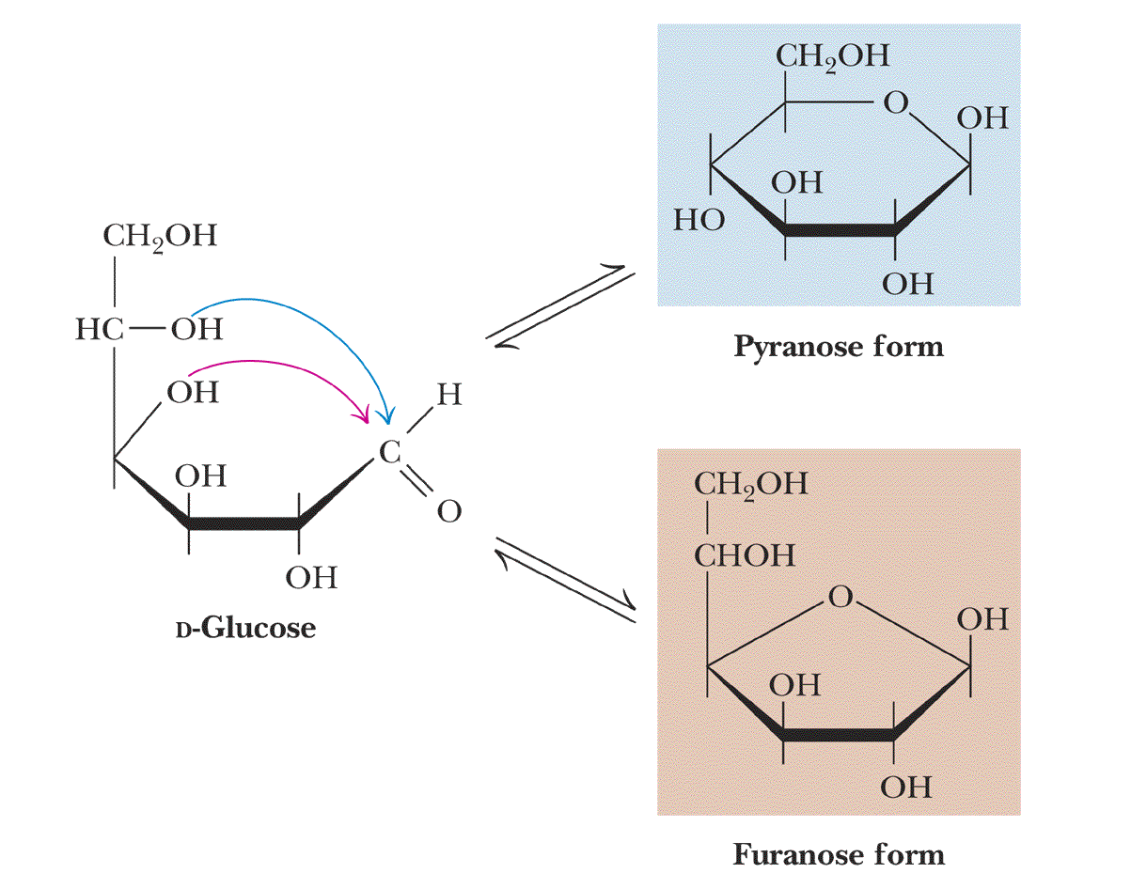
D-glucose can cyclize in two
ways forming either furanose or
pyranose structures

Slide 30
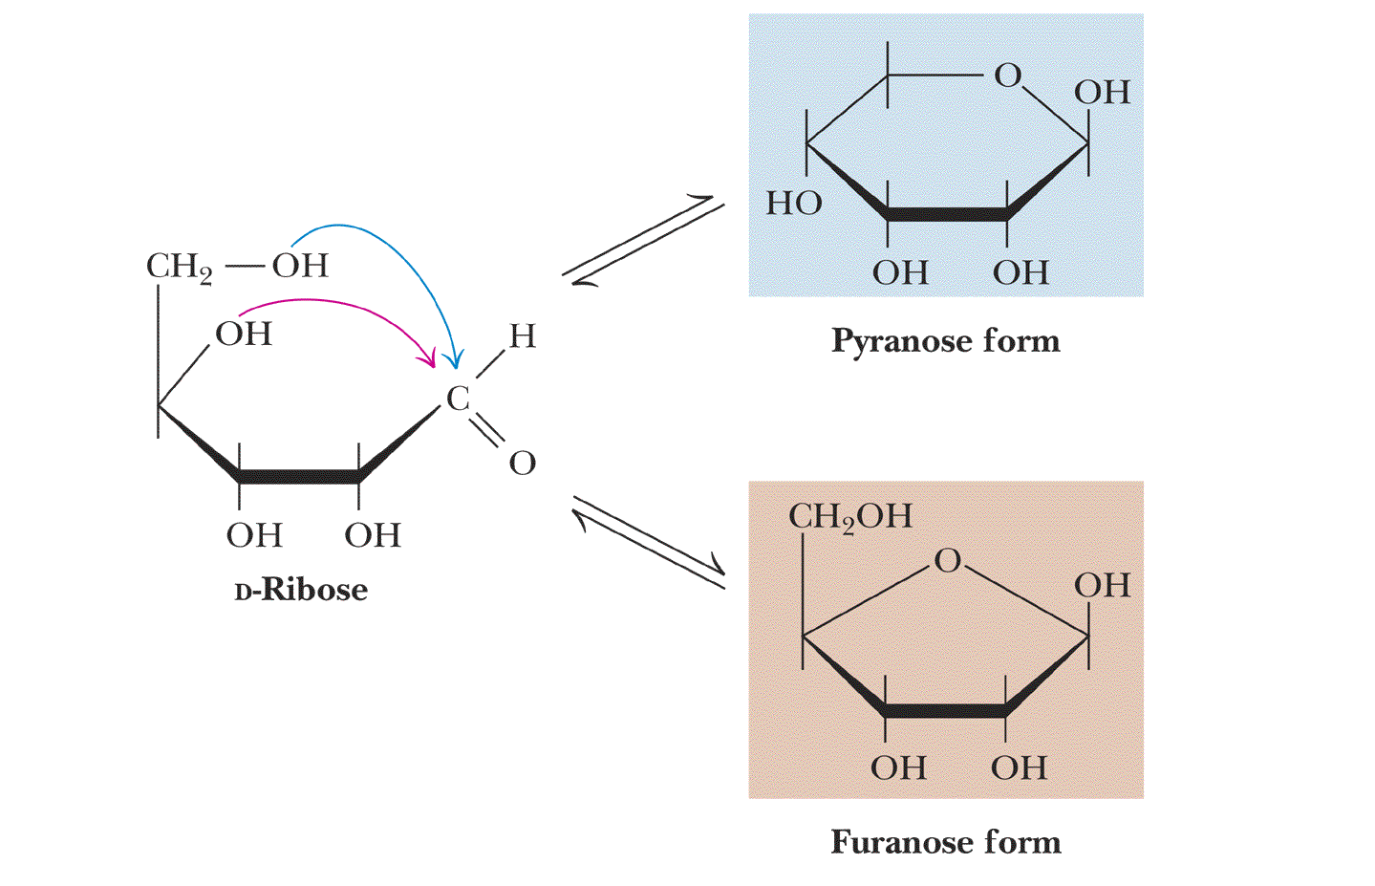
D-ribose and other five-carbon
saccharides can form either
furanose or pyranose structures

Slide 31
Cyclization of glucose produces a new asymmetric center at C1. The 2 stereoisomers are called anomers, α & β.
Haworth projections represent the cyclic sugars as having essentially planar rings, with the OH at the anomeric C1:
  α (OH below the ring)
  β (OH above the ring).

Slide 32
Structural representation of sugars
Fisher projection: straight chain representation
Haworth projection: simple ring in perspective
Conformational representation: chair and boat configurations

Slide 33
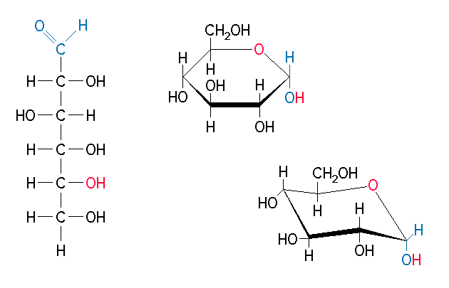
Different Forms of Glucose

Slide 34
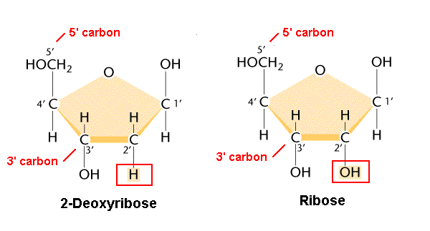
Oxygen of the hydroxyl group is removed to form deoxy sugars.
􀁺
Non reducing and non osazone forming.
􀁺
Important part of nucleic acids.

Slide 35
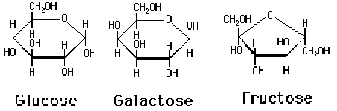
Three Monosaccharides
C₆H₁₂O₆

Slide 36
Rules for drawing Haworth projections
for D-sugars the highest numbered carbon (furthest from the carbonyl) is drawn up. For L-sugars, it is drawn down
for D-sugars, the OH group at the anomeric position is drawn down for α and up for β. For L-sugars α is up and β is down

Slide 37
Glucose oxidase
glucose oxidase converts glucose to gluconic acid and hydrogen peroxide
when the reaction is performed in the presence of peroxidase and o-dianisidine a yellow color is formed
this forms the basis for the measurement of urinary and blood glucose
    Testape, Clinistix, Diastix (urinary glucose)
    Dextrostix (venous glucose)

Slide 38
Reduction
either done catalytically (hydrogen and a catalyst) or enzymatically
the resultant product is a polyol or sugar alcohol (alditol)
glucose form sorbitol (glucitol)
mannose forms mannitol
fructose forms a mixture of mannitol and sorbitol
glyceraldehyde gives glycerol

Slide 39
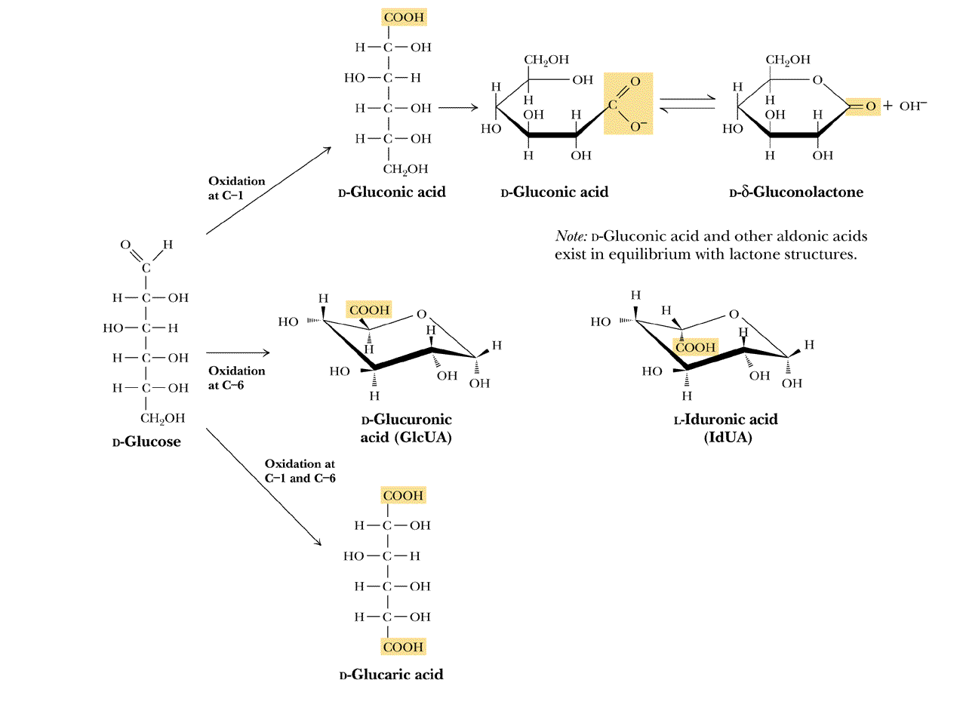

Slide 40
Glycosidic Bonds
The anomeric hydroxyl and a hydroxyl of another sugar or some other compound can join together, splitting out water to form a glycosidic bond:
R-OH + HO-R' → R-O-R' + H₂O
E.g., methanol reacts with the anomeric OH on glucose to form methyl glucoside (methyl-glucopyranose).

Slide 41
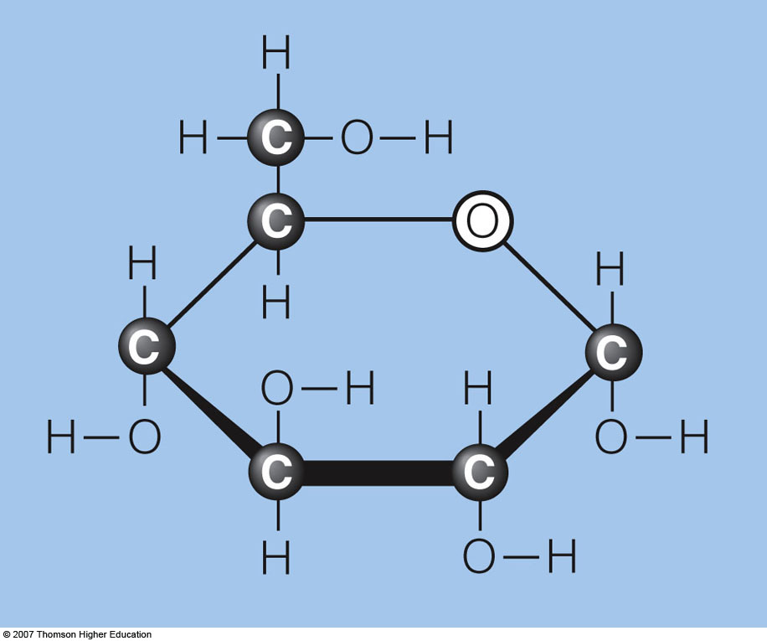
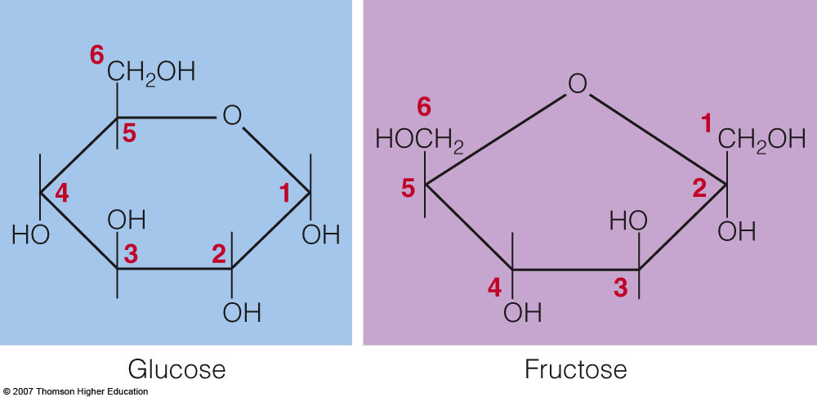
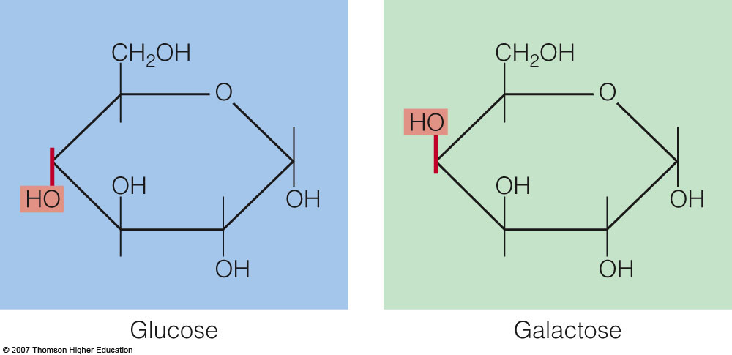

Slide 43
Sugar derivatives
sugar alcohol - lacks an aldehyde or ketone; e.g., ribitol.
sugar acid - the aldehyde at C1, or OH at C6, is oxidized to a carboxylic acid; e.g., gluconic acid, glucuronic acid.

Slide 44
Sugar derivatives
amino sugar - an amino group substitutes for a hydroxyl. An example is glucosamine.
The amino group may be acetylated, as in N-acetylglucosamine.

Slide 45
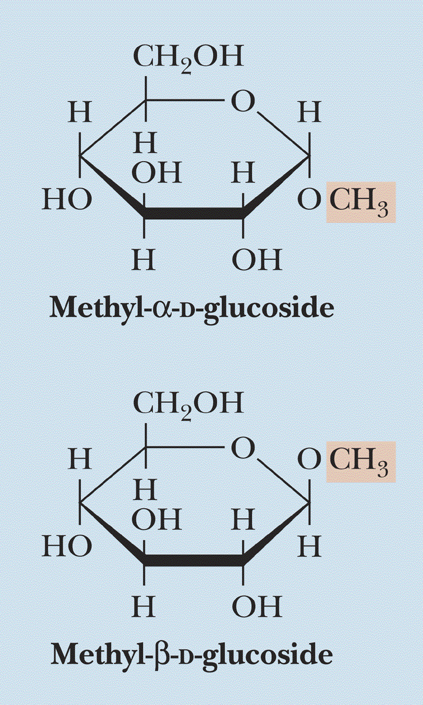
The anomeric forms of
methyl-D-glucoside

Slide 46
Disaccharides:
Maltose, a cleavage product of starch (e.g., amylose), is a disaccharide with an α(1→ 4) glycosidic link between C1 - C4 OH of 2 glucoses.
It is the α anomer (C1 O points down).
Cellobiose, a product of cellulose breakdown, is the otherwise equivalent β anomer (O on C1 points up).
The β(1→ 4) glycosidic linkage is represented as a zig-zag, but one glucose is actually flipped over relative to the other.

Slide 47
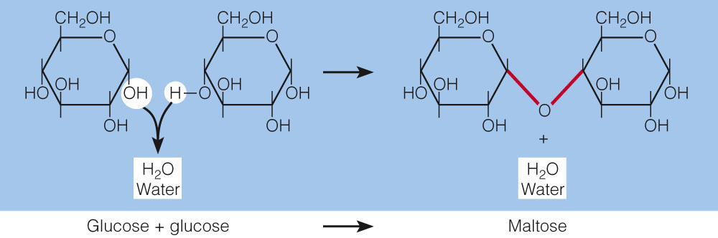
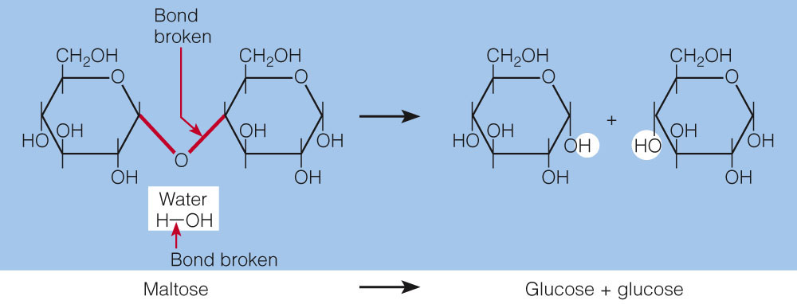

Slide 48
Other disaccharides include:
Sucrose, common table sugar, has a glycosidic bond linking the anomeric hydroxyls of glucose & fructose.
Because the configuration at the anomeric C of glucose is α (O points down from ring), the linkage is α(1→2).
The full name of sucrose is α-D-glucopyranosyl-(1→2)-β-D-fructopyranose.)
Lactose, milk sugar, is composed of galactose & glucose, with β(1→4) linkage from the anomeric OH of galactose. Its full name is β-D-galactopyranosyl-(1→ 4)-α-D-glucopyranose

Slide 49
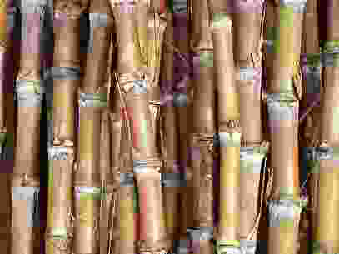
SUCROSE
Cane sugar.
α-D-glucose &β-D-fructose units held together by (α1→β2) glycosidic bond.
Reducing groups in both are involved in bond formation, hence non reducing.

Slide 50
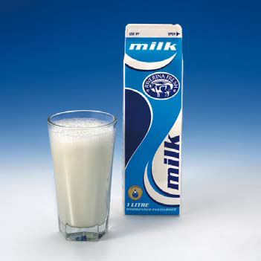
LACTOSE
Principal sugar in milk
β-D-galactose & β-D-glucose units held together by β(1→4) glycosidic bond.

Slide 51
Reducing:Maltose, Lactose –with free aldehyde or keto group.
Non-reducing:Sucrose, Trehalose –no free aldehyde or keto group.

Slide 52
Sucrose
2-0-α-D-Glucopyranosyl β-D-Fructofuranoside
Invert Sugar --- when sucrose in solution, the rotation changes from detrorotatory (+66.5) to levorotatory (-19.8). So, sucrose is called “Invert Sugar”. Sucrose has been hydrolyzed into glucose and fructose.

Slide 53
Oligosaccharides
Most common are the disaccharides
    Sucrose, lactose, and maltose
    Maltose hydrolyzes to 2 molecules of D-glucose
    Lactose hydrolyzes to a molecule of glucose and a molecule of galactose
    Sucrose hydrolyzes to a moledule of glucose and a molecule of fructose

Slide 54
Polysaccharides:
Plants store glucose as amylose or amylopectin, glucose polymers collectively called starch.
Glucose storage in polymeric form minimizes osmotic effects.
Amylose is a glucose polymer with α(1→4) linkages.
The end of the polysaccharide with an anomeric C1 not involved in a glycosidic bond is called the reducing end.

Slide 55
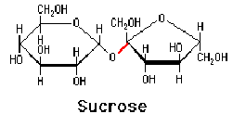

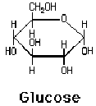

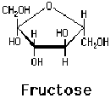
Dehydration Synthesis
of a Disaccharide

Slide 56
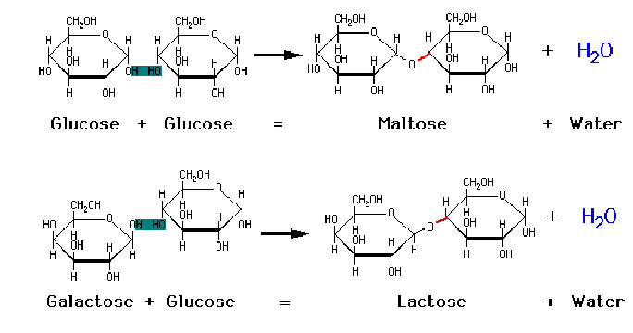
Formation of Disaccharides

Slide 57
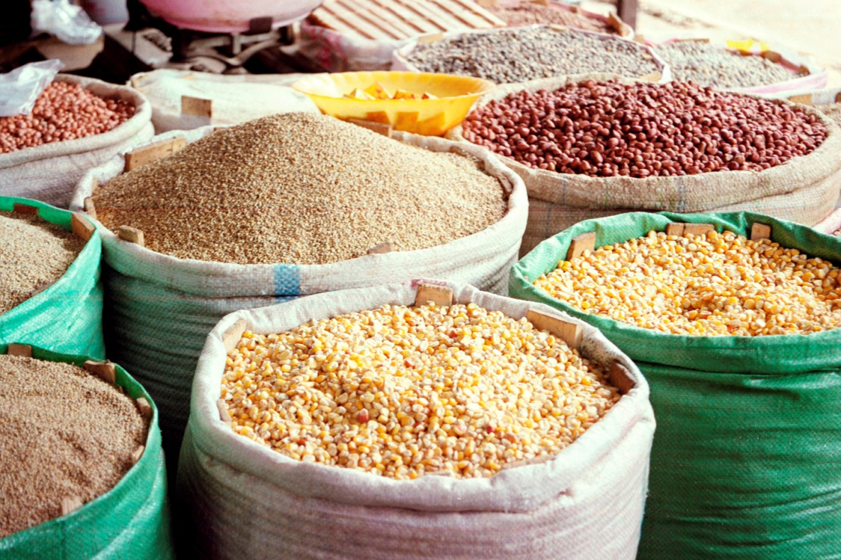
Starches
stored in plant cells
body hydrolyzes plant starch to glucose

Slide 58
Starch
most common storage polysaccharide in plants
composed of 10 – 30% α−amylose and 70-90% amylopectin depending on the source
the chains are of varying length, having molecular weights from several thousands to half a million

Slide 59
Polysaccharides
starch
cellulose
Starch 20% amylose (water soluble)
80% amylopectin (water insoluble)
amylose + H₂O → (+)-maltose
(+)-maltose + H₂O → (+)-glucose
starch is a poly glucose (alpha-glucoside to C-4)

Slide 60
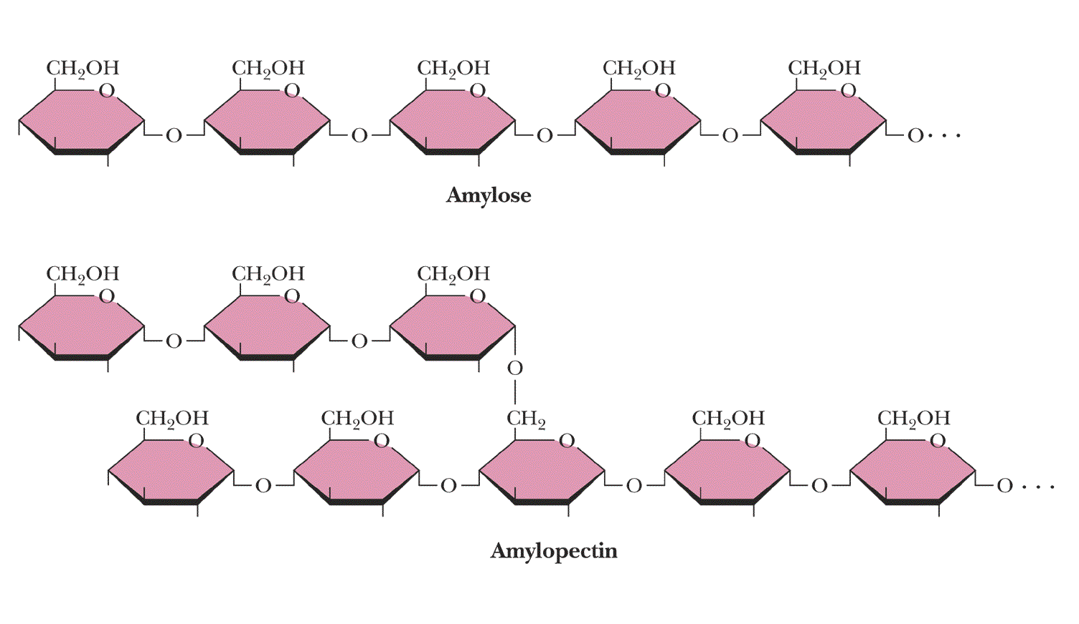
Amylose and amylopectin are the 2 forms of starch. Amylopectin
is a highly branched structure, with branches occurring every 12
to 30 residues

Slide 61
Amylopectin is a glucose polymer with mainly α(1→4) linkages, but it also has branches formed by α(1→6) linkages. Branches are generally longer than shown above.
The branches produce a compact structure & provide multiple chain ends at which enzymatic cleavage can occur.

Slide 62
Glycogen, the glucose storage polymer in animals, is similar in structure to amylopectin.
But glycogen has more α(1→6) branches.
The highly branched structure permits rapid glucose release from glycogen stores, e.g., in muscle during exercise.
The ability to rapidly mobilize glucose is more essential to animals than to plants.

Slide 63
Cellulose
Polymer of β-D-glucose attached by β(1,4) linkages
Only digested and utilized by ruminants (cows, deers, giraffes, camels)
A structural polysaccharide
Yields glucose upon complete hydrolysis
Partial hydrolysis yields cellobiose
Most abundant of all carbohydrates
    Cotton flax: 97-99% cellulose
    Wood: ~ 50% cellulose
Gives no color with iodine
Held together with lignin in woody plant tissues

Slide 64
Cellulose, a major constituent of plant cell walls, consists of long linear chains of glucose with β(1→4) linkages.
Every other glucose is flipped over, due to β linkages.
This promotes intra-chain and inter-chain H-bonds and
van der Waals interactions, that cause cellulose chains to be straight & rigid, and pack with a crystalline arrangement in thick bundles - microfibrils.
See: Botany online website; website at Georgia Tech.

Slide 65
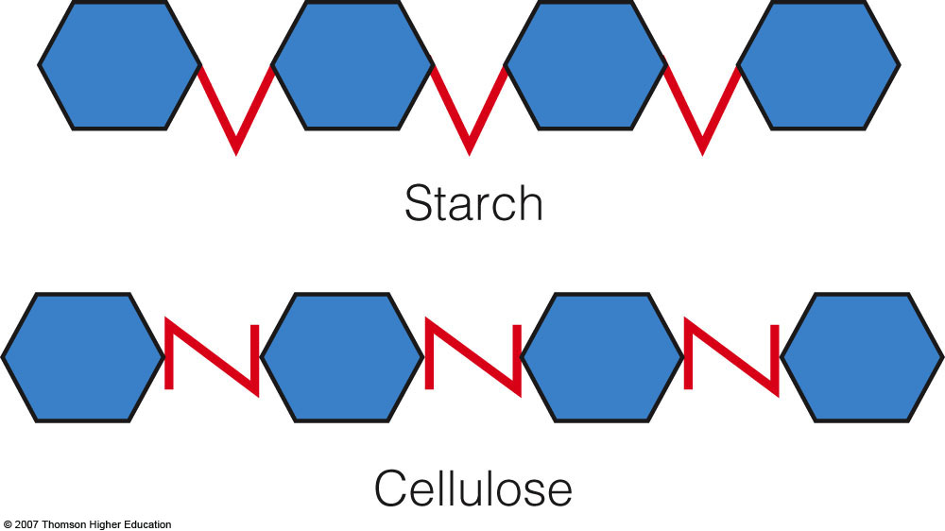

Slide 66
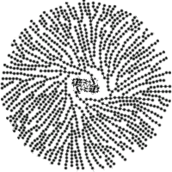
Glycogen
also known as animal starch
stored in muscle and liver (mostly)
present in cells as granules (high MW)
contains both α(1,4) links and α(1,6) branches at every 8 to 12 glucose unit (more frequent than in starch)
complete hydrolysis yields glucose
glycogen and iodine gives a red-violet color
hydrolyzed by both α and β-amylases and by glycogen phosphorylase

Slide 67


شكرا لاصغائكم
الفيس بوك: د. زياد حسين جواد
البريد الالكتروني: zyadalqaisi@yahoo.com

