Slide 1
Tissue processing
Histology:
It is the branch of science which deals with the gross & microscopic study of normal tissue
Histopathology:
It is the branch of science which deals with the gross & microscopic study of tissue affected by disease.
Histo-techniquse :
The techniques for processing the tissue, whether biopsies, larger specimen removed at surgery, or tissue from autopsy so as at to enable the pathologist to study them under the microscope .

Slide 2
Protocols followed in Histo-techniques
Receipt & Identification.
labeling of the specimen with numbering.
fixation.
Washing.
dehydration.
clearing.
impregnation.
Embedding.
section cutting.
staining.
mounting.

Slide 3
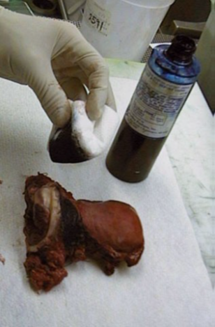
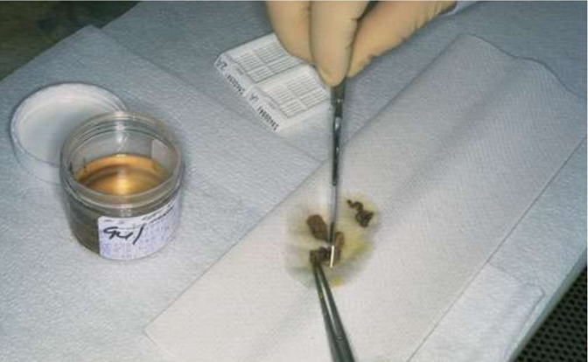
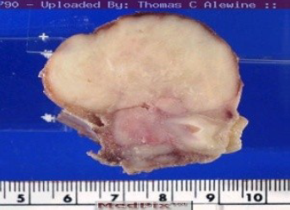
protocols followed in Histotechniques
1- Receipt & Identification
Tissue specimen received in the surgical pathology laboratory have a request form that list the patient information and history along with a description of the site of origin.

Slide 4
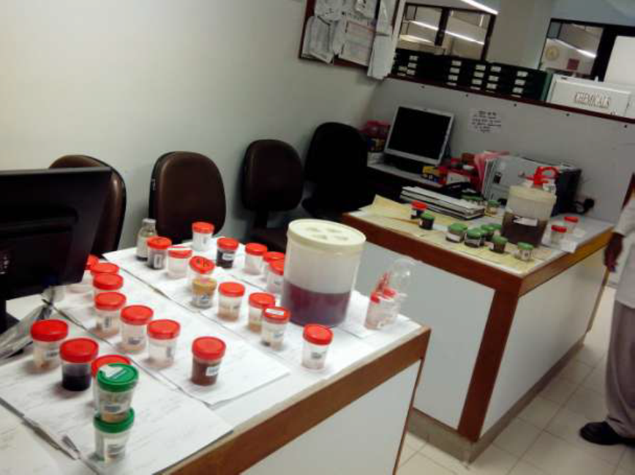
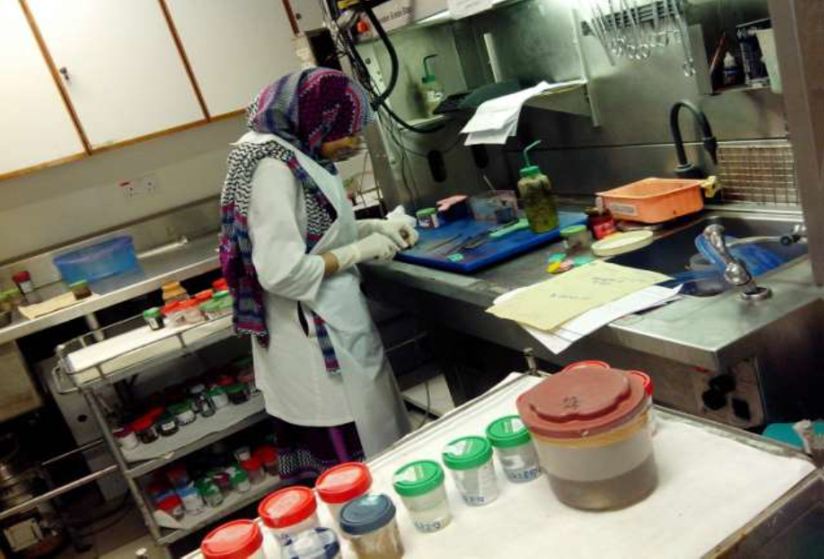
2-labeling of the specimen with numbering.
The specimen are accessioned by giving them a number that will identify each specimen for each patient.

Slide 5
3-fixation.
It is a process in which a specimen is treated by exposing it to a fixative for a particular period of time in order to facilitate the succeeding step.
The purpose of fixation is to preserve tissue permanently in as life-like a state as possible.
The fixative should be 15-20 times more in volume then the specimen.
Mechanism of action. it forms cross link between amino acid of proteins thereby making them insoluble.
The bite should of size of approximately 2x2 cm & 4-6 micrometer in thickness for optimum fixation to take place.
Tiny biopsies or small specimen can be wrapped in filter paper and then put in a cassette & fixed.

Slide 6
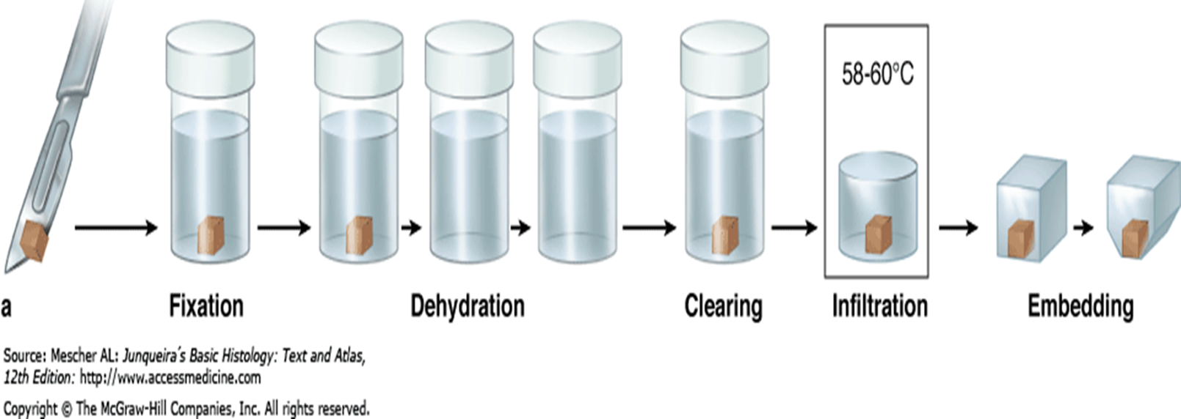

Slide 7
Aim of fixation
(Properties of an ideal fixative)
1- It should prevent autolysis & putrefaction of the cell.
2- It should penetrate evenly and rapidly .
3- It should harden the tissues .
4- Increase the optical density .
5- Should not cause shrinkage or swelling of the cells .
6- Must not react with the receptor sites & thus must not interfere with the staining procedure .
7- It must be cheap and easily available.

Slide 8
Classification of fixatives
A)Physical fixatives : heat , freezing …… etc .
B) Chemical fixatives :
1- simple fixatives .
2- compound fixative .

