Slide 1
Introduction to Endocrinology
Dr. Noori M. Luaibi

Slide 2
Coordination of Body Functions by Chemical Messengers
The multiple activities of the cells, tissues, and organs of the body are coordinated by the interplay of several types of chemical messenger systems:
1. Neurotransmitters are released by axon terminals of neurons into the synaptic junctions and act locally to control nerve cell functions.
2. Endocrine hormones are released by glands or specialized cells into the circulating blood and influence the function of cells at another location in the body.
3. Neuroendocrine hormones are secreted by neurons into the circulating blood and influence the function of cells at another location in the body.
4. Paracrines are secreted by cells into the extracellular fluid and affect neighboring cells of a different type.
5. Autocrines are secreted by cells into the extracellular fluid and affect the function of the same cells that produced them by binding to cell surface receptors.
6. Cytokines are peptides secreted by cells into the extracellular fluid and can function as autocrines, paracrines, or endocrine hormones. Examples of cytokines include the interleukins and other lymphokines that are secreted by helper cells and act on other cells of the immune system. Cytokine hormones (e.g., leptin) produced by adipocytes are sometimes called adipokines.

Slide 3
֎The endocrine hormones are carried by the circulatory system to cells throughout the body, including the nervous system in some cases, where they bind with receptors and initiate many reactions. Some endocrine hormones affect many different types of cells of the body; for example, growth hormone (from the anterior pituitary gland) causes growth in most parts of the body, and thyroxine (from the thyroid gland) increases the rate of many chemical reactions in almost all the body’s cells.
֎ Other hormones affect only specific target tissues, because only these tissues have receptors for the hormone. For example, adrenocorticotropic hormone (ACTH) from the anterior pituitary gland specifically stimulates the adrenal cortex, causing it to secrete adrenocortical hormones, and the ovarian hormones have specific effects on the female sex organs as well as on the secondary sexual characteristics of the female body.
The multiple hormone systems play a key role in regulating almost all body functions, including metabolism, growth and development, water and electrolyte balance, reproduction, and behavior. For instance, without growth hormone, a person would be a dwarf. Without thyroxine and triiodothyronine from the thyroid gland, almost all the chemical reactions of the body would become sluggish, and the person would become sluggish as well.
Without insulin from the pancreas, the body’s cells could use little of the food carbohydrates for energy.
And without the sex hormones, sexual development and sexual functions would be absent.

Slide 4
(Figure 1) shows the anatomical loci of the major endocrine glands and endocrine tissues of the body, except for the placenta, which is an additional source of the sex hormones. Table 1 provides an overview of the different hormone systems and their most important actions.
Figure 1

Slide 5
Chemical Structure and Synthesis of Hormones
There are three general classes of hormones:
Proteins and polypeptides, including hormones secreted by the anterior and posterior pituitary gland, the pancreas (insulin and glucagon), the parathyroid gland (parathyroid hormone), and many others (see Table 1).
Steroids, secreted by the adrenal cortex (cortisol and aldosterone), the ovaries (estrogen and progesterone), the testes (testosterone), and the placenta (estrogen and progesterone).
Derivatives of the amino acid tyrosine, secreted by the thyroid (thyroxine and triiodothyronine) and the adrenal medullae (epinephrine and norepinephrine). There are no known polysaccharides or nucleic acid hormones.
Polypeptide and Protein Hormones Are Stored in Secretory Vesicles Until Needed.
Most of the hormones in the body are polypeptides and proteins. These hormones range in size from small peptides with as few as 3 amino acids (thyrotropin-releasing hormone) to proteins with almost 200 amino acids (growth hormone and prolactin).
In general, polypeptides with 100 or more amino acids are called proteins, and those with fewer than 100 amino acids are referred to as peptides.

Slide 6
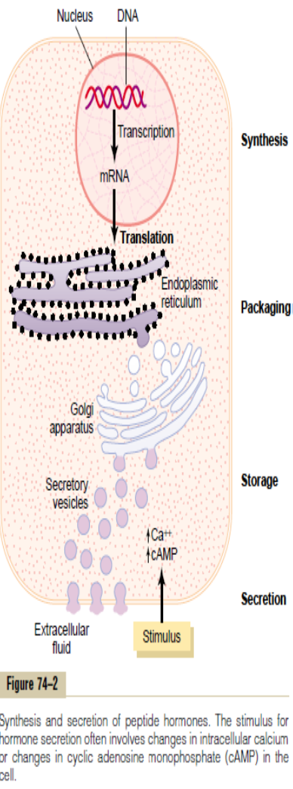
Protein and peptide hormones are synthesized on the rough end of the endoplasmic reticulum of the different endocrine cells, in the same fashion as most other proteins (Figure 2).
Figure 2

Slide 7
֍They are usually synthesized first as larger proteins that are not biologically active (preprohormones) and are cleaved to form smaller prohormones in the endoplasmic reticulum. These are then transferred to the Golgi apparatus for packaging into secretory vesicles.
֍ In this process, enzymes in the vesicles cleave the prohormones to produce smaller, biologically active hormones and inactive fragments.
The vesicles are stored within the cytoplasm, and many are bound to the cell membrane until their secretion is needed.
֍ Secretion of the hormones (as well as the inactive fragments) occurs when the secretory vesicles fuse with the cell membrane and the granular contents are extruded into the interstitial fluid or directly into the blood stream by exocytosis.
In many cases, the stimulus for exocytosis is an increase in cytosolic calcium concentration caused by depolarization of the plasma membrane.
֍ In other instances, stimulation of an endocrine cell surface receptor causes increased cyclic adenosine monophosphate (cAMP) and subsequently activation of protein kinases that initiate secretion of the hormone.
֍ The peptide hormones are water soluble, allowing them to enter the circulatory system easily, where they are carried to their target tissues.

Slide 8
Steroid Hormones Are Usually Synthesized from Cholesterol and Are Not Stored.
The chemical structure of steroid hormones is similar to that of cholesterol, and in most instances they are synthesized from cholesterol itself.
They are lipid soluble and consist of three cyclohexyl rings and one cyclopentyl ring combined into a single structure (Figure 3).
Although there is usually very little hormone storage in steroid-producing endocrine cells, large stores of cholesterol esters in cytoplasm vacuoles can be rapidly mobilized for steroid synthesis after a stimulus.
Much of the cholesterol in steroid-producing cells comes from the plasma, but there is also de novo synthesis of cholesterol in steroid-producing cells. Because the steroids are highly lipid soluble, once they are synthesized, they simply diffuse across the cell membrane and enter the interstitial fluid and then the blood.

Slide 9
Amine Hormones Are Derived from Tyrosine.
The two groups of hormones derived from tyrosine, the thyroid and the adrenal medullary hormones, are formed by the actions of enzymes in the cytoplasmic compartments of the glandular cells.
The thyroid hormones are synthesized and stored in the thyroid gland and incorporated into macromolecules of the protein thyroglobulin, which is stored in large follicles within the thyroid gland.
Hormone secretion occurs when the amines are split from thyroglobulin, and the free hormones are then released into the blood stream.
After entering the blood, most of the thyroid hormones combine with plasma proteins, especially thyroxine- binding globulin, which slowly releases the hormones to the target tissues.
Epinephrine and norepinephrine are formed in the adrenal medulla, which normally secretes about four times more epinephrine than norepinephrine.
Catecholamines are taken up into preformed vesicles and stored until secreted. Similar to the protein hormones stored in secretory granules, catecholamines are also released from adrenal medullary cells by exocytosis.
Once the catecholamines enter the circulation, they can exist in the plasma in free form or in conjugation with other substances.

Slide 10
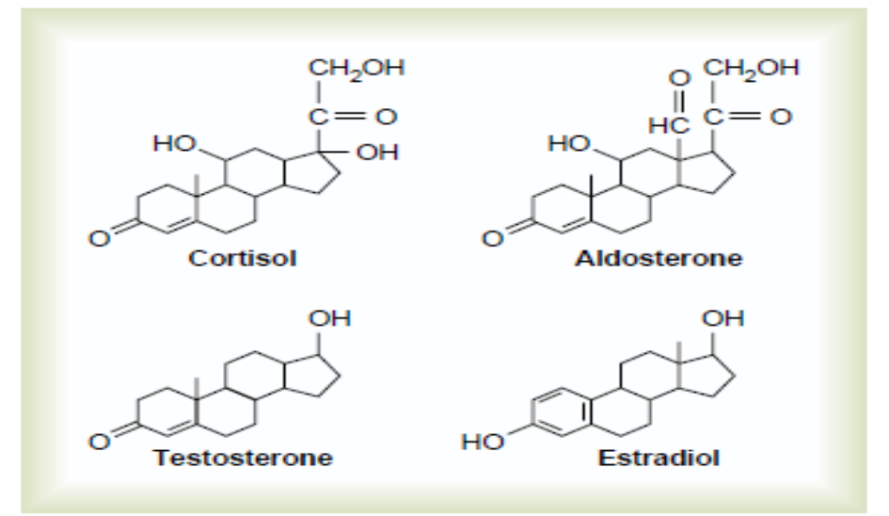
Figure 3: Chemical structures of several steroid hormones

Slide 11
Hormone Secretion, Transport, and Clearance from the Blood Onset of Hormone Secretion After a Stimulus, and Duration of Action of Different Hormones.
Some hormones, such as norepinephrine and epinephrine, are secreted within seconds after the gland is stimulated, and they may develop full action within another few seconds to minutes; the actions of other hormones, such as thyroxine or growth hormone, may require months for full effect.
Thus, each of the different hormones has its own characteristic onset and duration of action—each tailored to perform its specific control function.
Concentrations of Hormones in the Circulating Blood, and Hormonal Secretion Rates.
The concentrations of hormones required to control most metabolic and endocrine functions are incredibly small.
Their concentrations in the blood range from as little as 1 picogram (which is one millionth of one millionth of a gram) in each milliliter of blood up to at most a few micrograms (a few millionths of a gram) per milliliter of blood. Similarly, the rates of secretion of the various hormones are extremely small, usually measured in micrograms or milligrams per day.

Slide 12
Feedback Control of Hormone Secretion
Negative Feedback Prevents Overactivity of Hormone Systems.
Although the plasma concentrations of many hormones fluctuate in response to various stimuli that occur throughout the day, all hormones studied thus far appear to be closely controlled. In most instances, this control is exerted through negative feedback mechanisms that ensure a proper level of hormone activity at the target tissue.
After a stimulus causes release of the hormone, conditions or products resulting from the action of the hormone tend to suppress its further release. In other words, the hormone (or one of its products) has a negative feedback effect to prevent oversecretion of the hormone or overactivity at the target tissue.
The controlled variable is often not the secretory rate of the hormone itself but the degree of activity of the target tissue. Therefore, only when the target tissue activity rises to an appropriate level will feedback signals to the endocrine gland become powerful enough to slow further secretion of the hormone.
Feedback regulation of hormones can occur at all levels, including gene transcription and translation steps involved in the synthesis of hormones and steps involved in processing hormones or releasing stored hormones.

Slide 13
Surges of Hormones Can Occur with Positive Feedback.
In a few instances, positive feedback occurs when the biological action of the hormone causes additional secretion of the hormone.
One example of this is the surge of luteinizing hormone (LH) that occurs as a result of the stimulatory effect of estrogen on the anterior pituitary before ovulation.
The secreted LH then acts on the ovaries to stimulate additional secretion of estrogen, which in turn causes more secretion of LH. Eventually, LH reaches an appropriate concentration, and typical negative feedback control of hormone secretion is then exerted.

Slide 14
Transport of Hormones in the Blood
Water-soluble hormones (peptides and catecholamines) are dissolved in the plasma and transported from their sites of synthesis to target tissues, where they diffuse out of the capillaries, into the interstitial fluid, and ultimately to target cells.
Steroid and thyroid hormones, in contrast, circulate in the blood mainly bound to plasma proteins. Usually less than 10 per cent of steroid or thyroid hormones in the plasma exist free in solution. For example, more than 99 per cent of the thyroxine in the blood is bound to plasma proteins. However, protein-bound hormones cannot easily diffuse across the capillaries and gain access to their target cells and are therefore biologically inactive until they dissociate from plasma proteins.
The relatively large amounts of hormones bound to proteins serve as reservoirs, replenishing the concentration of free hormones when they are bound to target receptors or lost from the circulation. Binding of hormones to plasma proteins greatly slows their clearance from the plasma.

Slide 15
“Clearance” of Hormones from the Blood
Two factors can increase or decrease the concentration of a hormone in the blood. One of these is the rate of hormone secretion into the blood. The second is the rate of removal of the hormone from the blood, which is called the metabolic clearance rate. This is usually expressed in terms of the number of milliliters of plasma cleared of the hormone per minute.
To calculate this clearance rate, one measures
(1) the rate of disappearance of the hormone from the plasma per minute
(2) the concentration of the hormone in each milliliter of plasma. Then, the metabolic clearance rate is calculated by the following formula:
Metabolic clearance rate = Rate of disappearance of hormone from the plasma / Concentration of hormone in each milliliter of plasma.
Mechanisms of Action of Hormones Hormone Receptors and Their Activation
The first step of a hormone’s action is to bind to specific receptors at the target cell. Cells that lack receptors for the hormones do not respond. Receptors for some hormones are located on the target cell membrane, whereas other hormone receptors are located in the cytoplasm or the nucleus.
When the hormone combines with its receptor, this usually initiates a cascade of reactions in the cell, with each stage becoming more powerfully activated so that even small concentrations of the hormone can have a large effect.

Slide 16
Hormonal receptors are large proteins, and each cell that is to be stimulated usually has some 2000 to 100,000 receptors. Also, each receptor is usually highly specific for a single hormone; this determines the type of hormone that will act on a particular tissue.
The target tissues that are affected by a hormone are those that contain its specific receptors.
The locations for the different types of hormone receptors are generally the following:
In or on the surface of the cell membrane. The membrane receptors are specific mostly for the protein, peptide, and catecholamine hormones.
In the cell cytoplasm. The primary receptors for the different steroid hormones are found mainly in the cytoplasm.
In the cell nucleus. The receptors for the thyroid hormones are found in the nucleus and are believed to be located in direct association with one or more of the chromosomes.

Slide 17
The Number and Sensitivity of Hormone Receptors Are Regulated.
The number of receptors in a target cell usually does not remain constant from day to day, or even from minute to minute. The receptor proteins themselves are often inactivated or destroyed during the course of their function, and at other times they are reactivated or new ones are manufactured by the protein-manufacturing mechanism of the cell. For instance, increased hormone concentration and increased binding with its target cell receptors sometimes cause the number of active receptors to decrease.
This down-regulation of the receptors can occur as a result of
1. inactivation of some of the receptor molecules,
2. inactivation of some of the intracellular protein signaling molecules,
3. temporary sequestration of the receptor to the inside of the cell, away from the site of action of hormones that interact with cell membrane receptors.
4. destruction of the receptors by lysosomes after they are internalized
5. decreased production of the receptors.
In each case, receptor down-regulation decreases the target tissue’s responsiveness to the hormone. Some hormones cause up-regulation of receptors and intracellular signaling proteins; that is, the stimulating hormone induces greater than normal formation of receptor or intracellular signaling molecules by the protein-manufacturing machinery of the target cell, or greater availability of the receptor for interaction with the hormone. When this occurs, the target tissue becomes progressively more sensitive to the stimulating effects of the hormone.

Slide 18
Intracellular Signaling After HormoneReceptor Activation
Almost without exception, a hormone affects its target tissues by first forming a hormone-receptor complex.
This alters the function of the receptor itself, and the activated receptor initiates the hormonal effects.
To explain this, let us give a few examples of the different types of interactions.
Ion Channel–Linked Receptors.
G Protein–Linked Hormone Receptors.
Enzyme-Linked Hormone Receptors.

