Slide 1
Ovaries
By
Dr. Noori Mohammed Luaibi

Slide 2
ovaries
The ovaries are the female pelvic reproductive organs that house the ova and are also responsible for the production of sex hormones. They are paired organs located on either side of the uterus within the broad ligament below the uterine (fallopian) tubes. The ovary is within the ovarian fossa, a space that is bound by the external iliac vessels, obliterated umbilical artery, and the ureter. The ovaries are responsible for housing and releasing ova, or eggs, necessary for reproduction. At birth, a female has approximately 1 -2 million eggs, but only 300 of these eggs will ever become mature and be released for the purpose of fertilization.

Slide 3
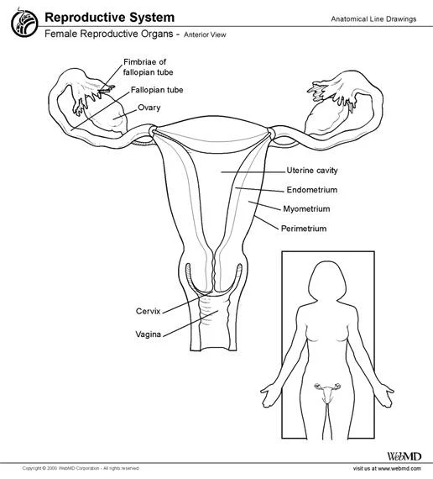
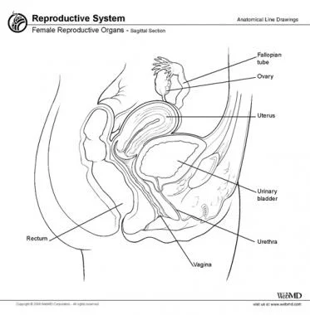

Slide 4
The ovaries are small, oval-shaped, and grayish in color, with an uneven surface. located alongside the lateral wall of the uterus in a region called the ovarian fossa. The ovarian fossa is the region that is bounded by the external iliac artery and in front of the ureter and the internal iliac artery. This area is about 4 cm x 3 cm x 2 cm in size. The ovaries are surrounded by a capsule, and have an outer cortex and an inner medulla. The actual size of an ovary depends on a woman’s age and hormonal status; the ovaries, covered by a modified peritoneum, are approximately 3-5 cm in length during childbearing years and become much smaller and then atrophic once menopause occurs. A cross-section of the ovary reveals many cystic structures that vary in size. These structures represent ovarian follicles at different stages of development and degeneration.

Slide 5
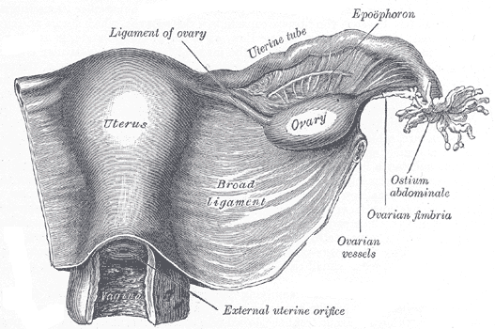

Slide 6
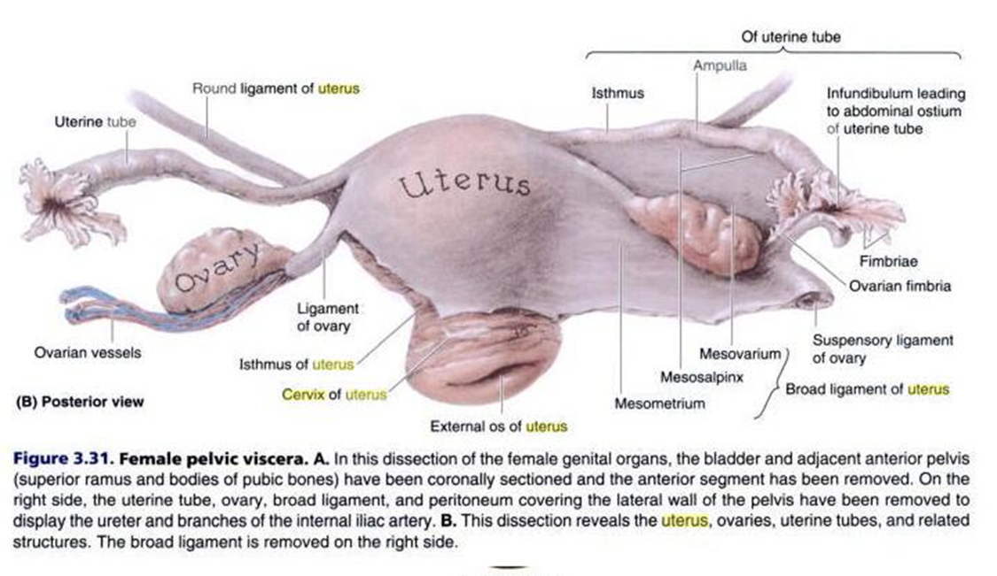

Slide 7
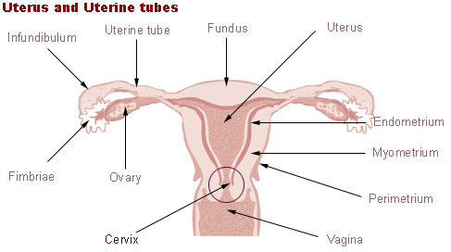

Slide 8
Usually, ovulation occurs in one of the two ovaries releasing an egg each menstrual cycle; however, if there was a case where one ovary was absent or dysfunctional then the other ovary would continue providing eggs to be released without any changes in cycle length or frequency. The side of the ovary closest to the fallopian tube is connected to it by infundibulopelvic ligament, and the other side points downwards attached to the uterus via the ovarian ligament
Other structures and tissues of the ovaries include:
Hilum of ovary
Capsule of ovary
The ovary also contains blood vessels and lymphatics.

Slide 9
1. Hilum of ovary
Ligaments
The ovaries lie within the pelvic cavity, on either side of the uterus, to which they are attached via a fibrous cord called the ovarian ligament. The ovaries are uncovered in the peritoneal cavity but are tethered to the body wall via the suspensory ligament of the ovary which is a posterior extension of the broad ligament of the uterus. The part of the broad ligament of the uterus that covers the ovary is known as the mesovarium.
Microanatomy
The surface of the ovaries is covered with membrane consisting of a lining of simple cuboidal-to-columnar shaped mesothelium.

Slide 10
The outermost layer is called the germinal epithelium.
The outer layer is the ovarian cortex, consisting of ovarian follicles and stroma in between them. Included in the follicles are the cumulus oophorus, membrana granulosa (and the granulosa cells inside it), corona radiata, zona pellucida, and primary oocyte. Theca of follicle, antrum and liquor folliculi are also contained in the follicle. Also in the cortex is the corpus luteum derived from the follicles. The innermost layer is the ovarian medulla. It can be hard to distinguish between the cortex and medulla, but follicles are usually not found in the medulla.
Follicular cells flat epithelial cells that originate from surface epithelium covering the ovary, are surrounded by Granulosa cells - that have changed from flat to cuboidal and proliferated to produce a stratified epithelium

Slide 11
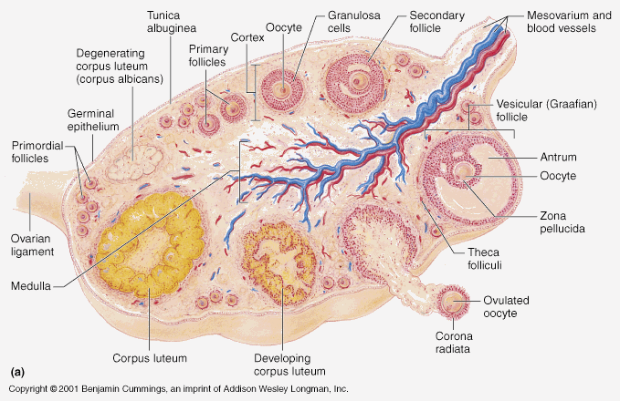

Slide 12
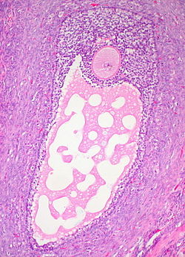
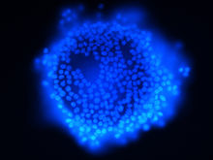
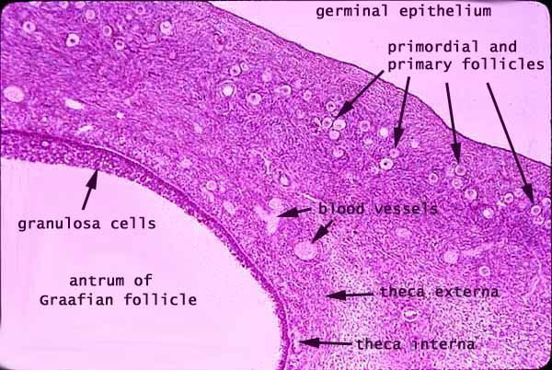
Histology section of a mature ovarian follicle. The oocyte is the large, round, pink-staining cell at top center of the image
oocyte surrounded by granulosa cells. Fluorescence microscopy

Slide 13
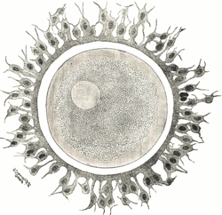
Human ovum examined fresh in the liquor folliculi. The zona pellucida is seen as a thick clear girdle surrounded by the cells of the corona radiata.
The egg itself shows a central granular deutoplasmic area and a peripheral clear layer, and encloses the germinal vesicle, in which is seen the germinal spot

Slide 14
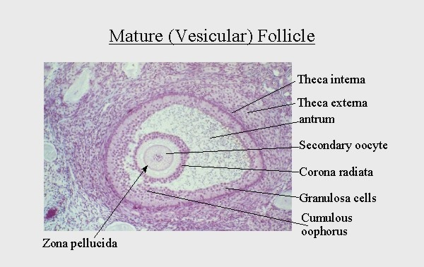

Slide 15
At puberty, the ovary begins to secrete increasing levels of hormones. Secondary sex characteristics begin to develop in response to the hormones. The ability to produce eggs and reproduce develops. The ovary changes structure and function beginning at puberty.
Gamete production (Oogenesis)
The ovaries are the site of production and periodical release of egg cells, the female gametes. In the ovaries, the developing egg cells (or oocytes) mature in the fluid-filled follicles. Typically, only one oocyte develops at a time, but others can also mature simultaneously. Follicles are composed of different types and number of cells according to the stage of their maturation, and their size is indicative of the stage of oocyte development

Slide 16
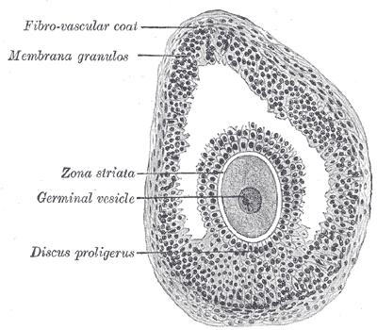
Section of vesicular ovarian follicle

Slide 17
When the oocyte finishes its maturation in the ovary, a surge of luteinizing hormone secreted by the pituitary gland stimulates the release of the oocyte through the rupture of the follicle, a process called ovulation. The follicle remains functional and reorganizes into a corpus luteum, which secretes progesterone in order to prepare the uterus for an eventual implantation of the embryo
Hormone secretion
At maturity, ovaries secrete estrogen, testosterone,inhibin, and progesterone. In women, fifty percent of testosterone is produced by the ovaries and adrenal glands and released directly into the blood stream. Estrogen is responsible for the appearance of secondary sex characteristics for females at puberty and for the maturation and maintenance of the reproductive organs in their mature functional state.

Slide 18
Progesterone prepares the uterus for pregnancy, and the mammary glands for lactation. Progesterone functions with estrogen by promoting menstrual cycle changes in the endometrium

Slide 19
The Female Cycle (Menstrual cycle)
The menstrual cycle is the regular natural change that occurs in the female reproductive system (specifically the uterus and ovaries) that makes pregnancy possible. The cycle is required for the production of ovocytes, and for the preparation of the uterus for pregnancy. Up to 80% of women report having some symptoms during the one to two weeks prior to menstruation. Common symptoms include acne, tender breasts, bloating, feeling tired, irritability and mood changes. These symptoms interfere with normal life and therefore qualify as premenstrual syndrome in 20 to 30% of women. In 3 to 8%, they are severe.

Slide 20
The first period usually begins between twelve and fifteen years of age, a point in time known as menarche. They may occasionally start as early as eight, and this onset may still be normal. The typical length of time between the first day of one period and the first day of the next is 21 to 45 days in young women and 21 to 35 days in adults (an average of 28 days). Menstruation stops occurring after menopause which usually occurs between 45 and 55 years of age. Bleeding usually lasts around 2 to 7 days.

Slide 21
The menstrual cycle is governed by hormonal changes. These changes can be altered by using hormonal birth control to prevent pregnancy. Each cycle can be divided into three phases based on events in the ovary (ovarian cycle) or in the uterus (uterine cycle). The ovarian cycle consists of the follicular phase, ovulation, and luteal phase whereas the uterine cycle is divided into menstruation, proliferative phase, and secretory phase.
Stimulated by gradually increasing amounts of estrogen in the follicular phase, discharges of blood (menses) flow stop, and the lining of the uterus thickens. Follicles in the ovary begin developing under the influence of a complex interplay of hormones, and after several days one or occasionally two become dominant (non-dominant follicles shrink and die).

Slide 23
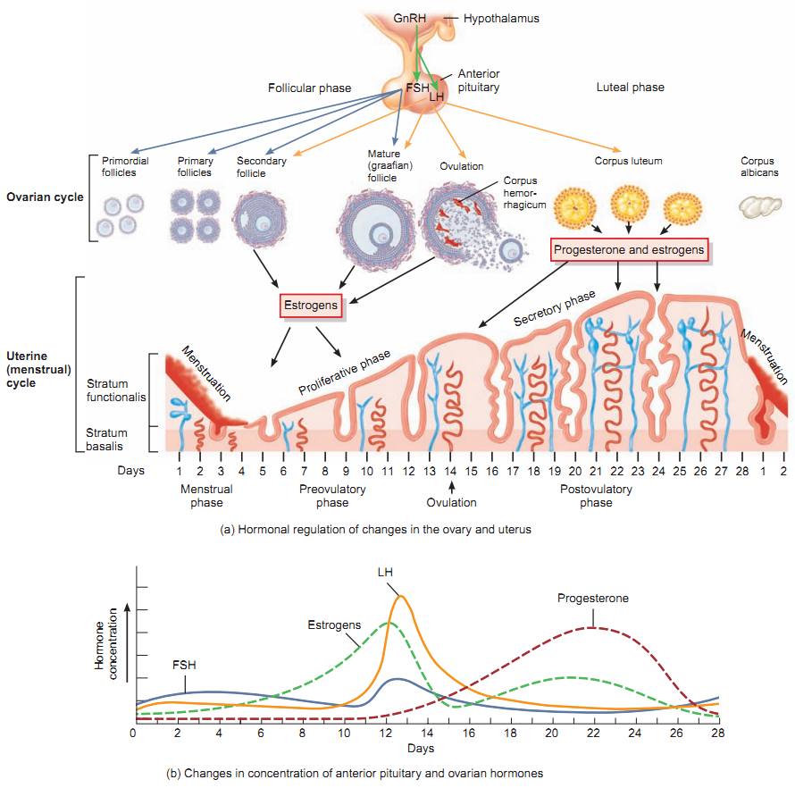

Slide 24
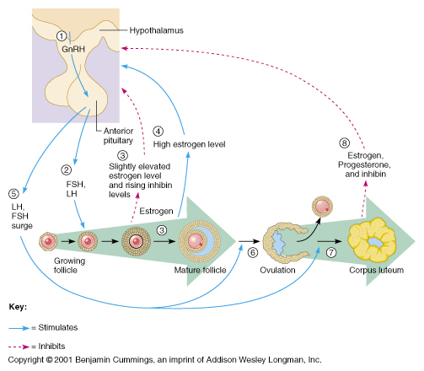

Slide 25
Approximately mid-cycle, 24–36 hours after the luteinizing hormone (LH) surges, the dominant follicle releases an ovocyte, in an event called ovulation. After ovulation, the ovocyte only lives for 24 hours or less without fertilization while the remains of the dominant follicle in the ovary become a corpus luteum; this body has a primary function of producing large amounts of progesterone. Under the influence of progesterone, the uterine lining changes to prepare for potential implantation of an embryo to establish a pregnancy. If implantation does not occur within approximately two weeks, the corpus luteum will involute, causing a sharp drop in levels of both progesterone and estrogen. The hormone drop causes the uterus to shed its lining in a process termed menstruation.

Slide 26
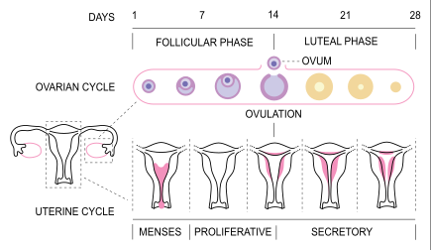
Menstrual cycle

Slide 27
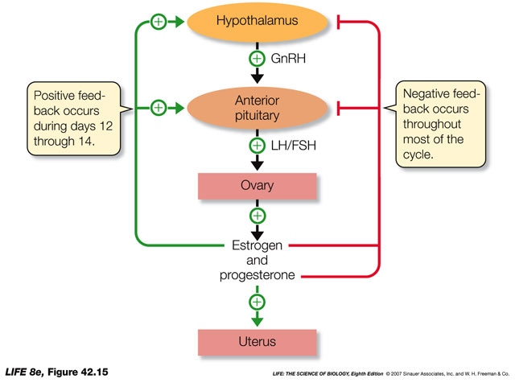

Slide 28
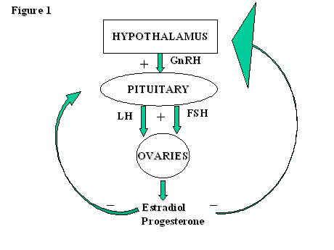

Slide 29
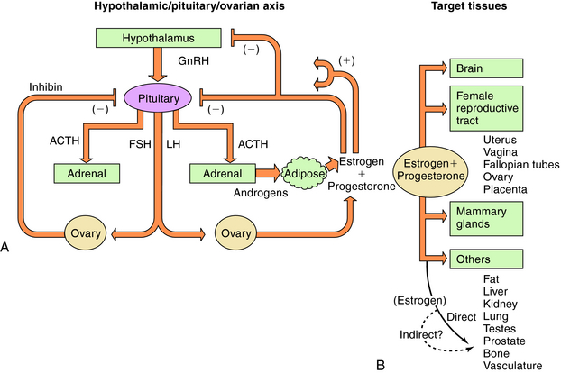

Slide 30
Fertilization usually occurs in the Fallopian tubes and marks the beginning of embryogenesis. The zygote will then divide over enough generations of cells to form a blastocyst, which implants itself in the wall of the uterus. This begins the period of gestation and the embryo will continue to develop until full-term. When the fetus has developed enough to survive outside the uterus, the cervix dilates and contractions of the uterus propel the newborn through the birth canal (the vagina).

Slide 31
Hormonal changes during pregnancy
Plasma levels of human chorionic gonadotropin increase immediately upon implantation of the ovum; the hormone is detectable in urine within 2 wk of implantation. It reaches a peak at ≈8 wk of gestation and then declines to a stable plateau until birth. Human chorionic gonadotropin maintains corpus luteum function for 8–10 wk. Human placental lactogen (also called human chorionic somatomammotropin) has a structure that closely resembles growth hormone, and its rate of secretion appears to parallel placental growth and may be used as a measure of placental function. At its peak, the rate of secretion of placental lactogen is 1–2 g/d, far in excess of the production of any other hormones.

Slide 32
Placental lactogen stimulates lipolysis, antagonizes insulin actions and may be important in maintaining a flow of energy-yielding substrates to the fetus. Placental lactogen along with prolactin from the pituitary may promote mammary gland growth. After delivery, placental lactogen rapidly disappears from the circulation.
The placenta becomes the main source of steroid hormones at weeks 8–10 of gestation. Before then, progesterone and estrogens are synthesized in the maternal corpus luteum. These hormones play essential roles in maintaining the early uterine environment and development of the placenta. The placenta takes over progesterone production, which increases throughout pregnancy.

Slide 33
Progesterone, known as the hormone of pregnancy, stimulates maternal respiration; relaxes smooth muscle, notably in the uterus and gastrointestinal tract; and may act as an immunosuppressant in the placenta, where its concentration can be 50 times greater than in plasma. Progesterone may promote lobular development in the breast and is responsible for the inhibition of milk secretion during pregnancy.
The functions of high estrogen levels in pregnancy include stimulation of uterine growth, enhancement of uterine blood flow and possibly promotion of breast development. Because estrogen precursors originate in the fetus, maternal estrogen levels can be used as a measure of fetal viability.

Slide 34
The increased amount of estrogens during pregnancy also stimulates a population of cells (somatotrophs) in the maternal pituitary to become mammotrophs, or prolactin-secreting cells. The increased prolactin secretion probably helps promote mammary development. In addition, the increased number of pituitary mammotrophs at the end of pregnancy provides the large amounts of prolactin necessary to initiate and maintain lactation.
Endocrine regulation of lactation
he establishment and maintenance of human lactation are under the influence of complex neuroendocrine control mechanisms (28). After parturition, elevated levels of prolactin and withdrawal of estrogens and progesterone results in the onset of milk secretion (lactogenesis).

Slide 35
The breasts must have undergone appropriate growth and development beginning in puberty and completed during pregnancy for milk secretion to occur.
The initiation of lactogenesis does not require infant sucking but lactation cannot be maintained unless the infant is put to the breast by 3 or 4 d postpartum. For the first 3–5 d postpartum the mammary secretion is termed “colostrum.” This early milk is thick and straw-colored, rich in minerals and immune factors (i.e., lactoferrin and secretory immunoglobulin A) and low in lactose and total protein. The concentration of lactose increases and that of sodium and chloride decrease as milk secretion is enhanced. The characteristics of mature milk are evident by day 10 of lactation.

Slide 36
With established lactation, prolactin is required for maintenance of milk production. Prolactin release into the circulation from mammotrophs in the anterior pituitary is in response to sucking. Prolactin secretion is mediated by a transient decline in the secretion of dopamine from the hypothalamus, which normally inhibits its secretion. Milk secretion continues as long as the infant continues to nurse more than once a day. The daily milk volume transferred to the infant increases through lactation. Most women can secrete considerably more milk than needed by a single infant. Milk secretion is continuous and the quantity produced is principally regulated by infant demand.

Slide 37
Oxytocin release from the posterior pituitary results from neural impulses reaching the hypothalamus caused by sucking of the nursing infant. Circulating oxytocin causes contraction of myoepithelial cells that surround mammary alveoli and ducts, forcing milk into ducts of the nipple so that it can be removed by the infant.
This response is termed “milk ejection” or “let-down” and can be initiated by the mere sight of the infant or by hearing the infant cry.
Milk secretion ceases in 1 or 2 d when infant sucking or milk removal is terminated.

Slide 38
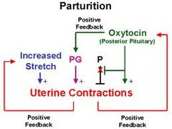

Slide 39
