Slide 1
Testes
By
Dr. Noori Mohammed Luaibi

Slide 2
Testicle
The testicle or testis is the male reproductive gland in all animals, including humans. It is homologous to the female ovary. The functions of the testes are to produce both sperm and androgens, primarily testosterone. Testosterone release is controlled by the anterior pituitary luteinizing hormone; whereas sperm production is controlled both by the anterior pituitary follicle-stimulating hormone and gonadal testosterone.
Appearance
Males have two testicles of similar size contained within the scrotum , which is an extension of the abdominal wall. Scrotal asymmetry is not unusual: one testicle extends further down into the scrotum than the other due to differences in the anatomy of the vasculature.

Slide 4
Internal structure
Duct system
The testes are covered by a tough membranous shell called the tunica albuginea . Within the testes are very fine coiled tubes called seminiferous tubules. The tubules are lined with a layer of cells (germ cells) that develop from puberty through old age into sperm cells (also known as spermatozoa or male gametes ). The developing sperm travel through the seminiferous tubules to the rete testis located in the mediastinum testis , to the efferent ducts , and then to the epididymis where newly created sperm cells mature (spermatogenesis ). The sperm move into the vas deferens, and are eventually expelled through the urethra and out of the urethral orifice through muscular contractions.

Slide 5
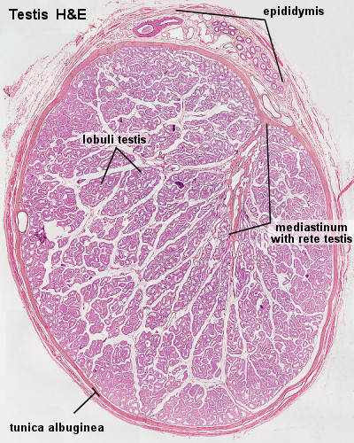

Slide 6
Primary cell types within the seminiferous tubules
Germ cells develop into spermatogonia, spermatocytes, spermatids and spermatozoon through the process of spermatogenesis. The gametes contain DNA for fertilization of an ovum
Sertoli cells – the true epithelium of the seminiferous epithelium, critical for the support of germ cell development into spermatozoa. Sertoli cells secrete inhibin.
Peritubular myoid cells surround the seminiferous tubules.

Slide 8
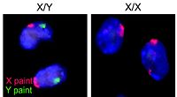
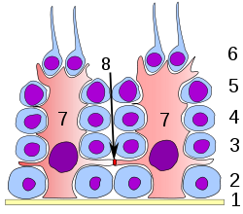
Germinal epithelium of the testicle.
1: basal lamina
2: spermatogonia
3: spermatocyte 1st order
4: spermatocyte 2nd order
5: spermatid
6: mature spermatid
7: Sertoli cell
8: tight junction (blood testis barrier)
A germ cell is any biological cell that gives rise to the gametes of an organism that reproduces sexually.

Slide 9
Primary cell types between tubules (interstitial cells)
Leydig cells – cells localized between seminiferous tubules that produce and secrete testosterone and other androgens important for sexual development and puberty, secondary sexual characteristics like facial hair, sexual behavior and libido, supporting spermatogenesis and erectile function. Testosterone also controls testicular volume.
Also present are:
Immature Leydig cells
Interstitial macrophages and epithelial cells

Slide 10
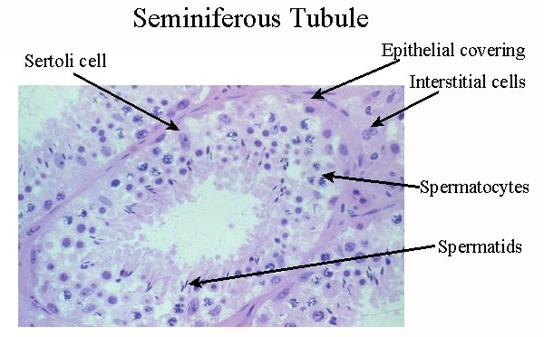

Slide 11
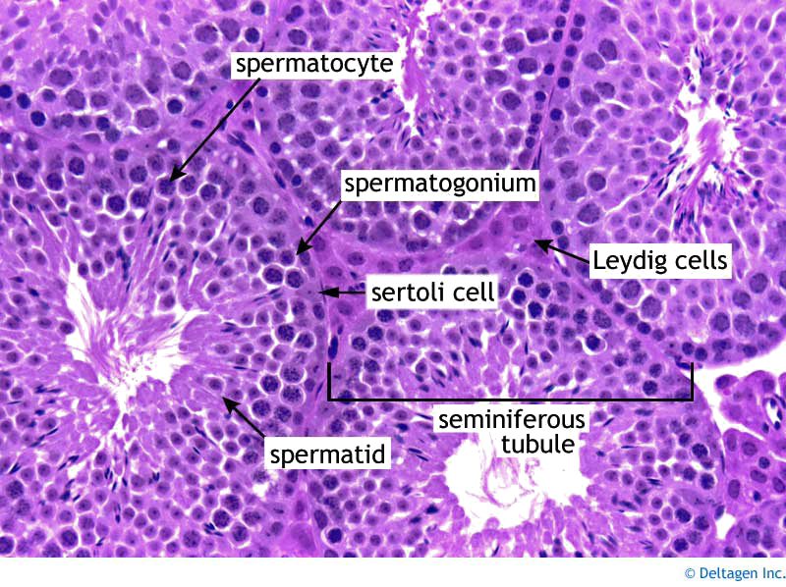

Slide 12
Cell division during spermatogenesis. During embryonic development the primordial germ cells migrate to the testis where they become spermatogonia. At puberty ( usually 12 to 14 years after birth), the spermatogonia proliferate rapidly by mitosis. Some begin meiosis to become primary spermatocytes and continue through meiotic division 1 to become secondary spermatocytes. After completion of meiotic division 2, the secondary spermatocytes produce spermatids, which differentiate to form spermatozoa.

Slide 13
Layers
Many anatomical features of the adult testis reflect its developmental origin in the abdomen. The layers of tissue enclosing each testicle are derived from the layers of the anterior abdominal wall. Notably, the cremasteric muscle arises from the internal oblique muscle.
The blood–testis barrier
Large molecules cannot pass from the blood into the lumen of a seminiferous tubule due to the presence of tight junctions between adjacent Sertoli cells. The spermatogonia are in the basal compartment (deep to the level of the tight junctions) and the more mature forms such as primary and secondary spermatocytes and spermatids are in the adluminal compartment.

Slide 14
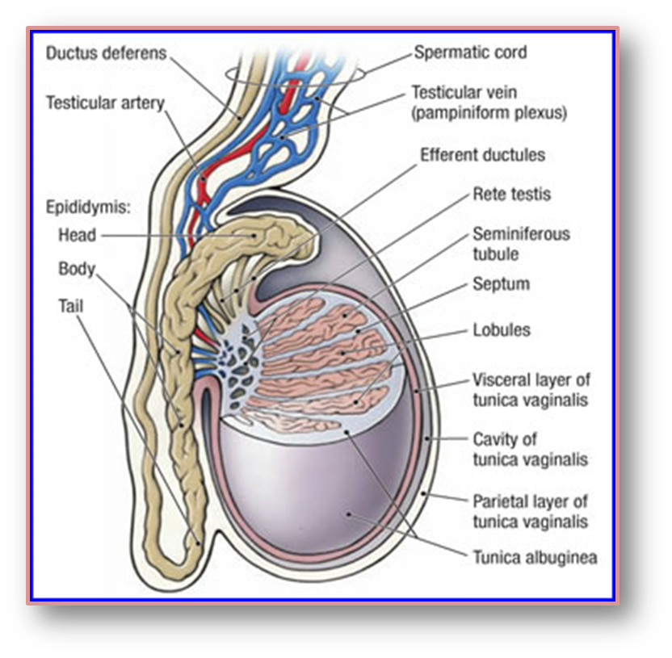
Partial sagittal section of testis

Slide 15
The function of the blood–testis barrier may be to prevent an auto-immune reaction. Mature sperm (and their antigens) arise long after immune tolerance is established in infancy. Therefore, since sperm are antigenically different from self tissue, a male animal can react immunologically to his own sperm. In fact, he is capable of making antibodies against them.
Temperature regulation
Spermatogenesis is enhanced at temperatures slightly less than core body temperature The spermatogenesis is less efficient at lower and higher temperatures than 33 °C. Because the testes are located outside the body, the smooth tissue of the scrotum can move them closer or further away from the body.

Slide 16
The temperature of the testes is maintained at 35 degrees Celsius (95 degrees Fahrenheit) two degrees below the body temperature of 37 degrees Celsius (98.6 degrees Fahrenheit). Higher temperatures affect spermatogenesis. There are a number of mechanisms to maintain the testes at the optimum temperature.
The cremasteric muscle is part of the spermatic cord. When this muscle contracts, the cord is shortened and the testicle is moved closer up toward the body, which provides slightly more warmth to maintain optimal testicular temperature. When cooling is required, the cremasteric muscle relaxes and the testicle is lowered away from the warm body and is able to cool.

Slide 17
Development
There are two phases in which the testes grow substantially; namely in embryonic and pubertal age.
Embryonic
During mammalian development, the gonads are at first capable of becoming either ovaries or testes. In humans, starting at about week 4 the gonadal rudiments are present within the intermediate mesoderm adjacent to the developing kidneys. At about week 6, sex cords develop within the forming testes. These are made up of early Sertoli cells that surround and nurture the germ cells that migrate into the gonads shortly before sex determination begins. In males, the sex-specific gene SRY that is found on the Y-chromosome initiates sex determination by downstream regulation of sex-determining factors, which leads to

Slide 18
development of the male phenotype, including directing development of the early bipotential gonad down the male path of development.
Testes follow the "path of descent" from high in the posterior fetal abdomen to the inguinal ring and beyond to the inguinal canal and into the scrotum. In most cases both testes have descended by birth. In most other cases, only one testis fails to descend (cryptorchidism) and that will probably express itself within a year.
2. Pubertal
The testes grow in response to the start of spermatogenesis. Size depends on lytic function, sperm production, interstitial fluid, and Sertoli cell fluid production. After puberty, the volume of the testes can be increased by over 500% as compared to the pre-pubertal size. Testicles are fully descended before one reaches puberty.

Slide 19
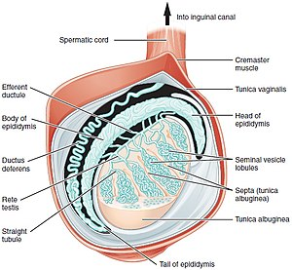

Slide 20
The testes of the male begin to produce testosterone at puberty in response to LH. Testosterone is the primary male sex hormone and an anabolic steroid, it plays a key role in the development of male reproductive tissues such as testes and prostate, it promotes maturation of the male reproductive organs, development of secondary sex characteristics(facial and body hair, also deepens the voice of a male at a certain age and maintaining healthy levels of muscle and bone mass) and production of sperm by the testes. Testosterone is biosynthesized in several steps from cholesterol and is converted in the liver to inactive metabolites. It exerts its action through binding to and activation of the androgen receptor

Slide 21
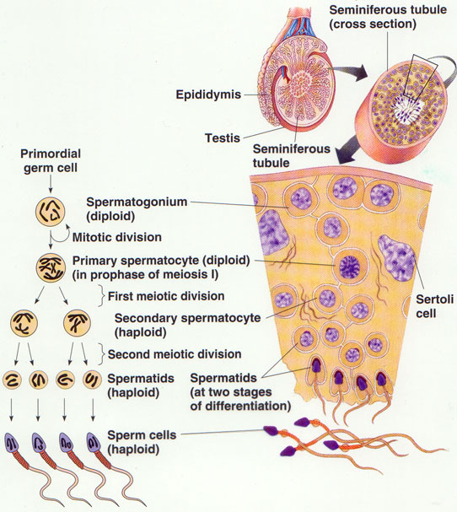

Slide 22
The testes produce three main hormones.
Action | Regulation | Produced by | Hormone
This hormone controls and maintains the growth and functions of the reproductive organs. It enhances libido and is essential for spermatogenesis. | GnRH from the Hypothalamus causes LH secretion from the Pituitary Gland which stimulates the Leydig Cells. | Leydig Cells | Testosterone
Prevents secretion of further FSH from the Pituitary Gland. | GnRH from the Hypothalamus causes FSH secretion from the Pituitary Gland which stimulates the Sertoli Cells. | Sertoli Cells | Inhibin
Converted from testosterone, this hormone's function is complex. It may prevent apoptosis of male germ cells. | GnRH from the Hypothalamus causes FSH secretion from the Pituitary Gland which stimulates the Sertoli Cells | Sertoli Cells | Oestradiol

Slide 24
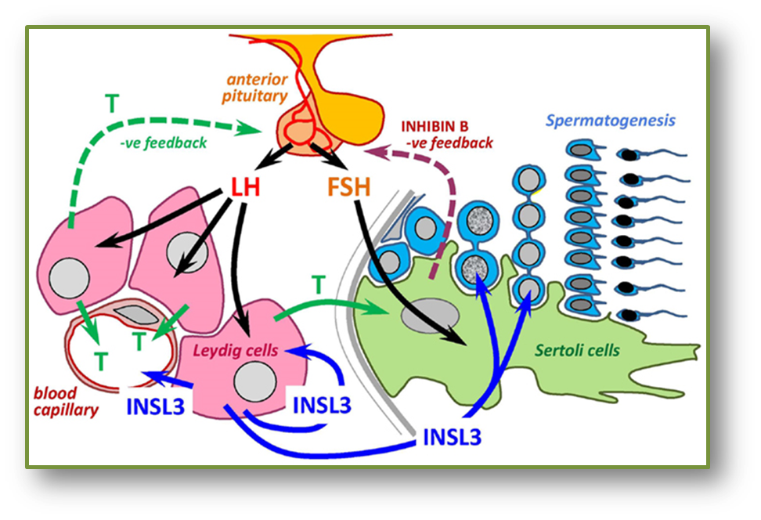
The hypothalamic–pituitary–gonadal (HPG) axis

Slide 25
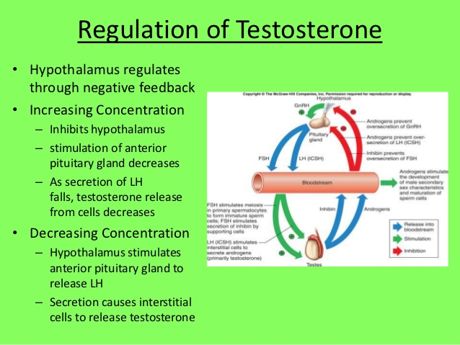

Slide 26
