Slide 1
Dr. Noori Mohammed Luaibi
Parathyroid Gland

Slide 2
Parathyroid GLANDs
The parathyroid glands are two pairs of glands usually positioned behind the left and right lobes of the thyroid. Each gland is a yellowish-brown flat ovoid that resembles a lentil seed, usually about 6 mm long and 3 to 4 mm wide, and 1 to 2 mm anteroposteriorly. There are typically four parathyroid glands. The two parathyroid glands on each side which are positioned higher are called the superior parathyroid glands, while the lower two are called the inferior parathyroid glands. Healthy parathyroid glands generally weigh about 30 mg in men and 35 mg in women. These glands are not visible or able to be felt during examination of the neck.

Slide 3
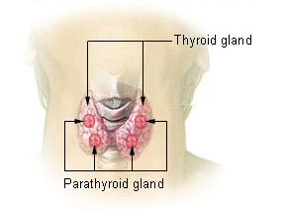
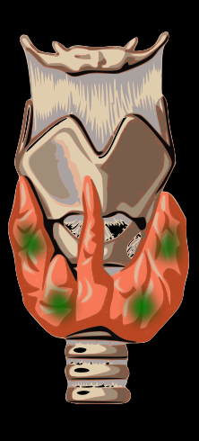
Diagram showing structures in the human neck. The four green shaded areas represent the most common position of the parathyroid glands, which are generally four in number and situated behind the lateral lobes of the thyroid gland (shaded orange).

Slide 4
Development
In early human embryonic life, a series of five branchial arches and four branchial pouches form that give rise to the human face, neck, and surrounding structures. The pouches are numbered such that the first pouch is the closest to the top of the embryo's head and the fourth is the furthest from it. The parathyroid glands originate from the interaction of the endoderm of the third and fourth pouch and neural crest mesenchyme. The position of the glands reverses during embryological life. The pair of glands which is ultimately inferior develops from the third pouch with the thymus, whereas the pair of glands which is ultimately superior develops from the fourth pouch. During embryological development, the thymus migrates downwards, dragging the inferior glands with it. The superior pair are not dragged downwards by the fourth pouch to the same degree. The glands are named after their final, not embryological, positions. Since the thymus's ultimate destination is in the mediastinum of the chest, it is occasionally possible to have ectopic parathyroids derived from the third pouch within the chest cavity if they fail to detach in the neck.
Parathyroid development is regulated by a number of genes, including those coding for several transcription factors.[

Slide 5
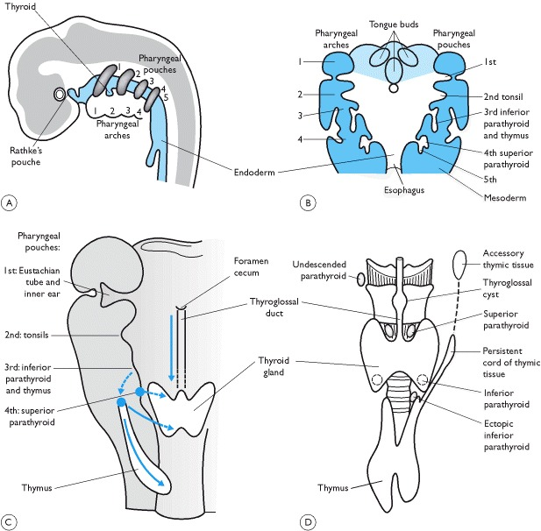
Embryology of the thyroid and parathyroid glands
Diagrammatic view of sagittal and transverse views of the pharyngeal regions of a human embryo during
the fifth week of gestation, showing the endodermal pharyngeal pouches and mesodermal pharyngeal arches.
Diagrams show the embryonic origin of the thyroid gland and parathyroid glands. Migration of the thyroid
gland and parathyroid glands (anterior view) is shown in .Diagram illustrates various abnormalities which
can occur during embryonic development.

Slide 6
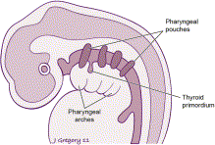
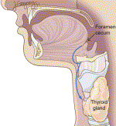
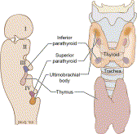
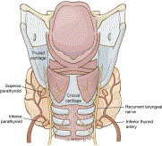
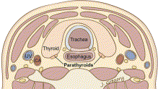

Slide 7
Histology of the Parathyroid Glands
The vast majority of the parathyroid gland parenchyma is composed of chief cells (also known the parathyroid gland principal cells) and oxyphil cells arranged in trabeculae, within a stroma composed primarily of adipose cells .The parathyroid glands are surrounded by a thin fibrous capsule dividing the glands into lobules. The stromal fat around the parathyroid glands increases gradually with age up to 30% by age 25. The percentage of fat is related to the constitutional fat percentage, but can be reduced in dying individuals; mean is 17% with wide variation . In preadolescence the parathyroid glands are made up largely by chief cells, which produce parathyroid hormone (PTH). Acidophilic oxyphil cells which are rich in mitochondria, developed from parathyroid principal cells, can be identified after puberty, and increase in numbers during adulthood.

Slide 8
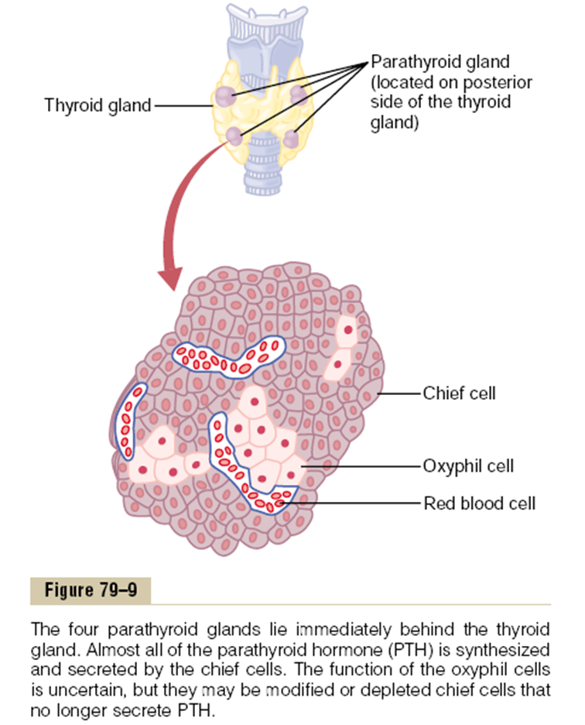

Slide 9
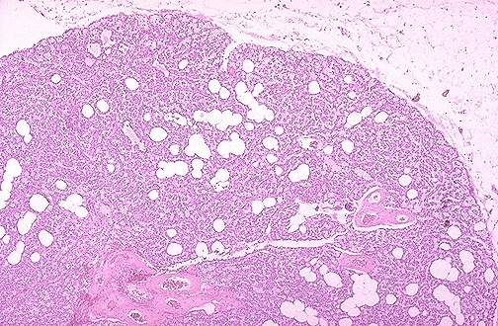
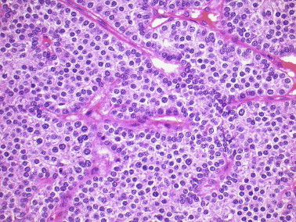
Here is a normal parathyroid gland for comparison. Adipose tissue cells are mixed with the parathyroid tissue. The amount of fat varies somewhat.
High magnification micrograph. H&E stain. The small, dark cells are chief cells, which are responsible for secreting parathyroid hormone.

Slide 10
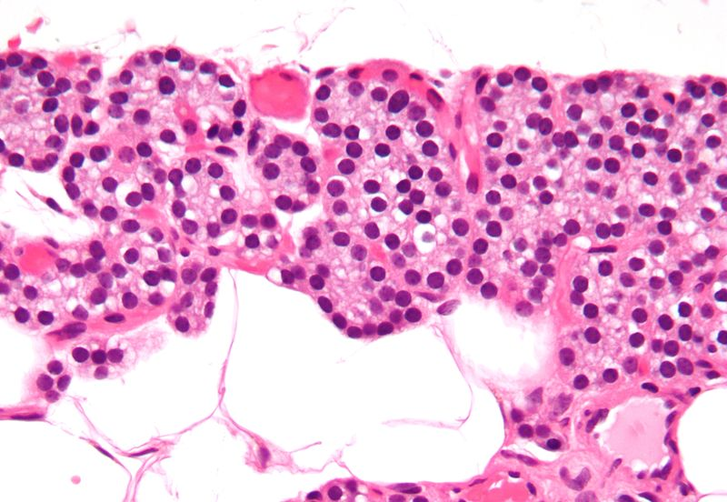
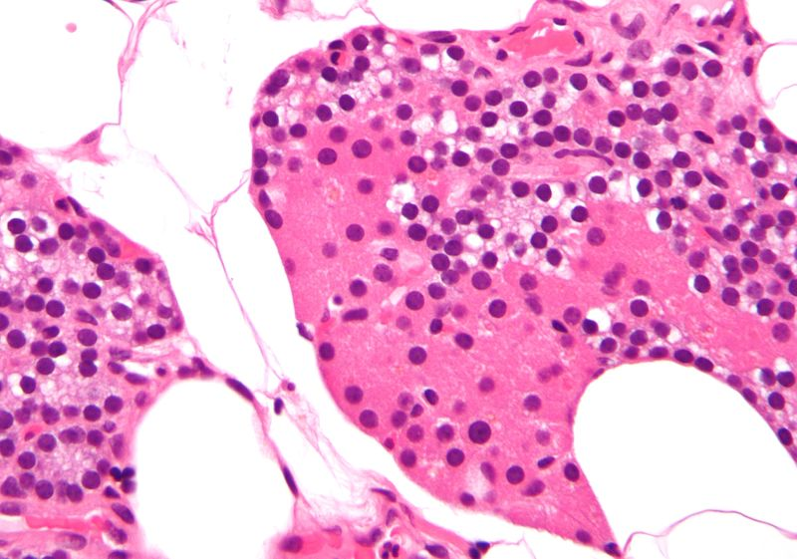
High magnification micrograph. H&E stain. The small, dark cells are chief cells, which are responsible for secreting parathyroid hormone.
High magnification micrograph. H&E stain. The cells with orange/pink staining cytoplasm are oxyphil cells

Slide 11
The water-clear cells, also appear to come from the chief cells. They appear in small numbers, and have abundant glycogen .While most oxyphil and water-clear cells retain the ability to secrete PTH, their functional significance is not known. The chief cells play a critical role in calcium homeostasis by sensing changes inextracellular calcium concentration and releasing the appropriate amount of PTH to correct or maintain normal blood calcium levels. The chief cells (parathyroid gland principal cells) measure approximately six to eight microns, they are polygonal in shape, have a centrally located round nuclei, and have secretory granules containing PTH. The chief cells appear dark purple in a hematoxylin and eosin stain . Approximately 80% of the chief cells have intracellular fat. The chief cell is the most sensitive of all the parathyroid gland cells to changes in the serum ionized calcium concentrations. The chief cells spend most of their time inactive due to normal calcium hemostasis. These inactive cells are categorized as cuboidal. They have low levels of secretory granules, as opposed to active chief cells. These granules can contain acid phosphatase. Acid phosphatase is only found in larger secretory

Slide 12
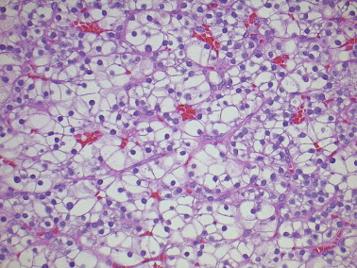
water-clear cells

Slide 13
granules, and is less prevalent in smaller secretory granules This acid phosphatase is also present in the Golgi apparatus of the chief cell. However, the Golgi apparatus areas associated with PTH packaging contained little or no acid phosphatase. The chief cells become active in response to low calcium serum concentrations. The low serum calcium concentrations are sensed by the calcium-sensing receptor . These active cells have a greater electron density than the inactive chief cells that is thought to be caused by the secretory granules containing PTH .The oxyphil cells are slightly larger than the chief cells, measuring approximately 12 microns, they have an acidophilic cytoplasm due to abundance of mitochondria, and they have no secretory granules .On hematoxylin and eosin staining they appear lighter than the chief cells .The mitochondrion of the oxyphil cells is the site for vitamin D metabolism. Vitamin D 1 hydroxylase is highly expressed in oxyphil cells.The rough endoplasmic reticulum is scarce and the Golgi complex associated with few pro-secretory granules is poorly developed. They first appear during puberty as single cells, then pairs, then nodules by age 40 . threadlike materials.

Slide 14
The oxyphil cells release PTH in a regulated fashion, and can also have the potential to produce autocrine/paracrine factors, such as parathyroid hormone related peptide (PTHrP) and calcitriol .The parathyroid gland water clear cells are extremely rare. Their presence is associated with parathyroid gland hyperplasia or even parathyroid adenoma formation .The water clear cells have an abundant clear cytoplasm with sharply defined cell membranes, and have excessive cytoplasmic glycogen .The water clear cells have an oval or round nucleus with occasional indentations. The cytoplasm is filled, for the most part, with membrane-limited vacuoles .Most vacuoles appear empty or contain finely particulate substance and

Slide 15
Micro description
=========================================================================
● Composed primarily of chief cells and fat with thin fibrous capsule dividing gland
into lobules.
● May have a pseudofollicle pattern resembling thyroid follicles (pink material is PAS
positive).
Chief cells:
● 6-8 microns, polygonal, central round nuclei, contain granules of parathyroid
hormone (PTH).
● Basic cell type, other cell types are due to differences in physiologic activity.
● 80% of chief cells have intracellular fat.
● Chief cell is most sensitive to changes in ionized calcium.
Oxyphil cells:
● Slightly larger than chief cell (12 microns), acidophilic cytoplasm due to
mitochondria.
● No secretory granules.
● First appear at puberty as single cells, then pairs, then nodules at age 40.
Water clear cell:
● Abundant optically clear cytoplasm and sharply defined cell membranes.
● Chief cells with excessive cytoplasmic glycogen.

Slide 16
Function
The major function of the parathyroid glands is to maintain the body's calcium and phosphate levels within a very narrow range, so that the nervous and muscular systems can function properly. The parathyroid glands do this by secreting parathyroid hormone.
Parathyroid hormone (PTH, known as parathormone) is a small protein that takes part in the control of calcium and phosphate homeostasis, as well as bone physiology. Parathyroid hormone has effects antagonistic to those of calcitonin.
Calcium: PTH increases blood calcium levels by directly stimulating osteoblasts and thereby indirectly stimulating osteoclasts to break down bone and release calcium. PTH increases gastrointestinal calcium absorption by activating vitamin D, and promotes calcium conservation (reabsorption) by the kidneys.
Phosphate. PTH is the major regulator of serum phosphate concentrations via actions on the kidney. It is an inhibitor of proximal tubular reabsorption of phosphorus. Through activation of vitamin D the absorption (intestinal) of Phosphate is increased.

Slide 17
The main effects of increased PTH secretion in response to decreased extracellular fluid calcium ion concentration:
(1) PTH stimulates bone resorption, causing release of calcium into
the extracellular fluid;
(2) PTH increases reabsorption of calcium and decreases phosphate
reabsorption by the renal tubules, leading to decreased excretion
of calcium and increased excretion of phosphate; and
(3) PTH is necessary for conversion of 25-hydroxycholecalciferol to
1,25-dihydroxycholecalciferol, which, in turn, increases calcium
absorption by the intestines. These actions together provide a
powerful means of regulating extracellular fluid calcium
concentration.
Parathyroid hormones have a very important purpose: keeping bones strong, the nervous system running (it is essential for the proper functioning of brain cells) ,clotting blood and muscle contraction throughout the body, including the heart.

Slide 18
While the names are similar and they are physically near each other, the functions of the thyroid and the parathyroid are unrelated. The parathyroids release parathyroid hormone (PTH), which regulates how much calcium is in the blood. In fact, calcium is the only mineral in the body that has its own dedicated regulatory gland.
Calcium is important for many reasons. Most people know that it helps with bone strength, but it is also used to conduct electrical impulses in the nervous system and is used as energy in muscle cells.
Bones store calcium that can be used in the body. When blood calcium levels are low, the parathyroids signal to the bones to release calcium into the bloodstream. If calcium is not replenished through a healthy diet, the loss of calcium in the bones can lead to bone deterioration.
PTH also signals the kidneys and small intestines to save calcium from digestion, instead of letting it get released in urine.

Slide 19
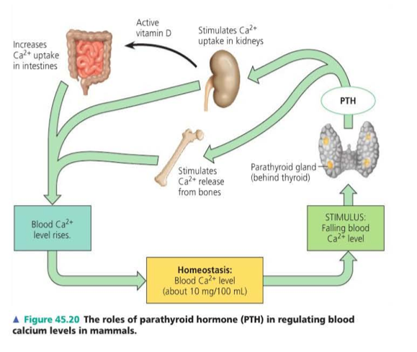
The roles of parathyroid hormone (PTH) in regulating blood calcium levels in mammals

Slide 21
