Slide 1
Thyroid Gland Dr. Noori M. Luaibi

Slide 2
Thyroid Gland
The thyroid gland is a butterfly shaped gland located immediately below the larynx on each side of and anterior to the trachea, it is one of the largest endocrine glands, normally weighing 15 to 20 grams in adults.
The thyroid secretes two major hormones, thyroxine and triiodothyronine, commonly called T4 and T3, respectively. Both of these hormones profoundly increase the metabolic rate of the body.
The thyroid gland also secretes calcitonin, a hormone involved in calcium metabolism.

Slide 3
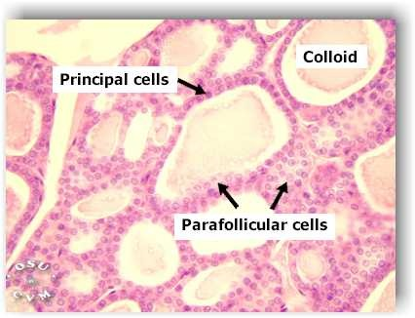
Thyroid hormone is Produced in Follicular cells precursor to thyroid hormones (T3, T4). Parafollicular cells= Secrete calcitonin, a hormone that is involved with calcium homeostasis, Calcitonin a thyroid hormone that tends to lower the level of calcium in the blood plasma and inhibit reabsorption of bone by action of Parathyroid gland.

Slide 4
PHYSIOLOGICAL ANATOMY OF THE THYROID GLAND
1. Divided into 2 lobes, each lobe is divided into lobules, which contains 20 - 40 round to oval follicles, each 50 - 500 microns, with a single layer of cuboidal to low columnar epithelium
2. Lumen contains colloid, which is scalloped and pale in follicles with active secretory activity, densely eosinophilic in inactive follicles and more flocculent ("like a clump or tuft of wool") and basophilic in elderly
3. Stroma contains C cells, formerly called parafollicular cells (actually are intrafollicular), derived from neural crest
4. C cells represent 0.1% of gland, produce calcitonin, are present in middle and upper third of lateral lobes along central axes, are not present in extreme upper and lower poles or in isthmus Usually 10 C cells per low power field in adults
5. C cells are more numerous in neonates, decrease in adults, increase and appear as nodular aggregates after age 60 years
C cells have pale / clear cytoplasm, oval nuclei, difficult to identify with H&E, use calcitonin stain.

Slide 5
6. The major constituent of colloid is the large glycoprotein thyroglobulin, which contains the thyroid hormones. 7. Once the secretion has entered the follicles, it must be absorbed back through the follicular epithelium into the blood before it can function in the body. 8. The thyroid gland has a blood flow about five times the weight of the gland each minute, which is a blood supply as great as that of any other area of the body.

Slide 6
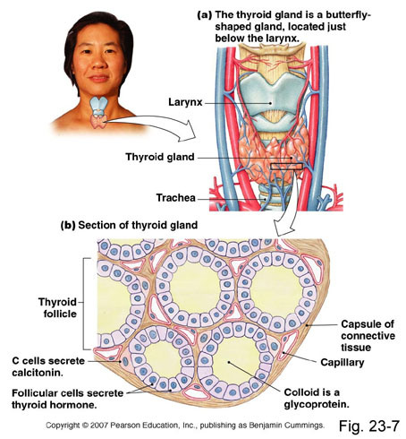

Slide 7
SYNTHESIS AND SECRETION OF THE THYROID METABOLIC HORMONES
About 93 percent of the metabolically active hormones secreted by the thyroid gland is thyroxine, and 7 percent is triiodothyronine. However, almost all the thyroxine is
eventually converted to triiodothyronine in the tissues, so both are functionally important. The functions of these two hormones are qualitatively the same, but they differ in rapidity and intensity of action. Triiodothyronine is about four times as potent as thyroxine, but it is present in the blood in much smaller quantities and persists for a much shorter time compared with thyroxine. To form normal quantities of thyroxine, about 50 milligrams of ingested iodine in the form of iodides are required each year, or about 1 mg/week.

Slide 9
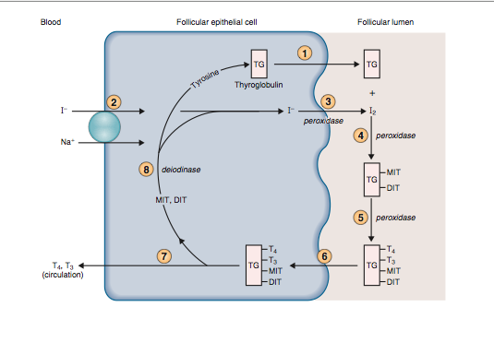

Slide 10
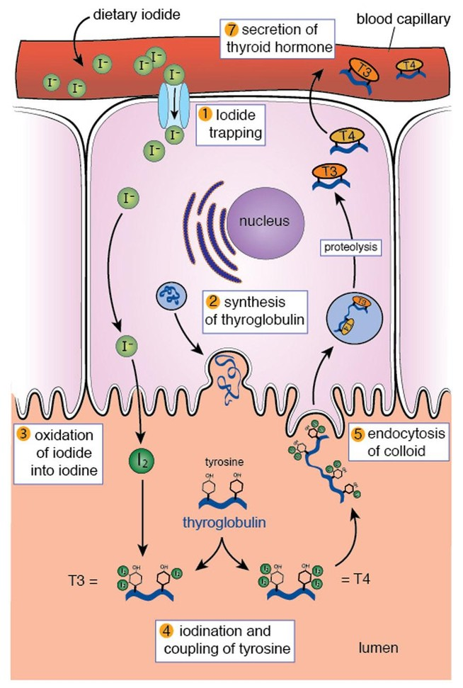

Slide 11
EFFECTS OF THYROID HORMONE ON SPECIFIC BODY FUNCTIONS
Stimulation of Carbohydrate Metabolism.
Stimulation of Fat Metabolism.
Effect on Plasma and Liver Fats.
Increased Requirement for Vitamins
Increased Basal Metabolic Rate
Decreased Body Weight
Increased Blood Flow and Cardiac Output
Increased Heart Rate
Increased Heart Strength
Normal Arterial Pressure
Increased Respiration
Increased Gastrointestinal Motility

Slide 12
14. Excitatory Effects on the Central Nervous System. 15. Effect on the Function of the Muscles. 16. Muscle Tremor. 17. Effect on Sleep. 18. Effect on Other Endocrine Glands. 19. Effect of Thyroid Hormone on Sexual Function.

Slide 13
REGULATION OF THYROID HORMONE SECRETION
To maintain normal levels of metabolic activity in the
body, precisely the right amount of thyroid hormone
must be secreted at all times; to achieve this ideal level of secretion, specific feedback mechanisms operate through the hypothalamus and anterior pituitary gland to control the rate of thyroid secretion.

Slide 14
FEEDBACK EFFECT OF THYROID HORMONE TO DECREASE ANTERIOR PITUITARY SECRETION OF TSH
Increased thyroid hormone in the body fluids decreases
secretion of TSH by the anterior pituitary. When the rate of thyroid hormone secretion rises to about 1.75 times normal, the rate of TSH secretion falls essentially to zero. Almost all this feedback depressant effect occurs even when the anterior pituitary has been separated from the hypothalamus. Therefore, it is probable that increased thyroid hormone inhibits anterior pituitary secretion of TSH mainly by a direct effect on the anterior pituitary gland itself. Regardless of the
mechanism of the feedback, its effect is to maintain an almost constant concentration of free thyroid hormones in the circulating body fluids.

Slide 15
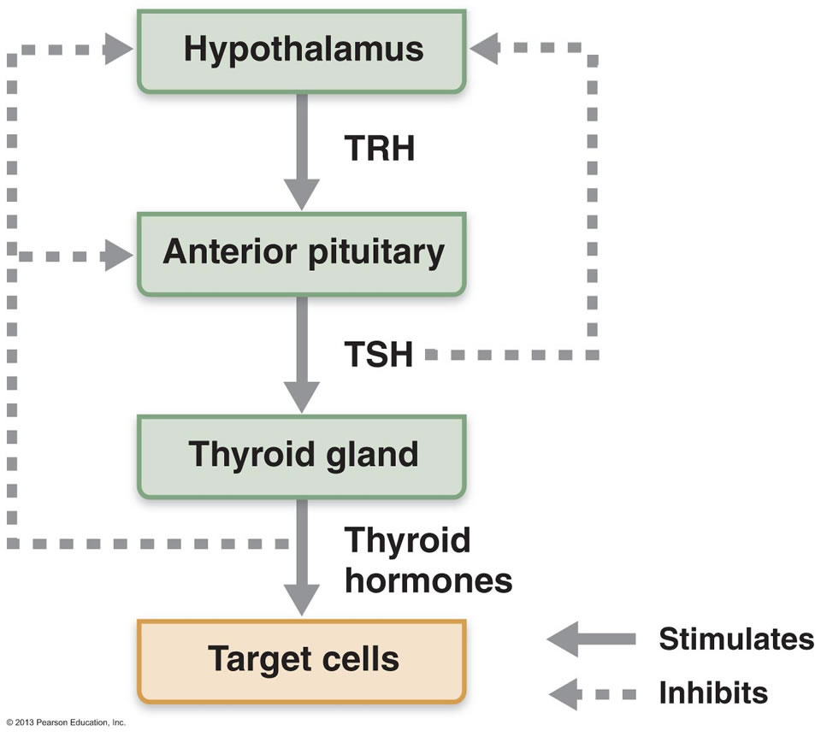
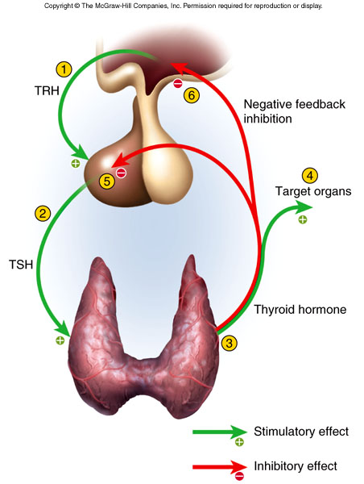

Slide 16
