Slide 1
AL-Mustansiriyah University
College of science
Biology Dept.
Zoology
4th class
Laboratory Technique LAB.
(4)
NAME :

Slide 2
Urine Sample
Urine sample collection rules:
Random.
Clean.
make notes for personal health ( male, female) or taking drugs.
Tested for:
    Chemical exam
    Specific gravity
    pH
    Albumin
    Glucose
    Microscopic exam

Slide 3
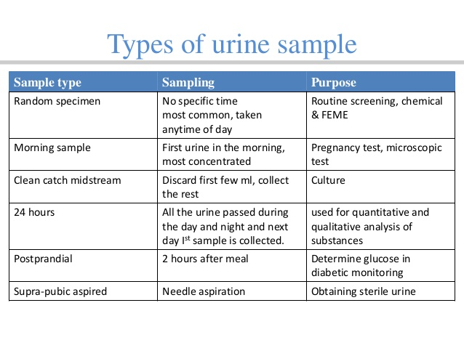

Slide 4
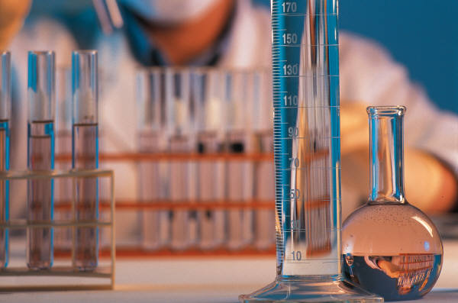
Common tests done on urine
UA = urinalysis
Urine Culture
1.Urinalysis
(normal values)
pH (4.8-8.0) average 6.0
Protein (none)
Glucose (none)
Ketones (none)
Blood (up to 2 RBC’S)
Specific gravity (1.010-1.025) WBC’S (0-4)
Bacteria (none) Casts (none)

Slide 5
2. Urine for C&S
Culture = ? Bacteria growing
Sensitivity = which antibiotics are effective
Readings after 24; 48; 72 hrs.
Midstream Urine
Sterile Catheter Specimen
(never from bag)

Slide 6
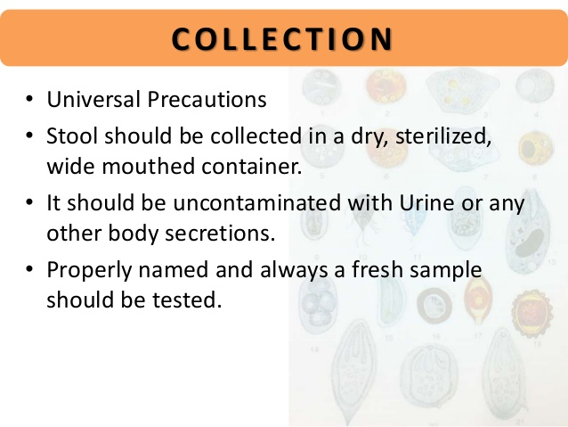
Stool Specimen
Analysis of fecal material can detect pathological conditions for ex: tumors, hemorrhage, infection –……..Tests(Pus,Rbc, Ova & Parasites)

Slide 7
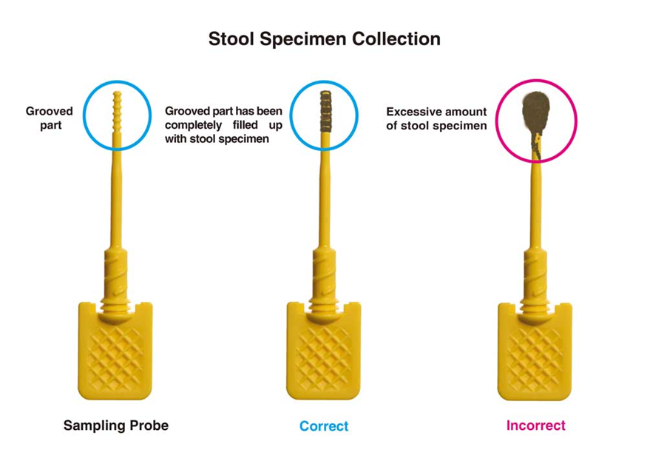
Random Collection
1. Universal precaution
2. Collect stool in a dry, clean container
uncontaminated with urine or other body secretions, such as menstrual blood
4. Collect the stool with a clean tongue blade or similar object.
5. Deliver immediately after collection

Slide 8
Ova and parasites collection
Warm stools are best for detecting ova or parasites.
Do not refrigerate specimen for ova or parasites.
If the stool should be collect in 10 % formalin or PVA
fixative, storage temperature is not critical.
Because of the cyclic life cycle of parasites, three
separate random stool specimens are recommended.

Slide 9
Sputum Specimens
Culture
Cytology
Tuberculosis
Collection:
Teach to cough effectively….. Not Saliva
Keep inside of container sterile
Document: color, consistency, odor
Early morning specimen

Slide 10
