Slide 1
AL-Mustansiriyah University
College of science
Biology Dept.
Zoology
4th class
Laboratory Technique LAB.
(3)
NAME :

Slide 2
Laboratory Departments
Teaching hospital
Clinical Biochemistry (Chemical Pathology)
Haematology
Histopathology
Microbiology
Immunology
Virology
Sub Fertility – associate department
Cytology
Others e.g. Genetics
Notes:
A number of the laboratories in this trust are Regional/ National centres. They carry out a wide variety of the more complex assays that would only be required in very limited numbers in most hospitals.

Slide 3
What constitutes a sample
Any biological material taken from a patient for diagnostic, prognostic or therapeutic monitoring
Under the new Human Tissues Act tissue includes
    blood
    urine
    faeces
    sweat
    semen
    tissue
    & other fluids

Slide 4
Infection risks
All samples must be considered to be infectious
Use of “Universal Precautions” handling
Never assume any sample is “safe”
Today’s symptoms may be tomorrow’s diagnosis of infection
Notes:
Is there such a thing as a safe sample? What might be incubating?
Some samples e.g. tonsil, CSF, neural tissue could be carrying a prion disease such as CJD long before clinical symptoms appear
Always consider the risk
Sharps injuries must be considered most serious and be properly dealt with. Needles etc must be correctly and safely disposed of.
Sample transport must also assume the potential infective risk and allow appropriate protection. Sample containers should be transported in a secondary container e.g. suitable sealed minigrip bag which carries the Biohazard label. Requests should be carried in proximity to but not in direct contact with the sample e.g wallet attached to the minigrip bag. This reduces the risk of the request becoming contaminated and allows the laboratory to deal with it in a safe manner should the sample be broken.

Slide 5
Phases of analysis
Pre-analytical (from the patient to the lab)
Analytical ( in the Lab.)
Post-analytical (from the lab to the notes)
1. From the patient to the lab
What can (and does) go wrong
Incorrect identification of patient
Patient preparation – fasting, diet, supine, time, drugs.
Sample poorly/ incorrectly taken
Inaccurate timing
Wrong type of sample
Notes:
Each phase contains its own risks, although the biggest variable is the pre-analytical phase. Unfortunately too many people in this part of the chain don’t appreciate the need for quality and the effect that variables can have. It can be shown that the majority of errors occur in this phase. The Serious Hazards Of transfusion (SHOT) reports show that the majority of errors occur at the bedside.

Slide 6
2. Analytical ( in the Lab.)
What can (does) go wrong?
Incorrect container(s)
Under-filling
Mislabelling/ no labelling
Incorrect storage/ transport (ice, warm, delay)
Loss, breakage etc.
2. Post-Analytical ( from the Lab.)
Write Patient’s name fully and correctly
Make sure for the test result
Notes:
Samples in the wrong type of container can be of no use. For example a sample in EDTA will give a calcium of zero, an under-filled coagulation sample will have the wrong sample to anticoagulant ratio. Air in a sample for a blood gas has significant effects.
Laboratories cannot accept samples where the method by which a patient is identified is in question. Providing Unknown male/ female have appropriate hospital number then they can be properly identified until the name becomes available.
Unlabelled samples will normally be destroyed . The exceptions tend to be the type of sample that cannot be reasonably re-collected e.g. neonatal CSF.
Consider a laboratory department receiving in excess of 1000 samples per day (Biochemistry & Haematology on this site each receive this magnitude) and the problems caused if samples are not clearly identified.

Slide 7
Blood
Blood is a liquid tissue. Suspended in the watery plasma are seven types of cells and cell fragments.
Red blood cells (RBCs) or erythrocytes
Thrombocytes
five kinds of white blood cells (WBCs) or leukocytes
Three kinds of granulocytes: Neutrophils; Eosinophils; Basophils
Two kinds of leukocytes without granules in their cytoplasm: lymphocytes and monocytes

Slide 8
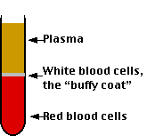
Blood Components
From 10 ml of blood:
Plasma or serum 6-7 ml
Lymphocytes and mononuclear cells 10-20 x 10⁶ Cells/ml
Erythrocyte (red blood cells) and other cells – 5 x 10⁶ cells/ul; 10-15 mg HB

Slide 9
Venous blood sampling
Syringe
Hybrid
Evacuated

Slide 10
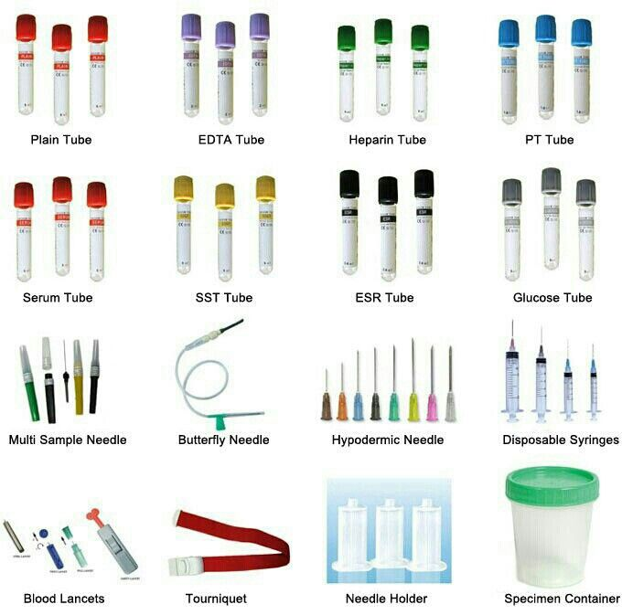

Slide 11
Vacuum Collection Tubes
Vacuum collection tubes are glass or plastic tubes sealed with a partial vacuum inside by rubber stoppers.
The air pressure inside the tube is negative, less than the normal environment.
The difference in pressure between the inside of the tube and the vein causes blood to fill the tube.
Different blood tests requires different types of blood specimens.
Most tubes have additives called anticoagulants which prevent clotting/coagulation of the blood.
Plastic tubes may have an additive to enhance clotting of the blood

Slide 12
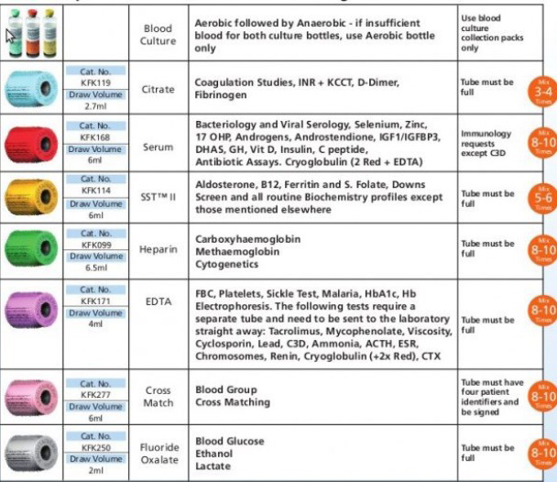

Slide 13
Blood Collection: Color-code Tubes
Red-top tubes
contain no additives.
These tubes are used for tests performed on serum samples and DNA.
When you use the red-top tubes, the sample an be placed for 1-2 hours so that the serum and blood clots will be separated.
Blood clots can be used for DNA analysis.

Slide 14
Blood Collection: Color-code Tubes
Green-top tubes contain heparin
Blue-top tubes contain sodium citrate and citric acid
Black-top tubes contain sodium oxalate
Yellow-top tubes contain acid-citrate-dextrose (ACD) solution.
Grey-top tubes contain a glycolytic inhibitor.

Slide 15
Blood Collection: Color-code Tubes
Lavender-top tubes contain EDTA, commonly used clinically for complete blood cell counts.
This is the way to obtain lymphocytes for DNA extraction, plasma for nutritional analysis, and red blood cells for other assays.

