Slide 1
Glandular tissue
GLANDS
are cells or aggregations of cells specialized to secrete and excrete material.
Definition of secretion
The process of production and release of a useful substance by a
gland or cell
ex: secretion of hormones, milk , saliva, mucus, tears.
Definition of Excretion
Excretion is the removal of toxic materials, the waste products of metabolism such urea and co2 and substance in excess of requirements from the body ex: water and salts

Slide 2
Classification of the glands
Glands are divided according to how their products are released.
Endocrine glands :secrete substances that circulate through the blood stream. These glands lack a duct system. ex hormones,
Exocrine glands: secrete their products through a duct onto an outer surface of the body, (skin, gastrointestinal tract etc.).

Slide 3
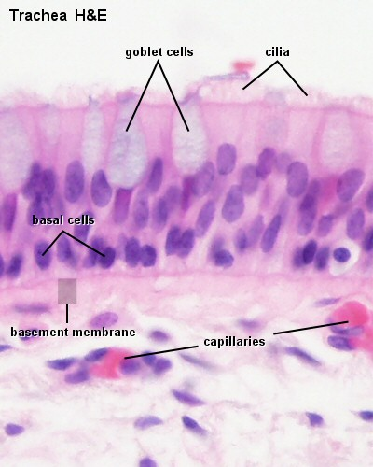
Exocrine glands can be classified according to cell Number :
1.Unicellular Glands: consist of a
single secretory cell ex: goblet cells
2. Multicellular glands :are composed of more than one cell, The end pieces of the gland contain the secretory cells.
Exocrine glands can be classified according to the presence or absence of branching of the duct elements.
First:- Simple glands: unbranched duct

Slide 4
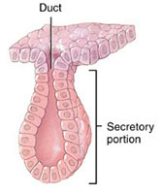
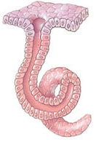
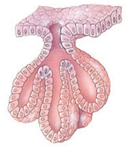
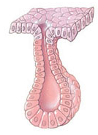
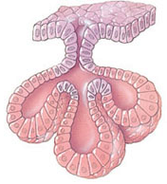
A- Simple tubular glands:
1-Straight tubular glands. Single, straight
Found in the stomach and intestine.
2-Coiled tubular glands: coiled, found in sweat glands.
3-Branched tubular glands: multiple tubular, found in the stomach, mouth, tongue and esophagus.
B-Simple alveolar glands
1-Unbranched alveolar glands .
Found along the urethra.
2-Branched alveolar glands, found in sebaceous glands
In the skin.

Slide 5
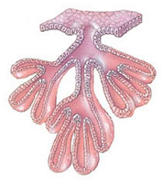
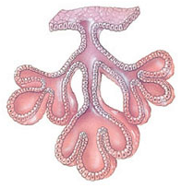
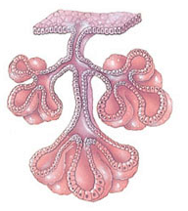
Second:-Compound glands :branched duct
1-Compound tubular glands: multiple, found n
in kidney tubule.
2-Compound Alveolar glands:
Multiple. Located in the
mammary glands.
3-Compound Tubuloalveolar
Some tubular, some alveolar. Found in salivary glands, and respiratory passages.

