Slide 1

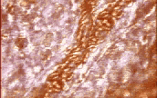
Components of the Circulatory System
Heart = Pump
Blood = Transport Medium
Blood vessel = Passageways

Slide 2
Functions of Blood
Transports:
Nutrients
Defense:
Foreign organisms
Electrolytes
Injury/infection
O₂ & CO₂
Waste Products
Clotting process
Hormones
Body temperature

Slide 3
Components of Blood
Blood is a mixture of cellular components
suspended in plasma:
1. Erythrocytes (RBCs)
2. Leukocytes (WBCs)
3. Thrombocytes (platelets)
Total Blood Volume: 8 % of body weight
2.75 / 5.5 liters of blood is plasma
(remaining is the cellular portion)
Notes:
Plasma (water + dissolved solutes)

Slide 4
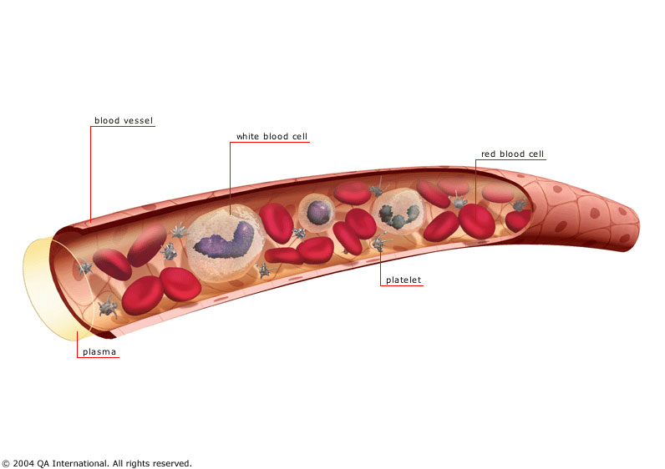
Blood vessel
White blood cell
Red blood cell
platelet
Plasma

Slide 5
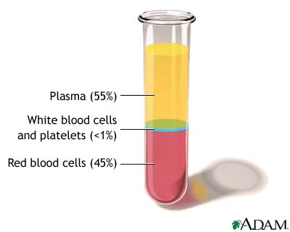
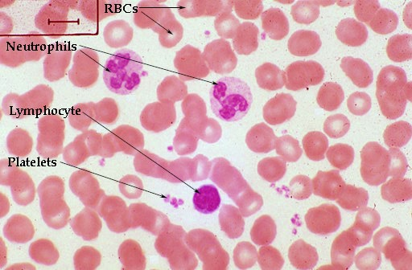
Cellular Elements of Blood
1. Red Blood Cells
2. White Blood Cells
3. Platelets

Slide 6
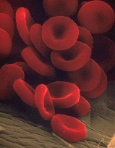
1. RBC’S (Erythrocytes)
Shape - a biconcave disc with large surface area
Can change shape
No Nucleus / organelles
Contains hemoglobin
New RBC’s (and platelets & leukocytes) are produced
in the Bone Marrow
Primary Function = Transport oxygen from the lungs to the cells of the body & assist with CO₂ removal

Slide 7
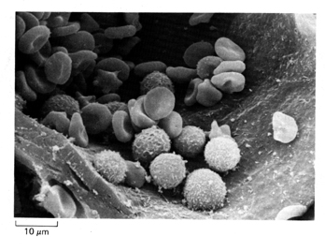
RBC’s
WBC’ s

Slide 8
2. White Blood Cells (Leukocytes)
Mobile units of body’s defense system:
“Seek and Destroy” Functions:
  Destroy invading microorganisms
  Destroy abnormal cells (ie: cancer )
Clean up cellular debris (phagocytosis)
  3. Assist in injury repair

Slide 9
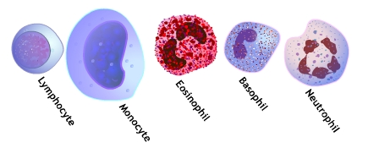
Types of WBC’s
Agranulocytes
Granulocytes
Each WBC has a specific function

Slide 10
Types of WBC’s
Polymorphonuclear Granulocytes
Neutrophils
Eosinophils
Basophils

Slide 11
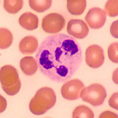
1. NEUTROPHILS
* 50-70% of all leukocytes
(most abundant of WBC’s)
* Important in inflammatory
responses
* Phagocytes that engulf
bacteria and Debris

Slide 12
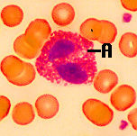
2. EOSINOPHILS
* 1-4% of the WBC's
* Attack parasitic worms
* Important in allergic reactions

Slide 13
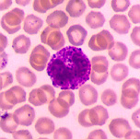
3. BASOPHILS
* 0.5% of the WBC's
* Release histamine
and heparin
* Important in Allergic
Reactions
* Heparin helps clear fat from blood

Slide 14
Types of WBC’s
Mononuclear Agranulocytes
4. Monocytes
5. Lymphocytes
(B and T cells)

Slide 15
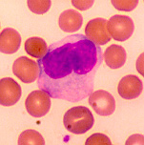
4. MONOCYTES
* 2-6 % of the WBC's
* Exit blood (diapedesis)
to become macrophages
* Phagocytic = defend against
viruses and bacteria

Slide 16
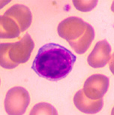
5. LYMPHOCYTES
* 25-33 % of the WBC's
* B-lymphocytes:
Produce Antibodies
* T-lymphocytes:
Directly destroy virus-
invaded cells and cancer
cells
Notes:
B cells responsible for antibody-mediated (or humoral) immunity. – An Ab binds with and marks for destruction (by phagocytosis) the specific foreign matter that induced production of the Ab.
T cells directly destroy their specific target cells by releasing chemicals that punch holes in the cell (process is called cell-mediated immunity)

Slide 17
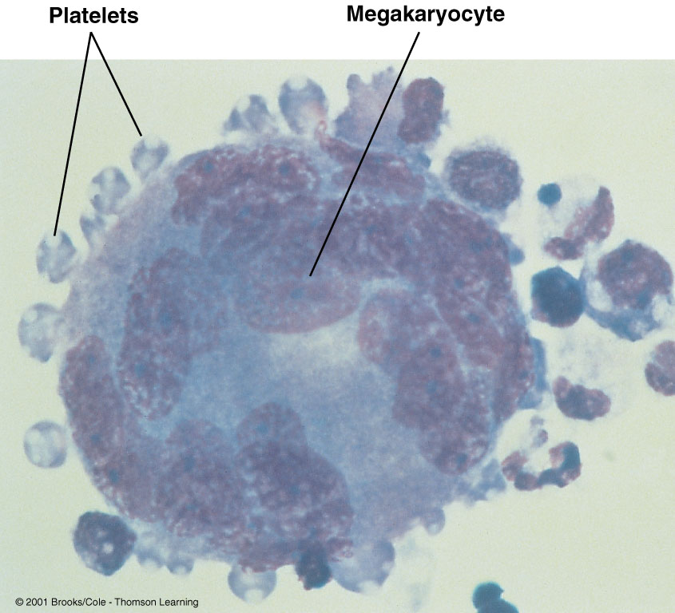
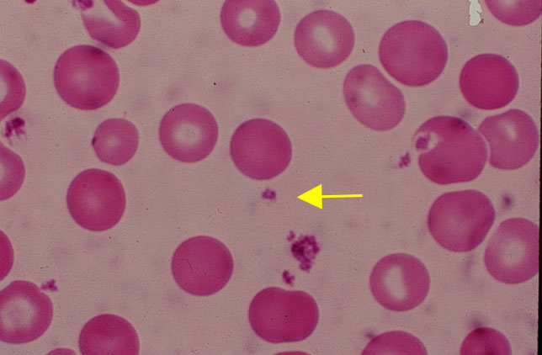
3. Platelets (Thrombocytes)
* Cell fragments bound to megakaryocytes
* “Bud Off” and are released into the blood
Notes:
Platelets are produced by the bone marrow. They are not whole cells, but are fragments of extraordinarily large bone marrow-bound megakaryocytes.
The hormone THROMBOPOIETIN (produced by liver) increases the # of megakaryocytes in the bone marrow, stimulating them to produce more platelets

